Slide 2
The Media and the Abolitionist Movement: Using Media to Inform Public Opinion
8th Grade U.S. History and Government

Slide 3
Magnetic Statements
The Guardian (November 14, 2018). 'Changing the world for the better': Katharine Viner tells us about her role. YouTube. Retrieved from https://www.youtube.com/watch?v=DqxNKbwwNo8

Slide 4
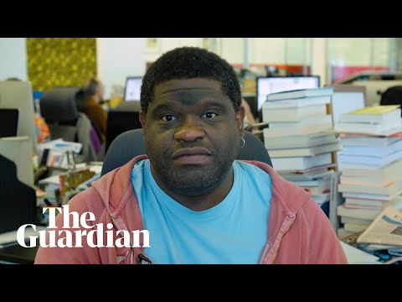
Magnetic Statements
The Guardian (December 5, 2018). What's the difference between news and opinion? Gary Younge tells us about his role. YouTube. Retrieved from https://www.youtube.com/watch?v=jgJJgvLaahg

Slide 5
Magnetic Statements
Read the statements based on the two videos.
Stand by the statement that most appeals to you.
Discuss your choice with other students gathered around the same statement.
Share your group’s ideas in a group discussion.

Slide 6
Class Discussion
Why is media important to a democratic society?

Slide 7
Essential Questions
Can citizens affect change?
How can we use the media to influence public opinion?
How did the Abolitionist Movement use media to fight for the end of slavery?

Slide 8
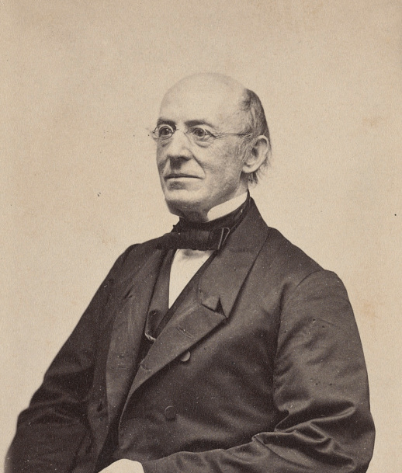
Media of the Abolition Movement
William Lloyd Garrison and The Liberator
Garrison gave speeches and published The Liberator, an abolitionist newspaper.
He did so to inform the public about the wrongs of slavery.
He wanted to encourage people to fight for the abolition of slavery, and for equality for black people.
Liljenquist Family Collection of Civil War Photographs (1870). William Lloyd Garrison, abolitionist, journalist, and editor of The Liberator. The Library of Congress. Retrieved from https://www.loc.gov/item/2017660623/

Slide 9
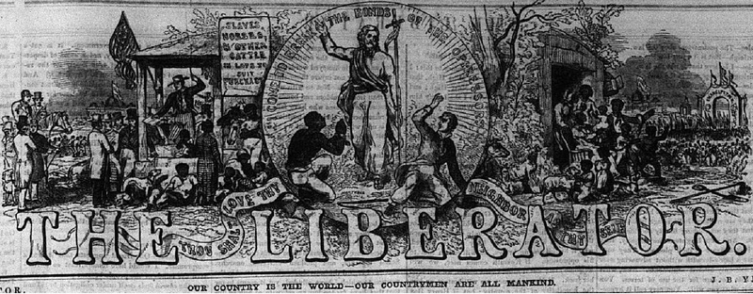
The Liberator Masthead
The Liberator Masthead. (June, 1850). Wikipedia Commons. Retrieved from: https://commons.wikimedia.org/wiki/File:The_Liberator_W_L_Garrison_Masthead_7_June_1850.pdf
Notes:
You can show students this image of The Liberator’s masthead if you choose.

Slide 10
Media of the Abolition Movement
Frederick Douglass and The North Star
Douglass gave speeches and published The North Star, an anti-slavery newspaper.
He did so to fight for the end of slavery in the United States.
His perspective as an escaped slave gave him a powerful voice in the abolition movement.
J.C. Buttre (1855). Frederick Douglass, My Bondage and My Freedom. Wikimedia Commons. Retrieved from https://en.wikipedia.org/wiki/My_Bondage_and_My_Freedom#/media/File:Frederick_Douglass_as_a_younger_man.jpg

Slide 11
The North Star Masthead
The North Star (1848). The North Star. Wikimedia Commons. Retrieved from https://upload.wikimedia.org/wikipedia/commons/1/1d/The_North_Star_%287222833218%29.jpg
Full Front Page
Notes:
You can show students this image of The North Star’s masthead if you choose. The full front page of The North Star is also available.

Slide 12
Sentence-Phrase-Word
After reading the speech or newspaper editorial assigned to your group, underline the following and use annotations in the margins to support your choices:
A sentence that was meaningful and reflects the main idea of the text
A phrase that moved, engaged, or provoked you
A word that captured your attention or is powerful to you

Slide 13
Media Chart
As a group, summarize text evidence from all four documents to complete the chart.
Identify and summarize three arguments that Frederick Douglass used to address the abolition of slavery in The Meaning of the 4th of July for the Slave and Our Paper and Its Prospects.
Identify and summarize three arguments that William Lloyd Garrison used to address the abolition of slavery in Defense of His Positions and To The Public.

Slide 14
Magnetic Statements Revisited
Return to the Magnetic Statements handout from the beginning of this lesson.
Choose two of the five statements made by modern day journalists. Craft a 2–3 sentence statement to explain how the work of Frederick Douglass and William Lloyd Garrison during the 19th century relates to journalism today.

