Slide 2
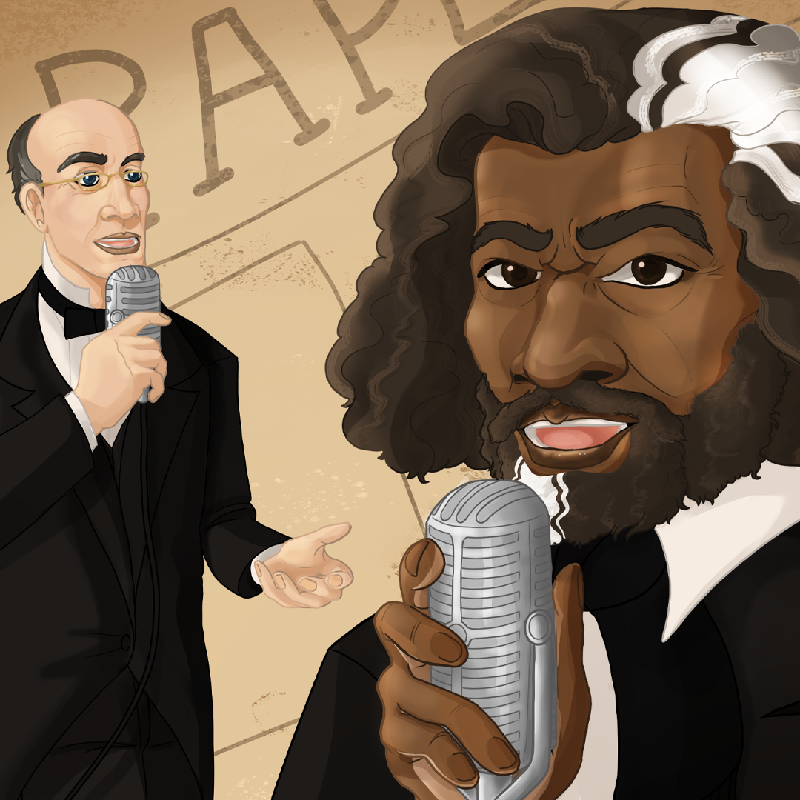
Using Media to Inform Public Opinion
The Media and the Abolitionist Movement

Slide 3
Think
As you watch the videos, think about:
  What are the roles of an editor and a columnist?
  What is the difference between an editor and a columnist?

Slide 4
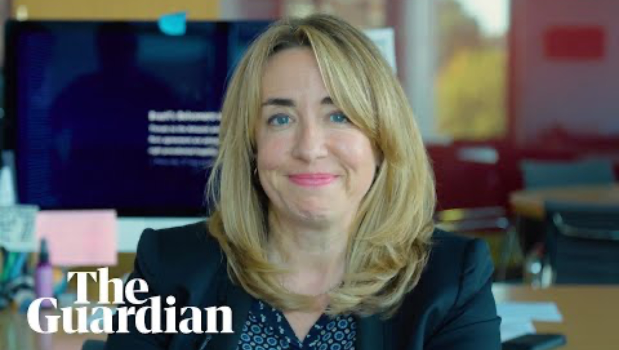
'Changing the world for the better': Katharine Viner tells us about her role
Notes:
The Guardian. (2018, November 14). ‘Changing the world for the better’: Katharine Viner tells us about her role [Video]. YouTube. https://www.youtube.com/watch?v=DqxNKbwwNo8

Slide 5
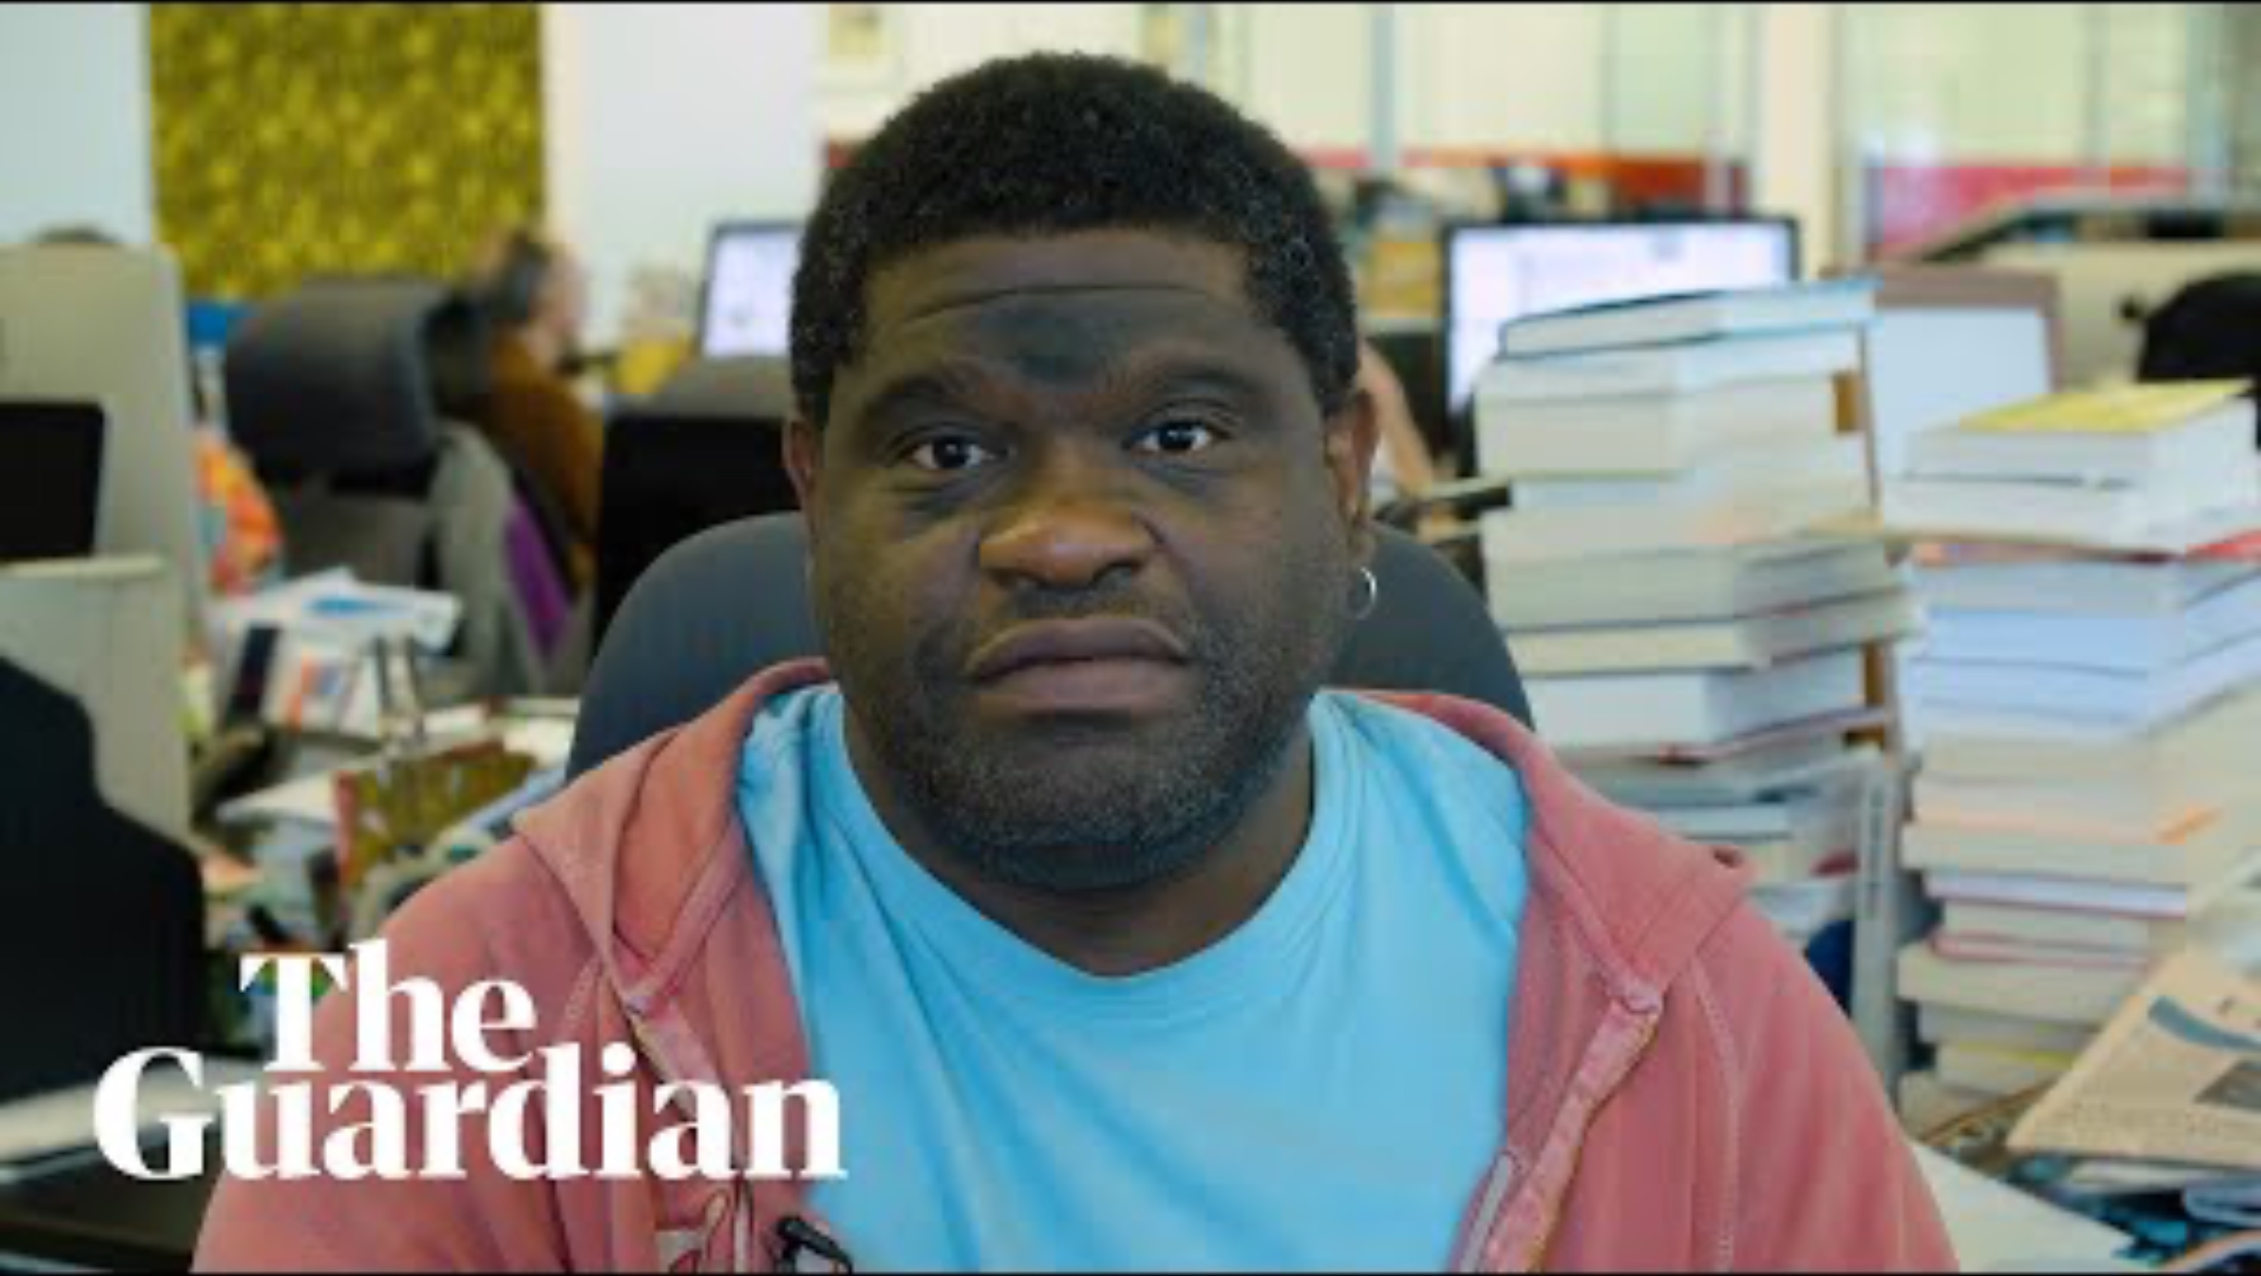
What's the difference between news and opinion? Gary Younge tells us about his role
Notes:
The Guardian. (2018, December 5). What’s the difference between news and opinion? Gary Younge tells us about his role[Video]. YouTube. https://www.youtube.com/watch?v=jgJJgvLaahg

Slide 6
Pair, Share
Discuss with a partner
  What is the job of an editor and a columnist?
  What is the difference between an editor and a columnist?

Slide 7
Essential Questions
Can citizens effect change?
How can ordinary citizens use the media to influence public opinion?
How did the abolitionist movement use media to fight for the end of slavery?

Slide 8
Learning Objective
Analyze how the media was used in the abolition movement.

Slide 9
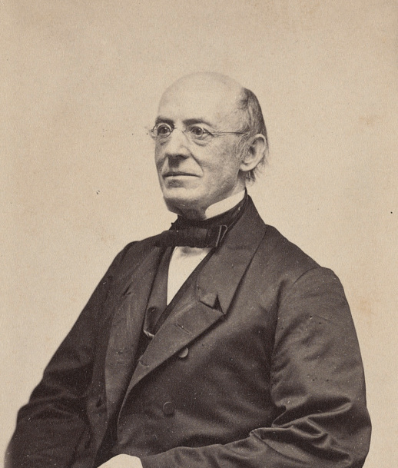
William Lloyd Garrison
Informed the public about the wrongs of slavery.
He encouraged people to fight for the abolition of slavery, and for equality for Black people.
Notes:
Liljenquist Family Collection of Civil War Photographs (1870). William Lloyd Garrison, abolitionist, journalist, and editor of The Liberator. The Library of Congress. Retrieved from https://www.loc.gov/item/2017660623/

Slide 10
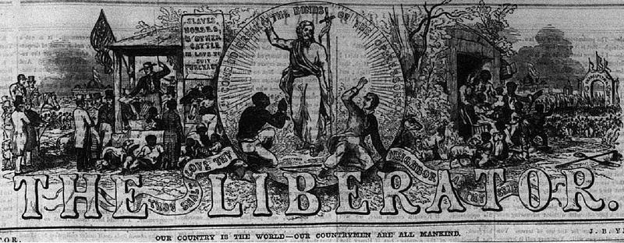
The Liberator Masthead
Notes:
The Liberator Masthead. (June, 1850). Wikipedia Commons. Retrieved from: https://commons.wikimedia.org/wiki/File:The_Liberator_W_L_Garrison_Masthead_7_June_1850.pdf

Slide 11
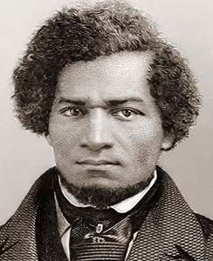
Frederick Douglass
Gave speeches and published The North Star, an anti-slavery newspaper.
His perspective as a person who escaped slavery gave him a powerful voice in the abolition movement.
Notes:
J.C. Buttre (1855). Frederick Douglass, My Bondage and My Freedom. Wikimedia Commons. Retrieved from https://en.wikipedia.org/wiki/My_Bondage_and_My_Freedom#/media/File:Frederick_Douglass_as_a_younger_man.jpg

Slide 12
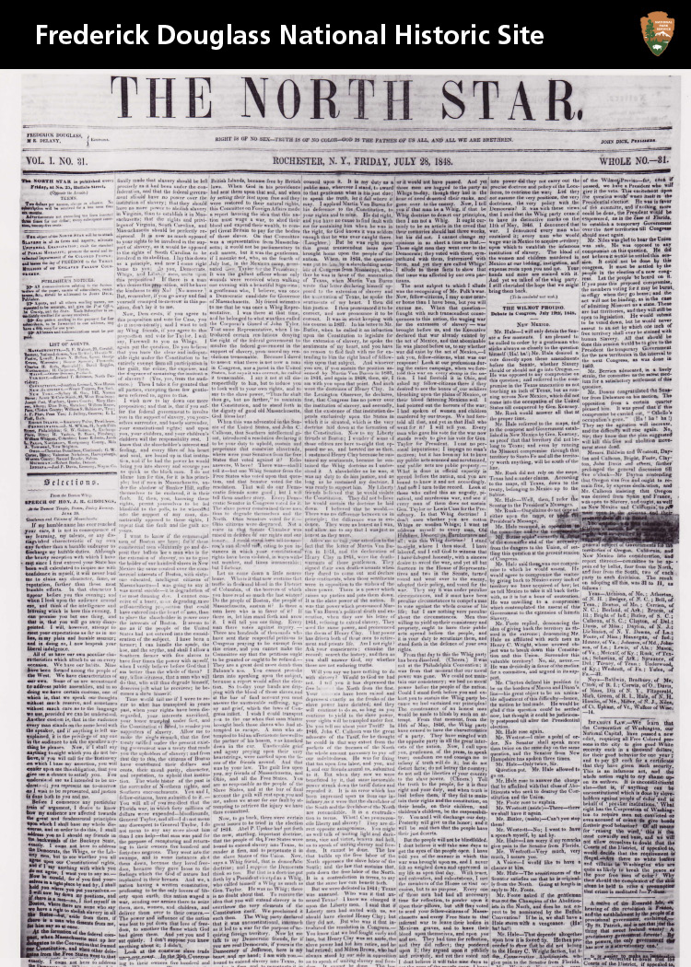
The North Star Masthead
Notes:
The North Star (1848). The North Star. Wikimedia Commons. Retrieved from https://upload.wikimedia.org/wikipedia/commons/1/1d/The_North_Star_%287222833218%29.jpg

Slide 13

Sentence-Phrase-Word
After reading the source, underline the following and use annotations in the margins to support your choices:
  A sentence that was meaningful and reflects the main idea of the text.
  A phrase that moved, engaged, or provoked you.
  A word that captured your attention or is powerful to you.

Slide 14
Sentence-Phrase-Word
In your group, take turns sharing the sentence, phrase, and word you wrote from the source.
Pick a person to share the sentence, phrase, and word your group feels best represents the source.

Slide 15
Media Chart
Identify and summarize three arguments that Frederick Douglass used to address the abolition of slavery in The Meaning of the 4th of July for the Slave and Our Paper and Its Prospects.
Identify and summarize three arguments that William Lloyd Garrison used to address the abolition of slavery in Defense of His Positions and To The Public.

Slide 16
Journalism Today
Listen to the story of someone who has worked as a journalist for two newspapers.
Be ready to discuss with a partner how journalism has changed and stayed the same since the abolition period of Frederick Douglass and William Lloyd Garrison.

Slide 17
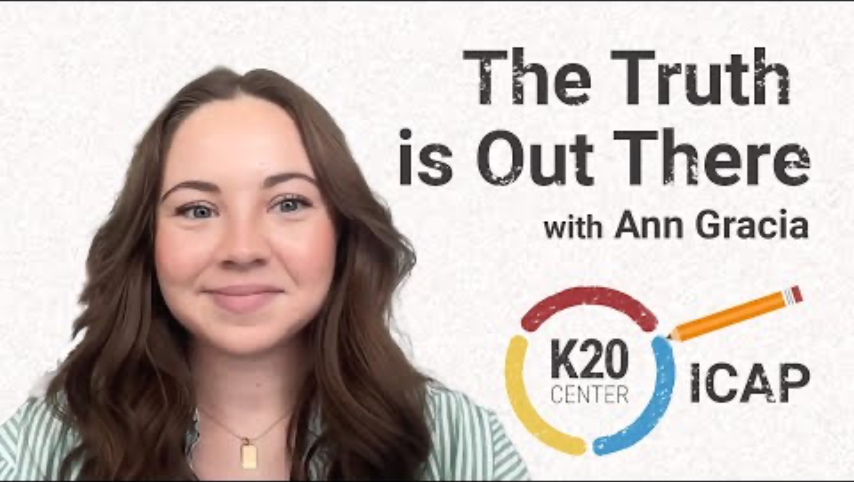
The Truth is Out There
Notes:
K20 Center, (n.d.). ICAP - The Truth is Out There. YouTube. https://youtu.be/NphSY4EGUgc?si=SEC2GbfE6IvmzCNZ

Slide 18
Discuss
How has journalism changed and stayed the same?
Why is the media important to a democratic society?
Do you have any interest in a journalism career?

Slide 19

Magnetic Statements
Read the posters around the room.
Stand near the poster you most agree with.
Discuss what drew you to the statement.

Slide 20
Magnetic Statements Revisited
Choose two of the five statements made by modern-day journalists.
Write 2–3 sentences to explain how the work of Frederick Douglass and William Lloyd Garrison relates to journalism today

