Slide 2

Who Runs the World?
Women in Business

Slide 3
Essential Questions
What characteristics do successful female entrepreneurs have in common?
What does it take to be a successful entrepreneur?

Slide 4
Learning Objectives
Compare and contrast successful women entrepreneurs.
Analyze the risks and gains made by these women.

Slide 5

Fiction in the Facts
Read each of the statements about entrepreneurs.
With your group determine:
  Which two statements are true?
  Which one statement is a lie or false?
Be prepared to share how your group identified true and false statements.

Slide 6
Fiction in the Facts
Beyonce, Taylor Swift, and Rihanna got their big break singing in church choirs.
The Taylor Swift Eras tour is the highest grossing tour of all time.
Beyonce and Rihanna have their own beauty lines.

Slide 7
Fiction in the Facts
Beyonce, Taylor Swift, and Rihanna got their big break singing in church choirs.
The Taylor Swift Eras tour is the highest grossing tour of all time.
Beyonce and Rihanna have their own beauty lines.

Slide 8
Fiction in the Facts
Oprah Winfrey and Martha Stewart have both had TV shows and magazines.
Oprah is a member of the NRA.
Martha Stewart has gone to jail for financial crimes.

Slide 9
Fiction in the Facts
Oprah Winfrey and Martha Stewart have both had TV shows and magazines.
Oprah is a member of the NRA.
Martha Stewart has gone to jail for financial crimes.

Slide 10
Fiction in the Facts
Kim Kardashian and Reese Witherspoon both own clothing companies.
Kim Kardashian and Reese Witherspoon have both gone to Harvard.
Reese Witherspoon once gave up acting to become a professional skateboarder.

Slide 11
Fiction in the Facts
Kim Kardashian and Reese Witherspoon both own clothing companies.
Kim Kardashian and Reese Witherspoon have both gone to Harvard.
Reese Witherspoon once gave up acting to become a professional skateboarder.

Slide 12
Fiction in the Facts
Elizabeth Holmes created and currently runs a biomedical company that made millions of dollars.
Melinda Gates was part of the Gates Foundation, giving over millions of dollars and aid in the form of vaccines and access to clean water.
Melinda Gates was awarded the Presidential Medal of Freedom in 2016.

Slide 13
Fiction in the Facts
Elizabeth Holmes created and currently runs a biomedical company that made millions of dollars.
Melinda Gates was part of the Gates Foundation, giving over millions of dollars and aid in the form of vaccines and access to clean water.
Melinda Gates was awarded the Presidential Medal of Freedom in 2016.

Slide 14

Frayer Model
Read about one of these entrepreneurs:
Tory Burch
Lori Greiner
Joyce Meyer
Madam CJ Walker

Slide 15
Frayer Model
Complete the Frayer Model with the following information:
What specific skills did she need?
Which characteristics does she display in her everyday life?
What are some specific risks she had to take for this business venture?
What are some gains that she made in this successful venture?

Slide 16



What are the challenges that women face in the business world?

Slide 17

The Challenges of Entrepreneurship for Women
Notes:
K20 Center. (2025, Jan 23). ICAP – K20 ICAP - Women in Business [Video]. YouTube. https://www.youtube.com/watch?v=5TsmUqERVTI

Slide 18

Strategy Harvest
With a partner, read the scenarios of each potential businesswoman and identify obstacles to their success and strategies to overcome those obstacles.

Slide 19

Web Inquiry: Case Studies
Let’s explore the following successful women in business:
Ursula Burns
Debbie Fields
Arianna Huffington
Indra Nooyi
Sheryl Sandberg
Zhang Xin

Slide 20
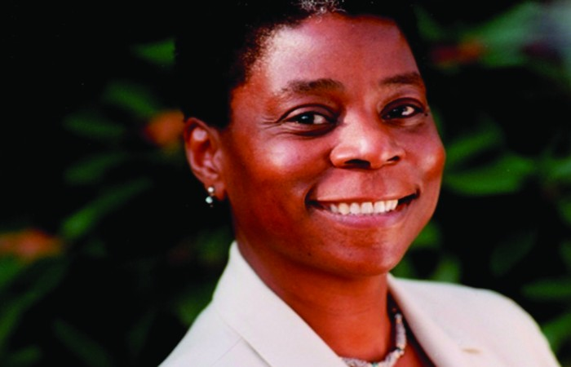
Ursula Burns
Former Chief Executive Officer of Xerox
Chairperson and Chief Executive Officer of VEON
Chairwoman Teneo
Co-founder of Integrum Holdings
Notes:
U.S. Government Printing Office (2004). Retrieved from https://commons.wikimedia.org/wiki/File:Ursula-Burns.jpg

Slide 21
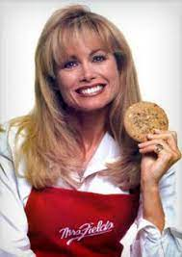
Debbi Fields
Founder
Baker
Chief Cookie Lover
Former Chairman of Mrs. Fields Cookies
Notes:
[Mrs. Fields with cookie.] Now I’ve heard everything. https://heardeverything.com/2020/08/07/debbi-fields/

Slide 22
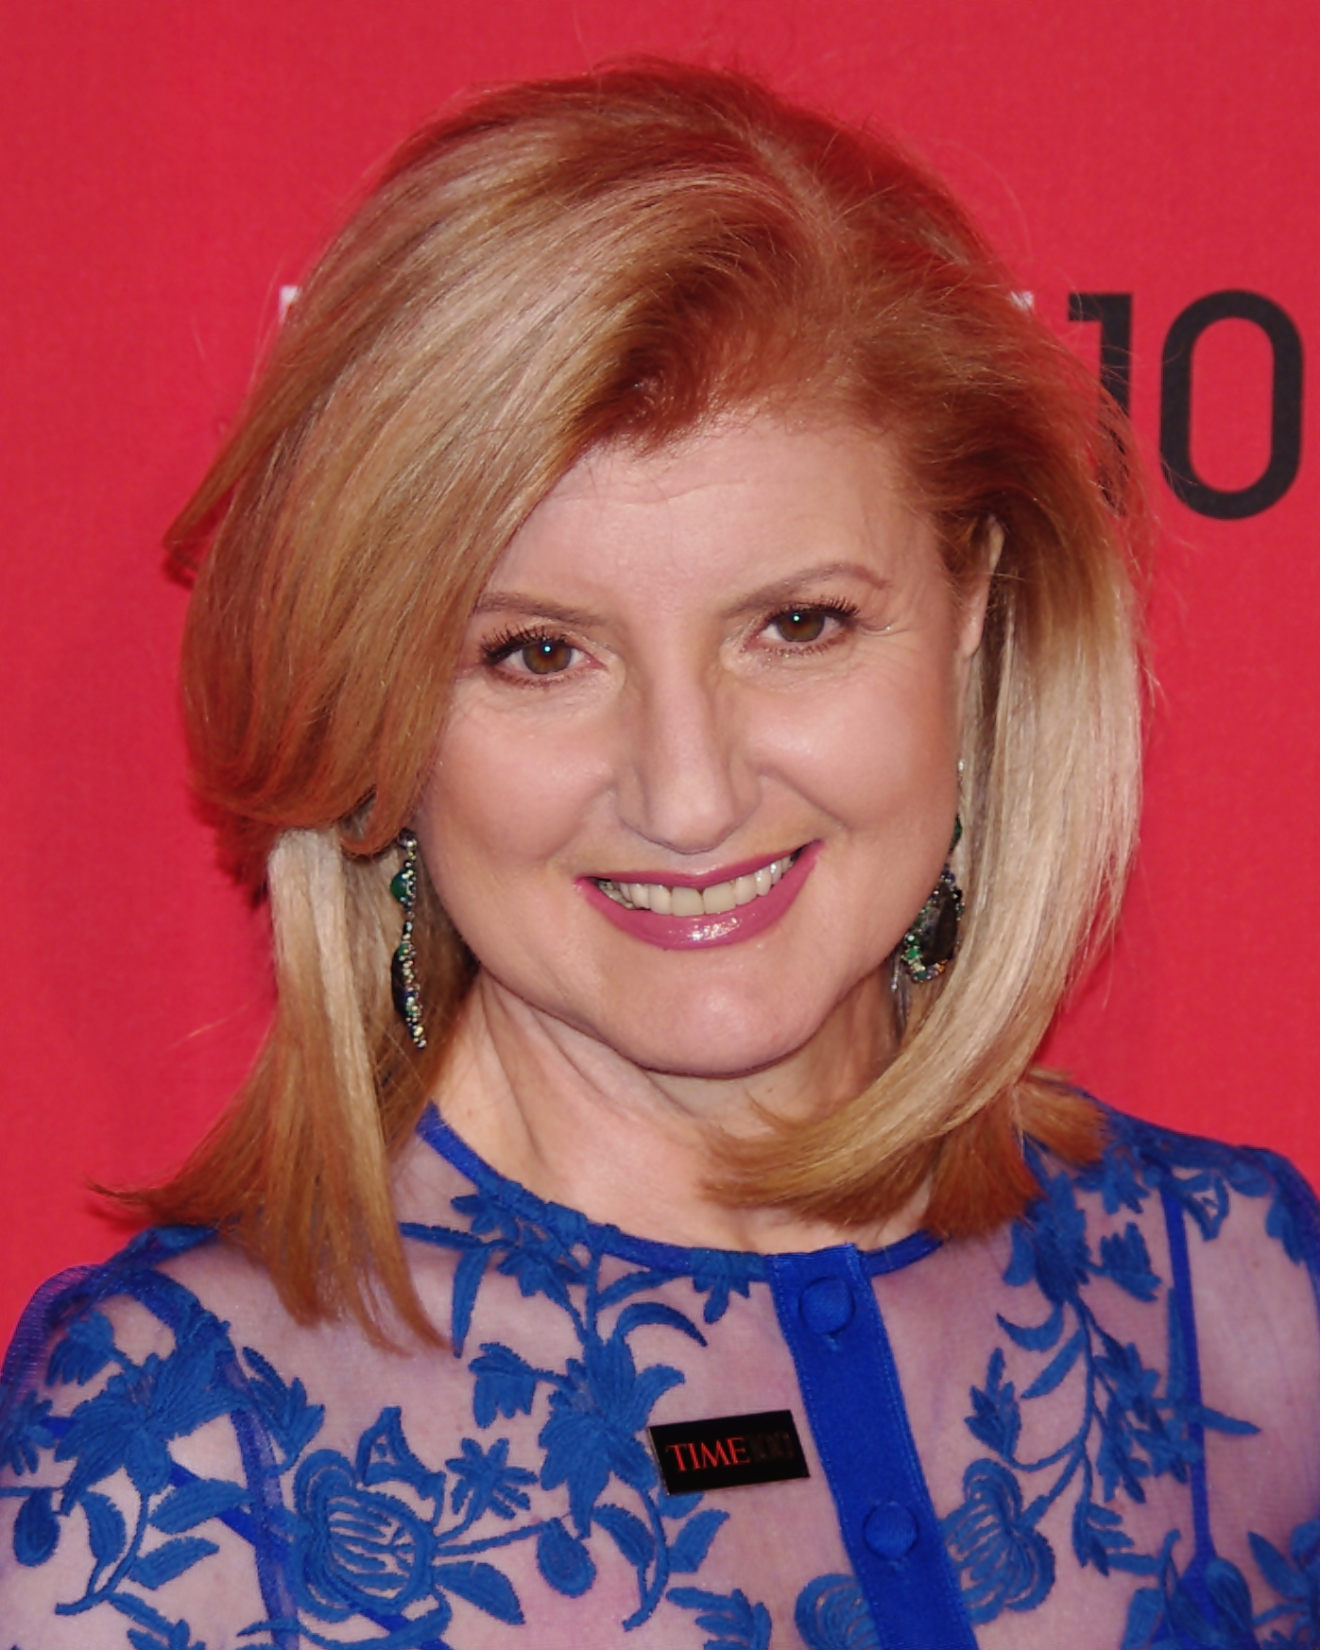
Arianna Huffington
Founder of The Huffington Post
Founder and CEO of Thrive Global
Best selling author
Notes:
Shankbone, D. 24 April 2012. [Photograph of Arianna Huffington.] https://commons.wikimedia.org/wiki/File:Arianna_Huffington_2012_Shankbone.JPG

Slide 23
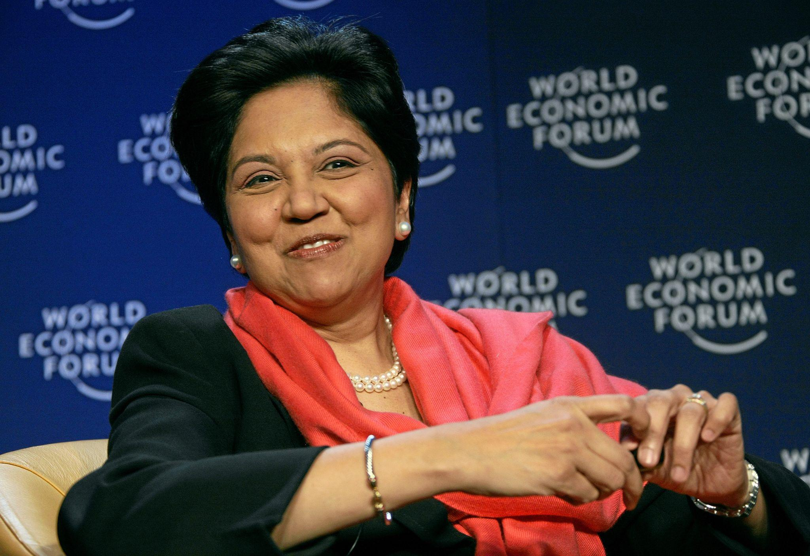
Indra Nooyi
Former Chairman and Chief Executive Officer of PepsiCo
Co-Director of Connecticut Economic Resource Center
Notes:
World Economic Forum. 27 Jan 2008. [Photograph of Indra Nooyi.] https://commons.wikimedia.org/wiki/File:Indra_Nooyi_-_World_Economic_Forum_Annual_Meeting_Davos_2008.jpg

Slide 24
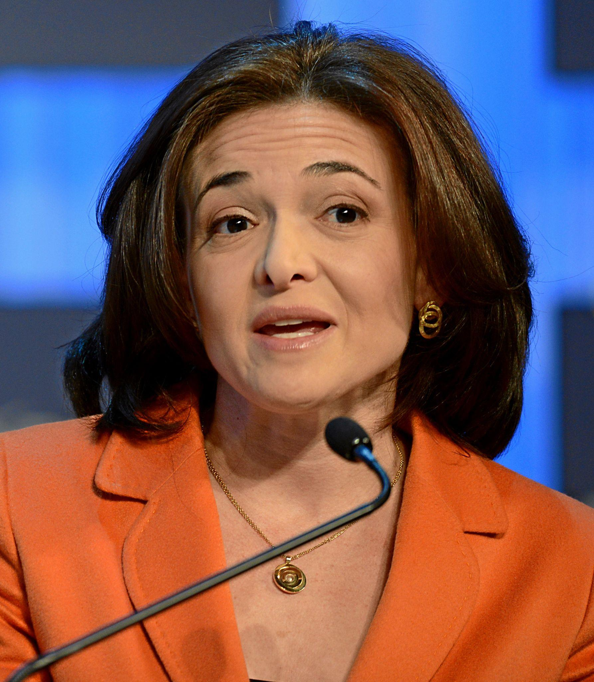
Sheryl Sandberg
Former Chief Operating Officer of Facebook (Meta)
Former Vice President of Global Online Sales and Operations at Google
Best selling author
Notes:
World Economic Forum. 25 Jan 2013. [Photograph of Sheryl Sandberg.] https://commons.wikimedia.org/wiki/File:Sheryl_Sandberg_WEF_2013_(crop_by_James_Tamim).jpg

Slide 25
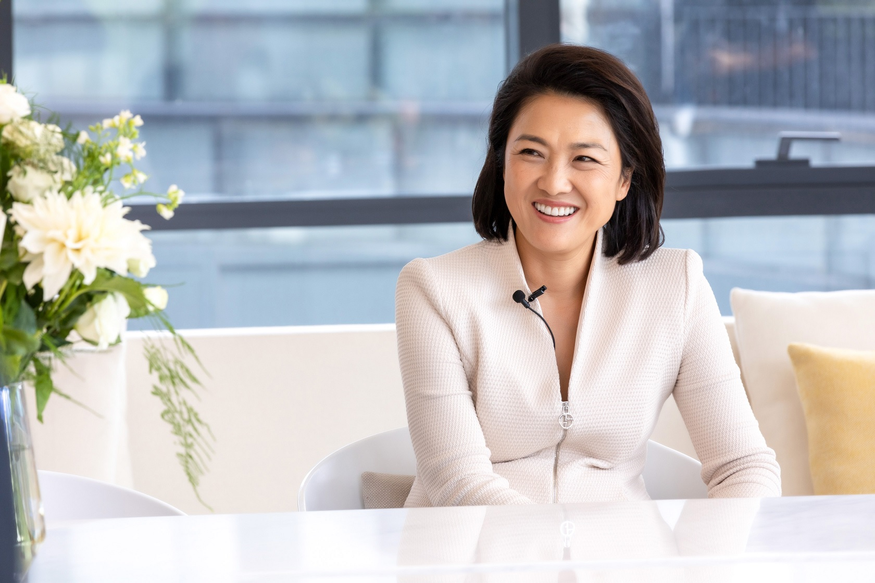
Zhang Xin
Co-Founder and former CEO of SOHO China
Founder of Closer Media
Known as the “Woman who Built Beijing”
Notes:
AsAuSo. 12 Aug 2020. [Photograph of Zhang Xin.] https://commons.wikimedia.org/wiki/File:Zhang_Xin_2019_Interview_Documentary_%281%29.jpg

Slide 26
Web Inquiry HIVE: Go to https://k20.ou.edu/uw
As you read, note the following information:
  Her background information
    When was she born? Where is she from?
    Education and training – or lack of education and training!
  The business
    When did she start the business? What is its focus?
    Why did she choose that business?
    When did she know it was successful?
    How does she measure success?
  What were some challenges she faced?
  How did she overcome the challenges?

Slide 27
Web Inquiry Graphic Organizer
Information about businesswoman | Article #1 | Article #2 | Article #3
Article title:
Web address and author:
Businesswoman background info:
Details of her business or career:
Challenges she faced:
How she overcame those challenges:

Slide 28

start
Where and when was she born? What was her background like?
Did she receive education and training? What kind?
How did she overcome her challenges?
Her name
What were some challenges for her?
When and why did she start her business or career?
How does she measure success?
When did she know it was successful?

Slide 29
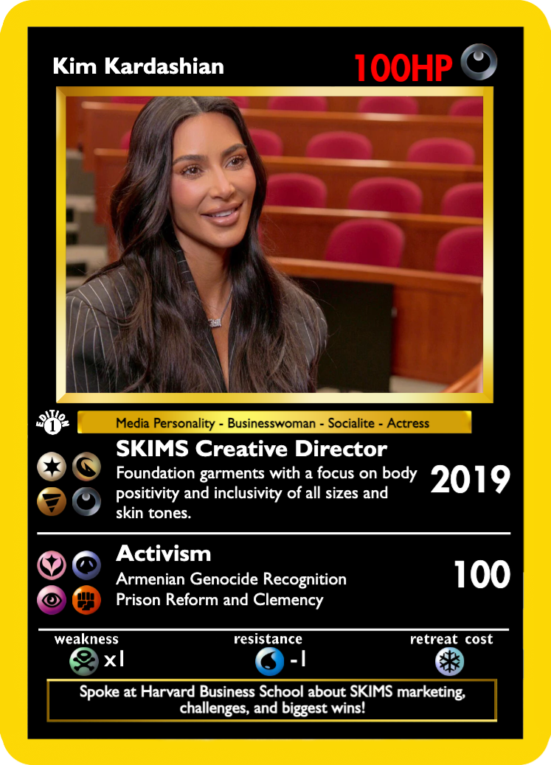
Trading Card
Create a trading card on the professional you researched.
Include the following:
  A picture
  Background information
  Business information
  Challenges
Be creative in your design!

Slide 30
Name
Description of SKIMS, the year it was started, and icons to represent the wide variety of skin tones the brand offers.
Image
Occupations
Activism with icons to represent the work she has done with each organization.
Fun Fact

Slide 31
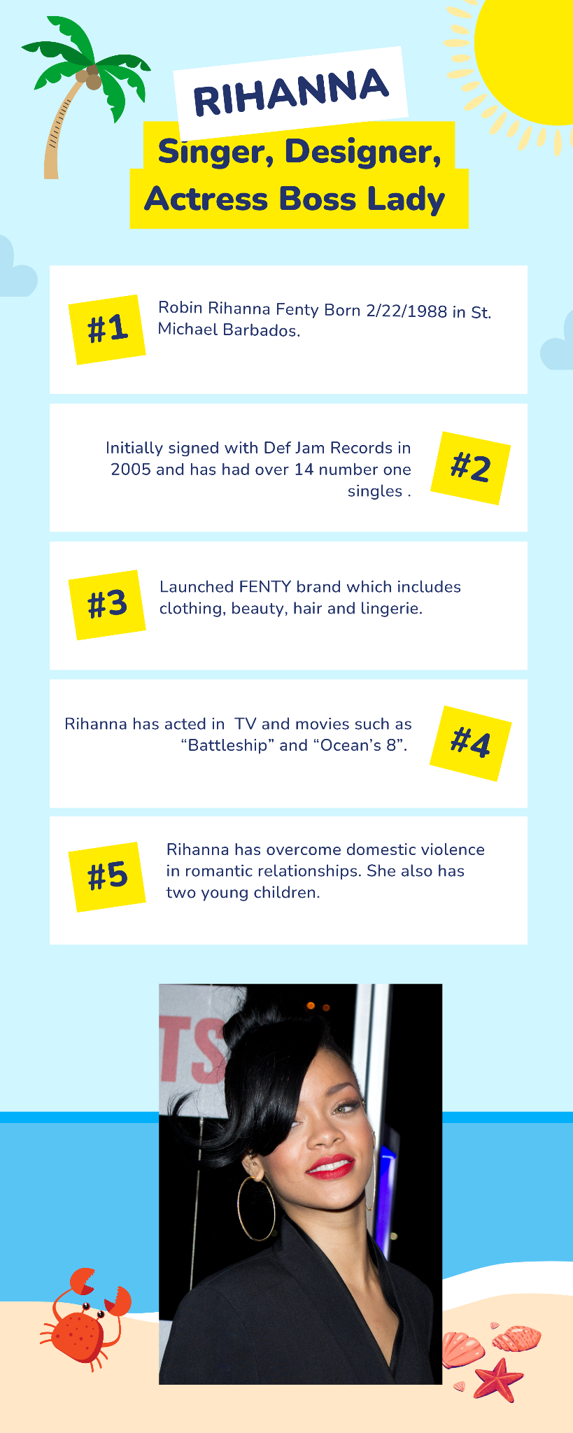
Name
Occupations
Facts about Rihanna
Information about what her brand offers
Image

Slide 32
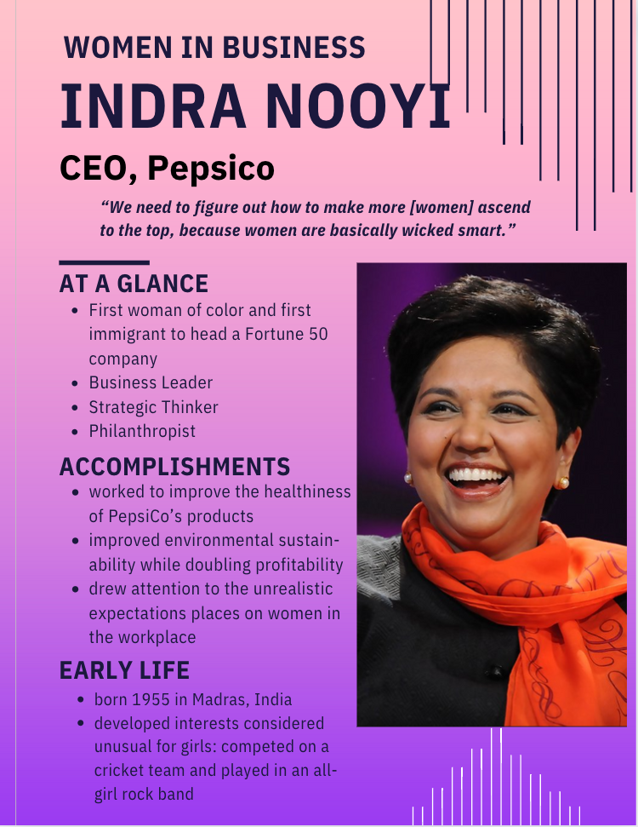
Name
Memorable quote
Image
Achievements
Background information

Slide 33

Exit Ticket
What three trading cards would you put together to form the strongest powerhouse business or team of business advisors?

