Slide 1
Junk Food Junction:
What’s Your Function?
8th and 9th Grade Mathematics

Slide 2
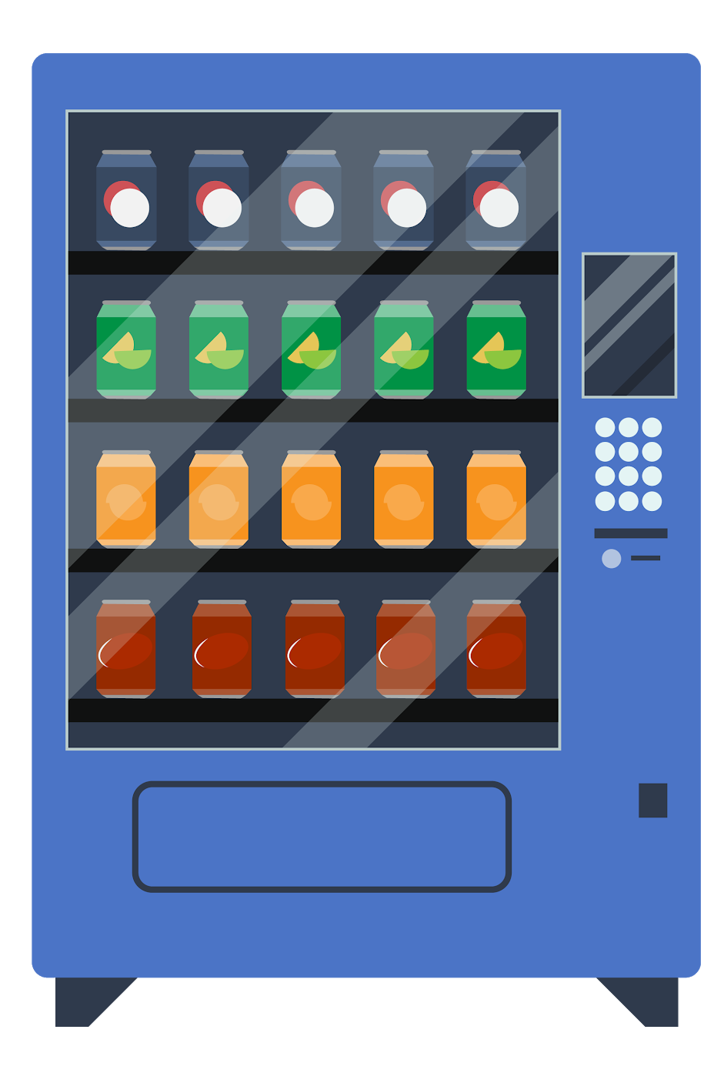
Vending Machine 3-2-1
3
2
1
Items you are going to sell
Methods of payment
Unique aspect of your vending machine

Slide 3
Function Machine
Visit this link:
  https://www.mathplayground.com/functionmachine.html
Pick an input to put into the function and figure out the pattern.
Play at least three rounds.

Slide 4
Based on your experience with the Function Machine, how would you define “function”?

Slide 5
Domain | Range

Slide 6
Independent Variable | Dependent Variable

Slide 7
Vending Machine Advertisement
It’s time to advertise your vending machine!
Include all of the following:
Name of the vending machine
Picture of the vending machine
Description of the products
Cost of the products
Sales pitch, why a customer would want the products

Slide 8
What Do You Want To Buy?
Check out the vending machine advertisements around the room.
Evaluate the following:
  Vending machine name
  Domain and range
  Independent and dependent variables
  Function (pattern)

