Slide 2
Shiver Me Functions!
Function Notation

Slide 3
Essential Question
What can you represent with function notation?

Slide 4
Lesson Objectives
Evaluate a function using function notation.
Interpret the meaning of something written with function notation.
Simplify polynomial expressions.

Slide 5
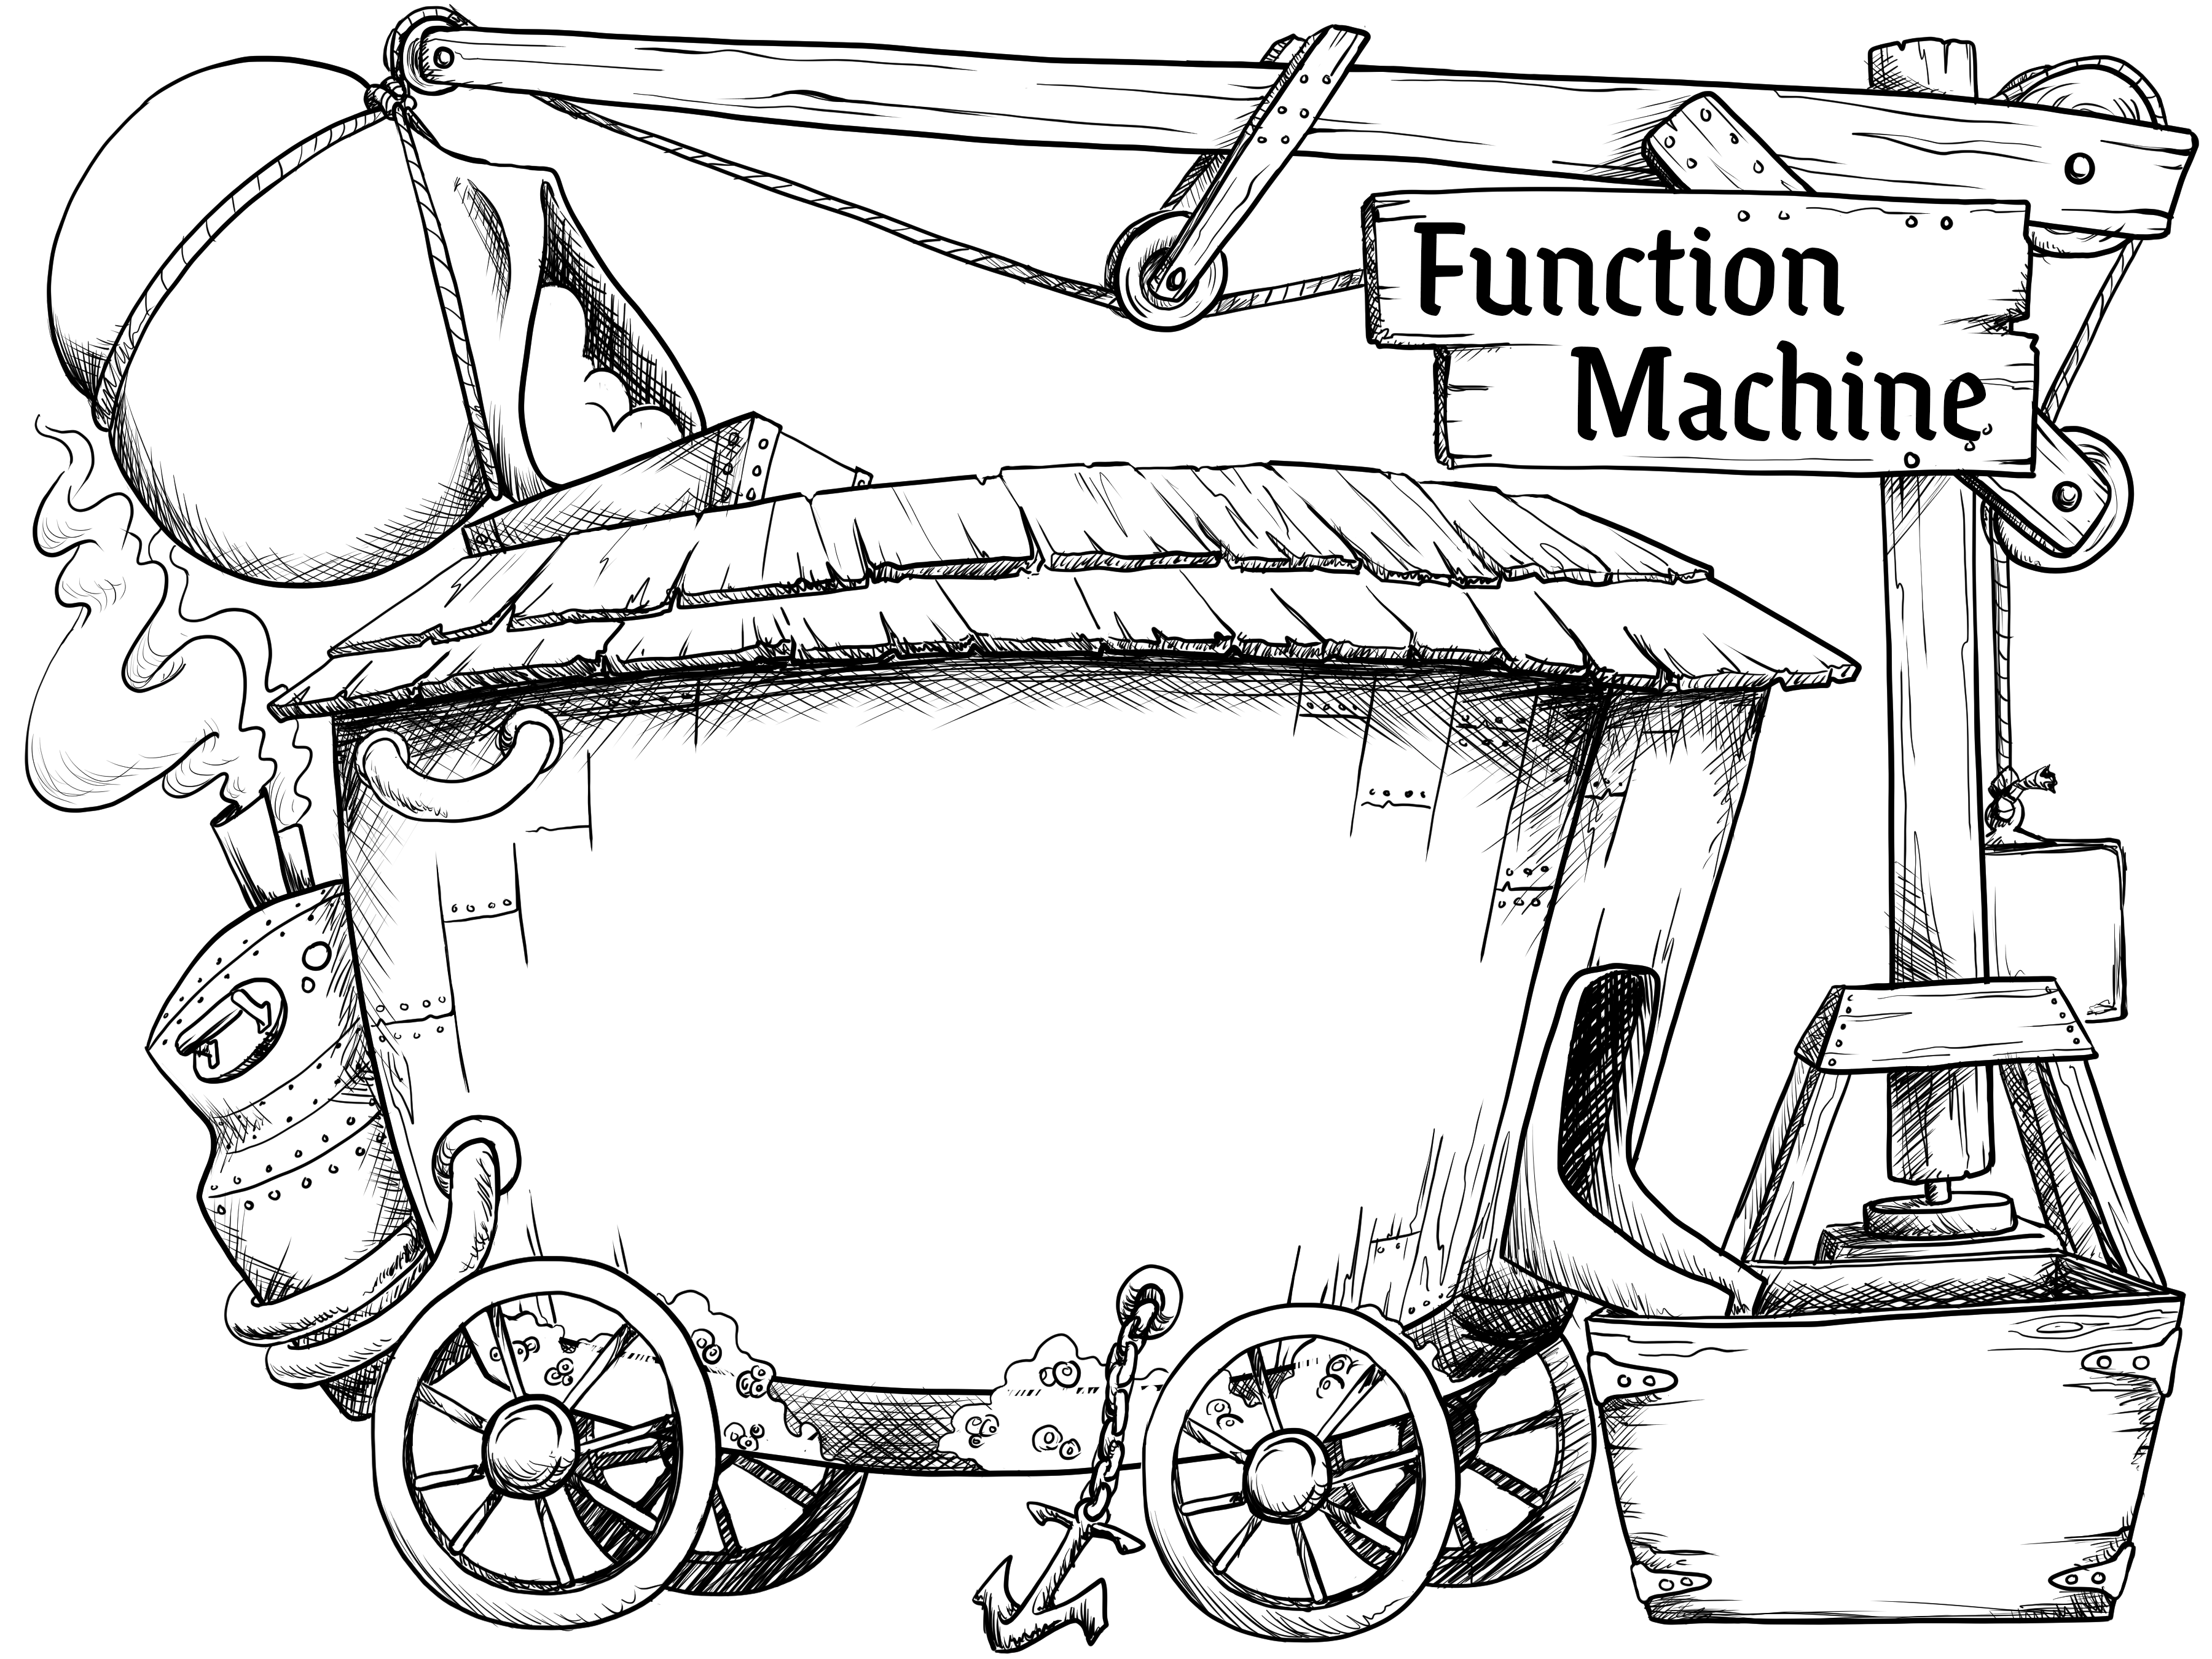
What’s My Function?
Work with a partner to determine what two operations were used to make the input into the output.
In your own words, describe how the machine would turn any input into an output.
input
output
Notes:
K20 Center. (2022). Function Machine (Image).

Slide 6
What’s My Function? (Sample Solution 1)
Compare your answer with what you see here.
How could we write this algebraically?
input
The input times 2,
then add 1.
output
Notes:
K20 Center. (2022). Function Machine (Image).

Slide 7
What’s My Function? (Sample Solution 1)
input
output = 2(input) + 1
The input times 2,
then add 1.
output
Notes:
K20 Center. (2022). Function Machine (Image).

Slide 8
What’s My Function? (Sample Solution 2)
Compare your answer with what you see here.
How could we write this algebraically?
input
The machine multiplied the input by 3, then subtracted 5.
output
Notes:
K20 Center. (2022). Function Machine (Image).

Slide 9
What’s My Function? (Sample Solution 2)
input
output = 3(input) – 5
The machine multiplied the input by 3, then subtracted 5.
output
Notes:
K20 Center. (2022). Function Machine (Image).

Slide 10
What’s My Function? (Sample Solution 3)
Compare your answer with what you see here.
How could we write this algebraically?
input
The machine squared the input then subtracted 2.
output
Notes:
K20 Center. (2022). Function Machine (Image).

Slide 11
What’s My Function? (Sample Solution 3)
input
output = (input)² – 2
The machine squared the input then subtracted 2.
output
Notes:
K20 Center. (2022). Function Machine (Image).

Slide 12
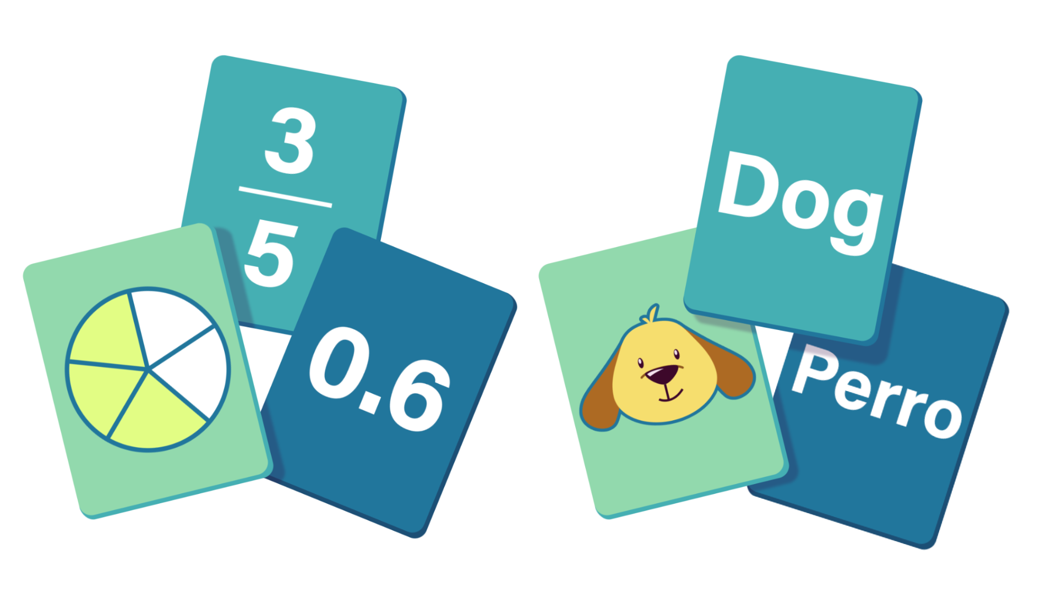
Card Matching
Work with your partner to match the following cards:
  Scenario
  Equation
  Function Notation
Notes:
K20 Center. (n.d.). Card Matching. Strategies. Retrieved from https://learn.k20center.ou.edu/strategy/1837

Slide 13
Card Matching: Solution
Check your work to see if you
matched your cards correctly.
Scenario | A | B | C | D | E | F | G | H
Equation | 2 | 6 | 8 | 5 | 4 | 1 | 7 | 3
Function Notation | R | N | L | M | J | K | Q | P
Notes:
K20 Center. (n.d.). Card Matching. Strategies. Retrieved from https://learn.k20center.ou.edu/strategy/1837

Slide 14
Card Matching: Reflection
We just saw f (x), g(x), h(x), and k(x). What do you think they mean?

Slide 15
Function Notation
Think about the previous three function machines.
We could have written the equations as y = 2x + 1,
y = 3x – 5, and y = x² – 2.
What does y equal when x equals 3?

Slide 16
Function Notation: Great for Naming
Now you see why there is function notation.
Example:
$$\text{th}\text{e} \text{f} \text{funct}\text{ion} \text{at} a \text{given} x\text{−}\text{value} has \text{that} y\text{−}\text{value}$$

Slide 17
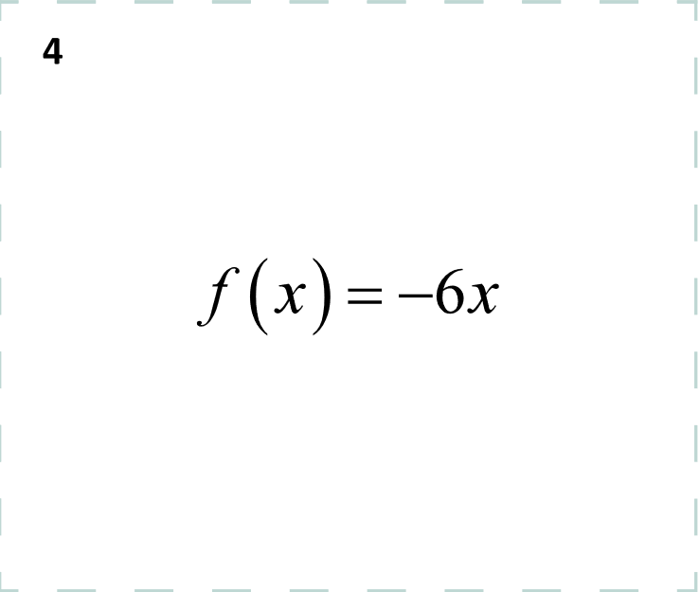
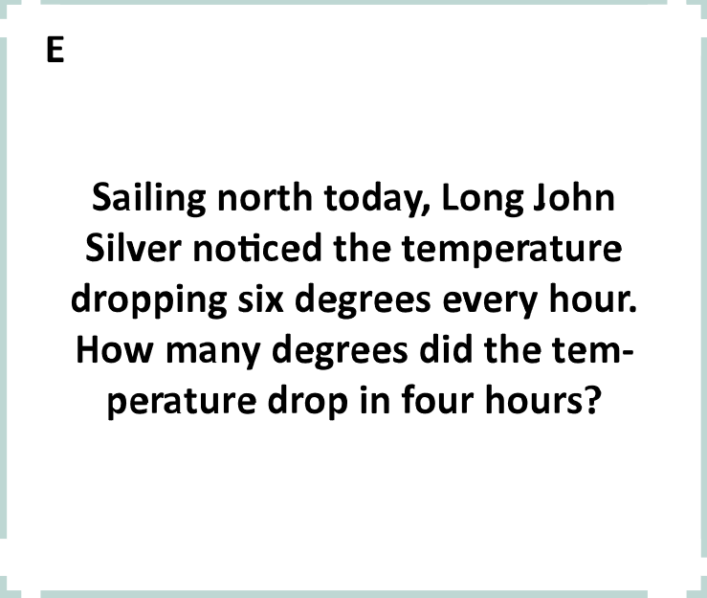
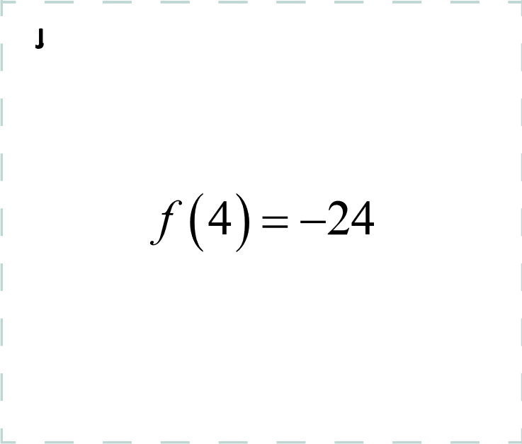
Function Notation: Card Matching
As Long John Silver sailed north today, he noticed the temperature dropped 6 degrees every hour. How many degrees did the temperature drop
in 4 hours?

Slide 18
Function Notation: Card Matching
As Long John Silver sailed north today, he noticed the temperature dropped 6 degrees every hour. How many degrees did the temperature drop in 4 hours?
f (x) = –6x
f (4) = –24 means that after 4 hours, the temperature has dropped 24°.

Slide 19
Function Notation: What’s My Function?
input
output = 2(input) + 1
y = 2x + 1
f (x) = 2x + 1
2(input) + 1
output
Notes:
K20 Center. (2022). Function Machine (Image).

Slide 20
Function Notation: Example 1
Given: f (x) = (2x – 5) + (–4x + 2)
Find: f (3) =

Slide 21
Function Notation: Example 2
Given: g(x) = (–2x + 8) – (5x – 2)
Find: g(–3) =

Slide 22
Function Notation: Example 3
Given: h(x) = (3x – 2)·(–2x + 4)
Find: h(2) =

Slide 23
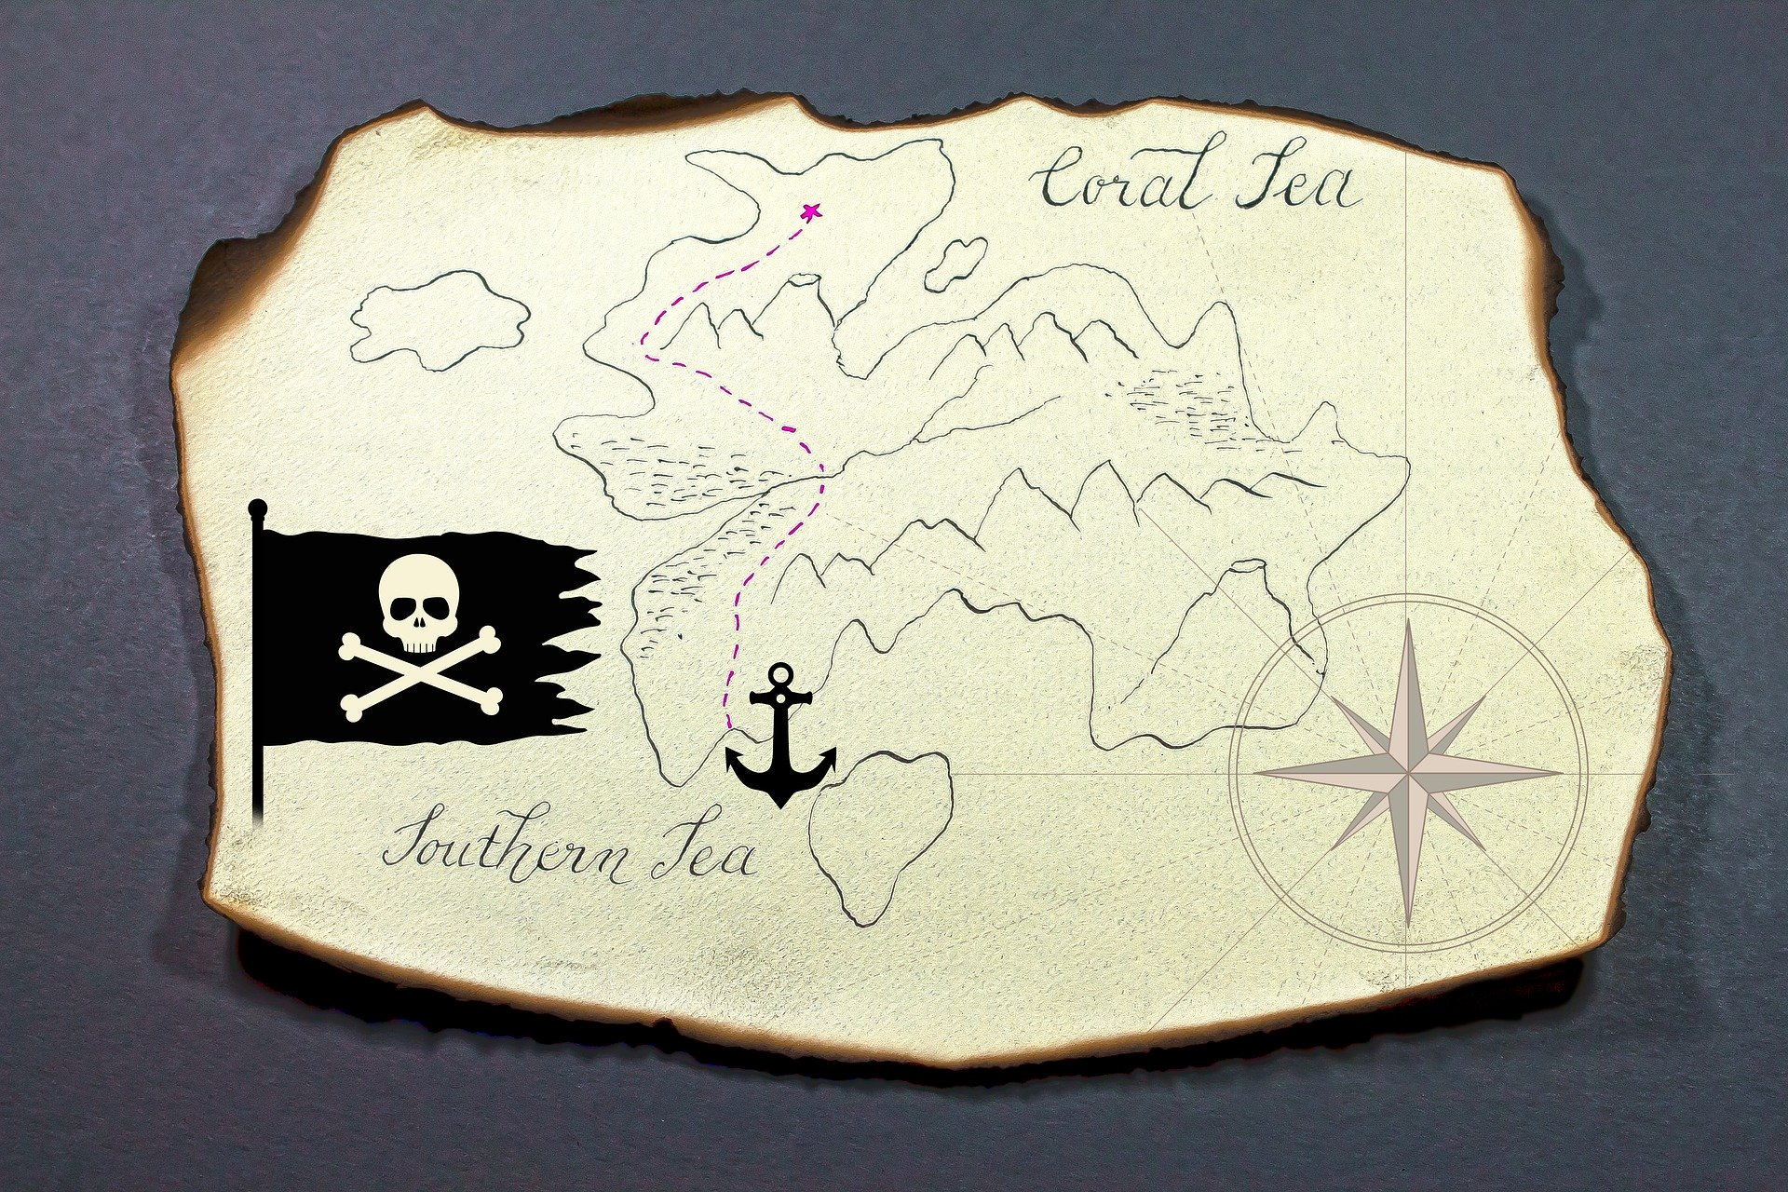
Can You Find the Treasure Map?
You are with a group of sailors who are on a voyage to find the missing treasure map. It is your job as the captain to find the keys to retrieve the map that leads you to your destiny.
Will you get to the treasure map first?
Notes:
Schweihofer, S. (2019, January 30). Treasure Map [Photograph]. Pixabay. https://pixabay.com/photos/treasure-map-island-map-3964944/

Slide 24
Digital Breakout: Treasure Map Hunt
Find the clues to get the keys to the three locks.
“clue” – the challenge you must complete to get the key
“key” – a code (arrangement of letters)
“locks” – where you put the keys (in the Google Form)
Notes:
Schweihofer, S. (2019, January 30). Treasure Map [Photograph]. Pixabay. https://pixabay.com/photos/treasure-map-island-map-3964944/

Slide 25
Digital Breakout: Treasure Map Hunt
Now it’s time for you to try to find the treasure map! See if you can find the keys for each of the three locks before someone else finds the map.
Go to: https://bit.ly/treasurehuntbreakout.
On your handout, record:
Each clue location, the corresponding key, and how you found the key (show your mathematic work).
Notes:
Schweihofer, S. (2019, January 30). Treasure Map [Photograph]. Pixabay. https://pixabay.com/photos/treasure-map-island-map-3964944/

Slide 26
Using Function Notation
Work with a partner to answer the questions on the handout using the three given functions:
f (x), g(x), and h(x).
Read each question carefully.

Slide 27

Exit Ticket
If A(x) is the number of captain’s hats you can buy for x gold coins, what does A(36) = 4 represent?
Notes:
K20 Center. (n.d.). Bell Ringers and Exit Tickets. Strategies. https://learn.k20center.ou.edu/strategy/125

Slide 28
Exit Ticket (Sample Response)
A(36) = 4 means that for 36 gold coins, I can buy 4 captain’s hats.
Notes:
K20 Center. (n.d.). Bell Ringers and Exit Tickets. Strategies. https://learn.k20center.ou.edu/strategy/125

