Slide 1
Hold the Line… or Don’t
Linear vs. Non-Linear Functions

Slide 2
Walking to a Friend’s House
Graph the following scenario:
  You leave your house to meet up with a friend. You must stop and tie your shoe. Then, you sprint to make it to your friend’s house on time. When you get there, your friend wants to go back to your house because you have better Internet. You and your friend turn around and go back home.
Why did you graph the scenario the way that you did?

Slide 3

Card Sort
Pair up with a partner.
Match the following four cards:
  Function
  Scenario
  Table
  Graph

Slide 4
From the Card Sort:
What key components tell you how to match the graph?

Slide 5
From the Card Sort:
What makes the function linear?

Slide 6
From the Card Sort:
What makes the table linear?

Slide 7
From the Card Sort:
How did you match the scenario?

Slide 8
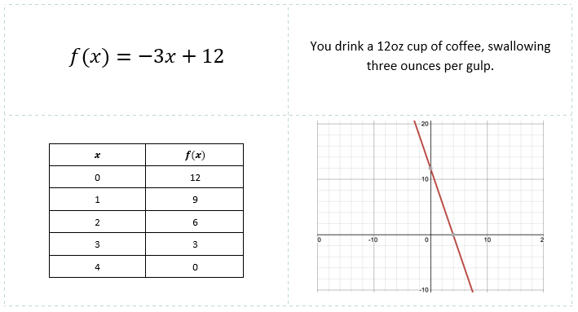
Card Sort Reveal
Check your Card Sort to see if you paired the equation, scenario, table, and graph correctly.

Slide 9
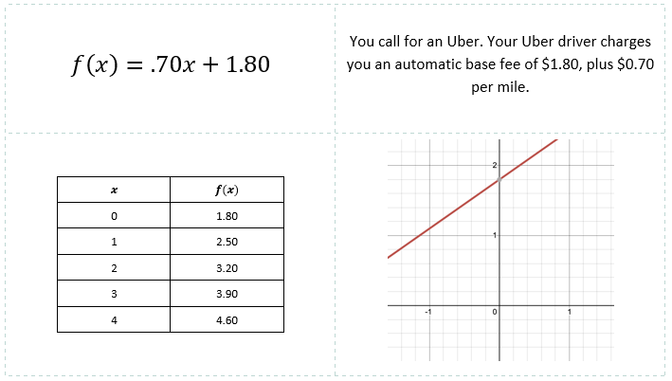
Card Sort Reveal
Check your Card Sort to see if you paired the equation, scenario, table, and graph correctly.

Slide 10
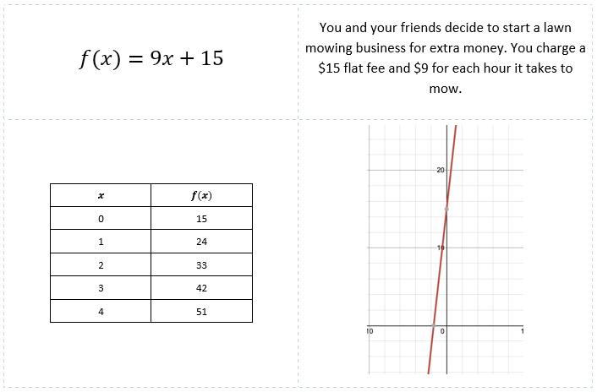
Card Sort Reveal
Check your Card Sort to see if you paired the equation, scenario, table, and graph correctly.

Slide 11
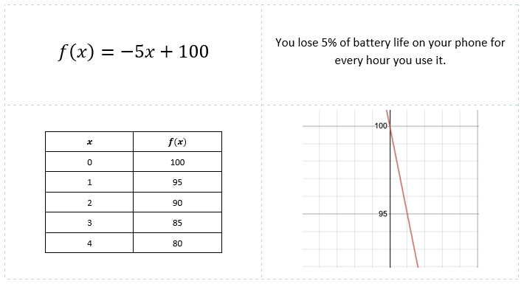
Card Sort Reveal
Check your Card Sort to see if you paired the equation, scenario, table, and graph correctly.

Slide 12
Your Turn
On your “Make Your Own Scenario” handout:
Create a scenario with a linear equation.
Fill out the table and graph to match the scenario.
Determine the function, then work out the function.
When finished, cut out your four cards on the dotted lines.
Be prepared to trade cards with others.

Slide 13
Your Turn
Navigate to this link: http://bit.ly/MakeYourOwnScenario (click “make a copy”). On your digital handout:
Create a scenario with a linear equation.
Fill out the table and create a graph to match the scenario. Use Desmos (https://www.desmos.com/) to create a graph.
Determine the function, then work out the function.
Receive your printed handout, and cut out your four cards on the dotted lines.
Be prepared to trade cards with others.

Slide 14
Class Scenarios
Each person should receive a card.
Find your group of four cards by matching the scenario, equation, graph, and table.

Slide 15

What Did I Learn Today?
Before you leave, answer the following questions:
  What did you learn today?
  How are functions connected to the real world?

