Slide 2
Know Your Rights
Interpreting the Bill of Rights
8th Grade US History and Government

Slide 3
Essential Questions
What value do people place on individual rights?
How does the Bill of Rights protect individual rights?

Slide 4
Letter from an Alien Nation
Greetings earthling,
Due to the recent demise of your country and our subsequent takeover, you are now under our control. Under your past government’s rule, you were allowed certain “rights” that we are not willing to recognize. However, we are a just society. We will acknowledge and enforce two of the Constitutional rights outlined in your first ten amendments (the Bill of Rights). It is up to you as a society to decide which two rights you will keep. This decision will be made by majority rule. You have little time to make your decision, so make haste!
Sincerely,
Zee-bo-dee-ba, Representative from Planet X
Read the ten amendments listed under your letter. Working individually, rank the amendments from 1 to 10, with 1 being the most valuable and 10 being the least.

Slide 5
Bill of Rights Sticky Bar Graph
Put the two amendments you value most on two separate sticky notes.
Place your sticky notes above each amendment number you chose to create a bar graph.
Which amendments are perceived as most important for our class? Why?
1 | 2 | 3 | 4 | 5 | 6 | 7 | 8 | 9 | 10

Slide 6
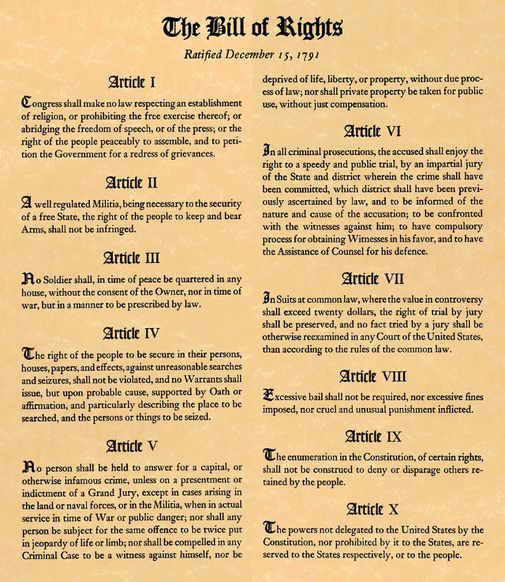
Bill of Rights Notes Organizer
Using the resources provided, work with your group to summarize the meaning of each amendment in the Bill of Rights.
Record your summaries in the Notes Organizer.
Texas Student Civic Engagement. (n.d.). Bill of Rights. Retrieved from https://www.txstudentcivics.org/bill-of-rights.html.

Slide 7
Congress shall make no law respecting an establishment of religion, or prohibiting the free exercise thereof; or abridging the freedom of speech, or of the press, or the right of the people peaceably to assemble, and to petition the Government for a redress of grievances."
What does the First Amendment say in your own words?

Slide 8
First Amendment Summary
We are free to practice any religion we want, or none at all. The government cannot limit our freedom to express ourselves through speech or publishing our ideas. We are allowed to peacefully gather together, and we can petition or challenge the government if we think something is wrong.

Slide 9
Visual Representations
Individually or as a group, choose three amendments to represent visually.
Draw your artwork in the “visual representation” section of the Bill of Rights Notes Organizer.
Amendment #1,
Freedom of the Press
Nicu Buculei. (2006, May 30). File: Newspaper nicu buculei 01.svg. Retrieved from https://commons.wikimedia.org/wiki/File:Newspaper_nicu_buculei_01.svg.

Slide 10
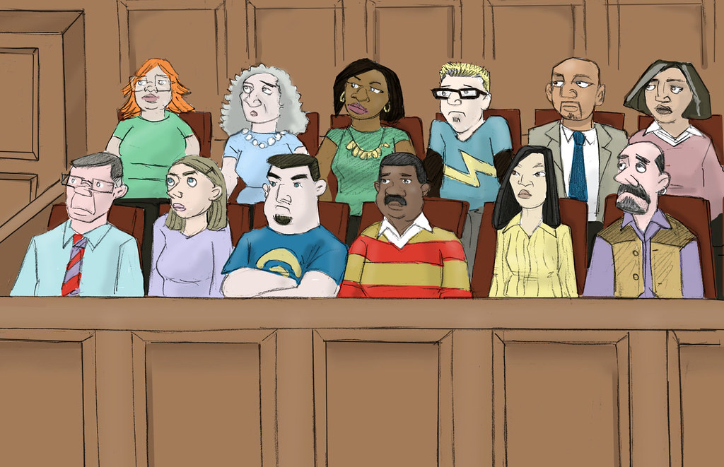
Applying the Bill of Rights
Work with your groups to determine which statement represents each amendment. Explain your answers in one or more complete sentences.
This Photo by Unknown Author is licensed under CC BY-SA-NC
Amendment #6, Right to an Impartial Jury
CALI - Center for Computer-Assisted Legal Instruction. (2012, January 23). Jury. Retrieved from https://www.flickr.com/photos/caliorg/6882839119/.

Slide 11
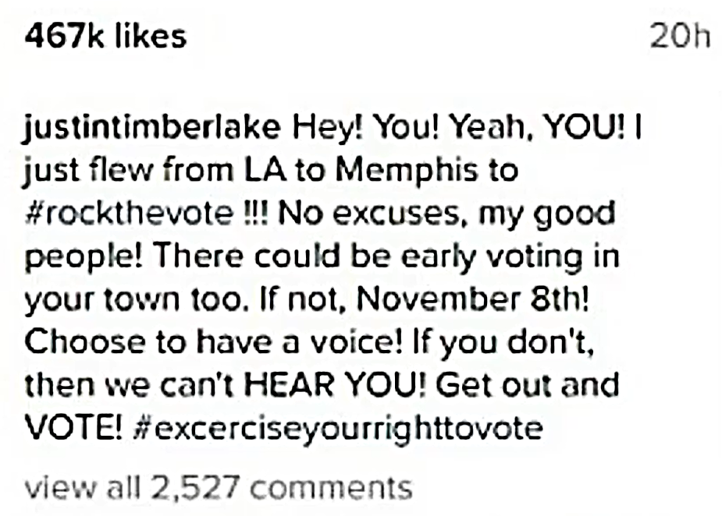
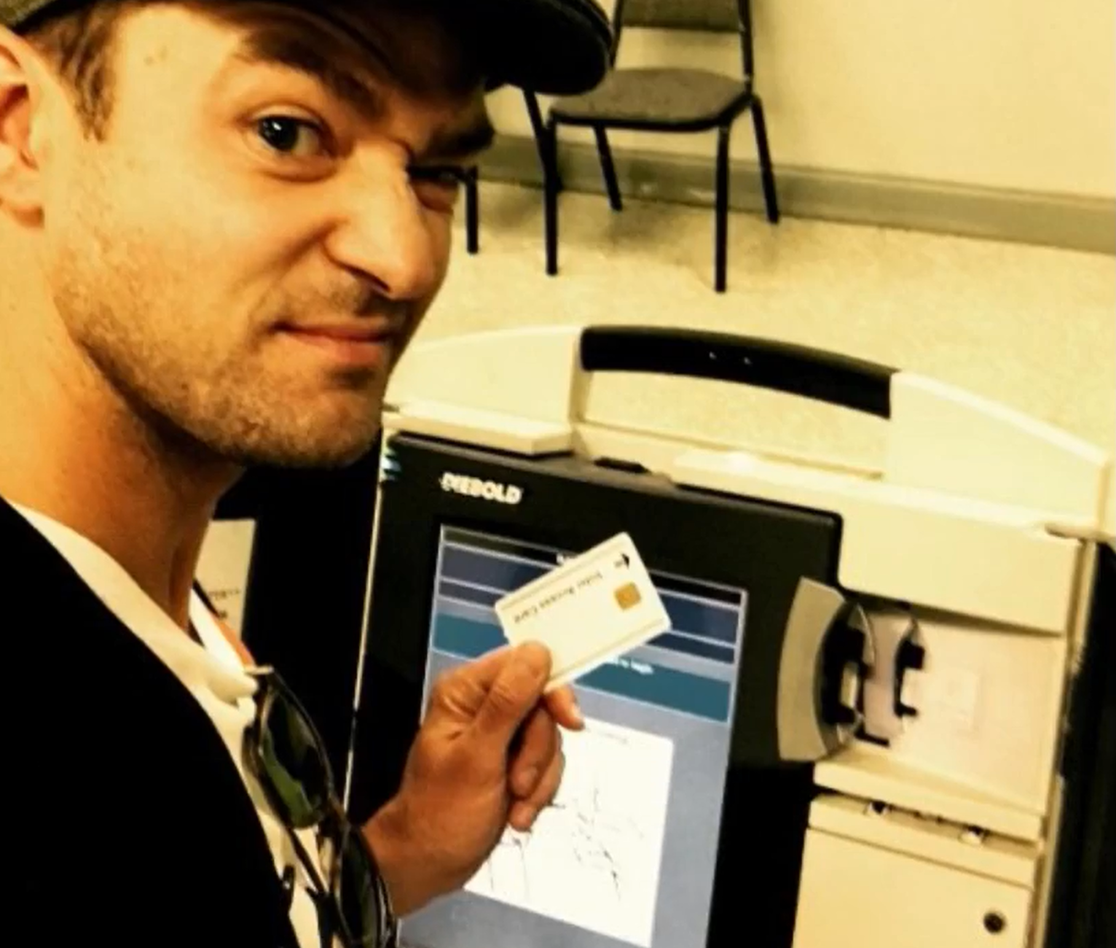
Ballot Selfies and the First Amendment
With your group, read the article about ballot selfies.
After reading, respond to the questions following the article. Use your knowledge of the First Amendment and how you think it should be interpreted.
Mandell, A. (2016, October 25). Justin Timberlake's voting selfie may have broken the law. USA Today. Retrieved from https://www.usatoday.com/story/life/people/2016/10/25/justin-timberlakes-voting-selfie-may- have-broken-law/92728472/

Slide 12
Sticky Bar Graph Revisited
Now that you have a better understanding of the rights guaranteed to citizens in the Bill of Rights, would you change the two amendments you think are most valuable or important? Explain.
1 | 2 | 3 | 4 | 5 | 6 | 7 | 8 | 9 | 10

