Slide 2
Know Your Rights
Interpreting the Bill of Rights

Slide 3
Essential Questions
What value do people place on individual rights?
How does the Bill of Rights protect individual rights?

Slide 4
Lesson Objectives
Recognize the impact of the Bill of Rights on the United States and U.S. citizens.
Identify and analyze the guarantees of individual rights and liberties as expressed in each of the ten amendments.

Slide 5
Alien Takeover
Greetings Earthling,
Read the ten amendments listed under your letter.
Rank the amendments from 1 to 10.
1: Most Valuable
10: Least Valuable

Slide 6
Bill of Rights: Sticky Bars
On one sticky note, write why you ranked an amendment as #1.
On your other sticky note, write why you ranked an amendment as #2. Place each sticky note above the corresponding amendment number on the board to create a bar graph.
1
2
3
4
5
6
7
8
9
10
Notes:
K20 Center. (n.d.). Sticky bars. Strategies. https://learn.k20center.ou.edu/strategy/129

Slide 7
Bill of Rights: Sticky Bars
Which amendments are most important to our class?
Why do you think these are most valued?
1
2
3
4
5
6
7
8
9
10
Notes:
K20 Center. (n.d.). Sticky bars. Strategies. https://learn.k20center.ou.edu/strategy/129

Slide 8
Fundamental Freedoms
Work together in your group to summarize the meanings of your assigned amendments.
Be ready to share with your classmates.
Notes:
K20 Center. (n.d.). Jigsaw. Strategies. https://learn.k20center.ou.edu/strategy/179

Slide 9
Bill of Rights: First Amendment
Congress shall make no law respecting an establishment of religion, or prohibiting the free exercise thereof; or abridging the freedom of speech, or of the press; or the right of the people peaceably to assemble, and to petition the Government for a redress of grievances.
How would you explain what the First Amendment says in your own words?
Notes:
U.S. Const. amend. I. https://www.archives.gov/founding-docs/bill-of-rights-transcript#toc-amendment-i
K20 Center. (n.d.). Jigsaw. Strategies. https://learn.k20center.ou.edu/strategy/179

Slide 10
Bill of Rights: First Amendment
Sample Summary:
We are free to practice any religion we want or none at all. The government cannot limit our freedom to express ourselves through speech or publication of our ideas. We are allowed to peacefully gather together, and we can petition or challenge the government if we think something is wrong.
Notes:
K20 Center. (n.d.). Jigsaw. Strategies. https://learn.k20center.ou.edu/strategy/179

Slide 11
Know Your Freedoms
Group A | Amendment I | Amendment IV
Group B | Amendment II | Amendment III
Group C | Amendment V | Amendment X
Group D | Amendment VI | Amendment VII
Group E | Amendment VIII | Amendment IV
Record your summaries on your handout.
Notes:
K20 Center. (n.d.). Jigsaw. Strategies. https://learn.k20center.ou.edu/strategy/179

Slide 12
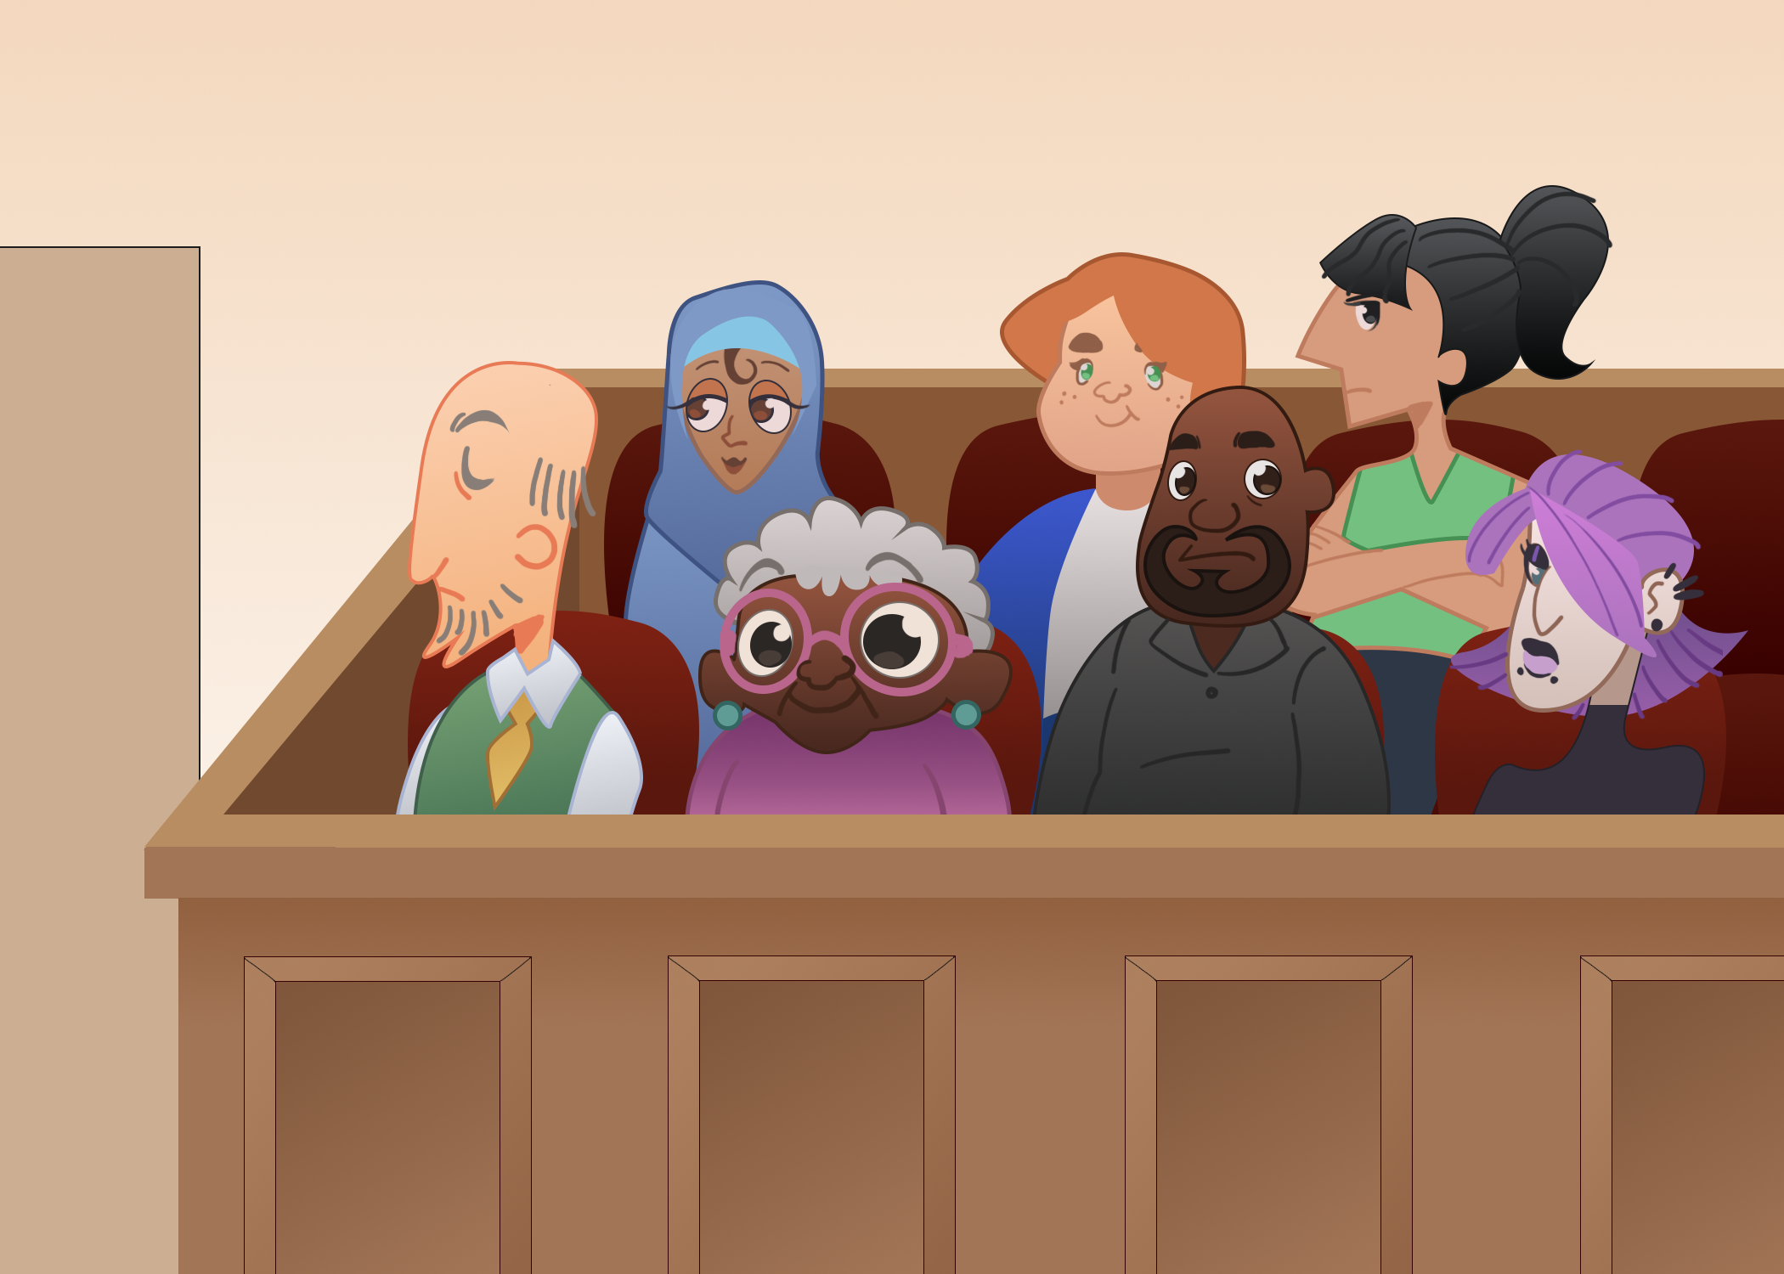
Applying the Bill of Rights
Amendment #6
Right to an Impartial Jury
Determine which amendment each statement represents.
Explain your answer using one or more complete sentences.

Slide 13
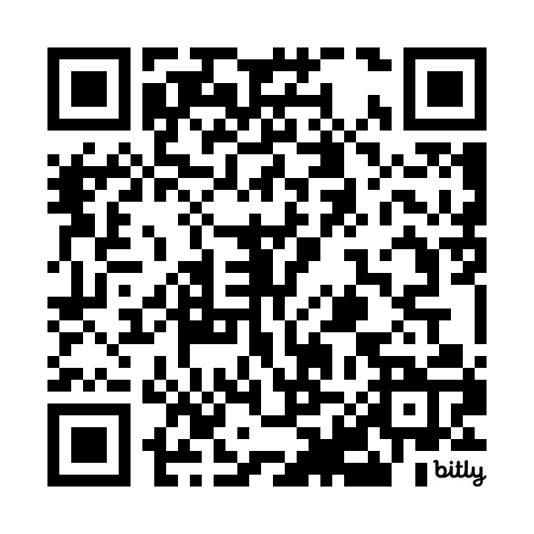
Ballot Selfies and the First Amendment
Visit bit.ly/BallotSelfie2016 or scan the QR code.
Read the article about Justin Timberlake’s ballot selfie.
As you read, consider how the First Amendment applies to this situation.
Notes:
Mandell, A. (2016, October 26). Justin Timberlake’s voting selfie may have broken the law. USA Today. https://www.usatoday.com/story/life/people/2016/10/25/justin-timberlakes-voting-selfie-may-have-broken-law/92728472/

Slide 14
Ballot Selfies and the First Amendment
Which First Amendment right is debated in the article? Share your reasoning.
Do you think taking a selfie, in any form, is an expression of our First Amendment rights? Why do you think that?
Do you think it is a violation of our First Amendment rights for a state to make taking and sharing “ballot selfies” against the law? Share your thinking.

Slide 15
Show Me What Freedom Looks Like…
Choose 3 amendments.
Draw and label your chosen amendments on your Show Me Freedom handout.
Amendment #1
Freedom of the Press
Notes:
Nicu Buculei. (2006, May 30). Newspaper nicu buculei [Illustration]. Wikimedia Commons. https://commons.wikimedia.org/wiki/File:Newspaper_nicu_buculei_01.svg

Slide 16
Sticky Bar Graph Revisited
Consider what you learned about the rights guaranteed to citizens in the Bill of Rights.
Would you change your opinion on which 2 amendments are most important? Why or why not?
1
2
3
4
5
6
7
8
9
10
Notes:
K20 Center. (n.d.). Sticky bars. Strategies. https://learn.k20center.ou.edu/strategy/129

