Slide 1

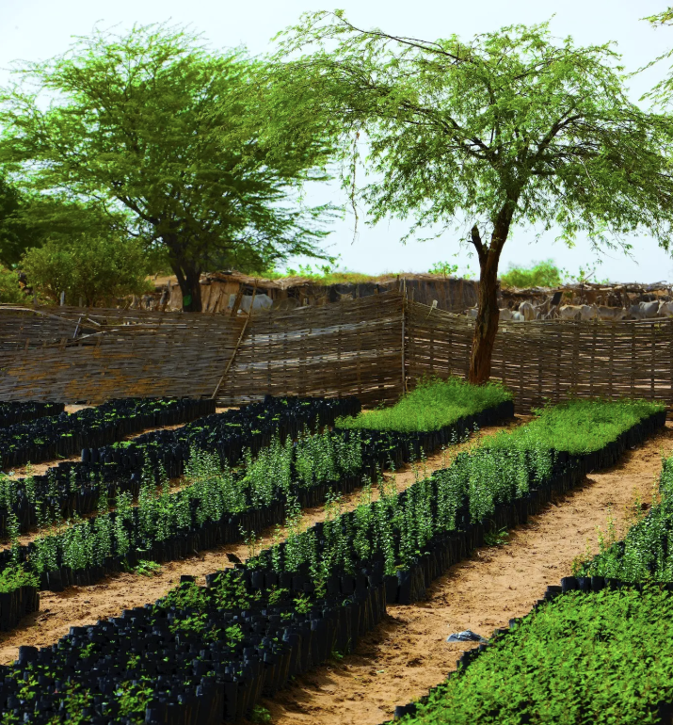
#1

Slide 2
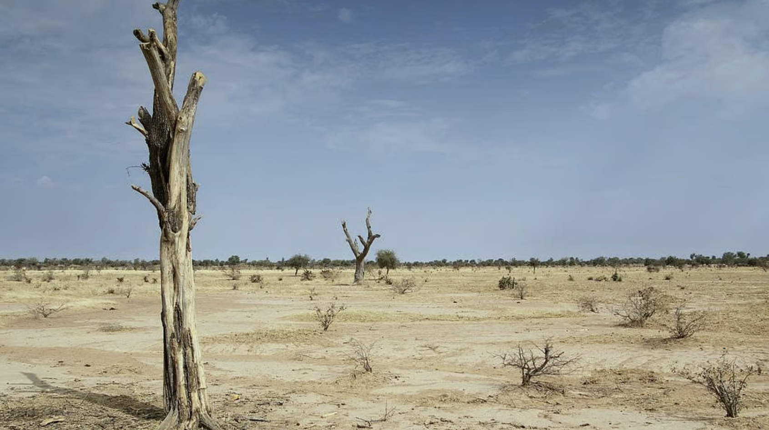
#2

Slide 3
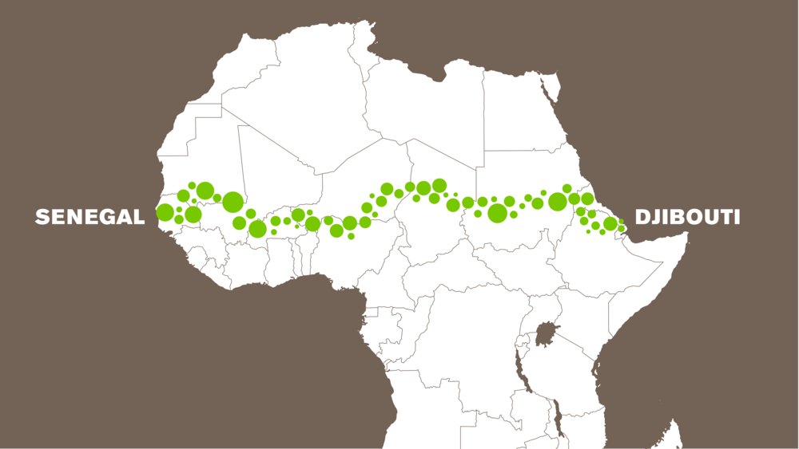
#3

Slide 4
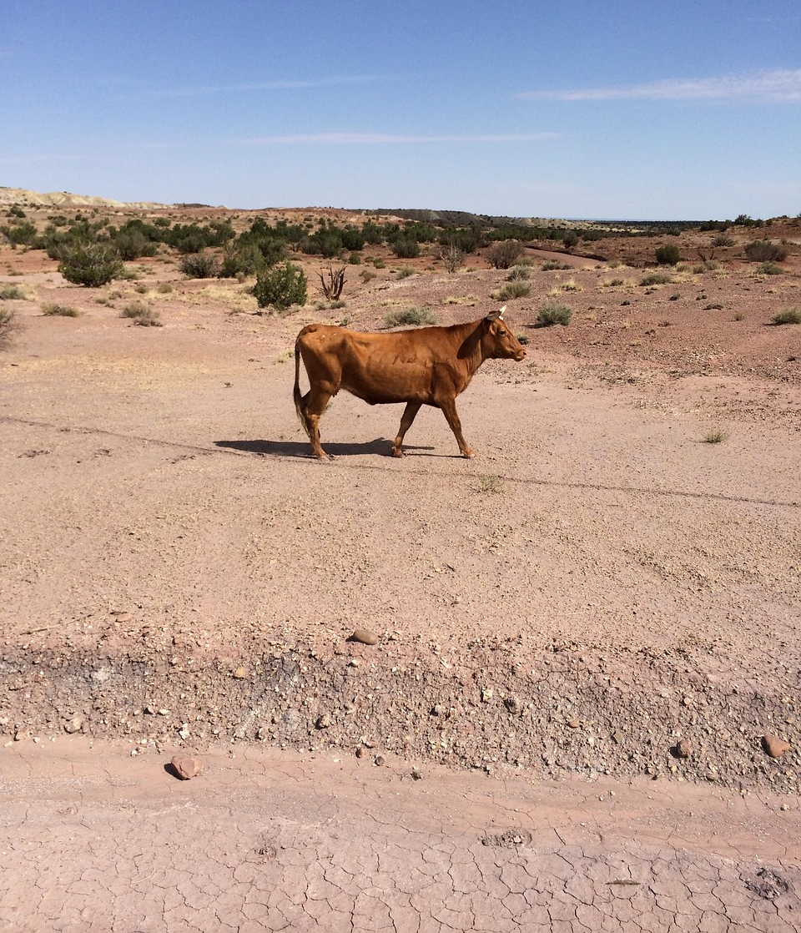
#4
Notes:
raventestingsupply. (2017, June 21). Cow. [Photograph]. Pixabay. https://pixabay.com/photos/cow-cattle-desert-livestock-beef-2429350/

Slide 5
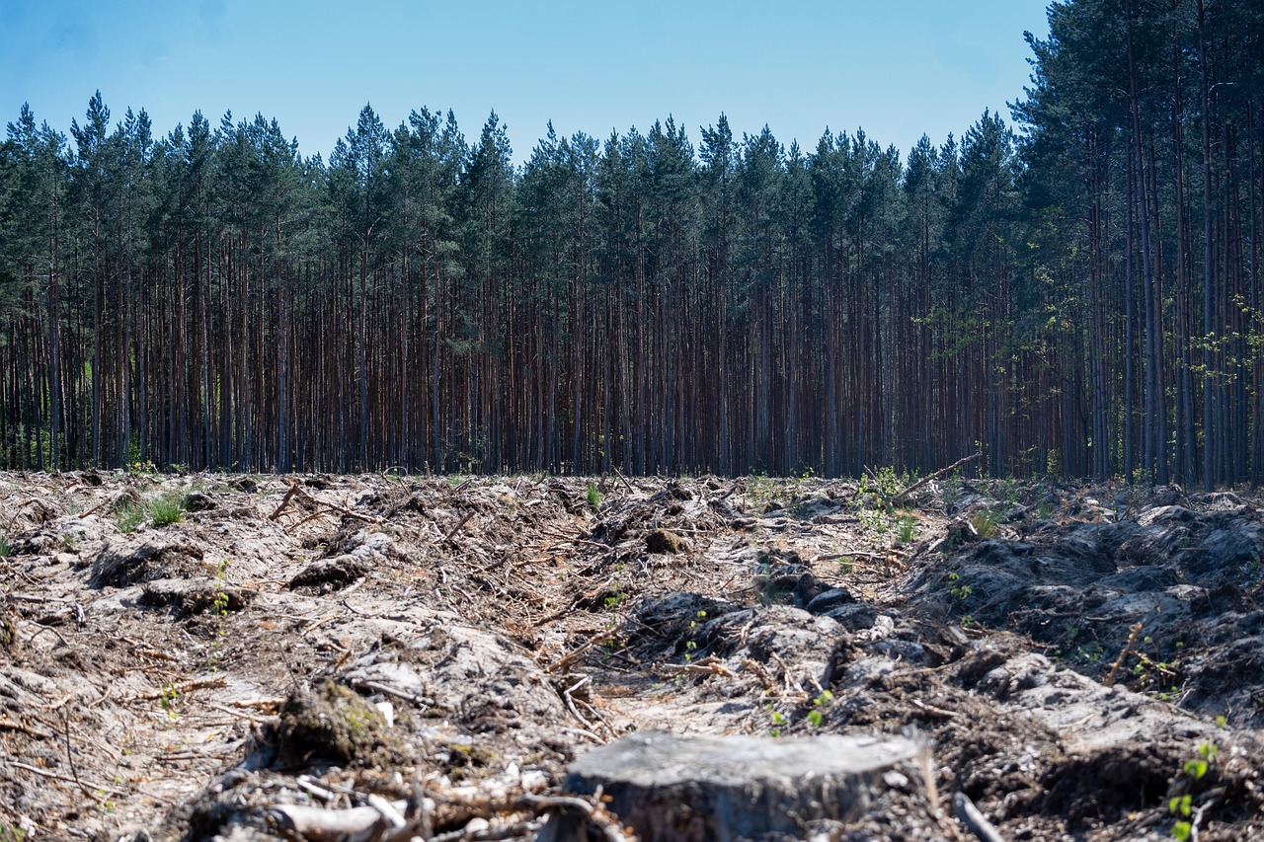
#5
Notes:
Elżbieta Michta. (2022, May 15). Forest. [Photograph]. Pixabay. https://pixabay.com/photos/forest-trees-deforestation-clearing-7198607/

Slide 6
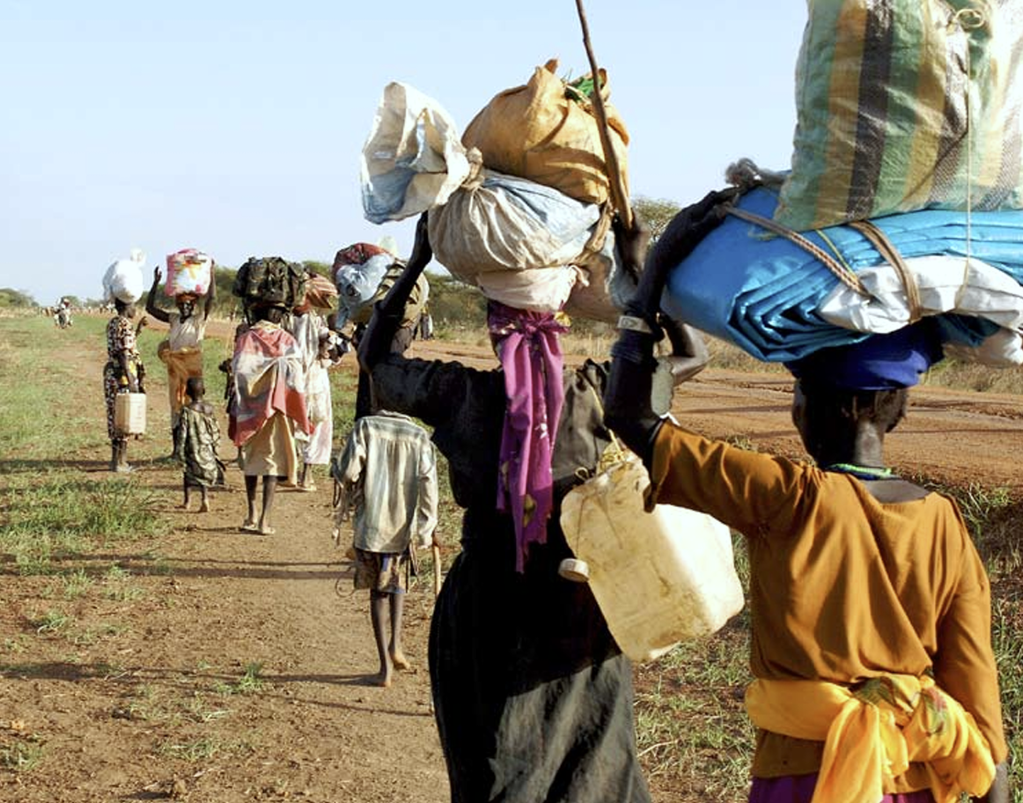
#6

