Slide 2
Africa’s Great Green Wall
Desertification of the Sahel

Slide 3
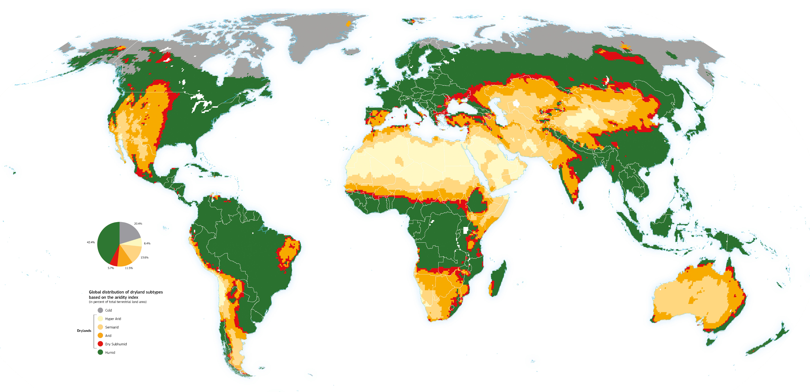
What do you think the various colors on the map represent?
Answer this question in the “think” column of your chart.
Notes:
Cherlet, M., Hutchinson, C., Reynolds, J., Hill, J., Sommer, S., von Maltitz, G. (Eds.). (2018). World Atlas of Desertification, Publication Office of the European Union, Luxembourg.
WAD. (2019, April 25). Patterns of aridity. World Atlas of Desertification. https://wad.jrc.ec.europa.eu/patternsaridity

Slide 4
Essential Questions
How do interactions between humans and their environment impact both the people and the natural environment of the Sahel?
Why is Africa building a great green wall?

Slide 5
Lesson Objectives
Examine the impact of climate patterns on human populations and the Earth’s natural environments.
Consider how humans have transformed natural environments to meet their needs and ambitions.

Slide 6
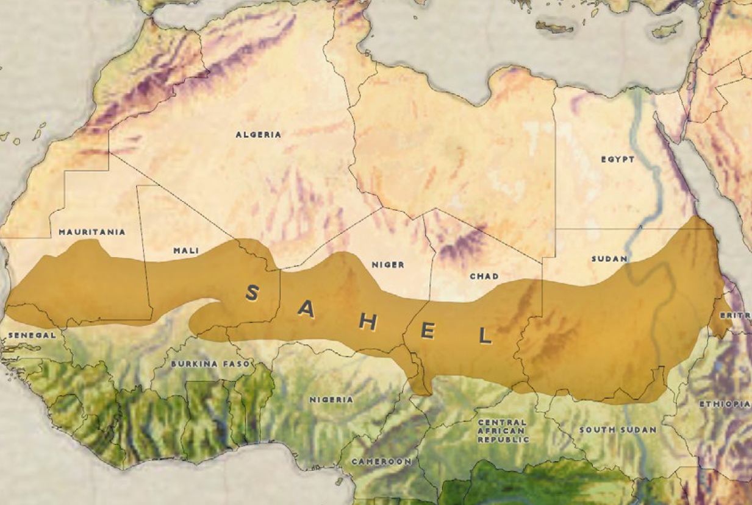
S A H A R A D E S E R T
Notes:
State of New Jersey Office of Homeland Security and Preparedness. (2019, February 21). Isis West Africa Posturing for Prolonged Insurgency. https://www.njhomelandsecurity.gov/analysis/isis-west-africa-posturing-for-prolonged-insurgency

Slide 7
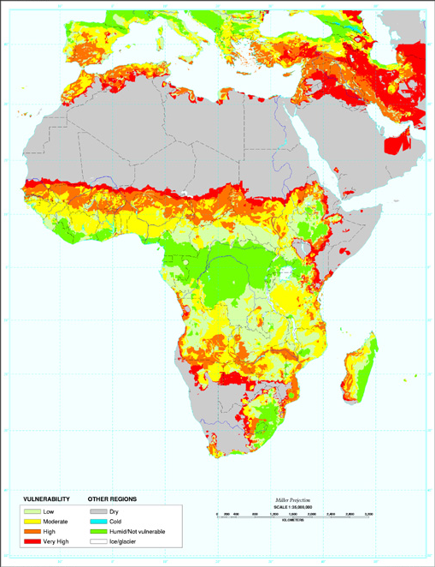
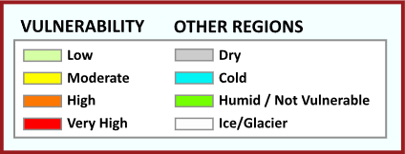
Vulnerability to Desertification
Notes:
State of New Jersey Office of Homeland Security and Preparedness. (2019, February 21). Isis West Africa Posturing for Prolonged Insurgency. https://www.njhomelandsecurity.gov/analysis/isis-west-africa-posturing-for-prolonged-insurgency
Reich, P. F., Numbem, S. T., Almaraz, R. A., & Eswaran, H. (2019). Land resource stresses and desertification in Africa. Response to Land Degradation, 101–116. doi: 10.1201/9780429187957-12. https://www.nrcs.usda.gov/wps/portal/nrcs/detail/soils/use/?cid=nrcs142p2_054025

Slide 8
Desertification Is…
a process by which productive land continues to become drier and drier until it turns into desert;
an advanced form of land degradation.

Slide 9

Categorical Highlighting
As you read the Desertification in
the Sahel article, highlight the following:
the causes of desertification in one color; and
the effects of desertification in another color.
Notes:
K20 Center. (n.d.) Categorical highlighting. Strategies. https://learn.k20center.ou.edu/strategy/192

Slide 10

Causes and Effects
Cause
Cause
Cause
Effect
Effect
Effect

Slide 11
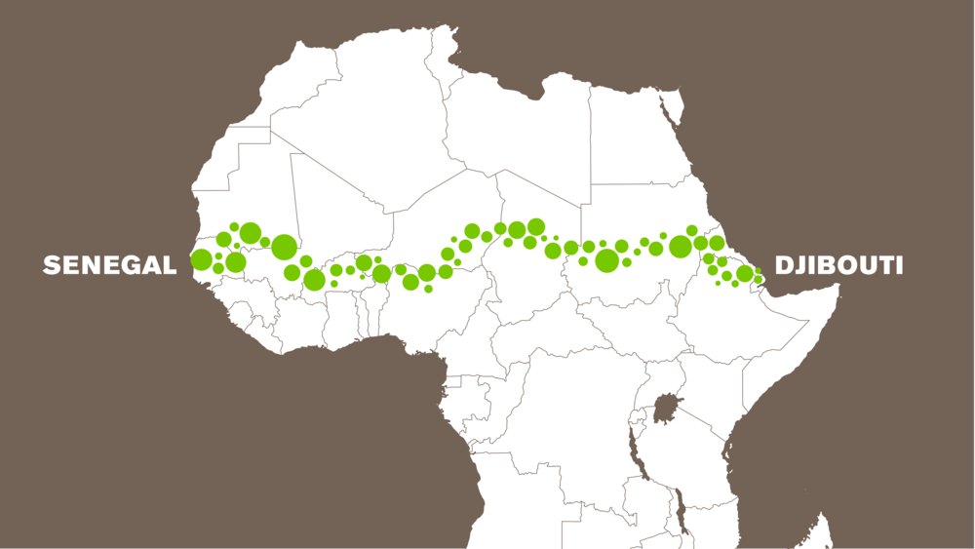
Why Is Africa Building a Great Green Wall?
You are going to watch a video about the Great Green Wall in Africa.
As you watch the
video, write down
why this wall is
being built.

Slide 12
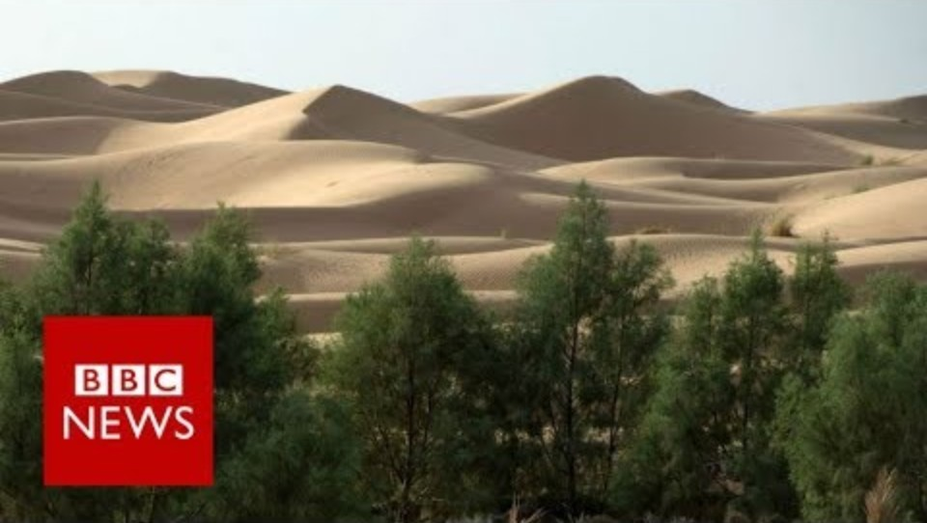
Why Is Africa Building a Great Green Wall?
Notes:
BBC News. (2017, September 26). Why is Africa building a great green wall? BBC News. [Video]. YouTube. https://www.youtube.com/watch?v=4xls7K_xFBQ

Slide 13

Bring Awareness
Create a social media post to help raise awareness for the Great Green Wall in Africa.
Find or create a picture.
Add a hashtag.
  Include a cause and/or effect of desertification.
Share your creation.

Slide 14

Gallery Walk
With your group, record how each photo relates to desertification in the Sahel.
Make sure you are matching the image number with the photo number on your paper.
Be ready to share.
Notes:
K20 Center. (n.d.). Gallery walk / carousel. Strategies. https://learn.k20center.ou.edu/strategy/118

