Slide 2
Why is Africa Building a Great Green Wall?
7th Grade Eastern Geography

Slide 3
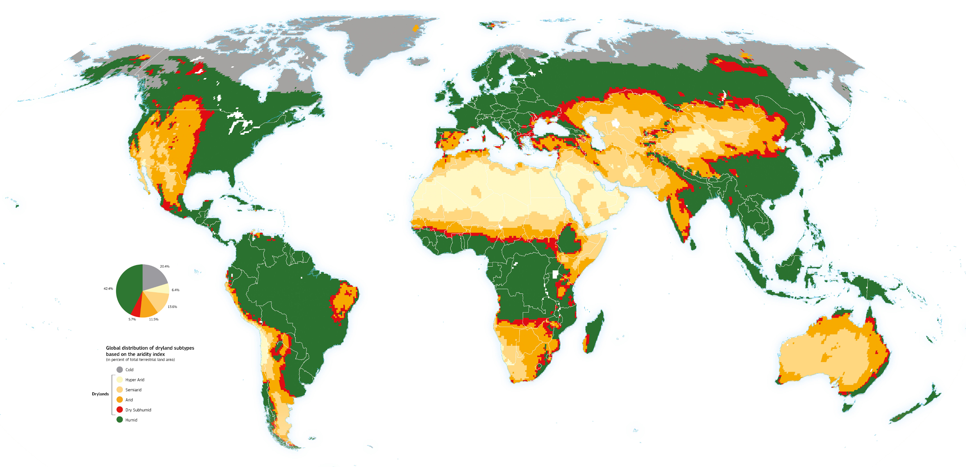
What do you think the various colors on the map represent?
Answer this question in the “think” column of your chart.
Notes:
Cherlet, M., Hutchinson, C., Reynolds, J., Hill, J., Sommer, S., von Maltitz, G. (Eds.), World Atlas of Desertification, Publication Office of the European Union, Luxembourg, 2018.
Image Source: Global Precipitation Climatology Centre and potential evapotranspiration data from the Climate Research Unit of the University of East Anglia (CRUTSv3.20), WAD3-JRC, modified from Spinoni J. 2015 [AP]. Retrieved from https://wad.jrc.ec.europa.eu/patternsaridity

Slide 4
Essential Questions
How do interactions between humans and their environment impact both the people and the natural environment of the Sahel?
What are the causes and effects of desertification of the Sahel?
Why is Africa building a great green wall?

Slide 5
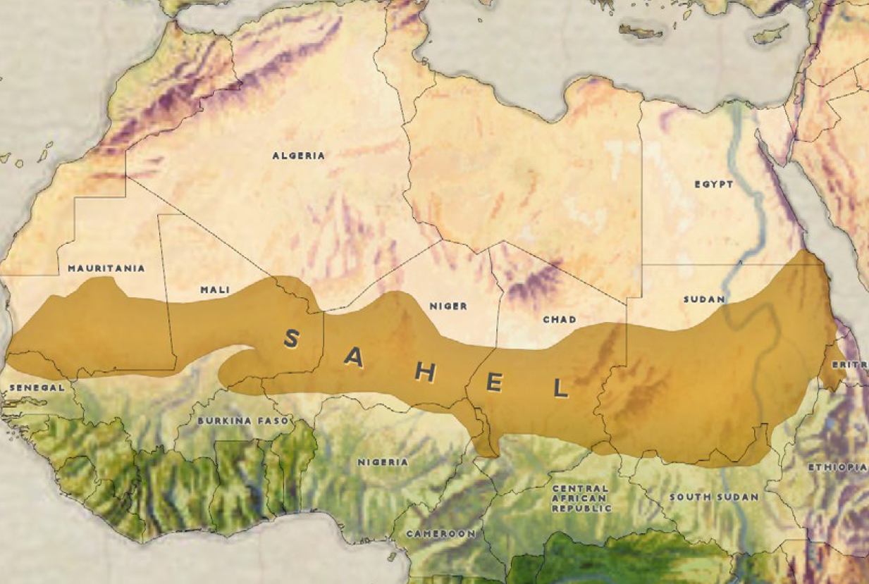
S A H A R A D E S E R T
Notes:
Image Source: State of New Jersey Office of Homeland Security and Preparedness. (2019, February 21). Isis West Africa Posturing for Prolonged Insurgency. Retrieved from https://www.njhomelandsecurity.gov/analysis/isis-west-africa-posturing-for-prolonged-insurgency

Slide 6
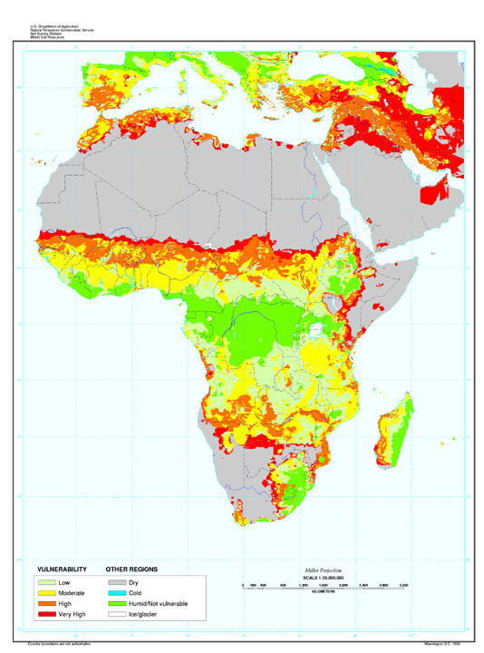
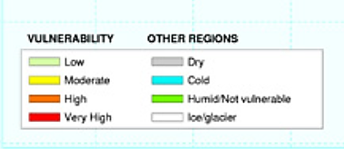
Vulnerability to Desertification
Notes:
Image sources:
State of New Jersey Office of Homeland Security and Preparedness. (2019, February 21). Isis West Africa Posturing for Prolonged Insurgency. Retrieved from https://www.njhomelandsecurity.gov/analysis/isis-west-africa-posturing-for-prolonged-insurgency
Reich, P. F., Numbem, S. T., Almaraz, R. A., & Eswaran, H. (2019). Land resource stresses and desertification in Africa. Response to Land Degradation, 101–116. doi: 10.1201/9780429187957-12. Retrieved from https://www.nrcs.usda.gov/wps/portal/nrcs/detail/soils/use/?cid=nrcs142p2_054025

Slide 7
Desertification is...
a process by which productive land becomes more and more dry until it turns into desert.
an advanced form of land degradation.

Slide 8
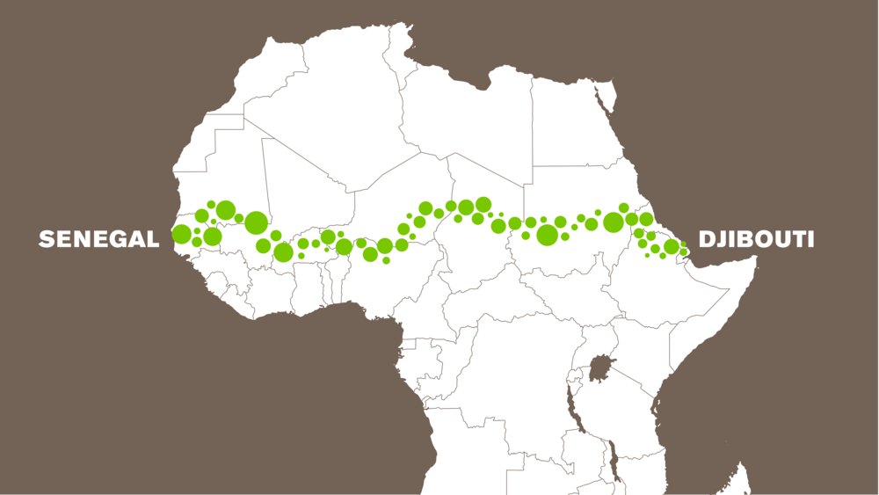
The Great Green Wall
Notes:
Image source: Great Green Wall. (n.d.). Results. Retrieved from https://www.greatgreenwall.org/results

Slide 9
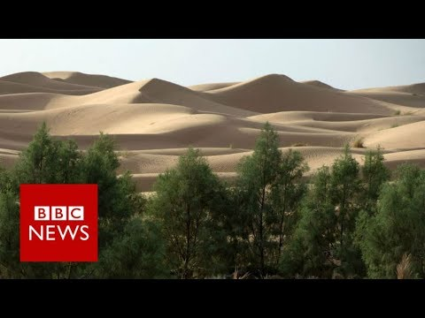
Why is Africa Building a Great Green Wall?
Notes:
Video source: BBC News. (2017, September 26). Why is Africa Building a Great Green Wall? BBC News. Retrieved November 25, 2019, from https://www.youtube.com/watch?v=4xls7K_xFBQ

Slide 10

Tweet Up
To raise awareness, create a tweet that informs the public about the causes and effects of desertification and/or the Great Green Wall initiative.
Your tweets should be short, to-the-point statements or phrases that demonstrate what you have learned. You can include hashtags.
Notes:
https://www.unccd.int/actions/great-green-wall-initiative

