Slide 2
A Mighty Fine Line
Visual Arts:
Exploring the Element of Line in Art

Slide 3
Essential Questions
What is “Line” in terms of art?
How does the element of line help create art?

Slide 4

????
What is this an image of?
What could it be used for?
Let’s draw one.
Notes:
This Photo by Unknown Author is licensed under CC BY-SA-NC

Slide 5
Think About Your Drawing
  Did you draw any straight lines?
  Did any of your lines curve?
  Did any lines connect?
  Were there any lines that crossed?
  Did any of your lines go from one point to another?

Slide 6
Initial Definition for LINE
Join another group and share your previous conversation about your cog drawing.
Then, together as a group, craft an initial definition for the Element of Line.

Slide 7
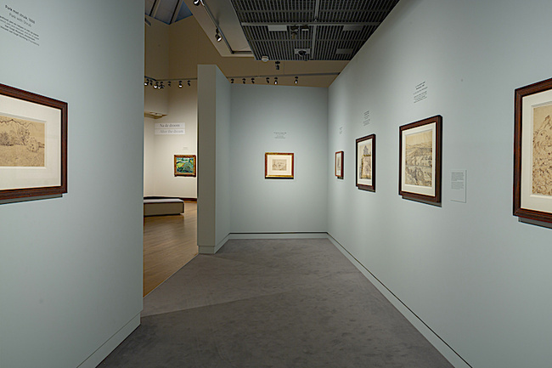
The Element of LINE in Objects and Nature
Take 5-6 photos
Upload your favorite in the Padlet
Padlet link:
Padlet QR code:
Example of a Photo
This Photo by Unknown Author is licensed under CC BY-NC
Notes:
Teacher: You will need to make a Padlet and insert the link or QR code for students to access your Padlet.

Slide 8
Types of Lines
While watching the following video:
Write the name of the type of line on your paper.
Draw simple examples to illustrate each type of line.
Notes:
public view link on Canva. This Info graphic is open to the public and was modified by PT.
https://bit.ly/4cerifD

Slide 9
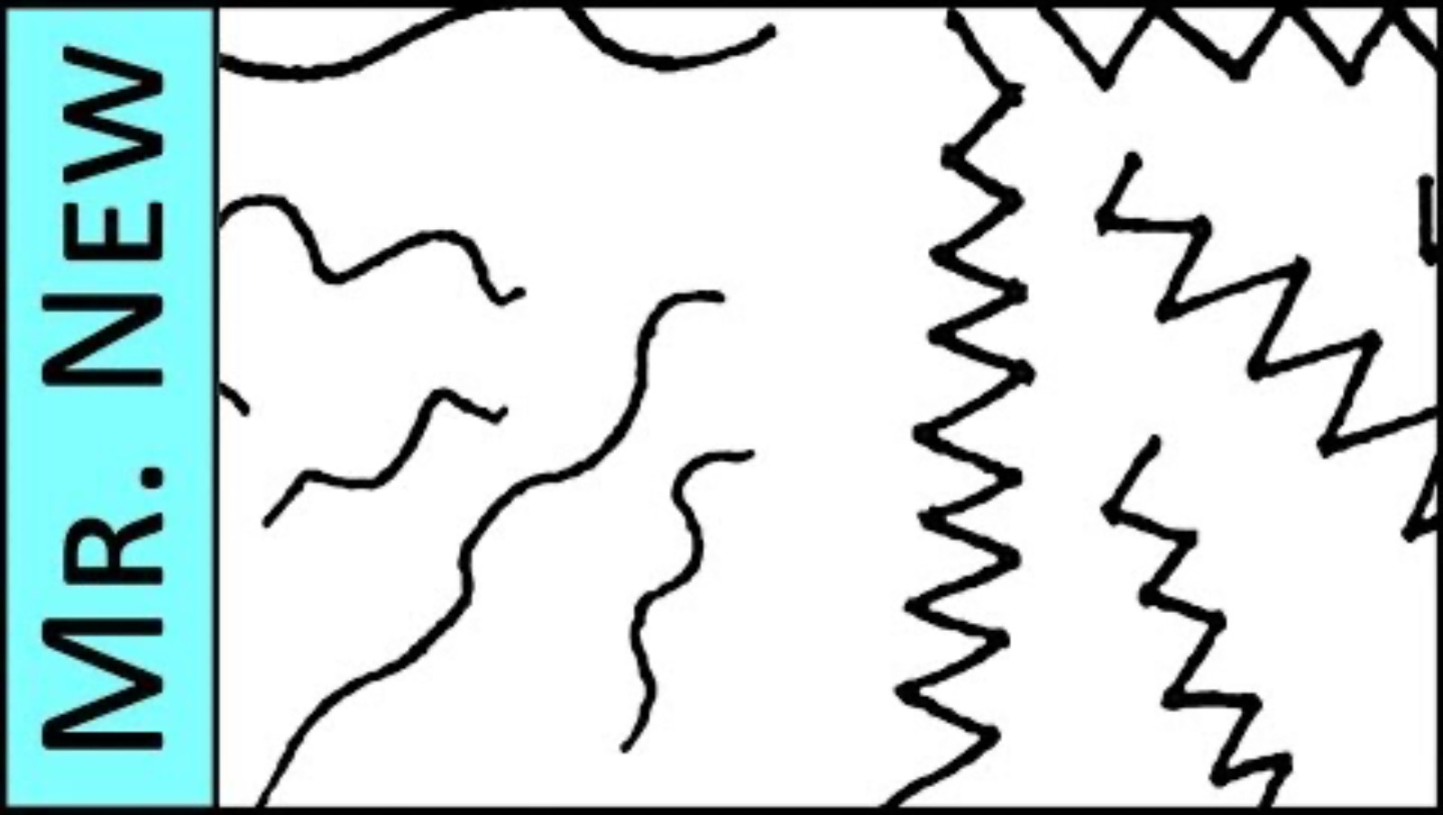
Mr. New’s Art Class
Notes:
All About Lines - Understanding the Elements of Art and Design. (2017, June 1). Mr. New’s Art Class [Video]. YouTube.
https://youtu.be/tos2et_JEgA?si=qgB-goVTMgypDfop

Slide 10
Video discussion
“ A line can be though of as a moving dot”
How do you visualize this?
What happens if the dots overlap?
What happens if the dots don’t overlap?

Slide 11
Think about these ideas while watching the video for a 2nd time.
How are lines described?
How can lines be used to outline something?
How can lines create patterns?
How can lines describe an object or idea?
How do hatching lines create form using value?
Do lines have a beginning and an end?
Can lines express emotion?

Slide 12
What happens when a cog is removed or when a line is changed?
Describe the lines you see in your cog drawings.

Slide 13
The Element of LINE in Objects and Nature
Identify the types of lines you see in the comments section of your Padlet photo.
Then comment on two or more of your classmates' photos, identifying additional line qualities present in those images.
Padlet link:
Padlet QR code:
Example of a Photo
Notes:
Teacher: You will need to make a Padlet and insert the link or QR code for students to access your Padlet.

Slide 14
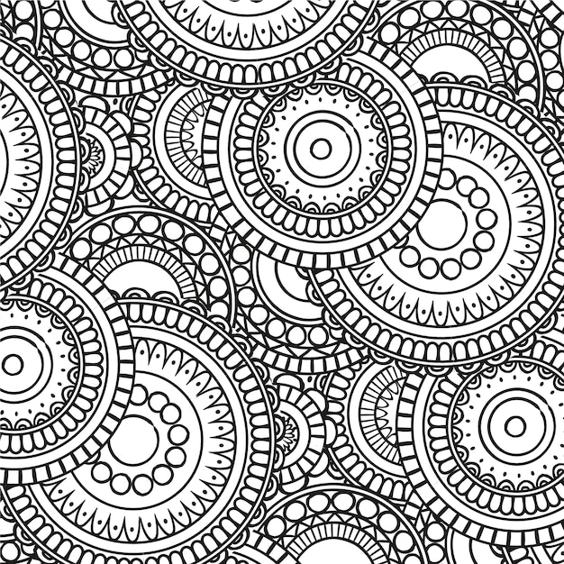
Zentangle
Notes:
Zentangle Images (2025) FreePik. https://www.freepik.com/free-photos-vectors/zentangle-pattern

Slide 15
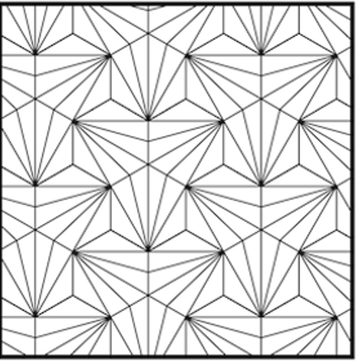
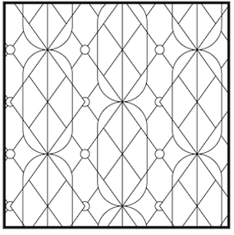
Zentangles
Notes:
Zentangle Images (2025) FreePik. https://www.freepik.com/free-photos-vectors/zentangle-pattern

Slide 16
Lines used to create Zentangles
Dots
Line
C-curve
S-curve
Orb

Slide 17
Three Steps to Begin A Zentangle
1. Create Your Frame – Choose a shape to outline your design.
2. Break Up Your Frame – Use 3-4 lines to divide the space into sections.
3. Fill Each Section with a Unique Pattern
  Add as much detail as possible.
  Use pattern sheets as references if needed.
  Create contrast by different line widths.
  Use a variety of patterns

Slide 18
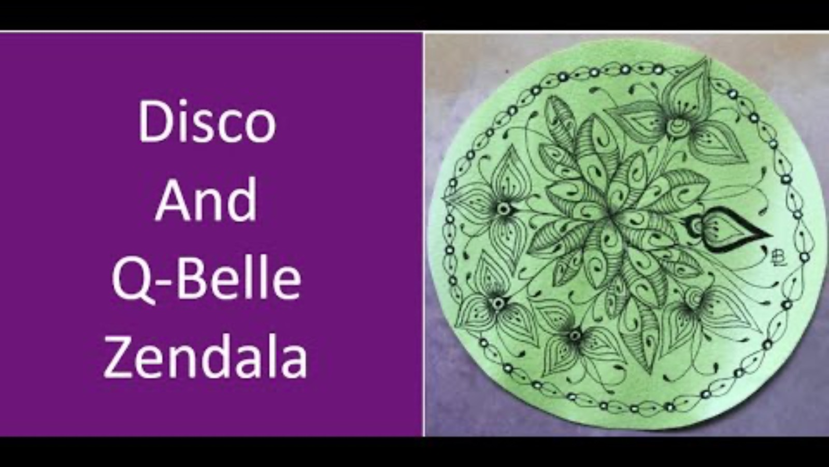
Making a Zentangle Pattern using DISCO
Notes:
Langston, Barbara. (2021). Zentangle Patterns Disco and Q-Belle on a Zendala Tile [Video]. YouTube. https://www.youtube.com/watch?v=E2kZGhtpTpQ&t=307s

Slide 19
"What? So What? Now What?
What? | So what? | Now what?
What did you do in this lesson? What were you working on? | Why is this important to you? Why does it matter? | How does this apply to your understanding of art? What can you do with this information?

Slide 20
Definition for LINE
Join another group and share your previous definition of Line.
Now rewrite your definition for the Element of Line using your new knowledge.

