Slide 2
That’s a Long Word!
Compound Words

Slide 3
Essential Questions
How can I read big words and know what they mean?
How are compound words different from other words?

Slide 4
Lesson Objectives
Students will identify, build, and display grade-level compound words.

Slide 5

Notes:
StoryTime with Charlie. (2021). Once there was a bull(frog) [Video]. YouTube. https://www.youtube.com/watch?v=7UM6XxCVPSM

Slide 6

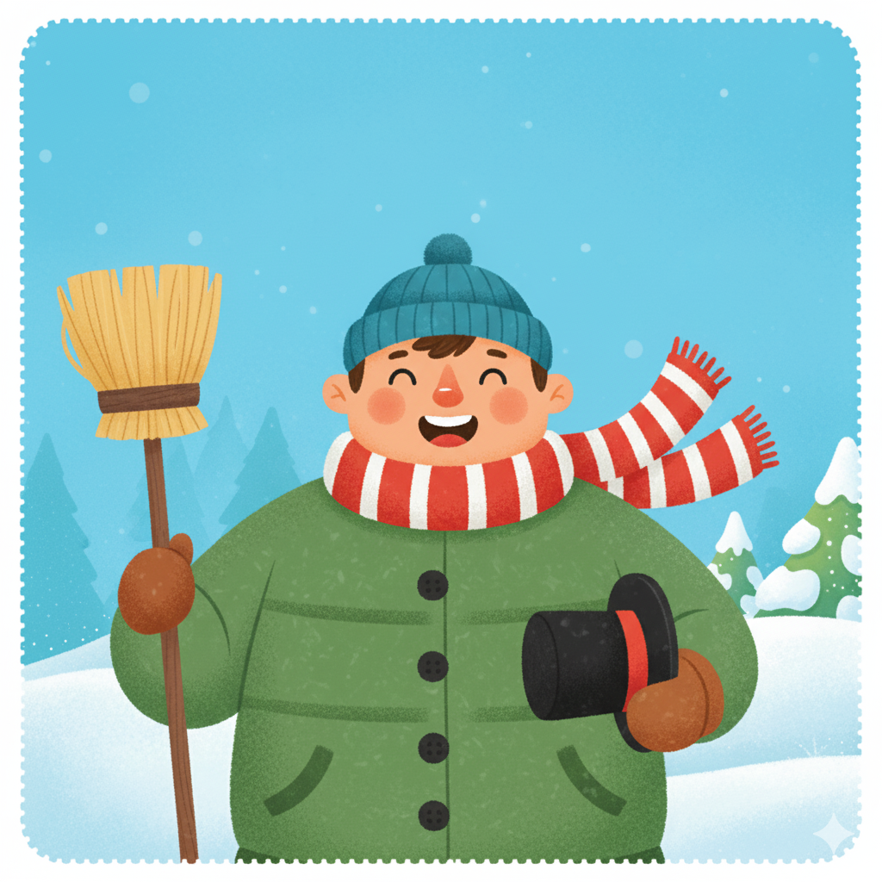
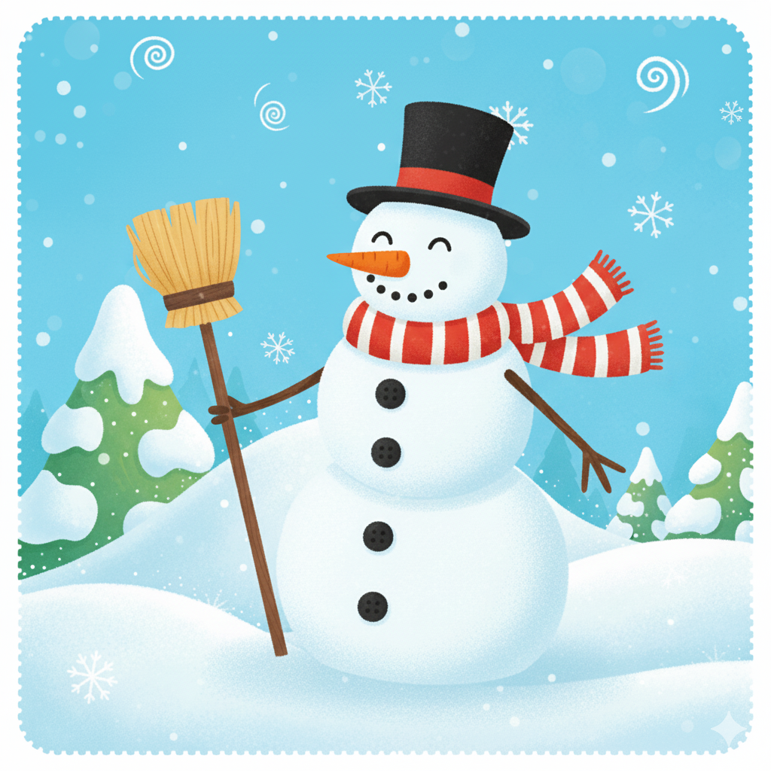
Compound Words
A compound word is made when two smaller words are put together to make a brand-new word.
+
=
snow
man
snowman
Notes:
Google. (2026, April 3). AI-generated drawing of snow, a man, and a snowman (Created using Gemini) [AI-generated image].

Slide 7

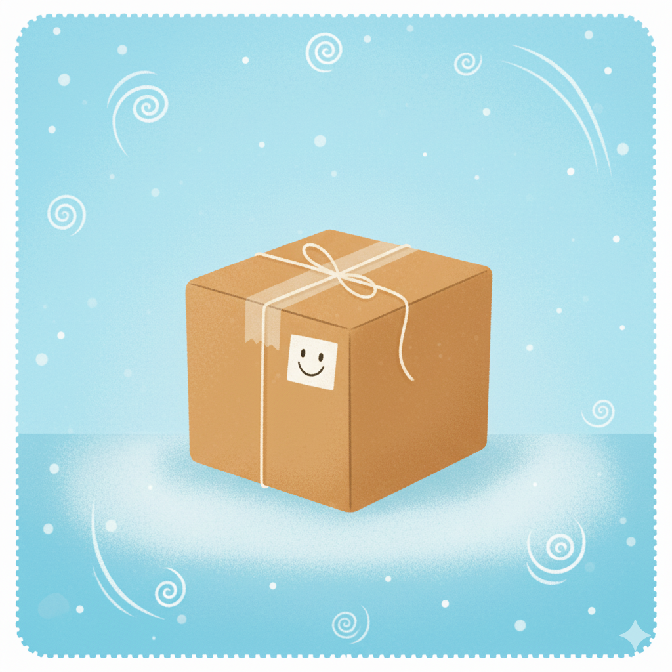
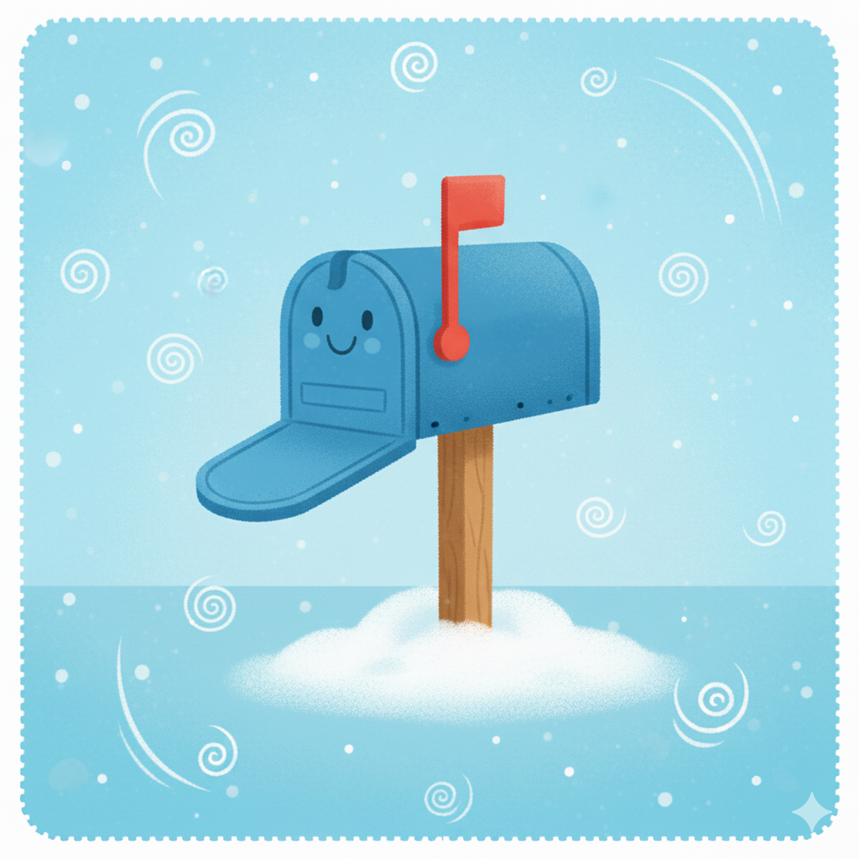
Compound Words
+
=
mail
box
mailbox
Notes:
Google. (2026, April 3). AI-generated drawing of mail, a box, and a mailbox (Created using Gemini) [AI-generated image].

Slide 8


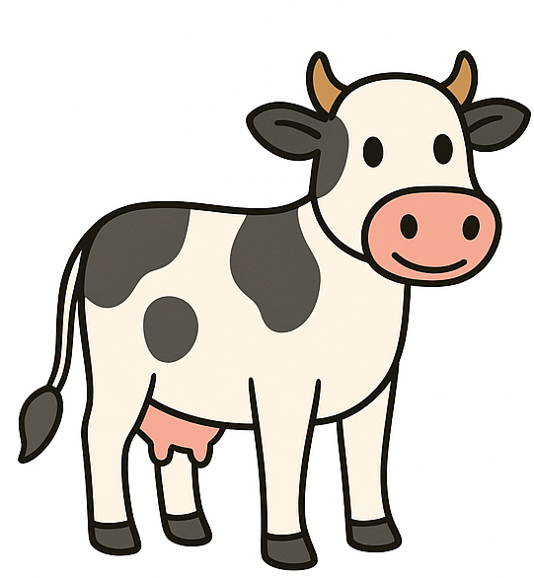
Compound Words
+
=
mail
box
mailbox
Notes:
OpenAI. (2026, April 3). AI-generated drawing of a cow, a boy, and a cowboy (Created using ChatGPT) [AI-generated image].

Slide 9
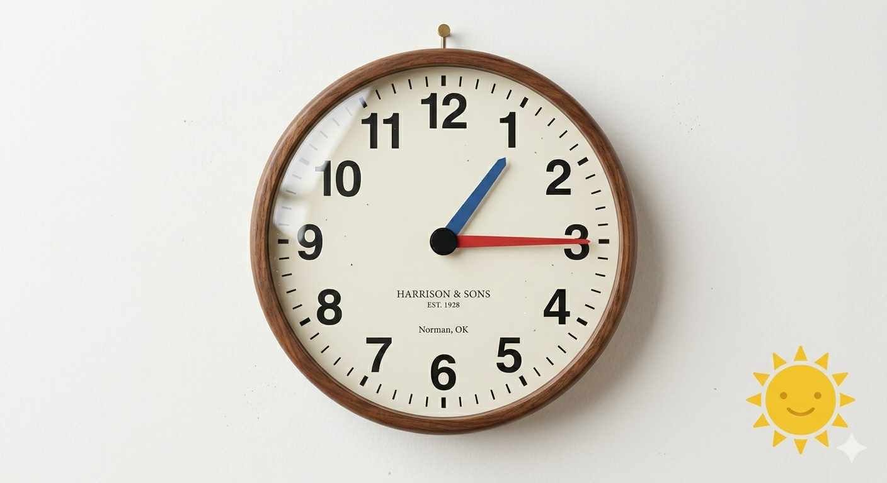
Is this word a compound word?
afternoon
Notes:
Google. (2026, May 11). Clock showing 1:15 p.m. (Created using Gemini) [AI-generated image].

Slide 10

Is this word a compound word?
afternoon = after + noon

Slide 11
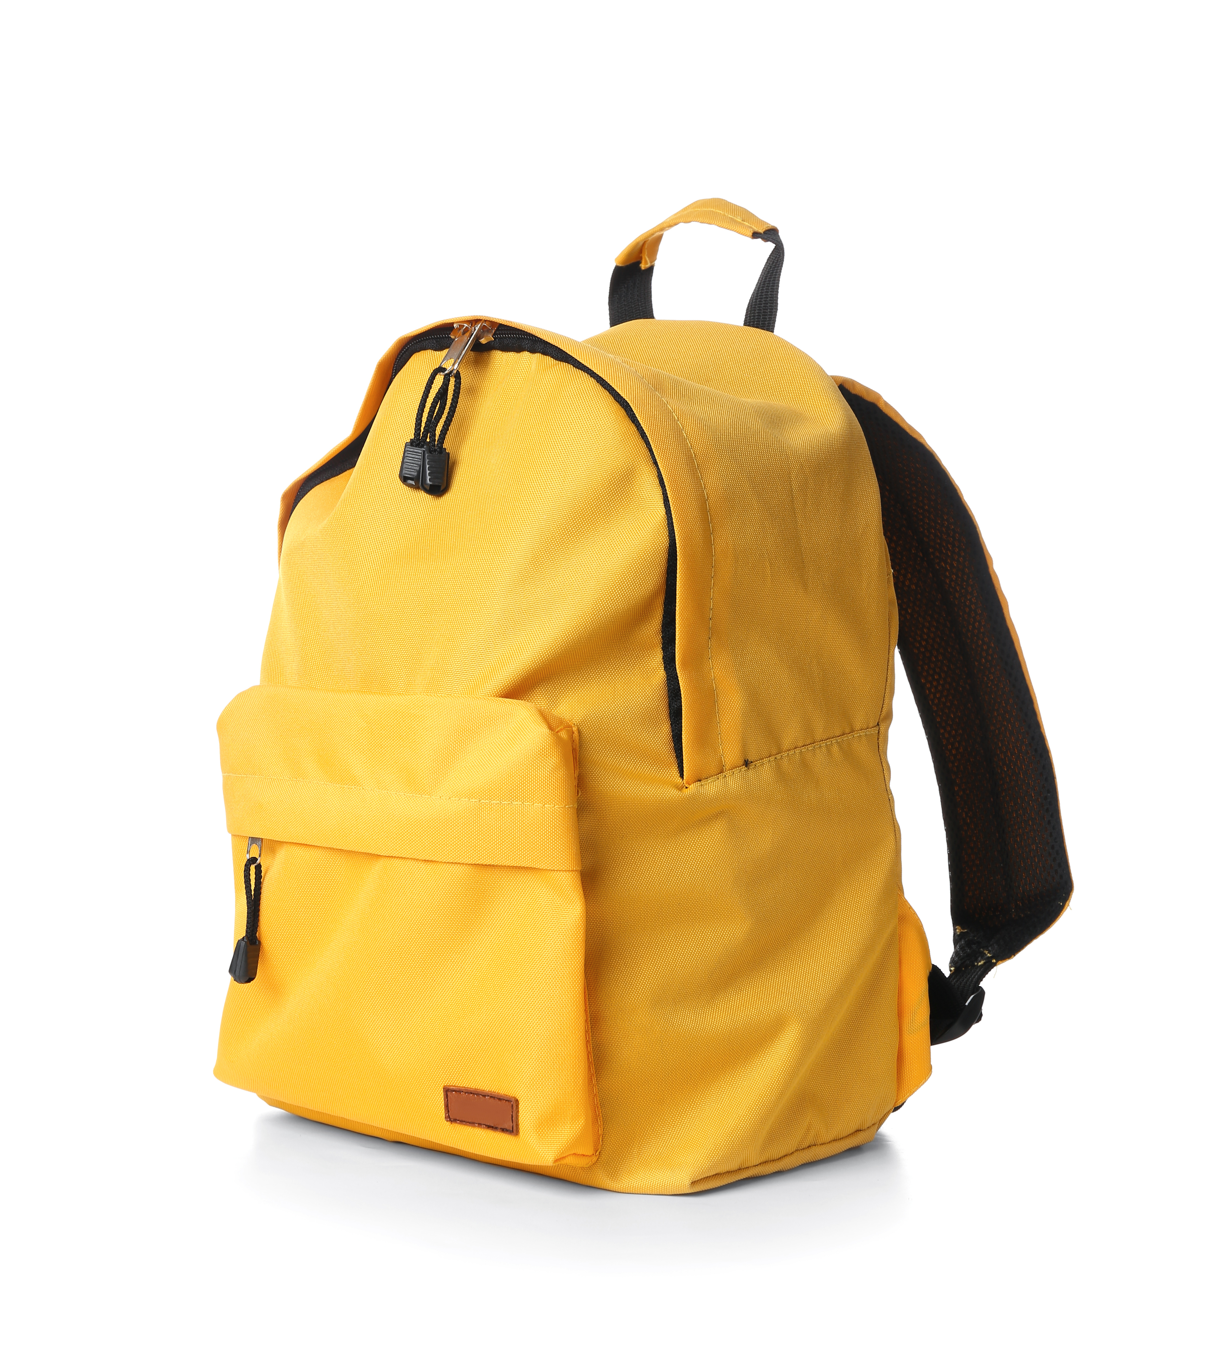
Is this word a compound word?
backpack
Notes:
Pixel-Shot. (n.d.). School backpack on white background [Photograph]. Adobe Stock. Asset ID: 276472512

Slide 12
Is this word a compound word?
backpack = back + pack

Slide 13
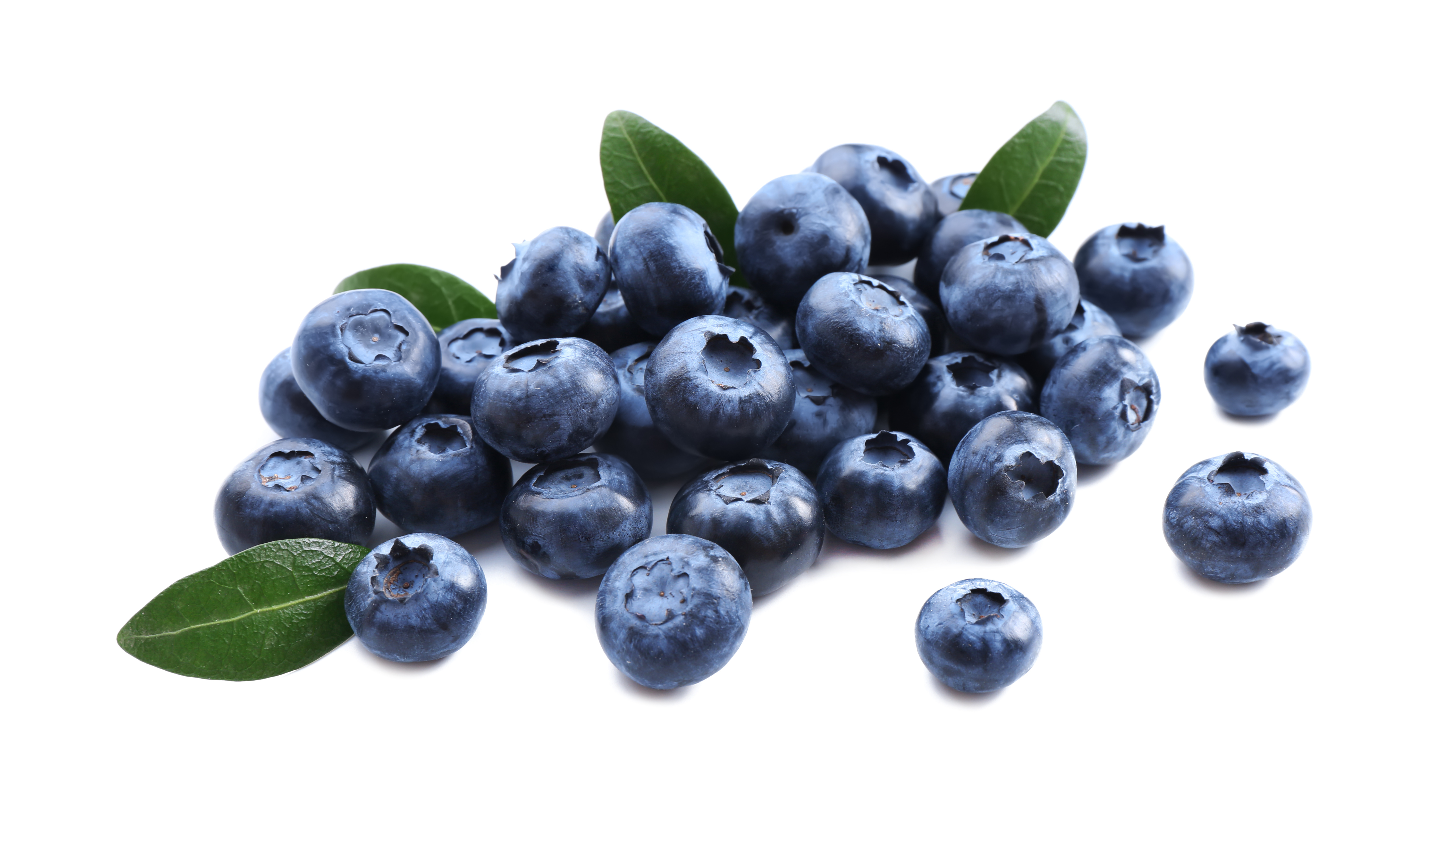
Is this word a compound word?
blueberries
Notes:
Pixel-Shot. (n.d.). Ripe blueberries on white background [Photograph]. Adobe Stock. Asset ID: 276472512

Slide 14
Is this word a compound word?
blueberries = blue + berries

Slide 15
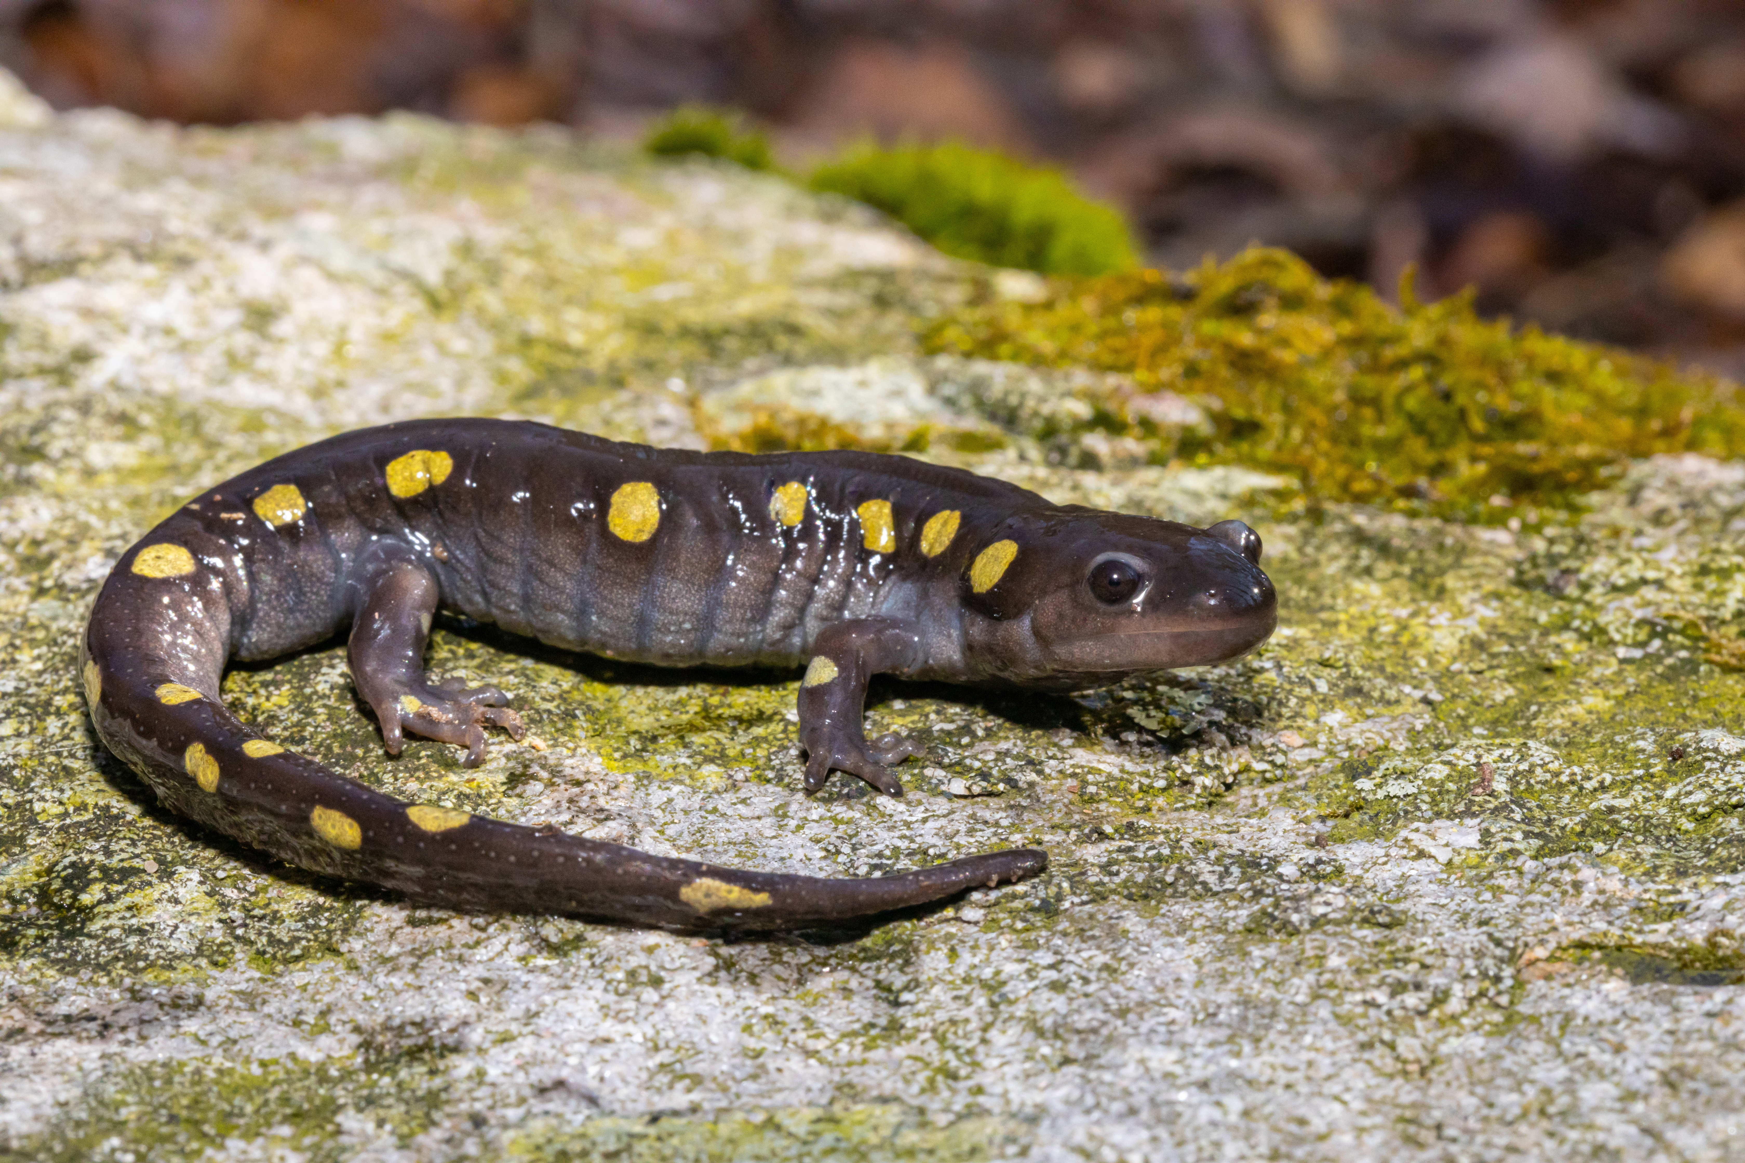
Is this word a compound word?
salamander
Notes:
Hamilton. (n.d.). Spotted salamander on a lichen-covered rock (Ambystoma maculatum) [Photograph]. Adobe Stock. Asset ID: 335153727

Slide 16

Is this word a compound word?
salamander

Slide 17
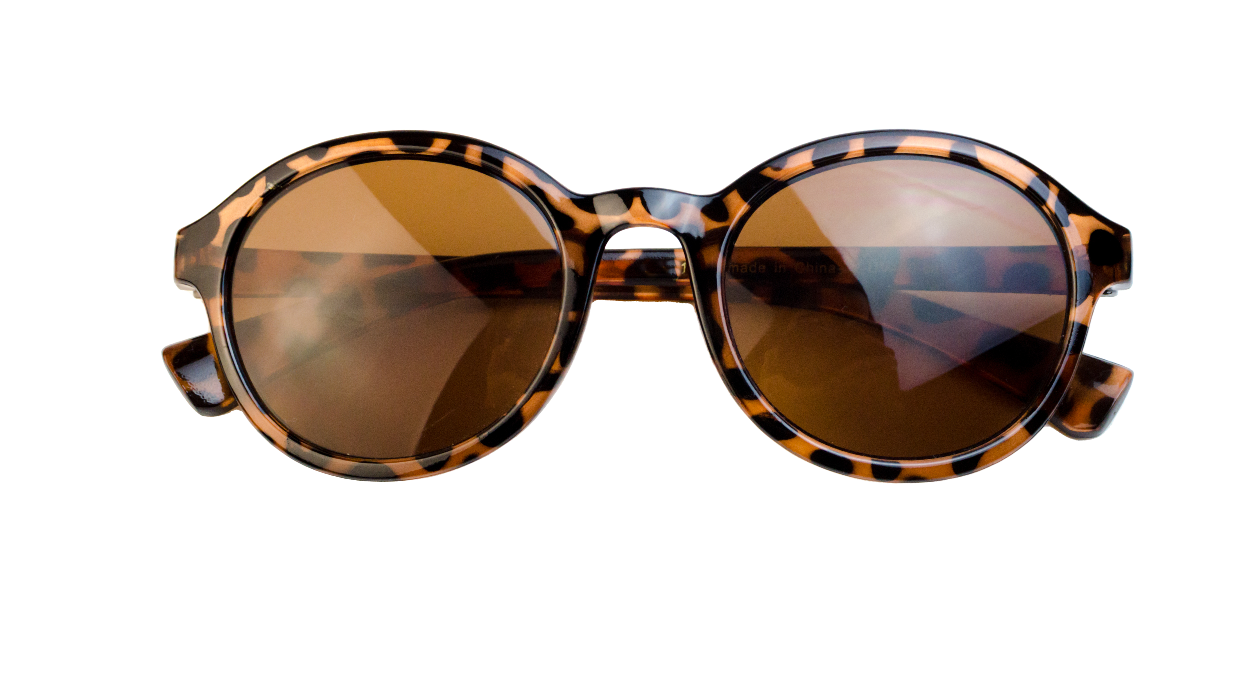
Is this word a compound word?
sunglasses
Notes:
m.lexandrovna. (n.d.). Round brown sunglasses isolate (AdobeStock_536803548) [Stock photograph]. Adobe Stock.

Slide 18
Is this word a compound word?
sunglasses = sun + glasses

Slide 19
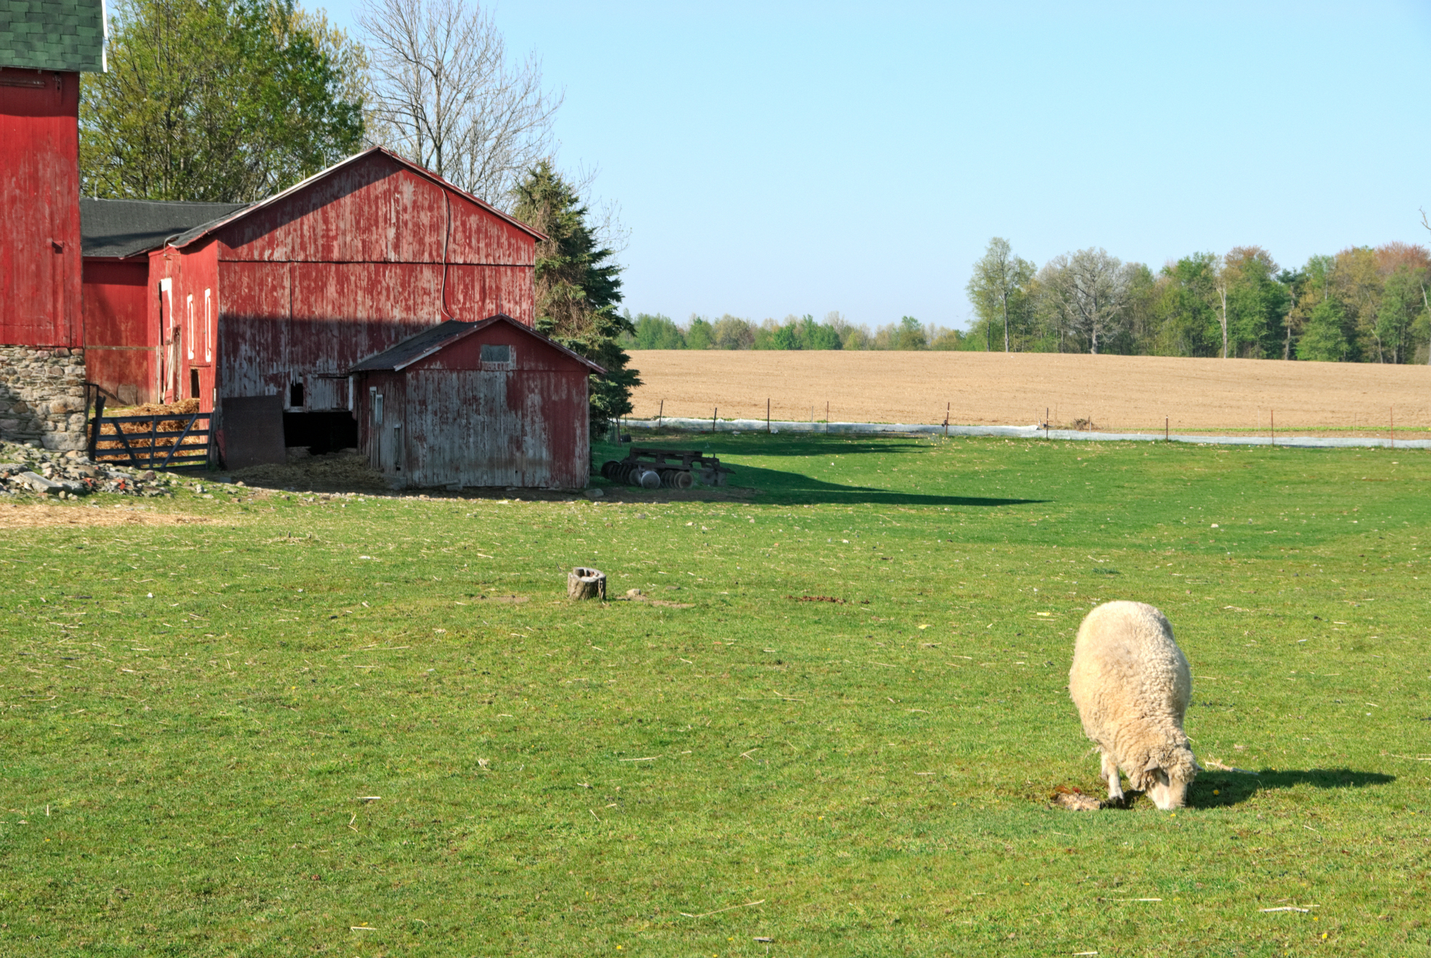
Is this word a compound word?
barnyard
Notes:
Bronwyn Photo. (n.d.). Sheep in barnyard [Photograph]. Adobe Stock.

Slide 20
Is this word a compound word?
barnyard = barn + yard

Slide 21
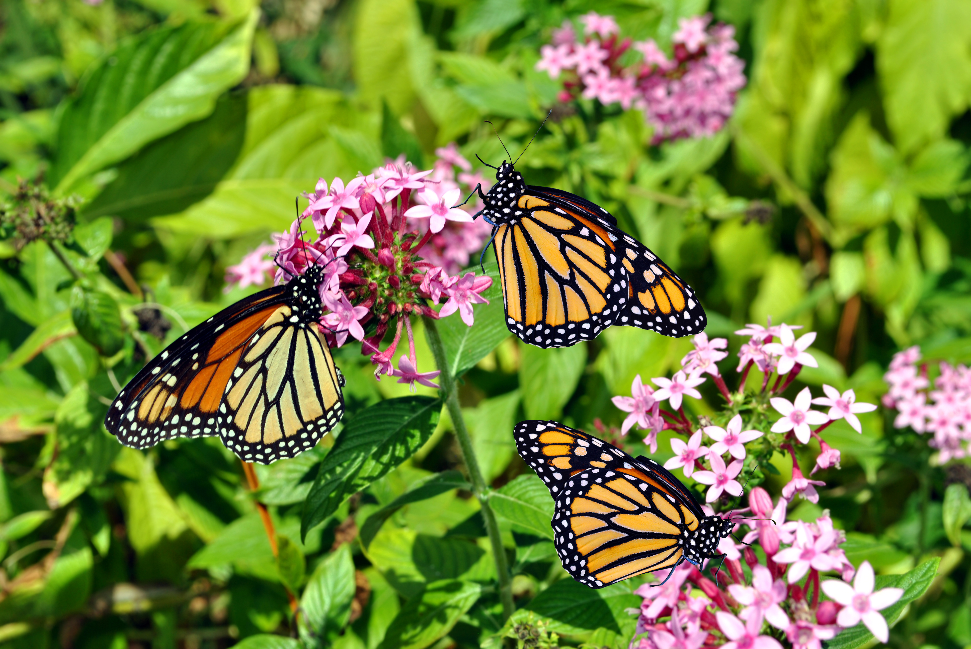
Is this word a compound word?
butterflies
Notes:
Peter. (n.d.). Monarch butterflies (Danaus plexippus) [Stock photograph].

Slide 22
Is this word a compound word?
butterflies

Slide 23
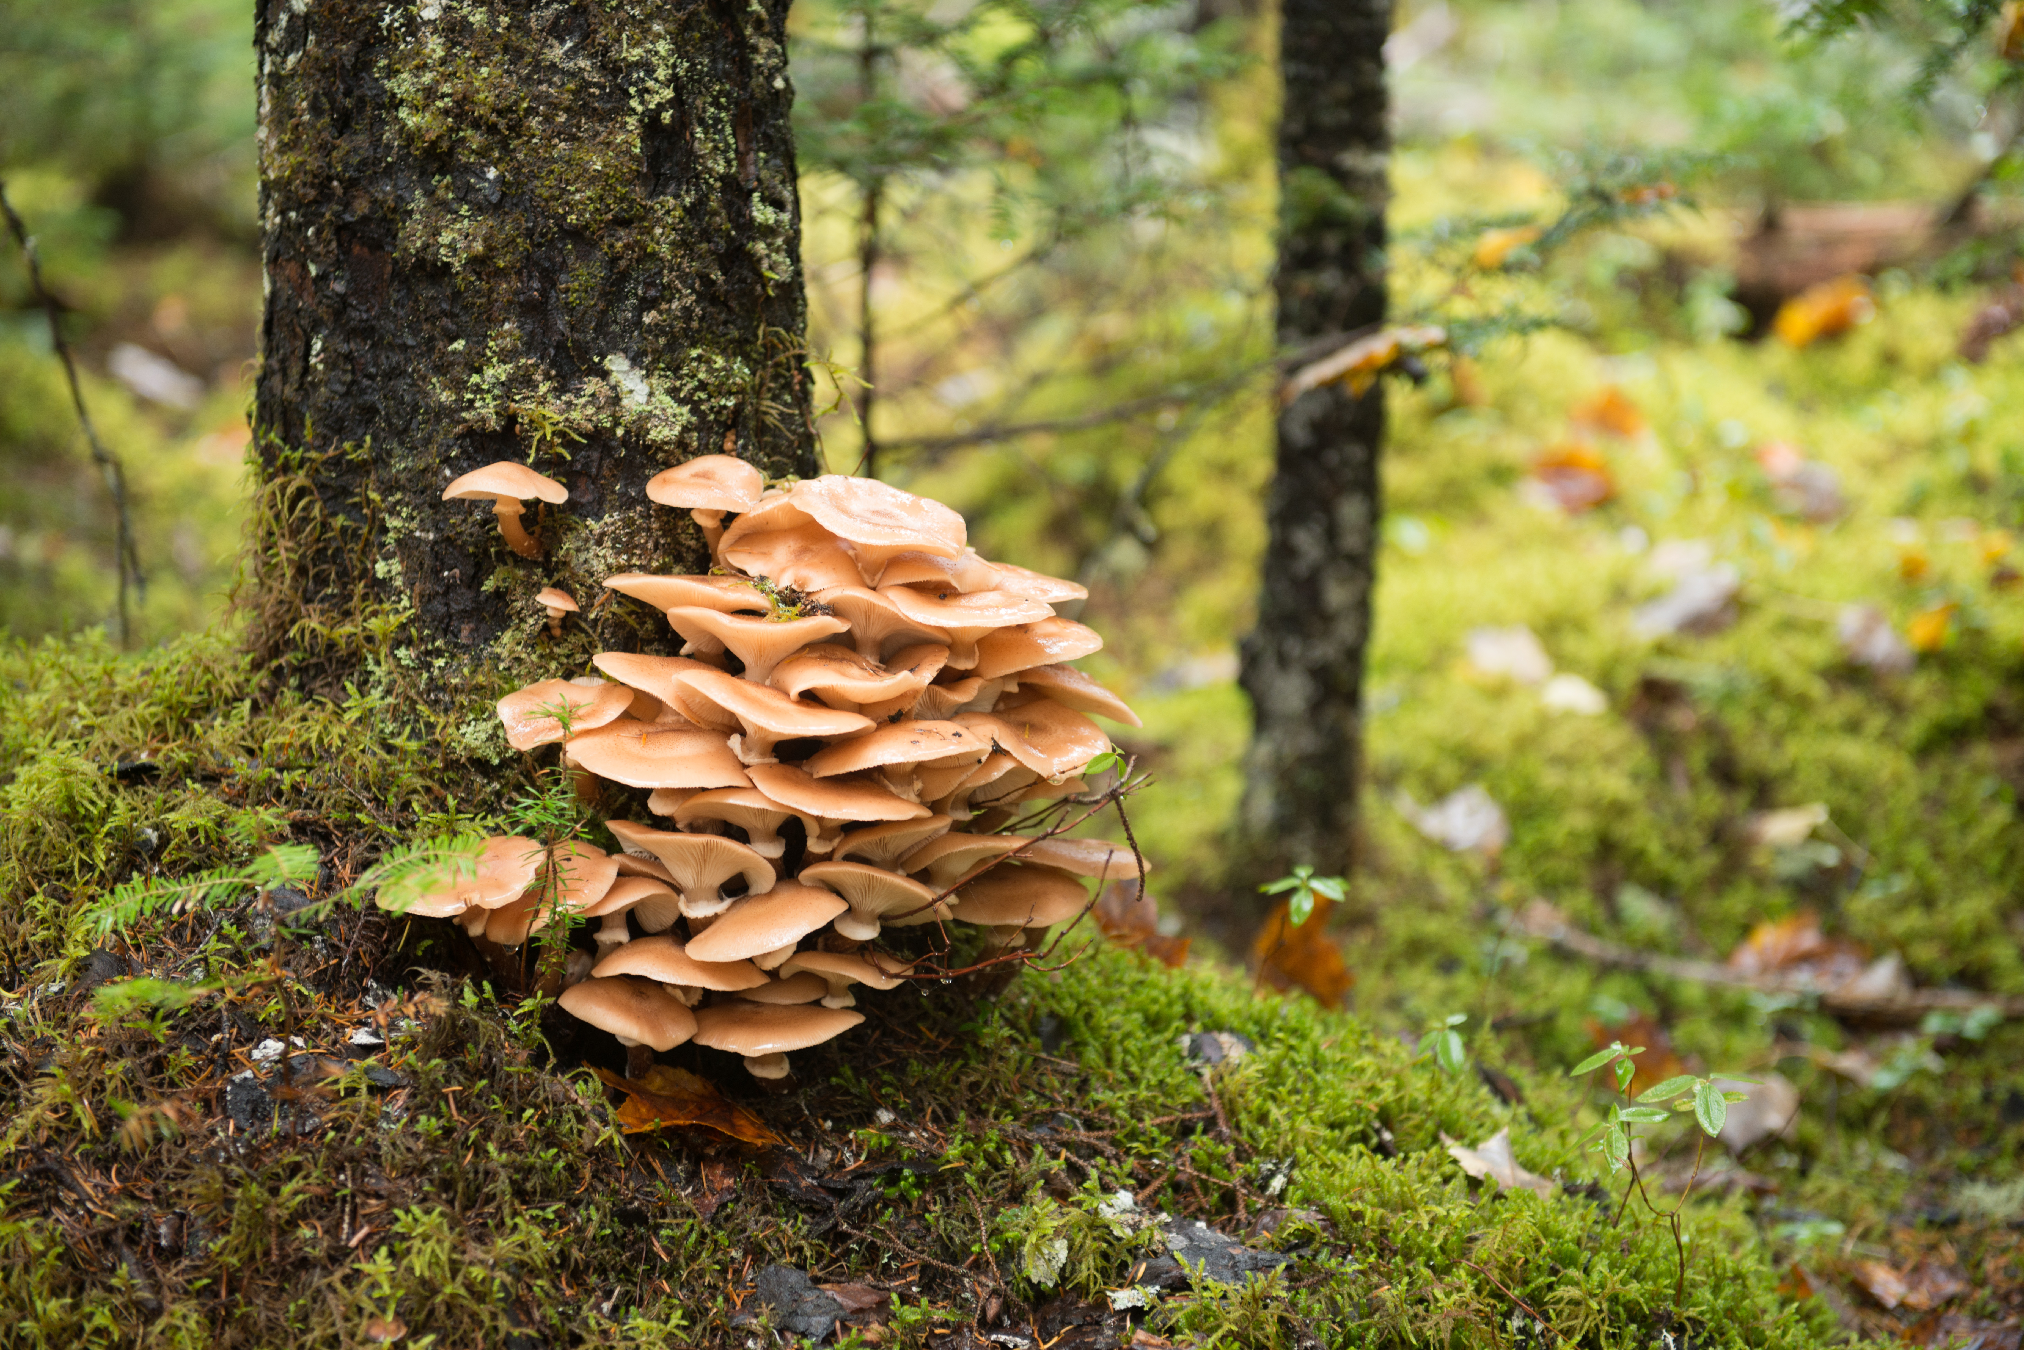
Is this word a compound word?
mushroom
Notes:
Bay, R. (n.d.). Oyster mushroom – 2 [Photograph]. Adobe Stock.

Slide 24
Is this word a compound word?
mushroom

Slide 25
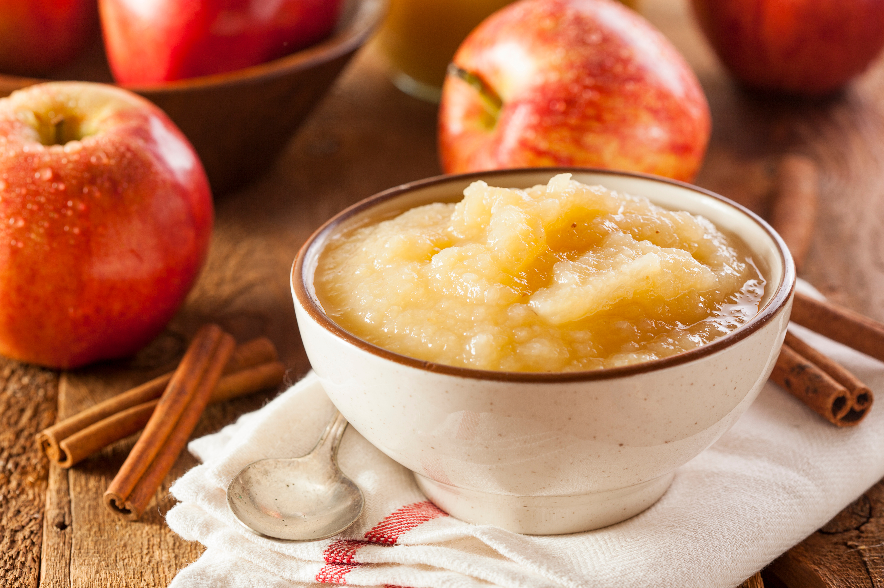
Is this word a compound word?
applesauce
Notes:
Hofacker, B. (n.d.). Healthy organic applesauce with cinnamon [Photograph]. Adobe Stock.

Slide 26
Is this word a compound word?
applesauce = apple + sauce

Slide 27

Is this word a compound word?
underwater
Notes:
zozulinskyi. (n.d.). Tranquil underwater scene 3D render [3D render]. Adobe Stock.

Slide 28
Is this word a compound word?
underwater = under + water

Slide 29
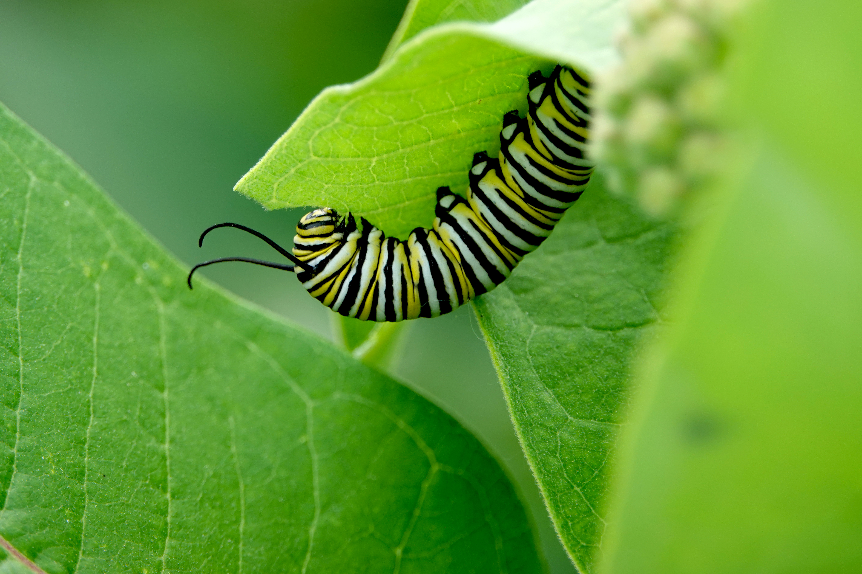
Is this word a compound word?
caterpillar
Notes:
Erik. (n.d.). Monarch caterpillar on milkweed leaves [Photograph]. Adobe Stock.

Slide 30
Is this word a compound word?
caterpillar

Slide 31
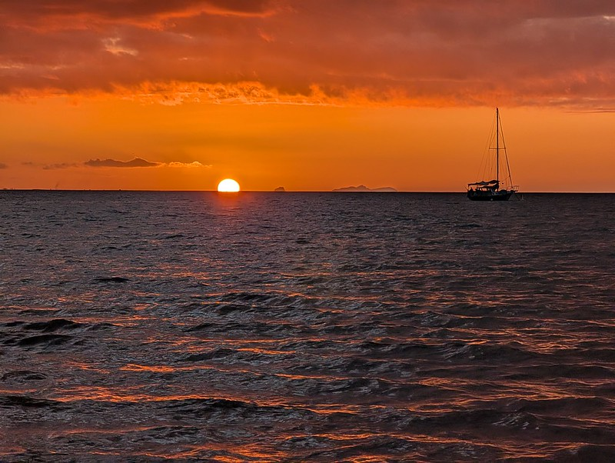
Is this a compound word?
sunset
Notes:
Kraus, M. J. (n.d.). [Photograph]. Flickr. https://www.flickr.com/photos/kraus/55262863152/

Slide 32
Is this word a compound word?
sunset = sun + set

Slide 33

Is this word a compound word?
handshake
Notes:
nanskyblack. (n.d.). Handshake isolated on white background [Stock photograph].

Slide 34
Is this word a compound word?
handshake = hand + shake

Slide 35
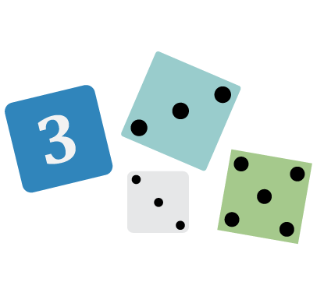
Not Like the Others!
Which words in each set are not compound words?
toothpaste, napkin, hairbrush
picture, birthday, cupcake
backpack, problem, classroom
grasshopper, salamander, bullfrog, rattlesnake
bedroom, mailbox, carpet, doorbell
Notes:
K20 Center. (n.d.). Not like the others. Strategies. https://learn.k20center.ou.edu/strategy/77

Slide 36
Not Like the Others!
hospital, airport, bookstore, library
freeze, playground, teammate, cartwheel
washcloth, bathtub, mirror, curtain
snowflake, thunder, lightning, raindrop
sunglasses, beachball, blanket, surfboard

