Slide 1
LOAN CONNECTION
Understanding Lending Practices

Slide 2
Essential Question:
What factors do financial institutions consider when deciding whether to approve or deny a loan, and why are these factors important?
Notes:
Ask students to share their thoughts while you create a list of these ideas on the board or chart paper.

Slide 3
Learning Objectives
Explain the characteristics that make a borrower eligible for a loan
Distinguish between standard and predatory lending practices

Slide 4
Would You Rather?
Lend money to…

Slide 5


OR
Notes:
https://ew.com/movies/2018/01/04/marvel-movie-club-iron-man/
https://www.reddit.com/r/Spiderman/comments/17qo6tr/say_something_bad_about_tobey_maguire/?rdt=64144

Slide 6

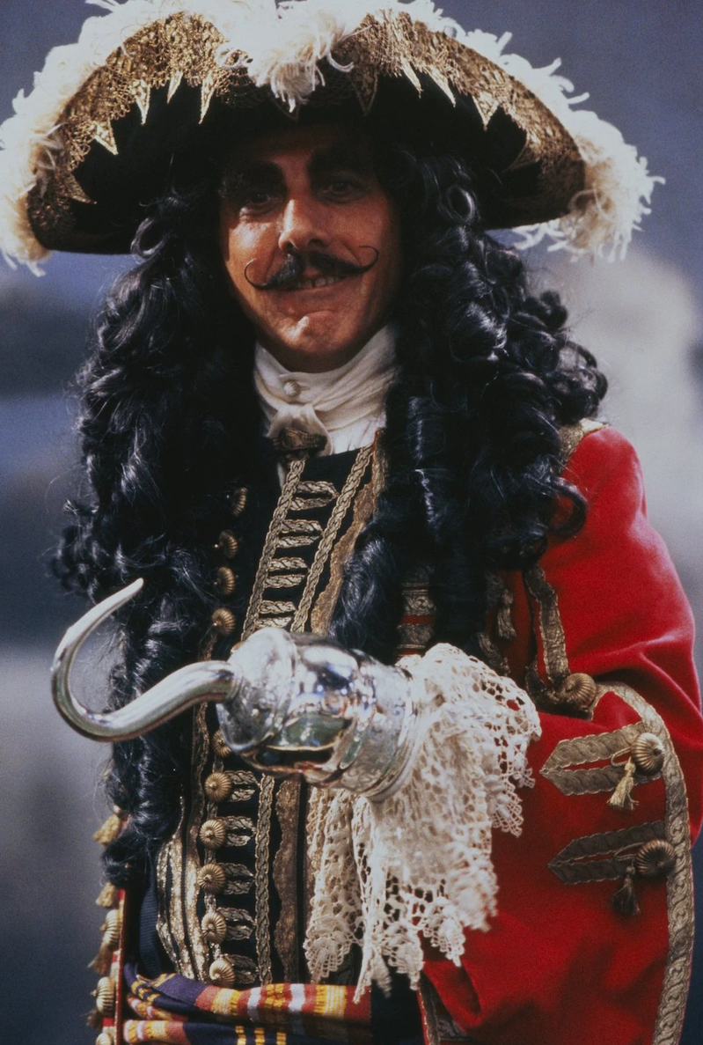
OR
Notes:
https://wall.alphacoders.com/big.php?i=633553
https://near-pure-evil.fandom.com/wiki/Captain_James_Hook_(Hook)

Slide 7


OR
Notes:
After you’ve been through all of the characters, note in a brief discussion if any of the factors on their list came into play in their decisions. Were there factors they considered that aren’t on the list? Add those to the list.
https://www.facebook.com/photo/?fbid=923240037803741&set=a.440367752757641
https://medium.com/@alissaphillips/character-spotlight-hermione-granger-7b4c49832c30

Slide 8
World Scramble
Match the scrambled words to their definitions.
Unscramble the words by writing the correct word spelling on a sticky note.
First team to match and unscramble all of the words wins!
Notes:
Have the winning group share their unscrambled words and the definition they matched it to. Every group should write down the correct terms and add them to their own matched sets.

Slide 9
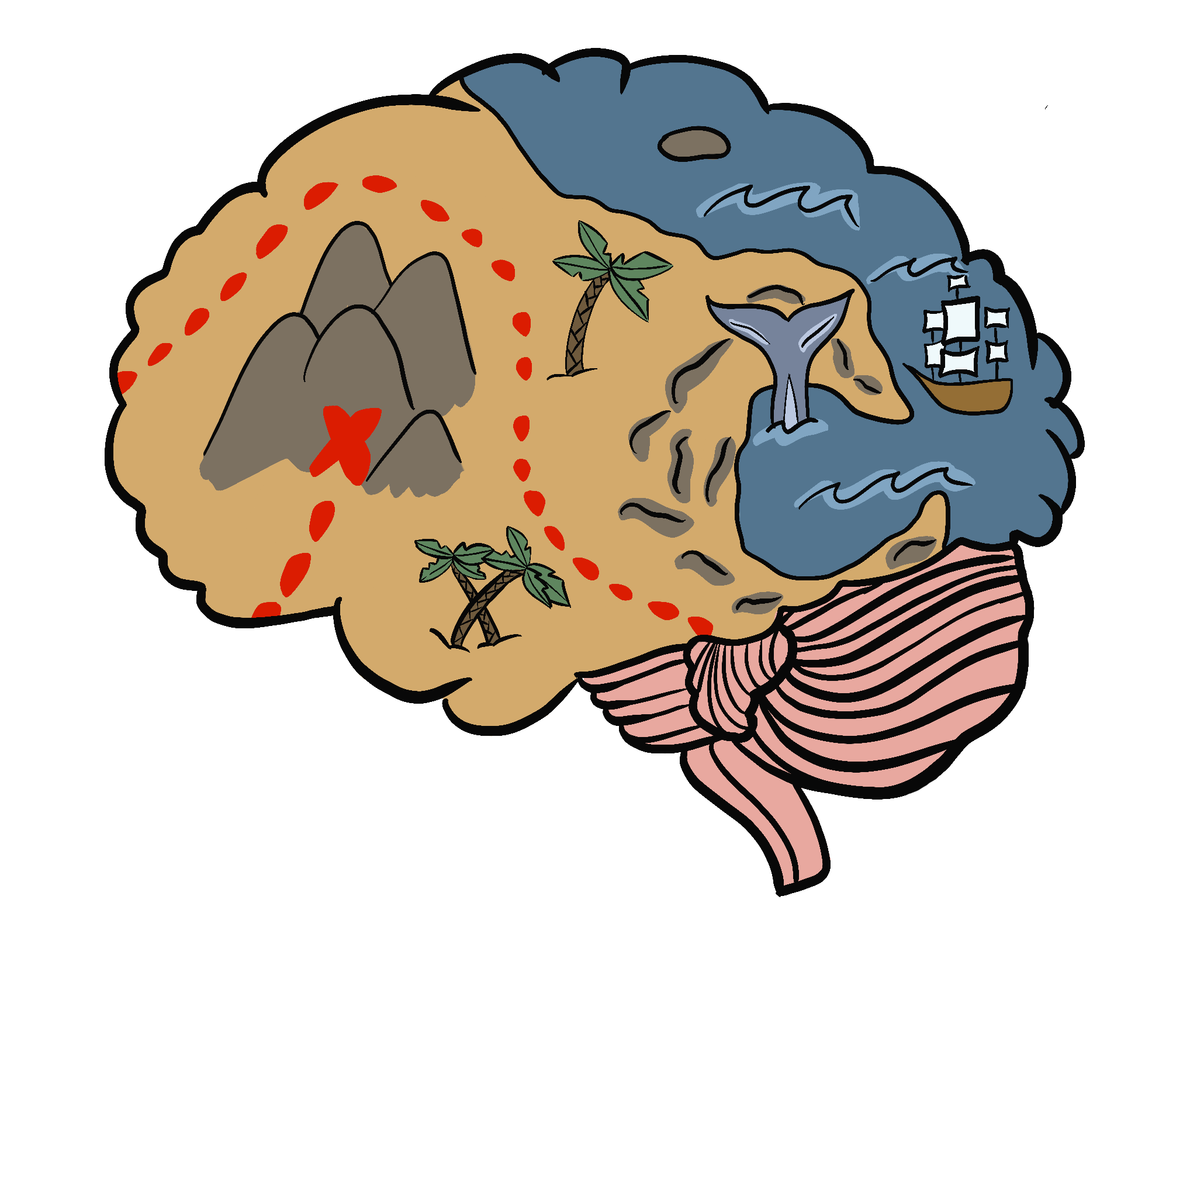
Mind Map
Using your sticky note words, chart paper, and markers, create a map of how the terms relate to each other.

Slide 10

Triangle-Square-Circle
Triangle - write three important points from the reading
Square - write something that squares with your thinking
Circle - write any questions still circling in your mind

Slide 11
Role-play Game
L🤑AN
C↻NNECTI♥️N

Slide 12
Game Directions
Read your character sheet and follow the information on your sheet closely. In each meeting:
Borrowers ask for a loan, present their financial situation and why they feel they need the loan
Lenders approve or deny loan requests
Both mark on your notes organizer whether the loan was approved or denied and why each time you meet with someone

Slide 13
Reflection & Discussion
Lenders
Borrowers
If you were a character in this scenario, which lender would you prefer to approach for a loan, and why?
Were there moments where you felt conflicted about denying or approving a loan? What are the ethical responsibilities of lenders?
What long-term effects might predatory lending practices have on borrowers?
How might the characters' lives change depending on the loan terms they were offered?
What are some risks that borrowers face when dealing with different types of lenders, and how can they protect themselves?
How do you think the decisions made in this game compare
to what happens in real life?

Slide 14
Summarize your learning
What surprising things have you learned about loans and making financial decisions?
What interesting things have you learned?
What troubling things have you learned?

