Slide 2
Going Viral
Solving Equations

Slide 3
Essential Question
How can you solve and write equations?

Slide 4
Learning Objectives
Solve algebraic equations.
Generate algebraic equations.

Slide 5
Not Like the Others
Which of the following is not like the others?
Poster 1 | Poster 2 | Poster 3 | Poster 4
Notes:
K20 Center. (n.d.). Not like the others. Strategies. https://learn.k20center.ou.edu/strategy/77

Slide 6
Pass the Problem: Round 1
Work with your partner to solve the 1st equation.
Show all your work so that your group can follow your thinking.
Notes:
K20 Center. (n.d.). Pass the Problem. Strategies. https://learn.k20center.ou.edu/strategy/151

Slide 7
Pass the Problem: Round 2
Pass your paper to the next pair.
Check their work.
Solve the 2nd equation.
Show all your work so that your group can follow your thinking.
Notes:
K20 Center. (n.d.). Pass the problem. Strategies. https://learn.k20center.ou.edu/strategy/151

Slide 8
Pass the Problem: Round 3
Pass your paper to the next pair.
Check their work.
Check the work from the 1st equation, too.
Solve the 3rd equation.
Show all your work so that your group can follow your thinking.
Notes:
K20 Center. (n.d.). Pass the problem. Strategies. https://learn.k20center.ou.edu/strategy/151

Slide 9
Pass the Problem: Round 4
Pass your paper to the next pair.
You should now have the handout you started with.
Check the work from all of the equations.
Solve the 4th equation.
Show all your work so that your group can follow your thinking.
Notes:
K20 Center. (n.d.). Pass the problem. Strategies. https://learn.k20center.ou.edu/strategy/151

Slide 10
Pass the Problem: Food
Round 1 | Round 2 | Round 3 | Round 4
Notes:
K20 Center. (n.d.). Pass the problem. Strategies. https://learn.k20center.ou.edu/strategy/151

Slide 11
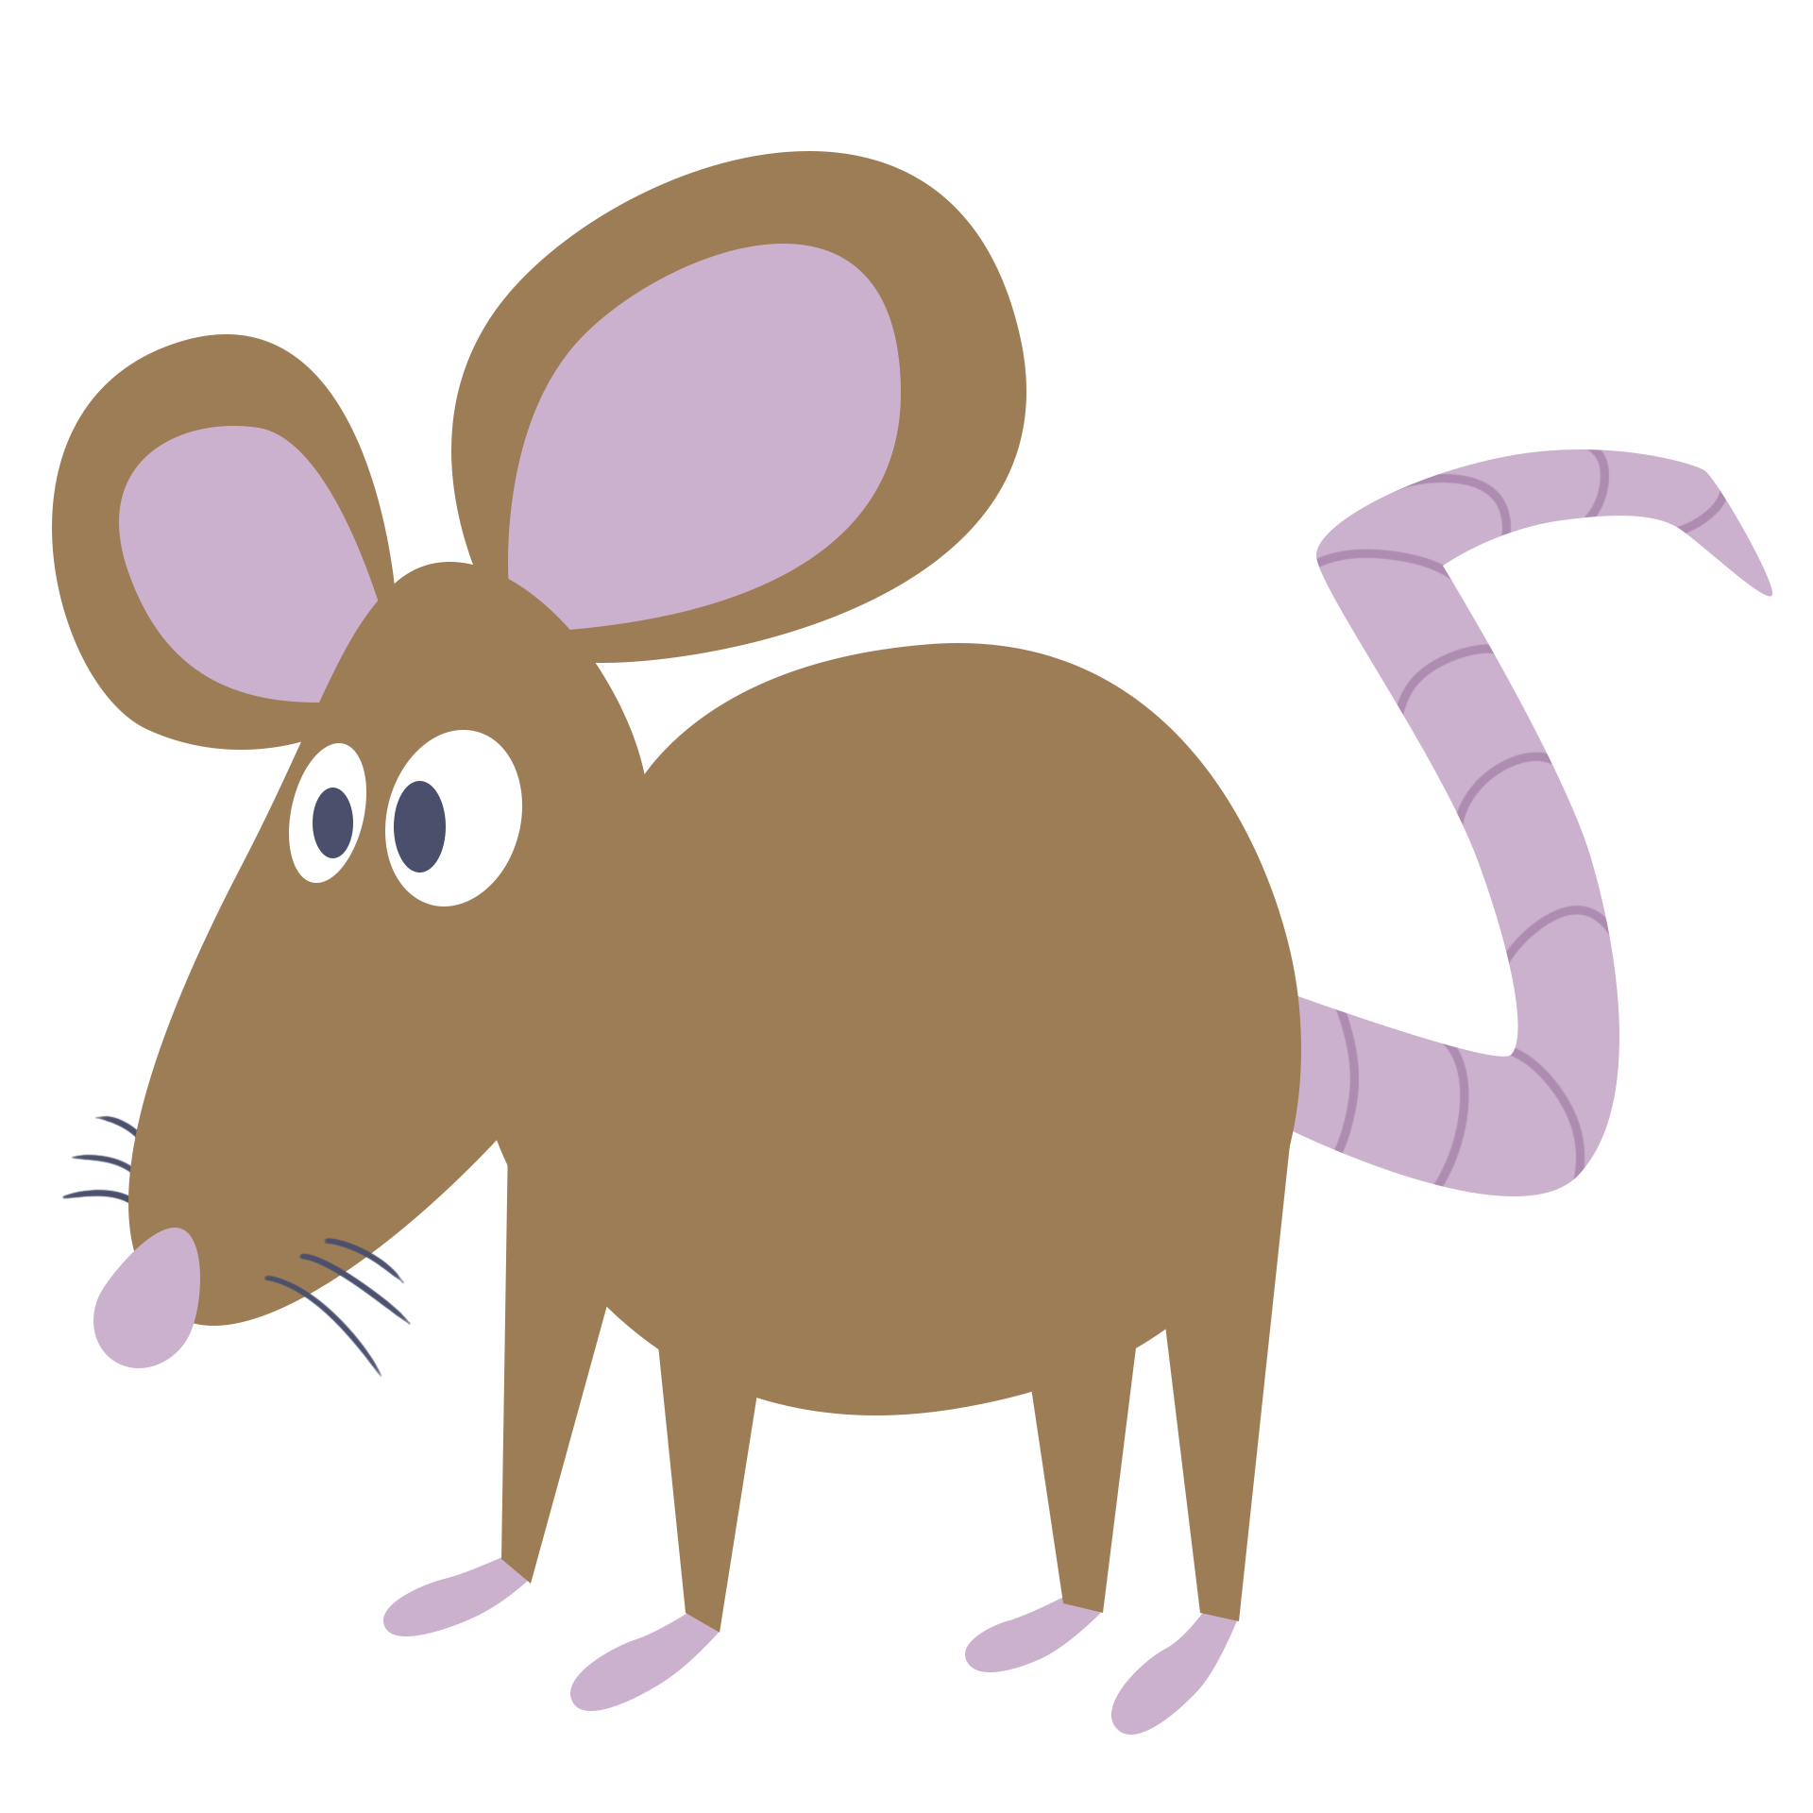
Pass the Problem: Pets
Round 1 | Round 2 | Round 3 | Round 4
Notes:
K20 Center. (n.d.). Pass the problem. Strategies. https://learn.k20center.ou.edu/strategy/151

Slide 12
Pass the Problem: Space
Round 1 | Round 2 | Round 3 | Round 4
Notes:
K20 Center. (n.d.). Pass the problem. Strategies. https://learn.k20center.ou.edu/strategy/151

Slide 13
Solving Equations With Do/Undo Tables
4x + 5 = 25
Do:
Write the equation. Combine like terms, if needed.
1
Do | Undo
x
· 4
+ 5
= 25

Slide 14
Solving Equations With Do/Undo Tables
4x + 5 = 25
Do:
Write the equation. Combine like terms, if needed.
Write the variable in the 1st row.
1
Do | Undo
x
· 4
+ 5
= 25
2

Slide 15
Solving Equations With Do/Undo Tables
4x + 5 = 25
Do:
Write the equation. Combine like terms, if needed.
Write the variable in the 1st row.
Write each operation that is happening to the variable.
1
Do | Undo
x
· 4
+ 5
= 25
2
3

Slide 16
Solving Equations With Do/Undo Tables
4x + 5 = 25
Do:
Write the equation. Combine like terms, if needed.
Write the variable in the 1st row.
Write each operation that is happening to the variable.
In the last row, write the other side of the equation.
1
Do | Undo
x
· 4
+ 5
= 25
2
3
4

Slide 17
Solving Equations With Do/Undo Tables
4x + 5 = 25
Undo:
Copy the number in the last row.
Do | Undo
x | 5
· 4 | ÷ 4
+ 5 | – 5
= 25 | 25
5

Slide 18
Solving Equations With Do/Undo Tables
4x + 5 = 25
Undo:
Copy the number in the last row.
Write the opposite of what is in the Do column.
Do | Undo
x | 5
· 4 | ÷ 4
+ 5 | – 5
= 25 | 25
6
5

Slide 19
Solving Equations With Do/Undo Tables
4x + 5 = 25
Undo:
Copy the number in the last row.
Write the opposite of what is in the Do column.
Read from bottom to top and perform those operations. Put your answer in the top row.
Do | Undo
x | 5
· 4 | ÷ 4
+ 5 | – 5
= 25 | 25
7
6
5

Slide 20
Tech Trouble

Slide 21
Solving Equations With Do/Undo Tables
Do | Undo

Slide 22
Solving Equations With Do/Undo Tables
Do | Undo
L | 8
· 3 | ÷ 3
= 24 | 24

Slide 23
Solving Equations With Do/Undo Tables
Do | Undo

Slide 24
Solving Equations With Do/Undo Tables
Do | Undo
P | 5
· 2 | ÷ 2
+ 8 | – 8
= 18 | 18

Slide 25
Solving Equations With Do/Undo Tables
Do | Undo

Slide 26
Solving Equations With Do/Undo Tables
Do | Undo
E | 1
· 2 | ÷ 2
· 8 | ÷ 8
= 16 | 16

Slide 27
Solving Equations With Do/Undo Tables
Do | Undo

Slide 28
Solving Equations With Do/Undo Tables
Do | Undo
H | 2
· 2 | ÷ 2
+ 5 | – 5
= 9 | 9

Slide 29
Tech Trouble

Slide 30
Create Your Own: Viral Post
Use your handout to plan your own viral post.
Pick your variables (pictures, emojis, etc.).
Create your viral post. It must include at least:
4 equations
3 variables
Create an answer key.

Slide 31
Create Your Own: Viral Post
Part 1: Pick Your Variables.
What do you want your post to be about? What are their values?
Part 2: Write Your Viral Post.
Use your variables to create equations for others to solve.
Part 3: Create an Answer Key.
Check your work by solving your own viral post.
Share Your Viral Post.
Now it’s time to share your creation!

Slide 32
Create Your Own: Sample Work
Part 1: Pick Your Variables.
Part 2: Write Your Viral Post.
5 + 5 = 10
5 + 3(2) = 11
2 + 9 = 11
5 · 2 – 9 = 1
= 5
= 2
= 9
+ = 5
planning work
+ + = 11
+ = 11
· + = ?

Slide 33
Gallery Walk
Solve viral posts from 5 classmates.
Be sure to write the equations first.
Show all your work to find the value of each unknown.

