Slide 2
If the Shoe Fits
Analyzing Forensic Impression Evidence

Slide 3
Essential Question
How is forensic impression evidence collected and analyzed?

Slide 4
Learning Objectives
Plan and carry out an investigation to collect two- and three-dimensional impression evidence.
Analyze distinctive features of footwear and shoe print impression evidence.

Slide 5
The Crime Scene
A suspect’s shoe and a series of shoeprints have been found in the mud at a crime scene.
Your team must recover these impressions using dental stone.
Then you and your team will document and analyze any observable characteristics to determine if the suspect’s shoe matches any of the prints.

Slide 6
Impression Evidence
Objects or materials that have retained characteristics of other objects or materials that have been impressed against them.

Slide 7
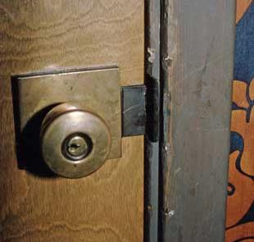
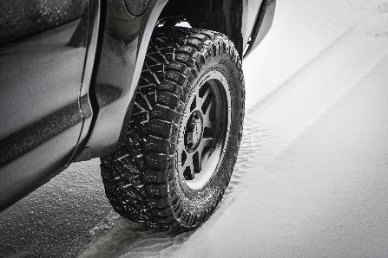
Types of Impression Evidence
Footprints/Shoe prints
Tire tracks
Tool marks
Notes:
Staggs, S. (2014, September 22). Evidence photography at the crime scene. Crime Scene Investigator Network. https://www.crime-scene-investigator.net/csp-evidence-photography-at-the-crime-scene.html
Foster, D. (n.d.). Grayscale photo of car wheel [Photograph]. Unsplash. https://unsplash.com/photos/grayscale-photo-of-car-wheel-kqhF9kF6J0A
Hochgesang, J. (n.d.). Black and white Nike [sic] sneakers [Photograph]. Unsplash. https://unsplash.com/photos/black-and-white-nike-sneakers-sA5wcAu4CBA

Slide 8
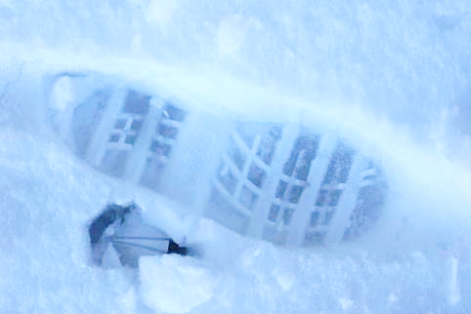
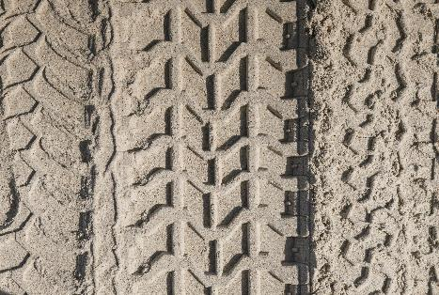
Types of Impressions: Three-Dimensional
An impression with length, width, and depth
Made in soft material, like mud or snow
Notes:
Haupt, M. (2020, August 3.). Black metal frame on brown sand [Photograph]. Unsplash. https://unsplash.com/photos/black-metal-frame-on-brown-sand-lKl1QESpy7E
Weeks, B. (2008, December 22). Shoeprint [Photograph]. Flickr. https://www.flickr.com/photos/92996378@N00/3167733779

Slide 9
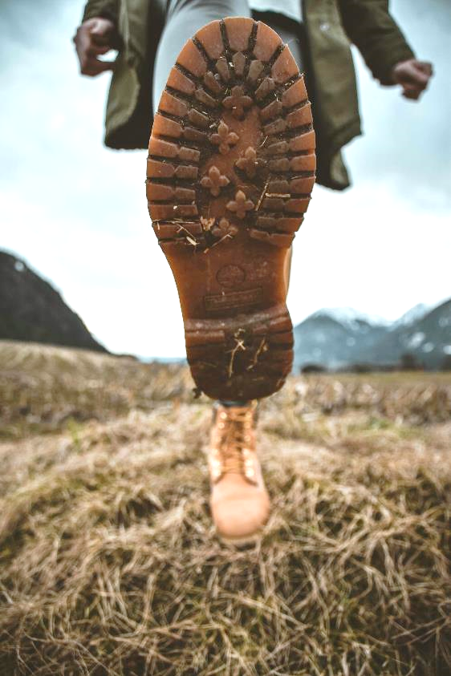
Shoes: Outsole
The portion of the shoe that contacts the ground and is exposed to wear
Notes:
Seeber, S. (2018, March 15). Person stepping on grass field [Photograph]. Unsplash. https://unsplash.com/photos/person-stepping-on-grass-field-Kmq7cFPlmao

Slide 10
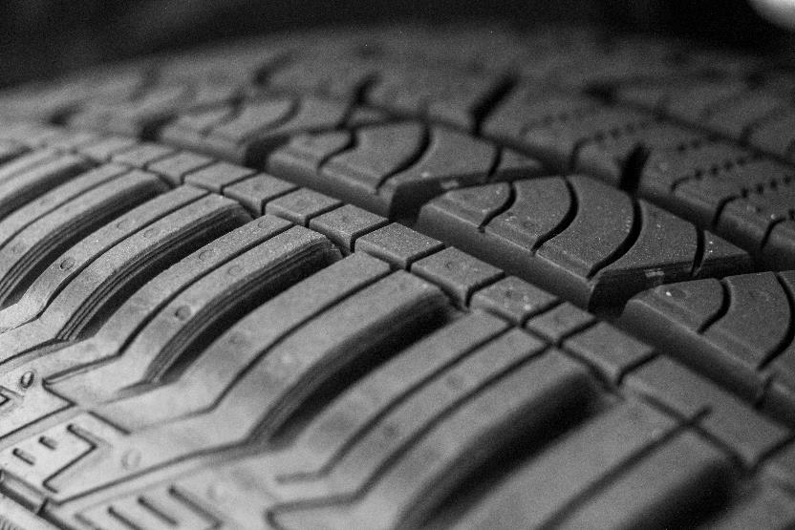
Tires: Tread
The portion of the tire that comes into contact with the road and is exposed to wear
Notes:
Yvette S. (2022, July 8). A close up of a tire [Photograph]. Unsplash. https://unsplash.com/photos/a-close-up-of-a-tire-tLEUi4OaQmQ

Slide 11
Documenting Evidence
Photographs
Overall crime scene photos document the location of the impressions in relation to the rest of the scene
High-quality photos of the impression from different distances (mid-range, close-up) and different flash angles
Taken both with and without scale
Measurements
Taken to document the exact location and directionality of the impression
Notes:
Photos should be taken with and without scale
Measurements should be triangulated from two fixed points

Slide 12
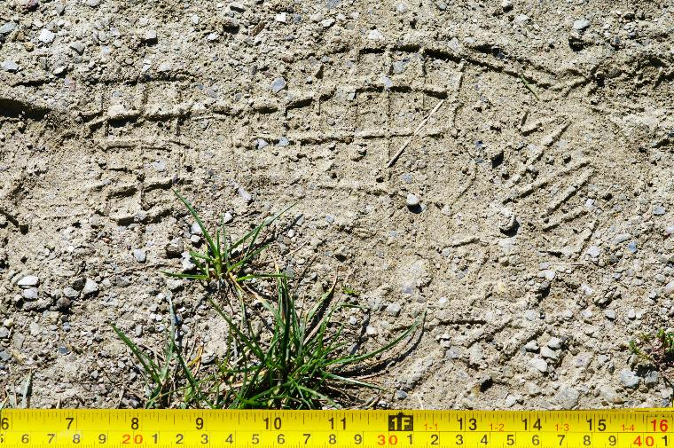
Close-Up Photography
Done with and without scale (e.g., ruler)
Taken at a 90° angle
Take pictures with multiple flash angles
Notes:
Wegmann, I. (2021, September 2). Green grass on gray soil [Photograph]. Unsplash. https://unsplash.com/photos/green-grass-on-gray-soil-PKKkFDCYir8

Slide 13
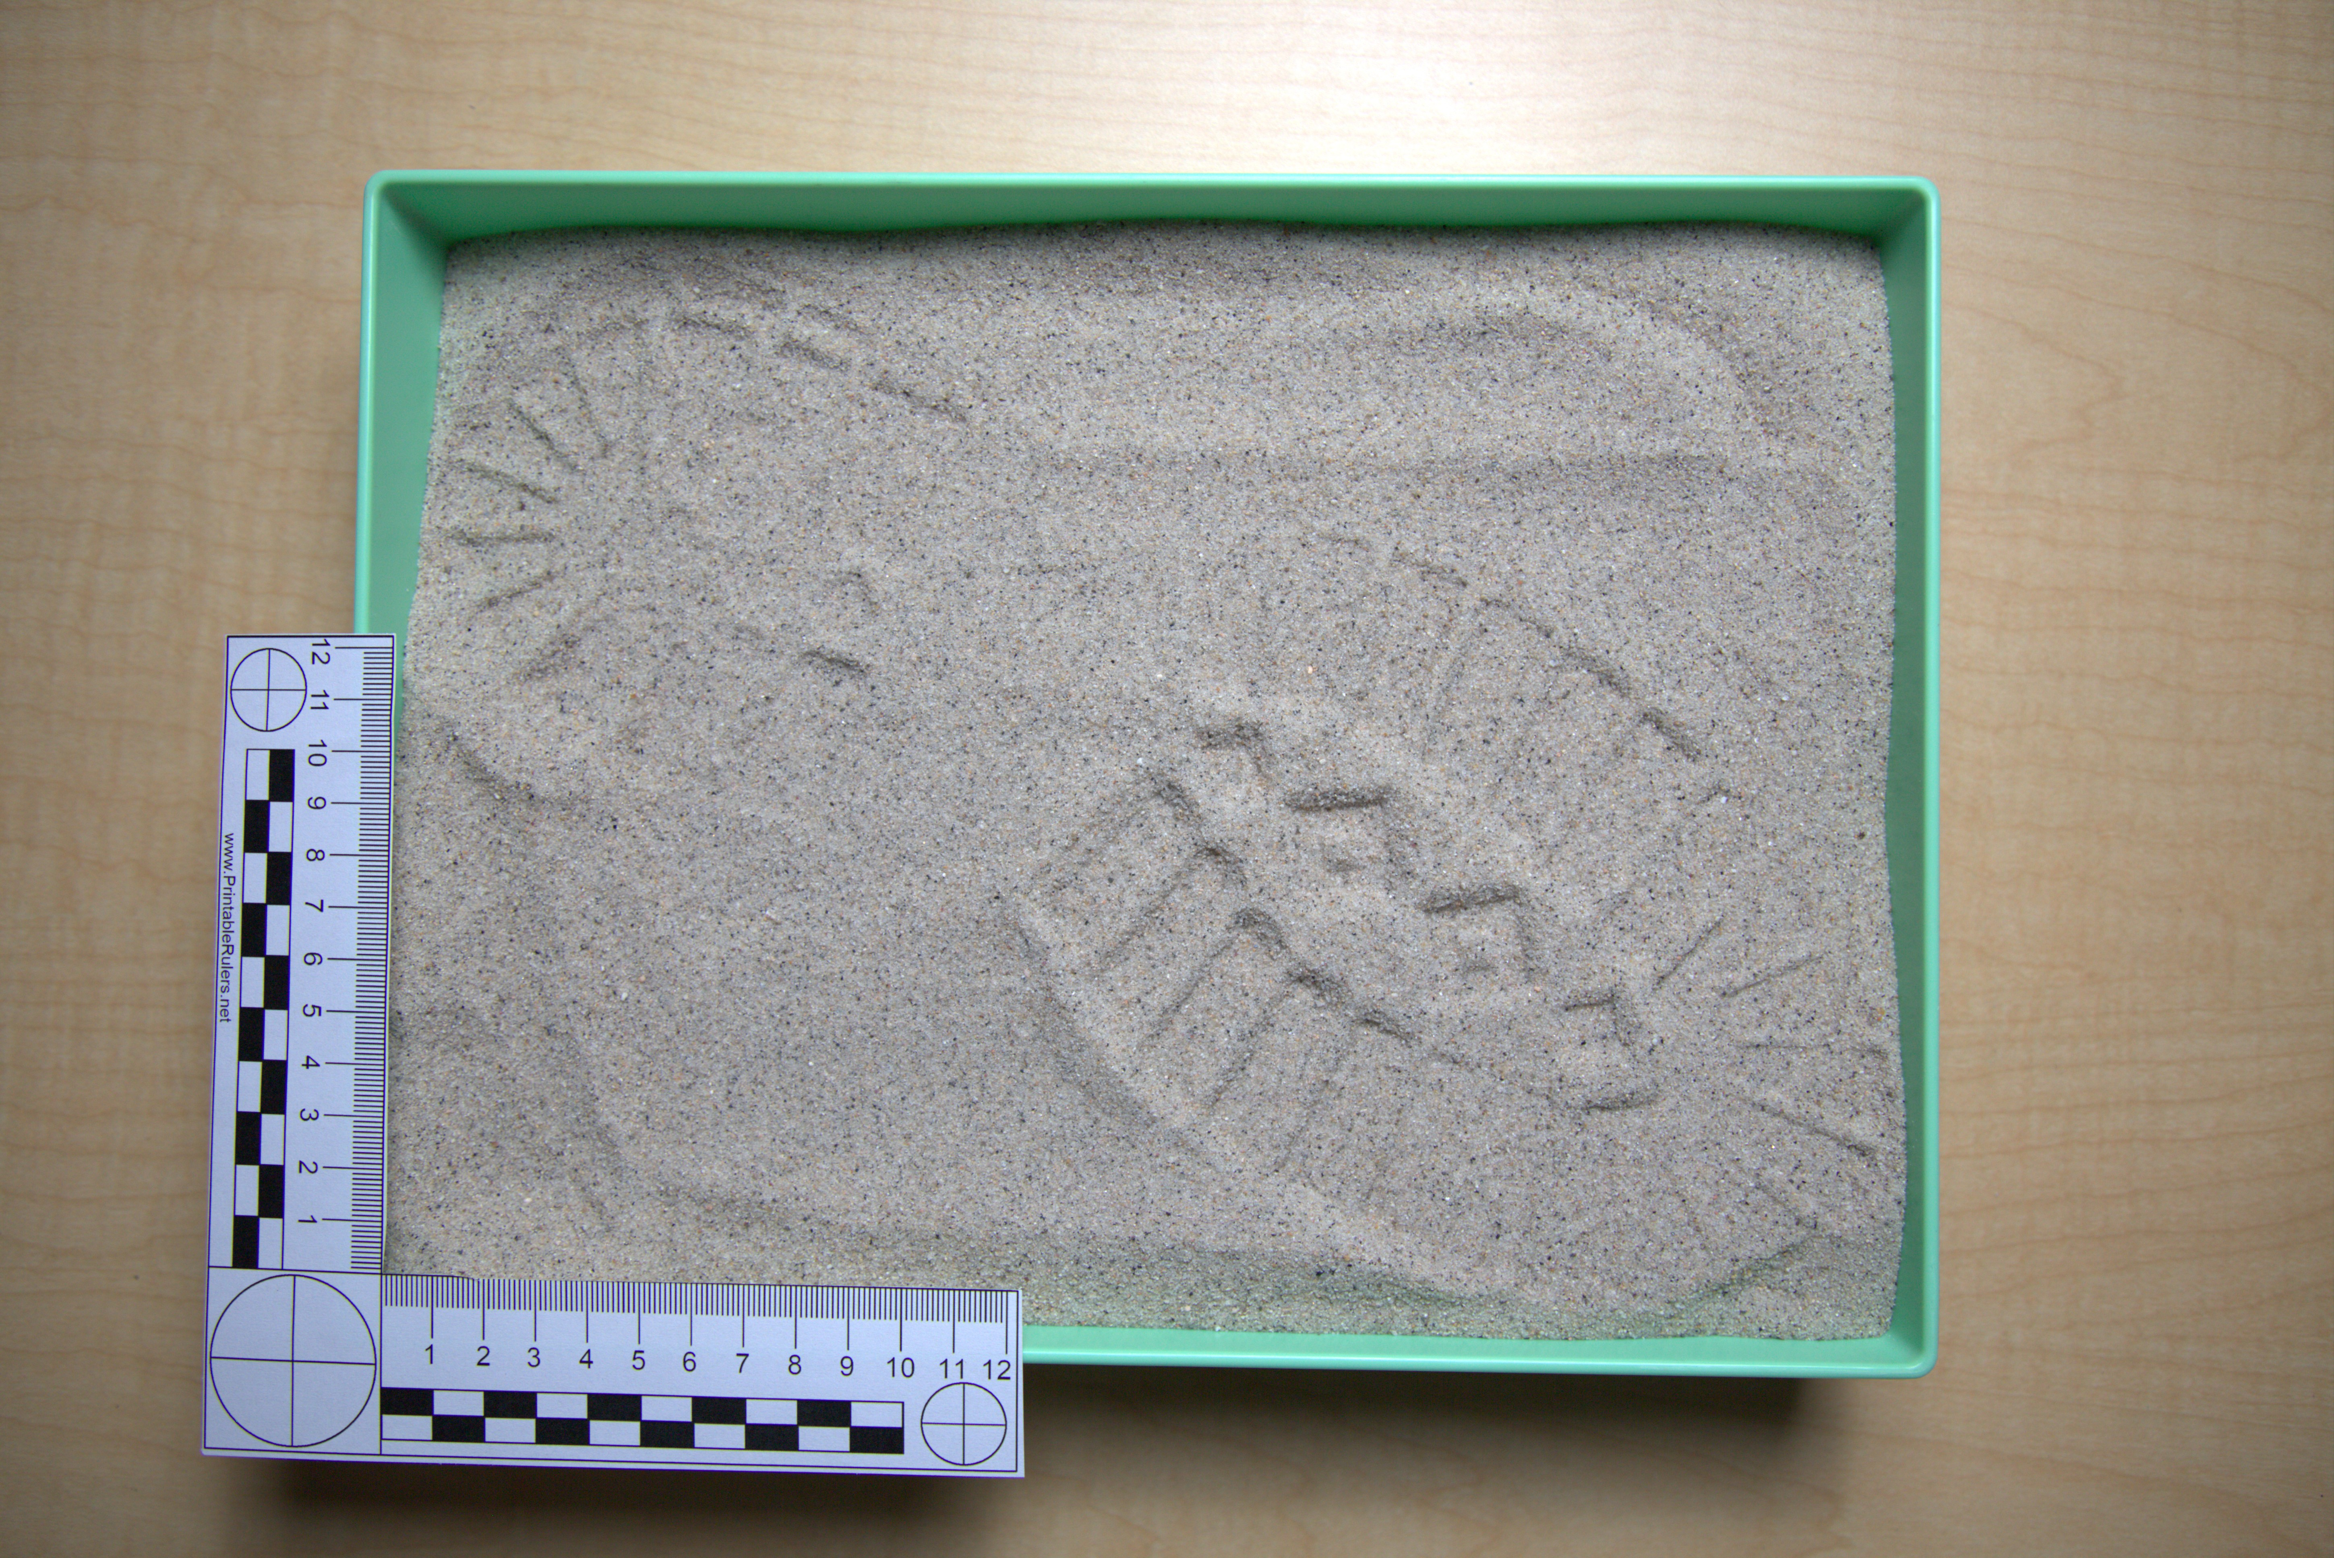

Slide 14
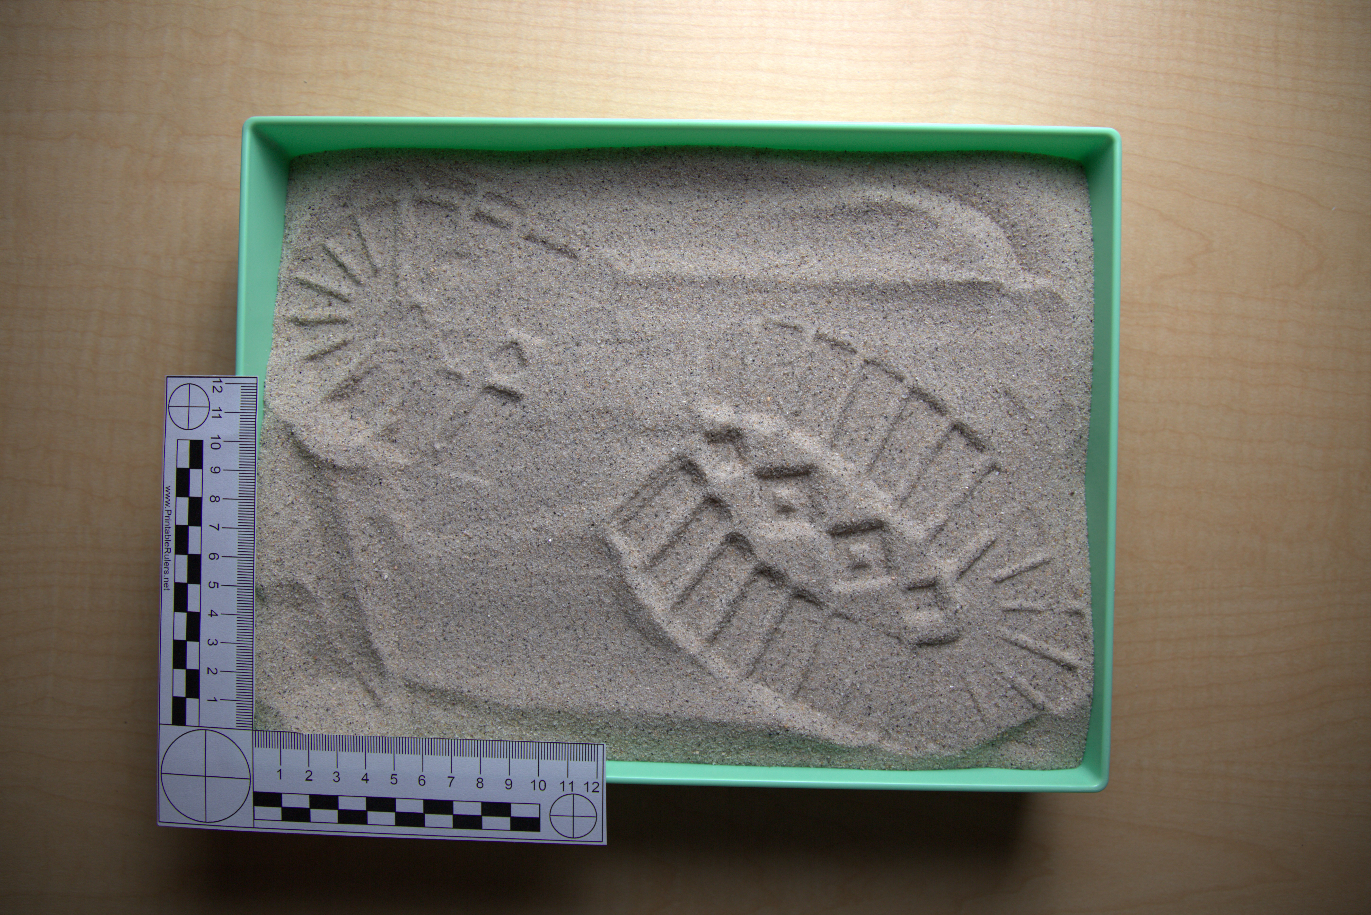

Slide 15
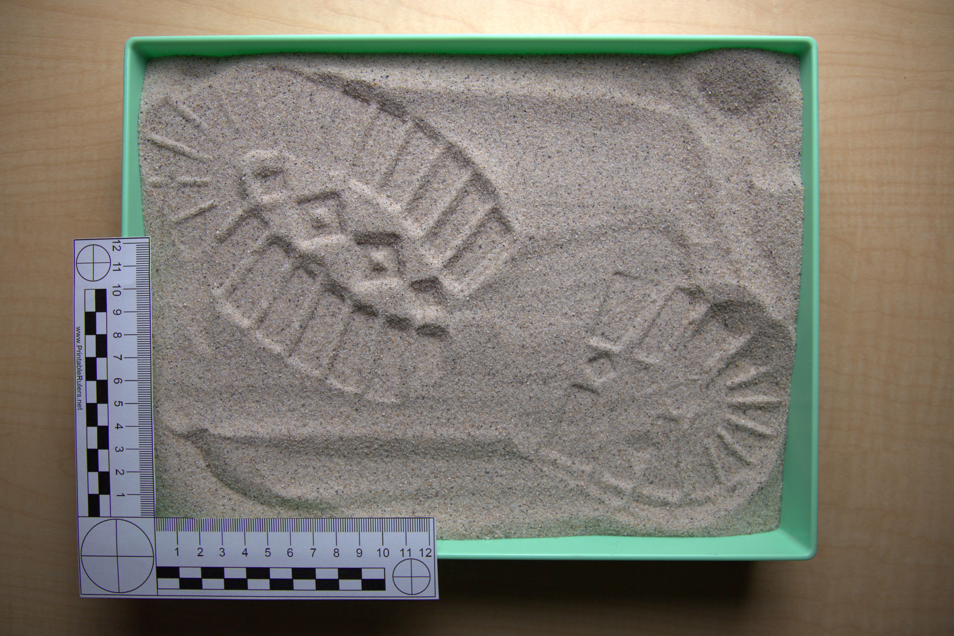

Slide 16
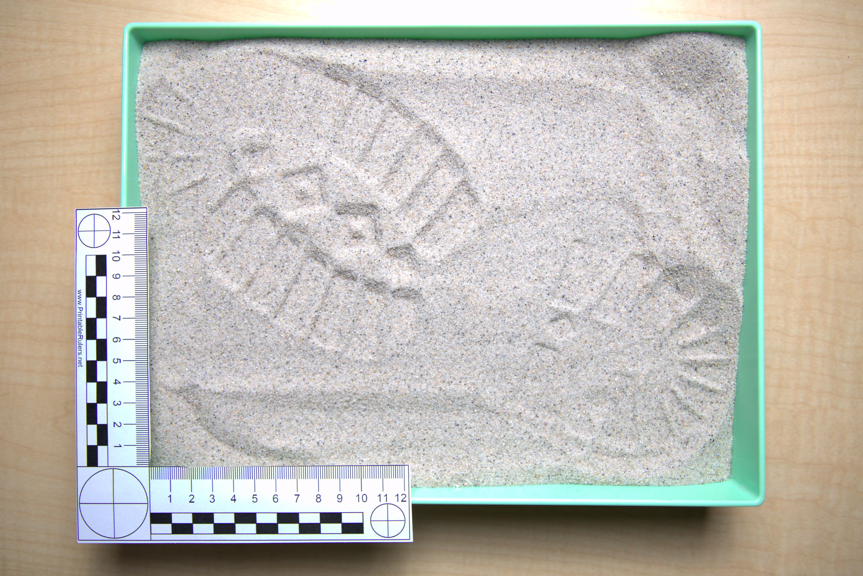

Slide 17
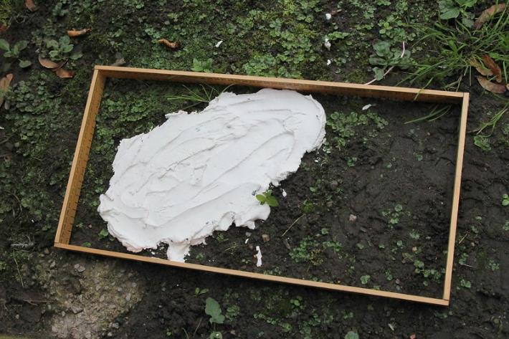
Collecting Impressions
Three-dimensional impressions can be cast utilizing dental stone.
Dental stone contains gypsum which allows for a harder and more durable cast than other casting materials.
Notes:
Pete. (2014, October 18). Finding footprints [Photograph]. Flickr. https://www.flickr.com/photos/comedynose/15369033609

Slide 18
Collecting Impressions
Photograph the shoe impression with different flash angles.
Weigh dental stone into a plastic bag.
Add water to the bag containing the dental stone.
Seal the bag and mix until it is evenly blended and without clumps.
Pour the dental stone into the impression and allow it to sit until cured.
Once the dental stone has hardened, gently remove and clean the casting.
Photograph the casting.

Slide 19
Collecting Impressions
Insert investigation procedures for your class here

Slide 20
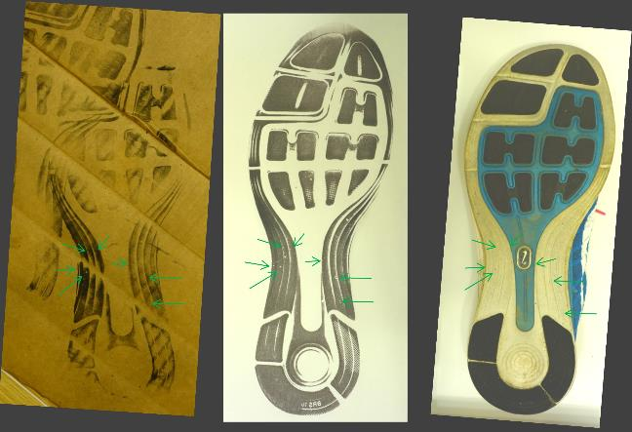
Examination
What are things you could look for to tell whether a shoeprint left at a crime scene matched a known shoe?
Notes:
Zalman992. (2015, January 1). Comparison of crime scene print Q1 with suspect’s shoes K1 left shoe with labels [Photograph]. Wikimedia Commons. https://commons.wikimedia.org/w/index.php?curid=39660318

Slide 21
Examination
When making comparisons, the examiner should consider:
the design, including any manufacturing characteristics (e.g., brand logo)
the physical shape and size
specific identifiable characteristics
wear characteristics

Slide 22
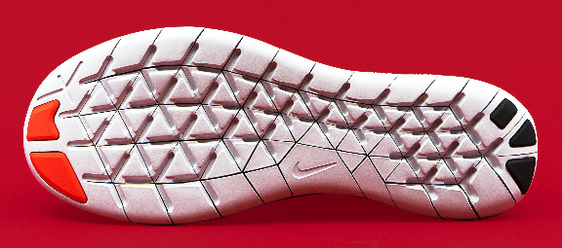
Examination: Class Characteristics
Class: a group of things that may share characteristics
(shoes → athletic shoes → Nike)
Features created during manufacturing, shared by all other shoes/tires in the class
(tread pattern, brand logo, shoe size)
Notes:
Domino Studio. (2019, January 29). White, black, and red shoe sole [Photograph]. Unsplash. https://unsplash.com/photos/white-black-and-red-shoe-sole-j7zu2kpTnwY

Slide 23
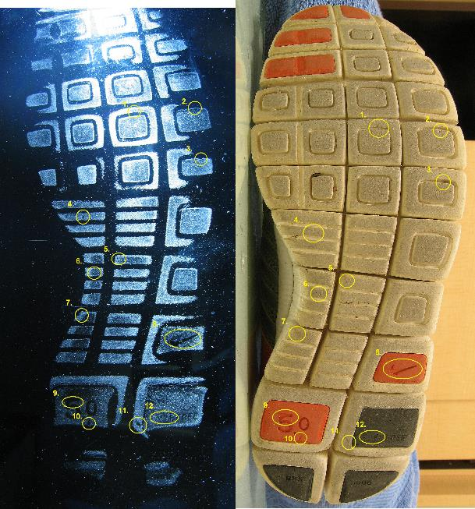
Examination: Individual Characteristics
A characteristic specific to a single shoe or tire
Created by something randomly added or removed from the shoe outsole or tire tread
Causes the outsole or tread to be unique (e.g., tear/cut, chunk missing, wear, etc.)
Individual characteristics are used to identify an exact shoe.
Notes:
Stechondanet. (2007, August 23). Shoeprint (forensic) [Photograph]. Wikimedia Commons. https://commons.wikimedia.org/w/index.php?curid=2605986

Slide 24
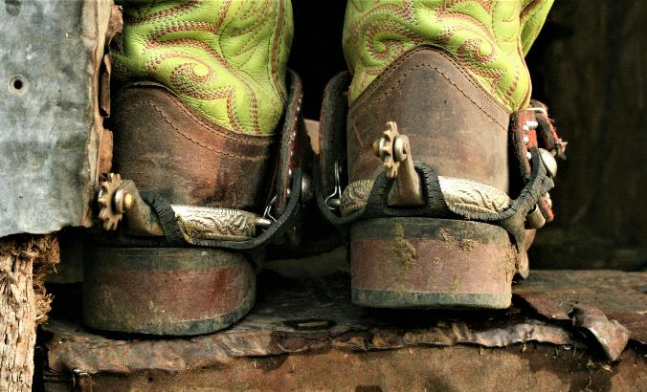
Examination: Wear
The erosion of the outsole of a shoe or tire tread that happens due to rubbing between the outsole/tread and the ground
Notes:
Mentink, K. (2022, January 26). Photo of green and brown boots with spurs [Photograph]. Unsplash. https://unsplash.com/photos/_om4w4O_Rqs

Slide 25
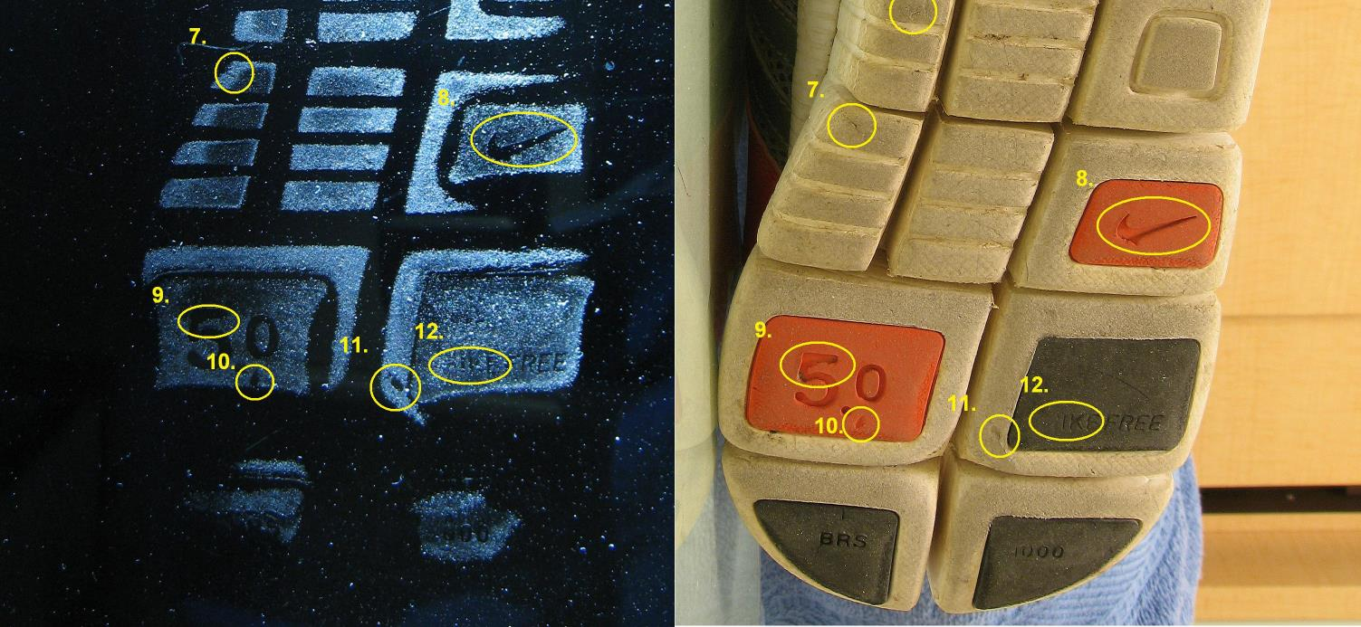
Notes:
7-12 are individual characteristics of this shoe:
7, 10, and 11 show places where part of the sole is damaged
8 & 9 show damage to class characteristics (missing pieces of the sole changing the shape of the Nike swoosh & 5.0 label)
12 shows wear to a class characteristic (N in “NIKE” worn down and absent)
Stechondanet. (2007, August 23). Shoeprint (forensic) [Photograph]. Wikimedia Commons. https://commons.wikimedia.org/w/index.php?curid=2605986

Slide 26
Analysis
Three conclusions: identification, inconclusive, elimination
Identifications are based on random, individual characteristics.
No set number of individual characteristics is required.
A positive identification can be made if the impression and the known shoe/tire have enough individual characteristics in common.

Slide 27
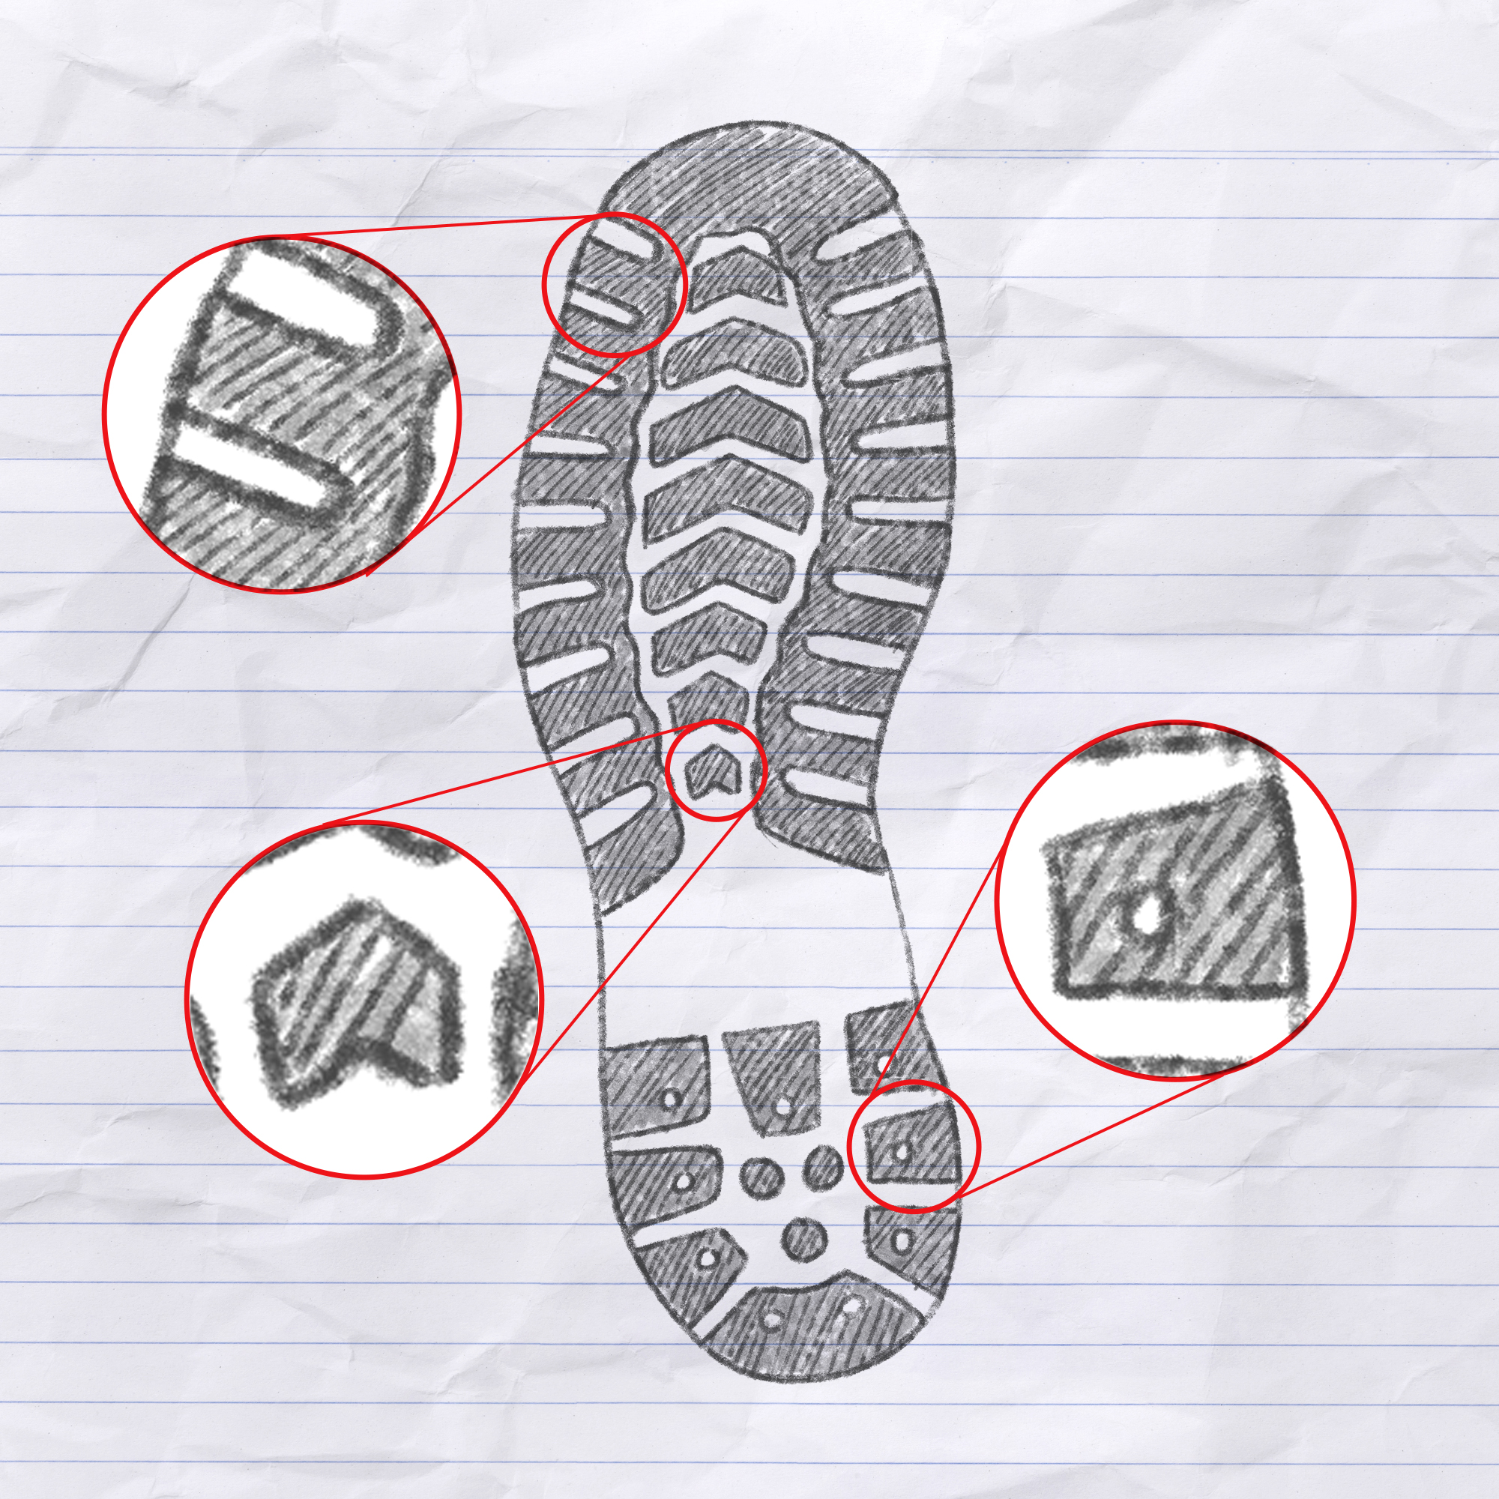
Analysis instructions
Class Characteristics | Individual Characteristics | Drawing w/ Measurements and Individual Characteristic Labels

Slide 28
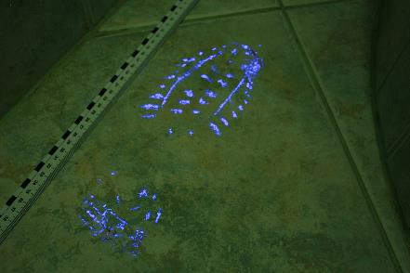
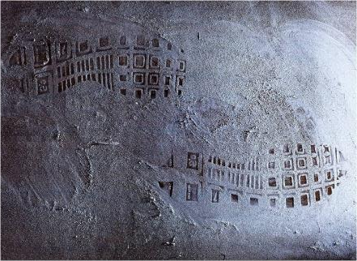
Two-Dimensional Impressions
An impression that has dimensions of length and width, but not significant depth
Can be left by adding or removing something from a surface
Adding: Shoe leaves blood on a tiled floor
Removing: Shoes pick up dust on a floor and leave clean spots
Notes:
JohnRambo PL. (2008, January 21). BucikUV [Photograph]. Wikimedia Commons. https://commons.wikimedia.org/w/index.php?curid=12207987
Zalman992. (2009, July 1). Shoeprint dusty [Photograph]. Wikimedia Commons. https://commons.wikimedia.org/wiki/File:Shoeprint_dusty.jpg

Slide 29
Documentation and Collection
Hard floor surfaces should be checked using oblique lighting to search for any impressions that are not readily visible.
Oblique lighting is shining a light source at a very low angle on the surface you are observing.

Slide 30
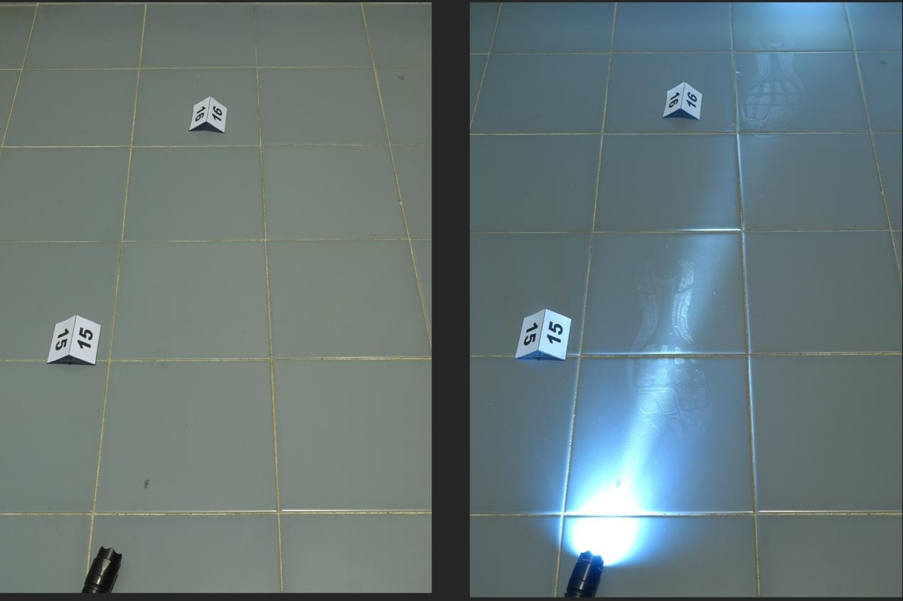
Notes:
Zalman992. (2016, September 26). Footwear impression detection light [Photograph]. Wikimedia Commons. https://commons.wikimedia.org/w/index.php?curid=60363918

Slide 31
2D Impressions
Roll black ink onto the sole of the shoe.
Place your hand inside the shoe and press it onto paper in a motion that mimics how you would walk (i.e., heel to toe).
Photograph the inked shoe print.
Document any observed individual or class characteristics.

Slide 32
Matching Impressions and Shoes
Insert investigation procedures for your class here

Slide 33
Drawing Conclusions from Impressions
How did you use evidence to match your 3D and 2D impressions to known shoes?

Slide 34
Drawing Conclusions from Impressions
How effective was the dental stone technique for recovering characteristics of a three-dimensional impression?

Slide 35
Drawing Conclusions from Impressions
How effective was the inking technique for recovering characteristics of a two-dimensional impression?

Slide 36
Drawing Conclusions from Impressions
Which technique was more effective for collecting characteristic evidence, in your opinion? Why?

Slide 37
Reflecting on Your Learning
Complete the following reflection based on what you’ve learned about forensic impression evidence:
I used to think…
But now I know…

