Slide 2
Is This for Real?
Evaluating Sources

Slide 3
Essential Questions
How do I know if what I read is true?
How can I tell the difference between a reliable and an unreliable source?

Slide 4
Lesson Objectives
To offer students a set of tools to evaluate sources.
To distinguish between reliable and unreliable sources.

Slide 5
Who to Believe?
Who should Nala believe?
Mrs. Jenkins
Mr. Thompson
Jenny

Slide 6
Quote
The reliability of the people giving you the facts is as important as the facts themselves.
—Harold S. Geneen

Slide 7
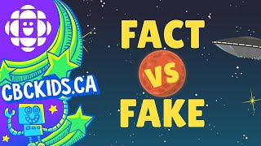
Fact vs. Fake
https://www.youtube.com/watch?v=9MJFRr7mY-Y
Notes:
CBC Kids. (2022, October 24). Fact vs. fake: A quick lesson in media literacy [Video]. YouTube. https://www.youtube.com/watch?v=9MJFRr7mY-Y

Slide 8
Fact vs. Fake
With your group, decide which sources on your List of Sources are real and which are fake.
Discuss why you think so.
Record your findings on your group chart.

Slide 9
What do they mean?
What is a source?
What is an expert?*
What do you think is reliable?
What is unreliable?
What is verified?
*What examples can you think of?

Slide 10
What do they mean?
Reliable sources: Often written by experts, checked for accuracy, and provide trustworthy information
For example: textbooks, educational websites, news from known outlets
Unreliable sources: Might include opinions, false information, or errors
For example: blogs without citations, some social media posts

Slide 11
Recap
https://www.youtube.com/watch?v=9MJFRr7mY-Y
Notes:
CBC Kids. (2022, October 24). Fact vs. fake: A quick lesson in media literacy [Video]. YouTube. https://www.youtube.com/watch?v=9MJFRr7mY-Y

Slide 12
Know Your Vocabulary
Expert
Reliable
Unreliable
Verified

Slide 13
Card Sort
How did you sort your cards?
Which words went together?
Were there any cards that you weren’t sure about?
Where did people fit into your sorting?
Were there any cards that overlapped?

Slide 14
How to Evaluate a Source
Author: Who wrote it? Where can I find that information? Are they an expert? How can I find out?
Date: When was it published? Where is that shown? Is it recent and up-to-date?
Publisher: Is it from a trusted organization? How do I know?
Purpose: Why was it written? To inform, persuade, entertain, or sell something? How can I tell?
Evidence: Is it reliable or unreliable? Why?

Slide 15
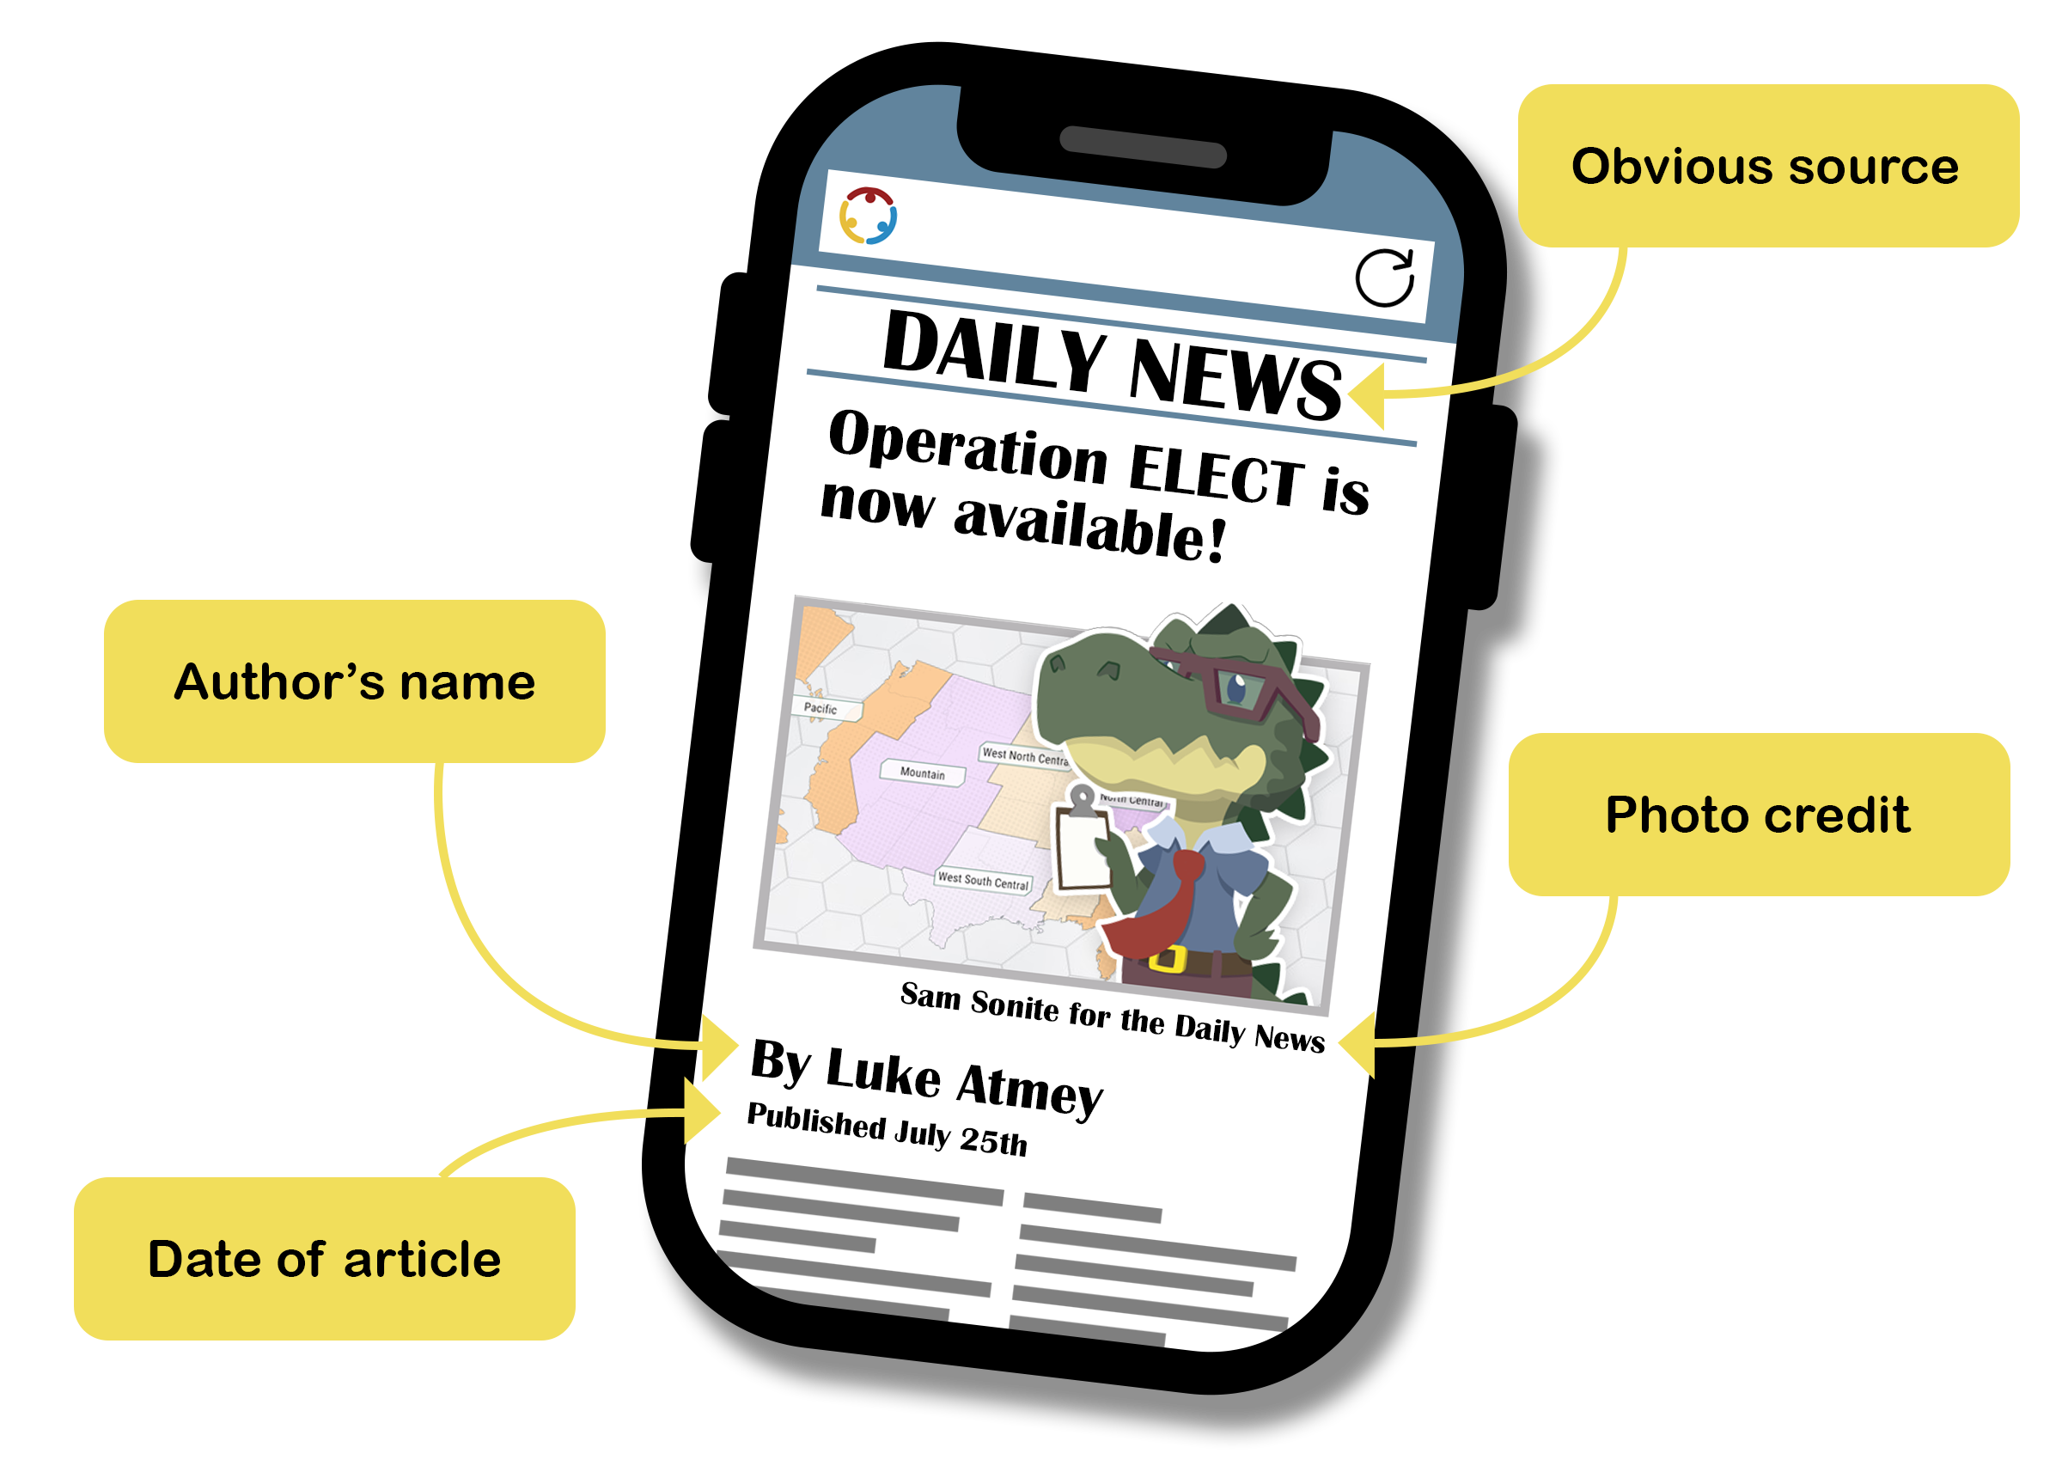
Where do I find it?

Slide 16
Criteria for Evaluation
Criteria | Questions | Answers
Author | Who wrote it? Expert?
Date | When did it appear?
Publisher | Is the source verified?
Purpose | Why was it written?
Evidence | Is it reliable?

Slide 17
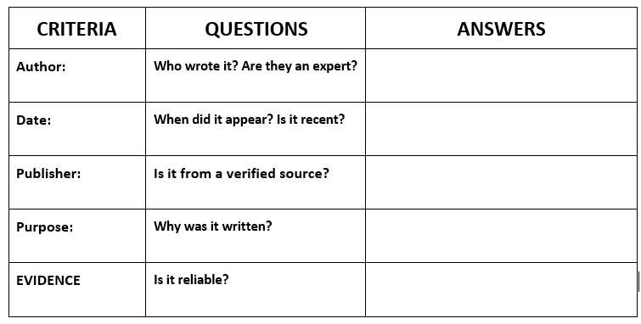
Criteria for Evaluation
Use the Criteria for Evaluation to decide if the sources on your Short List of Sources are fact or fake.

Slide 18
Remember to always:

