Slide 2
Identifying Character Traits for College Application Essays

Slide 3
Essential Question
How can we use narrative nonfiction to obtain a college acceptance letter?

Slide 4
Learning Objectives
Identify how a narrative can highlight particular character traits of an individual character.
Write a brief narrative that showcases their character traits effectively in a college application essay.

Slide 5
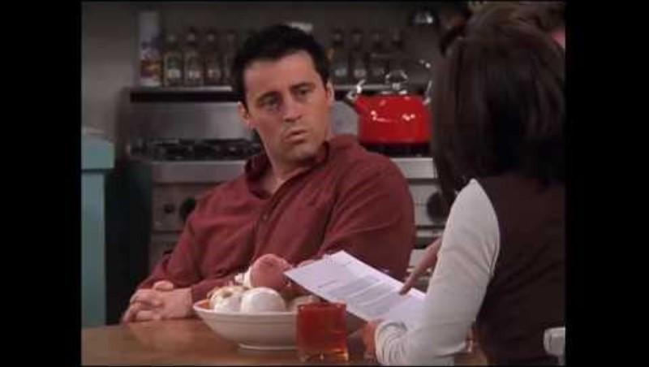
Joey Writes a Letter of Recommendation
Notes:
How you doin’? (2018, January 12). F.R.I.E.N.D.S - Joey writes a letter of recomendation [Video]. YouTube. https://youtu.be/n_ch8GWnJzQ?si=pqvUB08s4zgG52mD

Slide 6
Word Dump
What $10 words would you use in your essay that your classmates might not know, or could help everyone out?
Menti.com Code: [insert 8-digit join code here]
[Insert QR code here]

Slide 7
C.R.U.S.H. and Smush
Circle any new vocabulary (or words that are used in a way that make them new for the given context) as you read/listen.
After you have finished, in the margins, write the definitions of the words you have circled. Pay special attention to usage! The definition should match the context.
Notes:
K20 Center. (n.d.). C.R.U.S.H. & Smush. Strategies. https://learn.k20center.ou.edu/strategy/821

Slide 8
C.R.U.S.H. and Smush
Re-read the passage.
Underline the names of the characters Scout encounters or interacts with.
Star the points in the passage where each “encounter” begins.
Highlight words/phrases that reveal the lesson(s) Scout has learned from each encounter.
Notes:
K20 Center. (n.d.). C.R.U.S.H. & Smush. Strategies. https://learn.k20center.ou.edu/strategy/821

Slide 9
C.R.U.S.H. and Smush
Now, write a 100-word summary of the passage, focusing on what is revealed about Scout’s character traits from the passage.
Notes:
K20 Center. (n.d.). C.R.U.S.H. & Smush. Strategies. https://learn.k20center.ou.edu/strategy/821
K20 Center. (2021, September 21). K20 Center 5 minute timer [Video]. YouTube. https://youtu.be/EVS_yYQoLJg?si=fJvuvFWH3vJ3B0z9

Slide 10
C.R.U.S.H. and Smush
You will now take your 100-word summary and write a new 50-word summary, still focusing on what is revealed about Scout’s character traits.
Notes:
K20 Center. (n.d.). C.R.U.S.H. & Smush. Strategies. https://learn.k20center.ou.edu/strategy/821
K20 Center. (2021, September 21). K20 Center 3 minute timer. [Video]. YouTube. https://youtu.be/o9ViOMe_Wnk?si=RtCQ8rC3_PGpJjDe

Slide 11
C.R.U.S.H. and Smush
Once more, you will take your 50-word summary and reduce it to six words, still focusing on what is revealed about Scout’s character traits.
Notes:
K20 Center. (n.d.). C.R.U.S.H. & Smush. Strategies. https://learn.k20center.ou.edu/strategy/821
K20 Center. (2021, September 21). K20 Center 2 minute timer. [Video]. YouTube. https://youtu.be/HcEEAnwOt2c?si=5K1jIbi9rJpegjED

Slide 12
Elbow Partners
Share your six-word summary with your elbow partner. Together, agree on two adjectives that describe Scout’s character.
Notes:
K20 Center. (n.d.). Elbow Partners. Strategies. https://learn.k20center.ou.edu/strategy/116

Slide 13
Anchor Chart
In groups, you will watch a video about writing your college application essay.
On your paper, include the most important details from the video.
Notes:
K20 Center. (n.d.). Anchor Chart. Strategies. https://learn.k20center.ou.edu/strategy/58

Slide 14
Video Links
5 Don’ts
5 Do’s
The Ideal Essay
3 Awesome Personal Statements that Aren’t on Challenges
Notes:
College Essay Guy. (2021, August 18). 3 awesome personal statements that AREN’T on challenges [Video]. YouTube. https://www.youtube.com/watch?v=7Ab2G7wFd50
Garden of English. (2020, May 28). How NOT to SCREW UP your college essay (5 don’ts) [Video]. YouTube. https://www.youtube.com/watch?v=XjIpRV1FbGU
Garden of English. (2020, June 4). How NOT to SCREW UP your college essay (5 do’s) [Video]. YouTube. https://www.youtube.com/watch?v=wQGR_WdMaf0
Heinrichs, J. (2020, July 16). The ideal college essay [Video]. YouTube. https://www.youtube.com/watch?v=gakjxAq6KuQ

Slide 15
Gallery Walk
As you walk around the room and view each groups’ anchor chart, leave at least two sticky notes with comments or questions on each.
Notes:
K20 Center. (n.d.). Gallery Walk/Carousel. Strategies. https://learn.k20center.ou.edu/strategy/118

Slide 16
Essay Rubric
In your groups, use the blank rubric template to create a rubric for scoring personal narratives.
Remember to use the information you learned from the videos you watched, as well as your classmates’ Anchor Charts.

Slide 17
One Rubric to Rule Them All
Form new groups with one representative from each of the original groups.
Each new group should have at least one member from each of the groups who collaborated on the rubric creation.
In your new groups, use the affinity process to compile “One Rubric to Rule Them All.”
Notes:
K20 Center. (n.d.). Affinity Process. Strategies. https://learn.k20center.ou.edu/strategy/87

Slide 18
Teacher Rubric
Compare the Teacher Rubric to the “One Rubric to Rule Them All” your groups created.
What similarities and differences do you notice?
Which rubric do you think is more rigorous?

Slide 19
Scoring Example Essays
Using the Teacher Rubric, rate the essay examples you have been given.
Be prepared to explain why you rated each essay the way you did.

Slide 20
A Note on Writing Drafts
“Almost all good writing begins with terrible first efforts. You need to start somewhere. Start by getting something—anything—down on paper. A friend of mine says that the first draft is the down draft—you just get it down. The second draft is the up draft—you fix it up. You try to say what you have to say more accurately. And the third draft is the dental draft, where you check every tooth, to see if it’s loose or cramped or decayed, or even, God help us, healthy.” —Anne Lamott
Notes:
Lamott, Anne. (2005). Shitty first drafts. In Eschholz, P., Rosa, A., & Clark, V. (Eds.) Language awareness: Readings for college writers. (9th ed., pp. 93–96). Bedford/St. Martin's Pub.

Slide 21
Draft Your Essay
You will now write the first draft of your college application essay!
Your essay will need to be handwritten.

Slide 22
Peer Review
On the first page of the Peer Review Questions handout, answer the questions about your first draft.
Then share your draft and handout with your partner.
Before answering any questions on their handout, read the entirety of your partner’s draft.
There is no talking during this stage! Communicate with your writing.

Slide 23
Six-Word Memoir
Once you have completed your peer review of your partner’s essay, create a six-word memoir summarizing the author’s personal narrative.
Review the six-word narrative written about your essay, did the summary fit what you wanted to get across?
Notes:
K20 Center. (n.d.). Six-Word Memoirs. Strategies. https://learn.k20center.ou.edu/strategy/75

