Slide 2
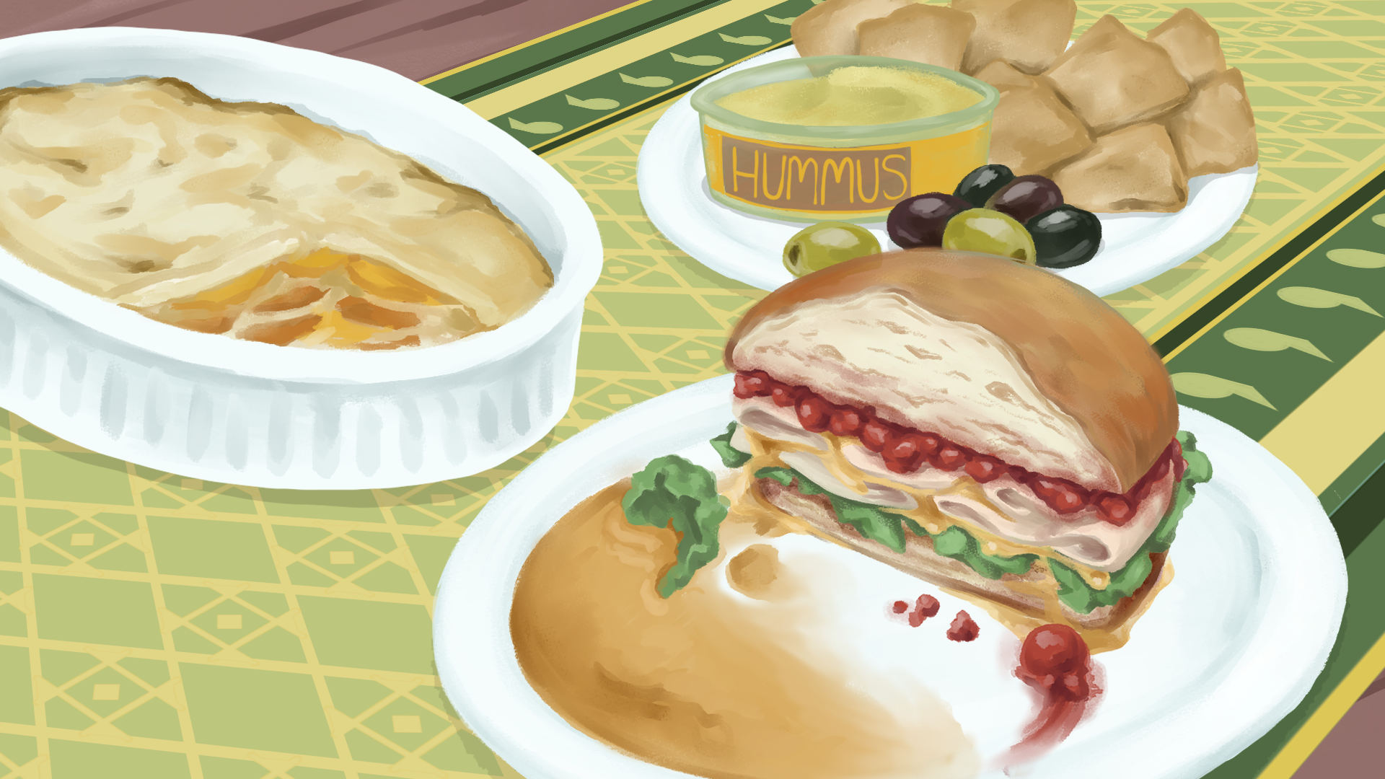
Why Pause?
Exploring the Power of Commas

Slide 3
Essential Questions
How does grammar enhance your writing?
How can you use commas in your own writing?

Slide 4
Lesson Objectives
Students review basic comma rules.
Students identify different commas in a text and determine their usage rules.
Students create an original text using commas with a variety of roles.

Slide 5
“Cooking Hacks”
Cooking is a skill, and it's an art. By mastering various techniques and experimenting with flavors, one can create culinary delights that tantalize the taste buds. For instance, when making pasta, it's crucial to boil the noodles until they are al dente, toss them with a rich tomato sauce, and sprinkle them with freshly grated Parmesan cheese. Each step contributes to the dish's overall flavor and texture.
When embarking on a culinary adventure, it's important to gather all necessary ingredients beforehand. For example, when baking a cake, one might need flour, sugar, eggs, butter, and vanilla extract. Ensuring that all ingredients are readily available makes the cooking process smoother and more enjoyable.
Understanding the importance of proper seasoning is essential, but it must be measured carefully. Whether it's a pinch of salt to enhance the savory flavors or a dash of cinnamon to add warmth to a dessert, seasoning can elevate a dish from good to extraordinary.
In summary, cooking is a delightful experience that allows for creativity and experimentation. Mastering various techniques and experimenting with flavors can lead to culinary delights.

Slide 6
Grammatically Correct
Review your assigned comma rule.
This is the “role” you will take on.
Re-read the passage “Cooking Hacks.”
Determine how your comma is being used in the passage.
Hint: Your comma may be used more than once.
Afterwards, you will mingle with people who have a different role then you.
Introduce yourself and assume the point of view of your comma based on its purpose.
Notes:
K20 Center. (n.d.). Grammatically correct. Strategies. Retrieved from https://learn.k20center.ou.edu/strategy/3555

Slide 7
Grammatically Correct
As you mingle around the room, introduce yourself and assume the point of view of your comma based on its purpose.
Use the information on your card to help you answer the question: How is my comma influencing the text?
Be sure to find a friend with a different role to mingle with.
K20 Center 10-minute timer
Notes:
K20 Center. (n.d.). Grammatically correct. Strategies. Retrieved from https://learn.k20center.ou.edu/strategy/3555
K20Center. (2021, September 21). K20 Center 10 minute timer. YouTube. Retrieved September 19, 2022, from https://youtu.be/9gy-1Z2Sa-c?si=Fb1S131aUwXzp73O

Slide 8
Key
“Cooking Hacks”
Cooking is a skill, and it's an art. By mastering various techniques and experimenting with flavors, one can create culinary delights that tantalize the taste buds. For instance, when making pasta, it's crucial to boil the noodles until they are al dente, toss them with a rich tomato sauce, and sprinkle them with freshly grated Parmesan cheese. Each step contributes to the dish's overall flavor and texture.
When embarking on a culinary adventure, it's important to gather all necessary ingredients beforehand. For example, when baking a cake, one might need flour, sugar, eggs, butter, and vanilla extract. Ensuring that all ingredients are readily available makes the cooking process smoother and more enjoyable.
Understanding the importance of proper seasoning is essential, but it must be measured carefully. Whether it's a pinch of salt to enhance the savory flavors or a dash of cinnamon to add warmth to a dessert, seasoning can elevate a dish from good to extraordinary.
In summary, cooking is a delightful experience that allows for creativity and experimentation. Mastering various techniques and experimenting with flavors can lead to culinary delights.
Notes:
Comma Roles for Grammatically Correct
FANBOY Comma (comma that separates two independent clauses)
INTRO Comma (comma after an introductory phrase)
OXFORD Comma (comma to separate items in a list)
FANBOY Comma (comma that separates two independent clauses)
INTRO Comma (comma after an introductory phrase)
OXFORD Comma (comma to separate items in a list)

Slide 9
Comma Roles for Grammatically Correct
FANBOY Comma
Commas are used to join one independent clause (a group of words with a subject, object, and verb) to another independent clause within a sentence. Join independent clauses by placing a comma after the first part of the sentence and following it with a coordinating conjunction. Coordinating conjunctions include and, or, for, so, but, yet.
INTRO Comma
A comma follows a phrase at the beginning of a sentence that depends on the next clause of the sentence.
OXFORD Comma
The comma known as the Oxford Comma is technically optional. When dividing a list of items, the Oxford Comma is the final comma in a list of subject words, following the second last item which usually precedes “and.”

Slide 10
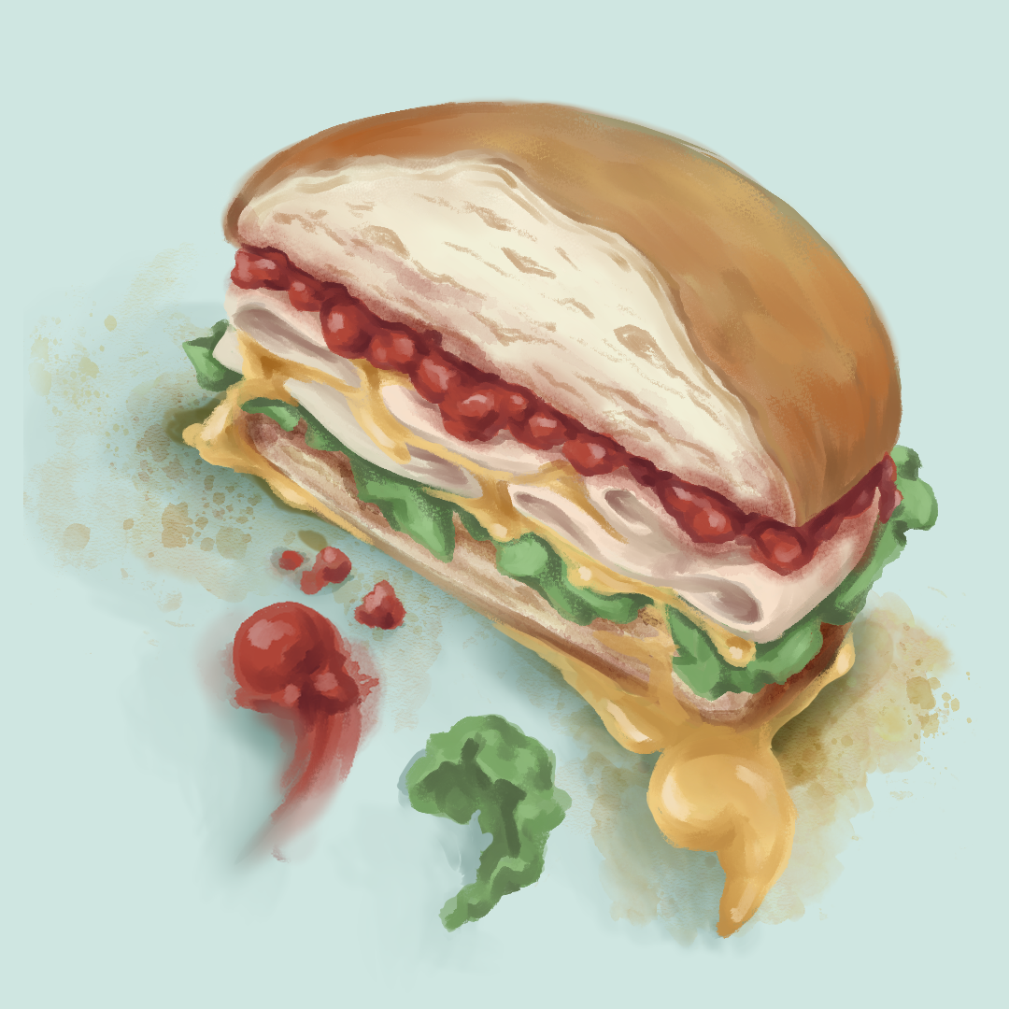
“Sandwiched in Between”
Go to www.commonlit.org .
Create an account (if needed).
Search for the short story, “Sandwiched in Between.”
Notes:
22 minutes to read aloud

Slide 11
Why-Lighting
As you read “Sandwiched in Between” use the annotation tools to highlight every sentence with a comma.
After you finish reading, discuss with a partner:
How is the comma being used?
Why do you think the author used a comma there?
Do you see similar ways the comma is being used to other commas in the text?
Notes:
K20 Center. (n.d.). Why-lighting. Strategies. Retrieved from https://learn.k20center.ou.edu/strategy/128

Slide 12
“Your Comma Rules”
Take your thoughts about commas from the reading and create your own rules.
Turn over your “Cooking Hacks” handout and with your partner describe at least 3 new comma rules.
These should be different then the ones we saw in the other reading.

Slide 13
Rules Review
A conjunctive adverb is a transitional word that can either join two related sentence clauses or introduce a sentence. Some conjunctive adverbs include however, nevertheless, furthermore, also, hence, anyway, and moreover. Use a comma after a conjunctive adverb, whether it comes at the beginning of a sentence or in the middle.
Example: The recipe is not difficult to follow. However, rolling out the dough for the dumplings is a challenge.
Adverb - a word or phrase that modifies or qualifies an adjective, verb, or other adverb or a word group, expressing a relation of place, time, circumstance, manner, cause, degree, etc. (e.g., gently, quite, then, there ).

Slide 14
Rules Review
A nonrestrictive clause provides nonessential information about the main clause of a sentence. Nonrestrictive clauses, which typically reveal additional information about a subject, are placed after the subject of the sentence after a comma. The nonrestrictive clause is closed with a comma which makes it similar to a parenthetical.
Example: After taking the meat off the chicken bones, which is a bit of a challenge, the meat is returned to the pot, and the broth is added.

Slide 15
Rules Review
An appositive is a noun or noun phrase that adds information to the primary noun. Use commas to separate this type of phrase from the rest of your sentence to prevent it from becoming a run-on.
Example: My grandmother, an expert baker, always adds a pinch of cinnamon to her apple pie.

Slide 16
Rules Review
Use the comma to introduce and end the quotation when it does not fall at the end of a sentence.
Example: "Add a pinch of salt," said the chef, "to enhance the flavor of the dish."
Use a comma after the year if you are referencing a specific date in a day/month/year format.
Example: We have a reservation for dinner on July 31, 2024, at the new Italian restaurant downtown.

Slide 17
I Notice, I Wonder
Compare the rules you wrote to the ones we just reviewed and are on your handout.
What did you notice about similarities and/or differences?
What are you still wondering or have a question about?
Notes:
K20 Center. (n.d.). I notice, I wonder. Strategies. Retrieved from https://learn.k20center.ou.edu/strategy/180

Slide 18
I Notice, I Wonder with Padlet
Go to <insert Padlet URL> or scan the QR code.
Click the + button under each heading.
Add your reflections.
Notes:
K20 Center. (n.d.). I notice, I wonder. Strategies. Retrieved from https://learn.k20center.ou.edu/strategy/180
K20 Center. (n.d.). I Notice, I Wonder with Padlet. Tech-Integrated Strategy. Retrieved from https://learn.k20center.ou.edu/tech-strategy/2956
K20 Center. (n.d.). Padlet. Tech Tool. Retrieved from https://learn.k20center.ou.edu/tech-tool/1077

Slide 19
Your Story
Go to www.bookcreator.com and create an account.
Create a short story.
Write about a time where someone is invited to a family meal that might be different from what they’re used to.
The story can be factual or fictional.
Using the Comma Rules handout, include commas from rules 5-8 in your story.
Before submitting your work, highlight each rule you included using the key below:
#5-Red #6-Blue #7-Green #8-Purple
Notes:
K20 Center. (n.d.). Book Creator. Tech Tool. Retrieved from https://learn.k20center.ou.edu/tech-tool/610

Slide 20
ACT Practice
Read the passage and answer the questions
K20 Center 9-Minute Timer
Notes:
K20 Center. (2021, September 21). K20 Center 9 minute timer. YouTube. https://www.youtube.com/watch?v=ZvN435zg2zE

Slide 21
“BBQ Passage” | Reflection
Question | Answer | Explanation
1 | D | A comma is needed to separate the dependent clause from the independent clause.
2 | F | The sentence "Seasonings, however, did not come from Native Americans" correctly uses commas to set off the word "however," which is a conjunctive adverb.
3 | B | When writing dates, a comma is needed to separate the day from the year.
4 | G | The phrase "Like the Native Americans" is an introductory clause and should be followed by a comma to separate it from the main clause of the sentence.

Slide 22
“BBQ Passage” | Reflection
Question | Answer | Explanation
5 | G | These independent clauses should be separated by a comma and a coordinating conjunction ("and").
6 | D | This sentence lists several ingredients, and correct punctuation is necessary to separate each item in the list.
7 | H | This sentence is a complex sentence with two clauses. The first clause is an introductory dependent clause and should be followed by a comma. Additionally, there should be a comma before the coordinating conjunction "so" to separate the two independent clauses.
8 | A | This sentence lists several ingredients, and correct punctuation is needed to separate each item clearly. Additionally, using an Oxford comma before "and hot peppers" ensures clarity.

