Slide 2
Antigone’s Themes Today
The Greek Drama Antigone

Slide 3
Essential Questions
How can Greek drama be connected to today’s high school students?
Are there universal themes in Antigone that are relevant today?

Slide 4
Learning Objective
We will be able to analyze themes in Antigone through textual evidence and real-world connections.

Slide 5
We’re having a tea party!

Slide 6
INSTRUCTIONS
Once you have received your card, move around the classroom until your teacher signals you to stop.
Form a group that is the size indicated by your teacher.
Take turns sharing card information with your group.
Discuss how you think your cards might be connected or related. Guess what the text might be about, based on what you have read on the cards.
Repeat this with a new group!

Slide 7
INSTRUCTIONS
Meet with your small group to discuss what you learned from the cards, and together, predict what the text might be about.
Write a “We Think” paragraph that details what you think the play will be about.
Consider using the following sentence stems:
“We think that this selection is about…”
“One reason we think this is because…”
“Another reason we think this is because…”

Slide 8
Antigone: Say Something
As you read the text with your partner, pause in places to:
Make a prediction.
Ask a question.
Clarify something confusing.
Make a comment.
Make a connection.

Slide 9
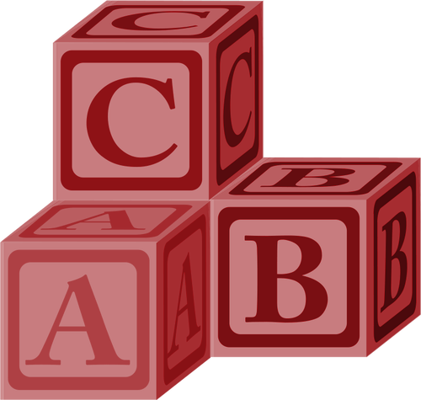
Alphabet Theme Page
You will be assigned a letter of the alphabet.
Choose a word that starts with that letter that you feel connects to a character, event, or theme from the play.
On your page, write the word and a theme sentence about the play that includes that word.
Decorate your page. Include connections you made to the real world.

Slide 10
ABC Book
We will be presenting our alphabet pages and assembling them into an ABC Book.

Slide 11
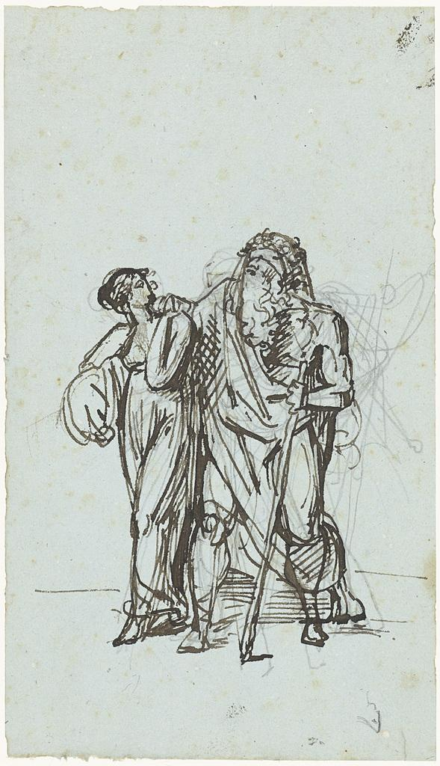
Reformulate the Story
How else could Antigone be told?
Comic book
Letters
Interview
Poem
Newspaper article
Movie script
Take an idea and reformulate the story of Antigone!
Notes:
Humbert de Superville, D. P. G. (ca. 1780-1849). De blinde Oedipus door Antigone geleid. Wikimedia Commons. https://commons.m.wikimedia.org/wiki/File:De_blinde_Oedipus_door_Antigone_geleid,_RP-T-1937-62.jpg

Slide 12
I Used to Think...
But Now I Know...
Looking back at your “We Think” paragraph, what did you think the play was going to be about? Put your thinking here.
After completing your ABC Book page and your story reformulation, what have you learned about the play? Put your thinking here.

