Slide 1

ARGUMENT: AN INTRODUCTION
Adapted from Chapter 1 (“Argument: An Introduction”) Writing Arguments: A Rhetoric with Readings, 9th edition By John D. Ramage, John C. Bean, June Johnson

Slide 2
WHAT DO WE MEAN BY ARGUMENT?

Slide 3
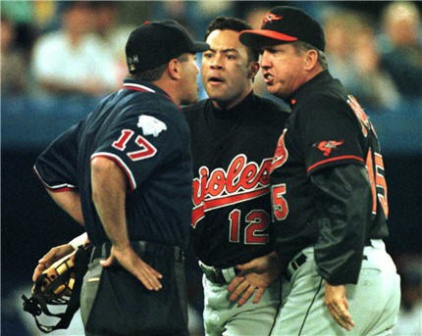
“ARGUMENT” DOES NOT HAVE TO BE A FIGHT OR A QUARREL

Slide 4
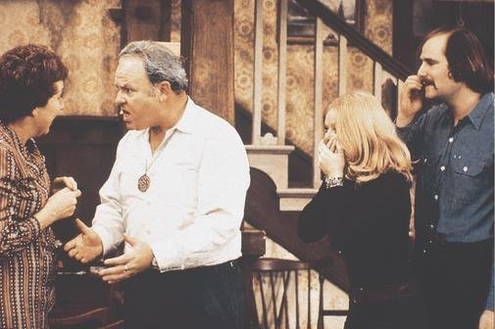
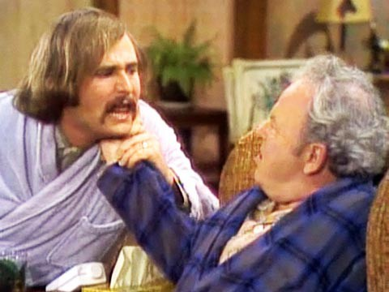

Slide 5
o reall
lo e orking
·th
IDI T !

Slide 6
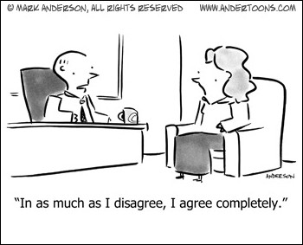
It’s Actually Possible to “Respectfully Disagree”

Slide 7

Let's agree to disagree
and agree you'll pay for it later.

Slide 8


ONE MORE THING TO KEEP IN MIND ABOUT ARGUMENTS:
THEY CAN BE EXPLICIT OR IMPLICIT.

Slide 9

By “EXPLICIT” we mean arguments that DIRECTLY state their claim and supply REASONS and EVIDENCE to
support their claim.

Slide 10
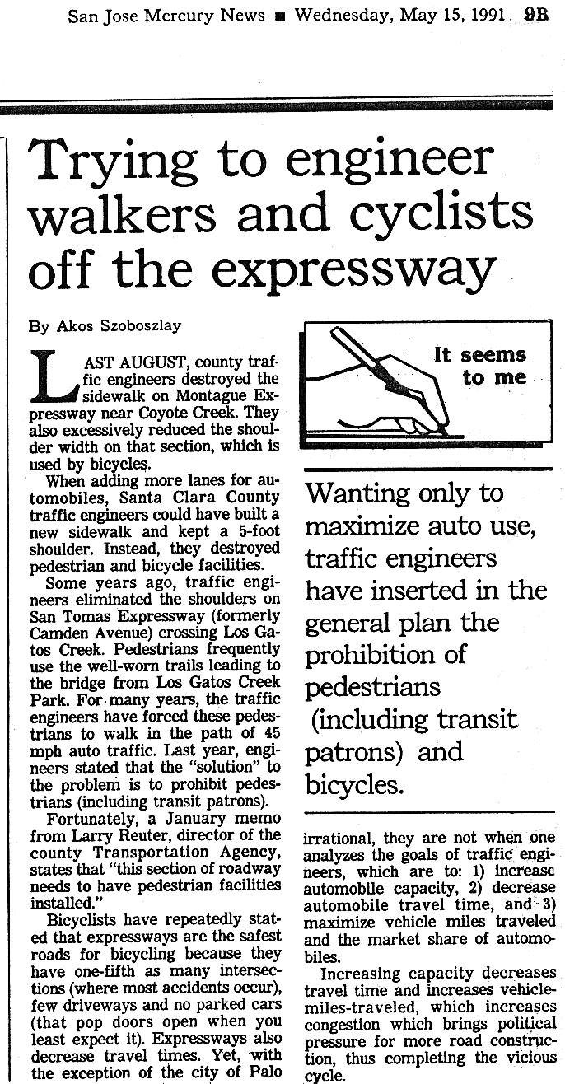
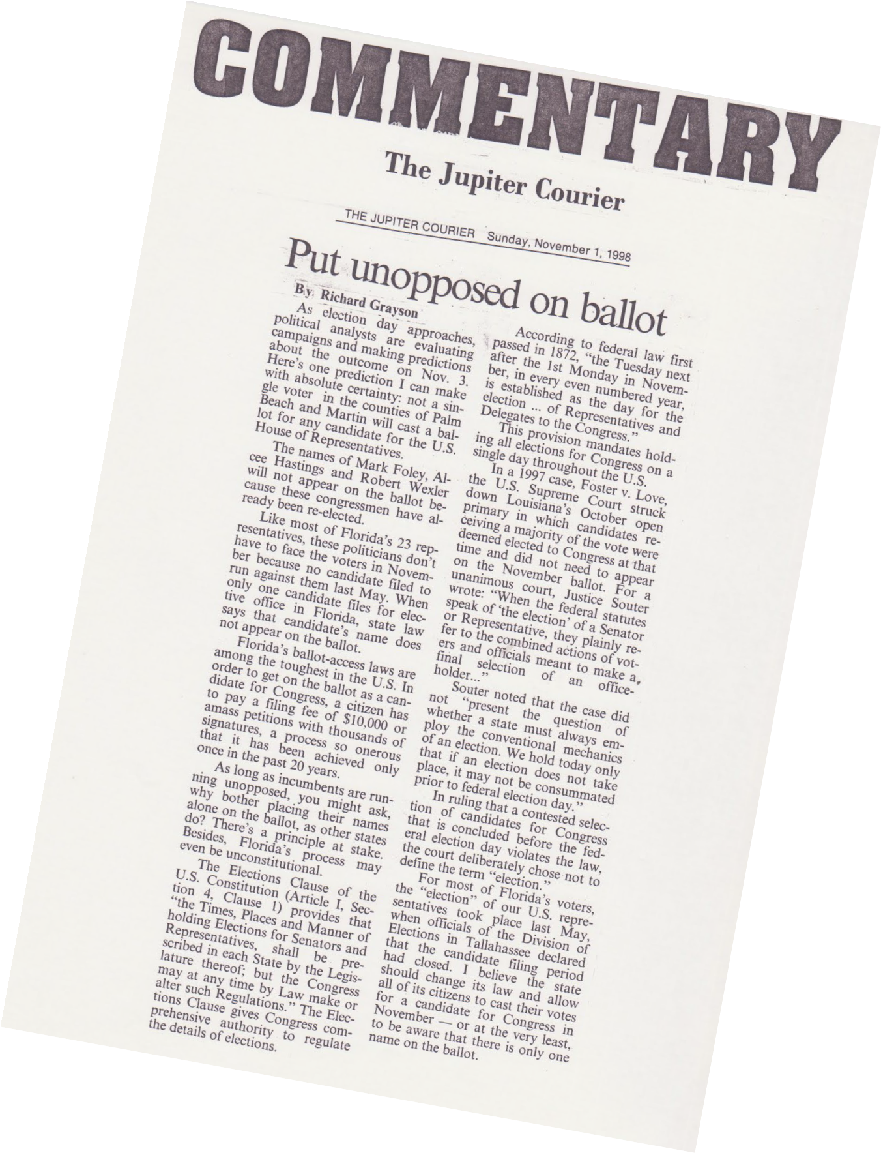

EXAMPLES OF EXPLICIT ARGUMENTS

Slide 11


By “IMPLICIT” we mean arguments that INDIRECTLY suggest their claim without providing evidence of their claim.

Slide 12
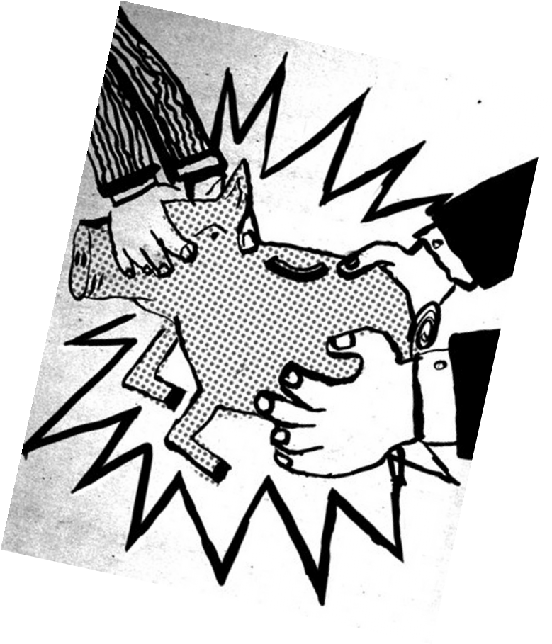


EXAMPLES OF IMPLICIT ARGUMENTS

Slide 13

Even though an implicit argument doesn’t LOOK like a traditional argument, it still attempts to PERSUADE an audience toward a certain point of view using visual graphics, slogans, or other non- verbal signals that evoke an emotional response in the viewer.

Slide 14
PRACTICE ANALYZING TWO IMPLICIT ARGUMENTS.

Slide 15


Analyze the implicit argument in the image to the right of the slide and answer the following questions on a sheet of scratch paper.
What is the claim (value, belief, perspective, position) being made in this argument?
What is an opposing or alternate view?
How does the argument try persuade its audience?
D.
How effective is this argument in making its claim? Why?

Slide 16

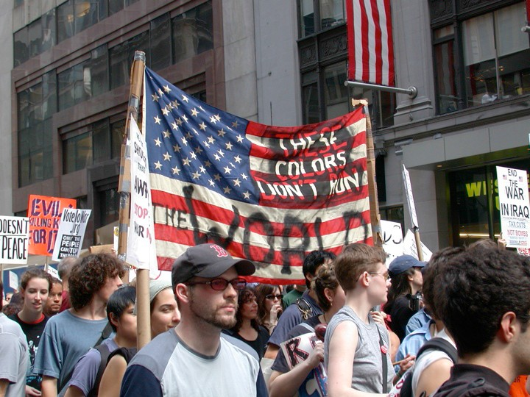
Now, do the same thing for the implicit argument in this slide.
What is the claim (value, belief, perspective, position) being made in this argument?
What is an opposing or alternate view?
How does the argument try persuade its audience?
D.
How effective is this argument in making its claim? Why?

Slide 17

END SHOW

