Slide 2
Gummy Bears in Space
Bivariate Data Analysis and Regression Models

Slide 3
Essential Question
How can we use linear and non-linear regression models for bivariate data to predict the distance of launched objects?

Slide 4
Lesson Objectives
Collect and record bivariate data accurately while manipulating multiple factors.
Create and compare regression models.
Evaluate and test the effectiveness of regression models.

Slide 5
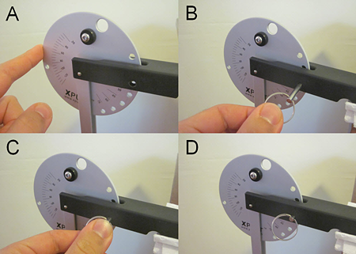
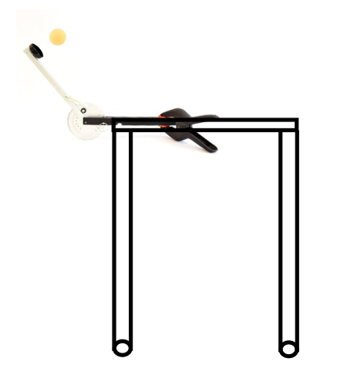
Catapult
Clamp the arm (black part) to the tabletop.
The disk and arm should be hanging off the table and have full range of motion to launch.
The launch angle is set by inserting a metal pin through holes on the aluminum disk that align with the black metal base of the catapult.
Notes:
Clamping the catapult to the table
Adjusting the Launch Angle
Adjusting the pull-back angle

Slide 6
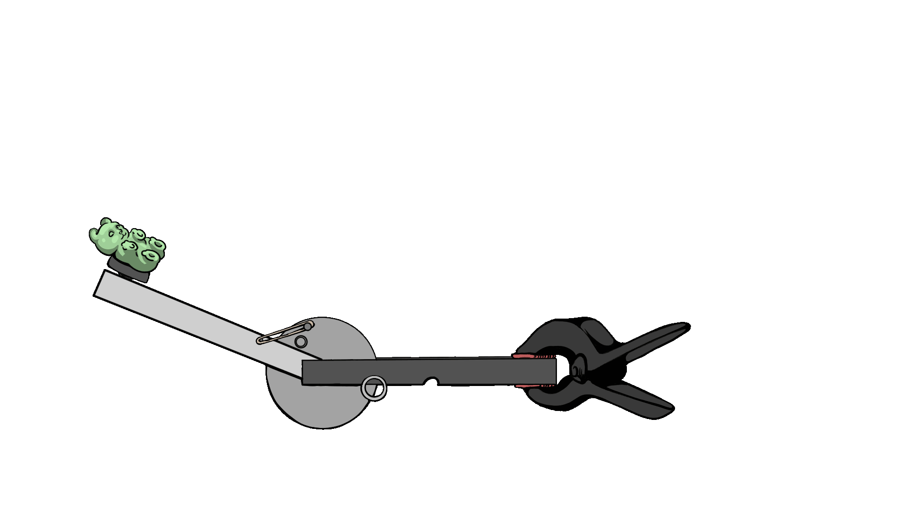
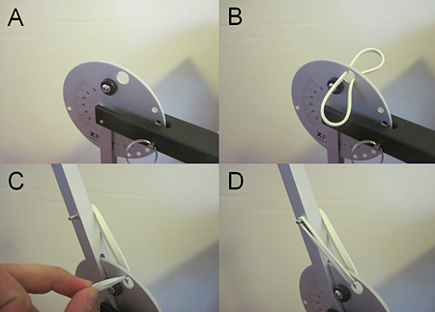
Catapult
The rubber bands go through a hole in the circular aluminum disk and hook onto pins on the launch arm.
Pull back on the arm (the silver part) to add tension to the rubber band to launch.
Notes:
Clamping the catapult to the table
Adjusting the Launch Angle
Adjusting the pull-back angle

Slide 7
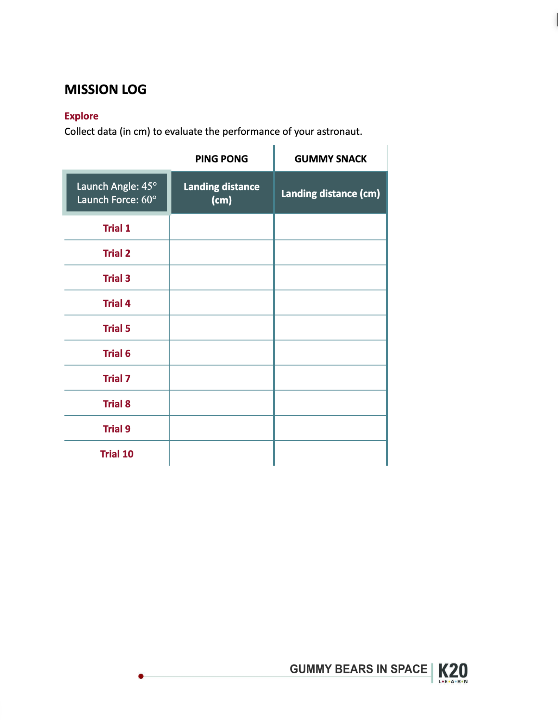
Use the Mission Log handout to record each trial.

Slide 8
Experimental Design
Place a piece of masking tape on the floor directly below the launch point of the catapult.

Slide 9
Experimental Design
Set launch angle to 45 degrees.
Set the pull-back angle to 60 degrees.

Slide 10
Data Collection Roles
Recorder: Record all measurements and data collected on their handout.
Launcher: Operate the Catapult.
Measurer: Measure the landing distance (where it first makes contact with the ground after launch) and retrieve the “astronauts.”
Notes:
Each group should have at least one person in each of the roles listed. Two students can be measurers.

Slide 11
Test Launch
Launch your astronauts and record your landing distances on the Explore portion of your handout.
Measurer should stand near the paper plate in order to be closer to the actual landing distance of the astronauts.

Slide 12
Statistical Analysis
 | Min | Q1 | Med | Q3 | Max | IQR | L-Fence | R-Fence
Ping Pong
Gummy Snack
Complete the 5-Number Summary and modified box-and-whisker plot for each treatment.
Given the information, students can answer questions B-H on the Mission Log handout.

Slide 13
Standard Deviation
Standard deviation is the measure of how spread out the data points are from the mean.
This information helps determine which astronaut is the most consistent in landing distance.
When data points are clustered closer to zero (or to the mean), they are said to have a smaller standard deviation, indicating more consistency in landing distance.
When data points are spread out or further from zero (or the mean), they are said to have a larger standard deviation, indicating greater variability in landing distance.

Slide 14
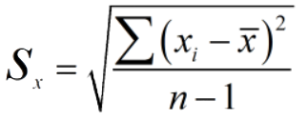
Standard Deviation
Find the mean of the data set.
Subtract the mean from each data point. (deviation)
Square each deviation.
Find the average of those squared deviations.
Take the square root to return the original units.

Slide 15
Experimental Design
Explanatory Variable:
Response Variable:
Fixed Variable:
State the Problem:
Most Consistent Astronaut:

Slide 16
Regression Models
Coefficient of determination -
Measures how well the regression model explains the variation in the data.
The closer is to 1, the better the model fits the data.
Think of as the percentage of the variation in the response variable that can be explained by the explanatory variable.
While a higher suggests a good fit, always check for outliers, residual plots, and context to ensure the model is appropriate.

Slide 17
Find the Optimal Launch and Pull-back Angle
Based on data collected so far, predict a launch angle or pull-back angle that could consistently land your astronaut on the base.
Adjust the pull-back angle while keeping the launch angle consistent.
Goal: Determine 1-2 launch angle and pull-back angle pairs that produce the most accurate and consistent landings.

Slide 18
Data Analysis
Recorder: Input data into data analysis software.
Groups:
Identify the strongest line of regression for the data.
Observe correlations between launch angle, pull-back angle, and distance traveled.

Slide 19
Aggregate Your Findings
Complete part A on the Extend portion of your Mission Log handout.

Slide 20
Using Your Models
Determine which regression model students think would be best to use if their target were 1.75 meters away from their launch point.
You will have 5 minutes to select the regression model and use it to determine the settings for your catapult, such as the pull-back and launch angle.

Slide 21
Using Your Models
Move your paper plate 1.75 meters from your launch point.
Make adjustments to your launch angle and pull-back angle between launches, as necessary.
Fill out Parts B and C after your first successful launch.
Track the number of successful launches in the next 10 attempts in Part D.

