Slide 2
Crown or Curse?
Leadership in Macbeth

Slide 3
Essential Question
How do leadership qualities shape a leader’s impact on history?

Slide 4
Learning Objectives
Evaluate the consequences of leadership qualities as demonstrated by historical figures and characters in Macbeth.
Identify similarities and differences between historical leaders and the characters of Macbeth and Lady Macbeth based on their attributes, actions, and impact.

Slide 5

Honeycomb Harvest
With your partner, organize and arrange the hexagons so that the sides of leader cards and leadership qualities are touching to create a honeycomb effect.
Be prepared to justify and explain your decisions.

Slide 6
Model
Hermione Grainger
Bookish
Beowulf
Consider how these literary characters are paired with their standout qualities.
Courageous
Belle (of The Beauty and the Beast)
Atticus Finch
Independent
Huckleberry Finn
Impartial (Fair)
Jane Eyre

Slide 7

Compare your honeycomb with another group.
Explain and justify why you sorted your cards the way you did.

Slide 8
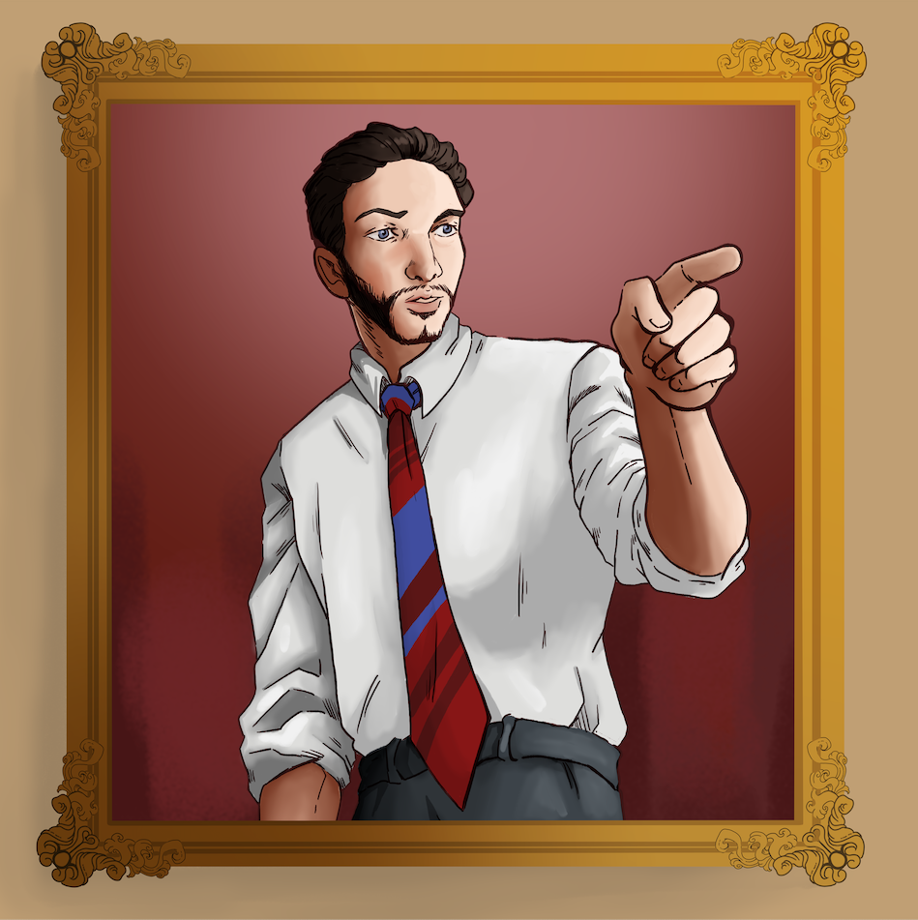
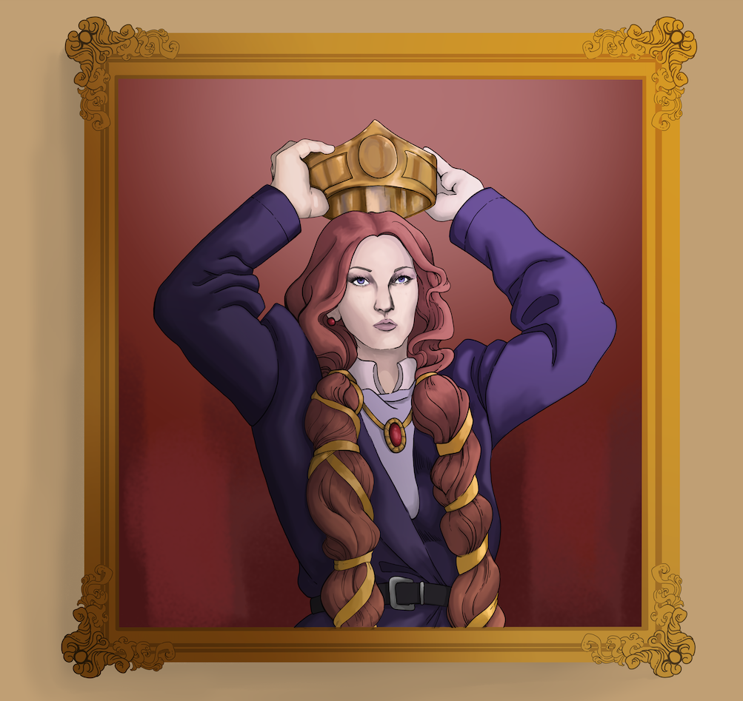


Slide 9

Soliloquy: Lady Macbeth
Notes:
Online: https://www.youtube.com/watch?v=7skhaOegpLA
Start Lady Macbeth (Judi Dench) video at 00:19:49 and end at 00:21:45.
[John Baxter]. (2019, October 17). Macbeth by William Shakespeare [Video]. Youtube.com. https://www.youtube.com/watch?v=7skhaOegpLA

Slide 10
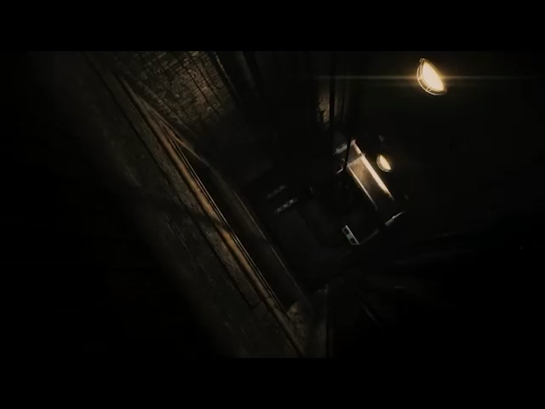
Soliloquy: Lady Macbeth
Notes:
Online video: https://www.youtube.com/watch?v=xUKrxHUCmnU
Begin video at 00:18:01 and end at 00:19:55.
This version of Lady Macbeth’s soliloquy skips lines 19b “What thou wouldst…” to 24b “Hie thee hither”.
[Baris Bayraktar]. (2023, October 24). Great Performances - Macbeth (2010) [Video]. Youtube.com. https://www.youtube.com/watch?v=xUKrxHUCmnU

Slide 11

Categorical Highlighting: Lady Macbeth
Using three different colors, highlight examples in the soliloquy of the following traits:
Moral Courage;
Loyalty;
Decision Making.
When you highlight, note which trait the highlighted text represents and why.

Slide 12

Why-Lighting: Lady Macbeth
Read the soliloquy.
Look for different leadership traits in the language. Highlight examples.
When you highlight, note which trait the highlighted text represents and why.

Slide 13
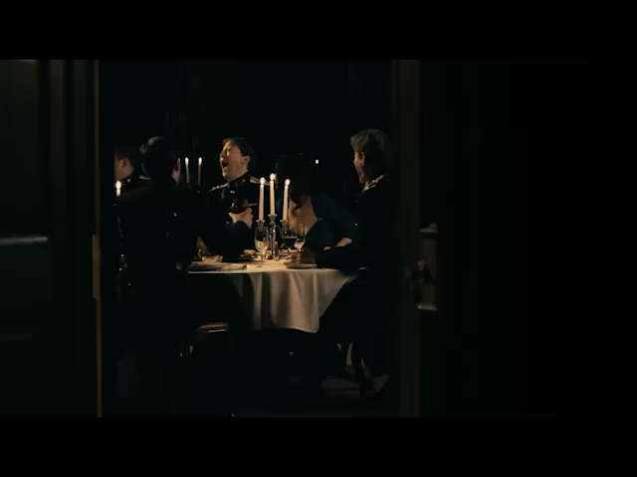
Soliloquy: Macbeth
Notes:
Online video: https://www.youtube.com/watch?v=xUKrxHUCmnU
Begin soliloquy at 00:25:44- and end at 00:28:30.
[Baris Bayraktar]. (2023, October 24). Great Performances - Macbeth (2010) [Video]. Youtube.com. https://www.youtube.com/watch?v=xUKrxHUCmnU

Slide 14
Categorical Highlighting: Macbeth
Using three different colors, highlight examples in the soliloquy of the following traits:
Moral Courage
Loyalty
Decision Making
When you highlight, note which trait the highlighted text represents and why.

Slide 15
Why-Lighting: Macbeth
Read the soliloquy.
Look for different leadership traits in the language. Highlight examples.
When you highlight, notate which traits the highlighted text represents and why.

Slide 16
Soliloquies: Act 1
What do the soliloquies reveal about the leadership traits that both Macbeth and Lady Macbeth possess?

Slide 17
Predict - View - Reflect
Use the “Predict” column of your handout to address these questions:
What insights do you already have regarding the leadership traits of leaders within your communities?
What traits do you value in a leader?
What traits are essential for Oklahoma leaders?

Slide 18

ICAP Video: Arturo Alonso Sandoval
Arturo Alonso Sandoval is a House Representative of Oklahoma District 89 in Oklahoma City.
Notes:
K20 Center. (n.d.). K20 ICAP - Leadership Lessons with State Rep. Arturo Alonso Sandoval. https://www.youtube.com/watch?v=WbCPysqejPw

Slide 19
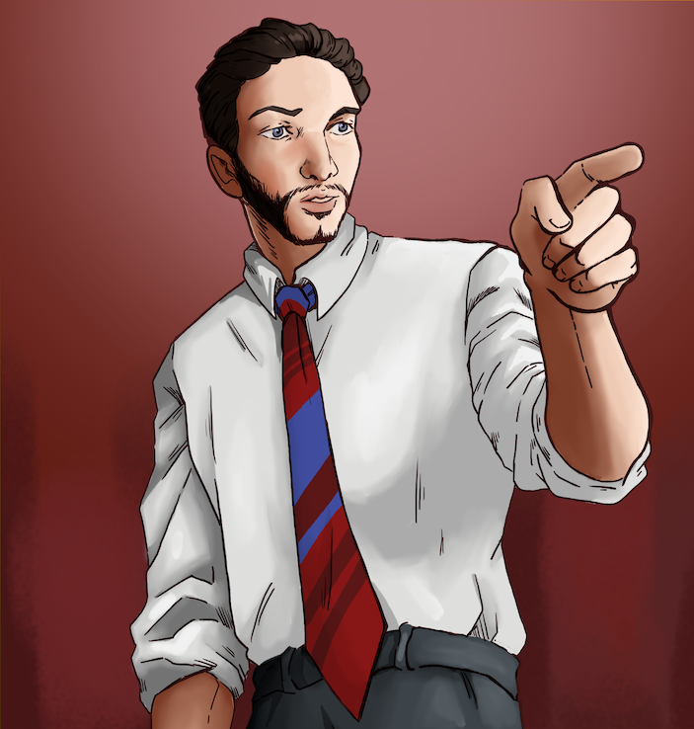
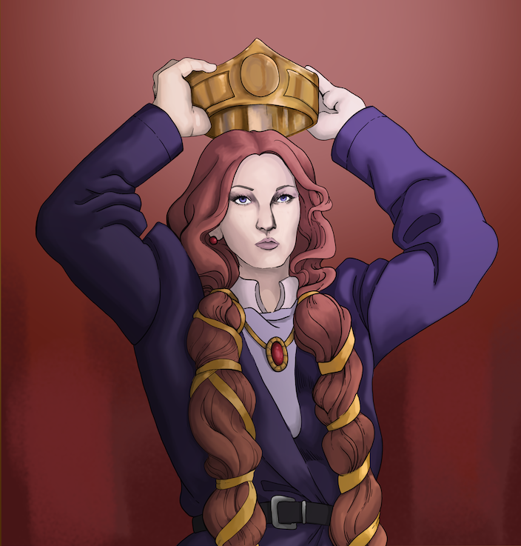
Honeycomb Harvest
Sort your hex cards again. This time
just for Macbeth and Lady Macbeth.

Slide 20

Triangle - Square - Circle
Triangle: Write three points you
have learned about leaders and
leadership traits.
Square: List four ideas that squared
with your thinking.
Circle: Write one question still
circling in your head.

Slide 21
Macbeth or Lady Macbeth?
Choose either Macbeth or Lady Macbeth.
Select a famous historical leader who shares similarities or who contrasts with your chosen character.
  For example, you might compare Macbeth to Julius Caesar
  or Lady Macbeth to Elizabeth I.

Slide 22
Claim - Evidence - Reasoning
C → Claim
Think about an exceptional statement or thesis that you can use to contrast a historical figure with Macbeth or Lady Macbeth.
E → Evidence
Identify proof that supports your claim.
R → Reasoning
Explain and defend how ideas from the text support your claim.

