Slide 1
The Witching World of Word Choice
The Crucible: Rhetorical Situation

Slide 2
Essential Question
How does word choice impact the rhetorical situation?

Slide 3
Learning Objectives
Examine how word choice, mood, and tone are interrelated and presented.
Construct an argument using Claim, Evidence, and Reasoning.

Slide 4
Card Sort
In your small groups
Organize the category cards (bold face) in one row.
Place each quote under the category you think it exemplifies.
Choose only one category for each quote.

Slide 5
Why-Lighting: Text Chat Between Friends
First, read the passage and highlight anything that stands out as important to you.
Read the passage a second time. Write notes about word choice and how it relates to the rhetorical situation.

Slide 6
SPACECAT
Read both the original and modern versions of Act I, Scene 2.
Use the SPACECAT handout to note word choice for each row (speaker, purpose, audience, context, etc.).

Slide 7
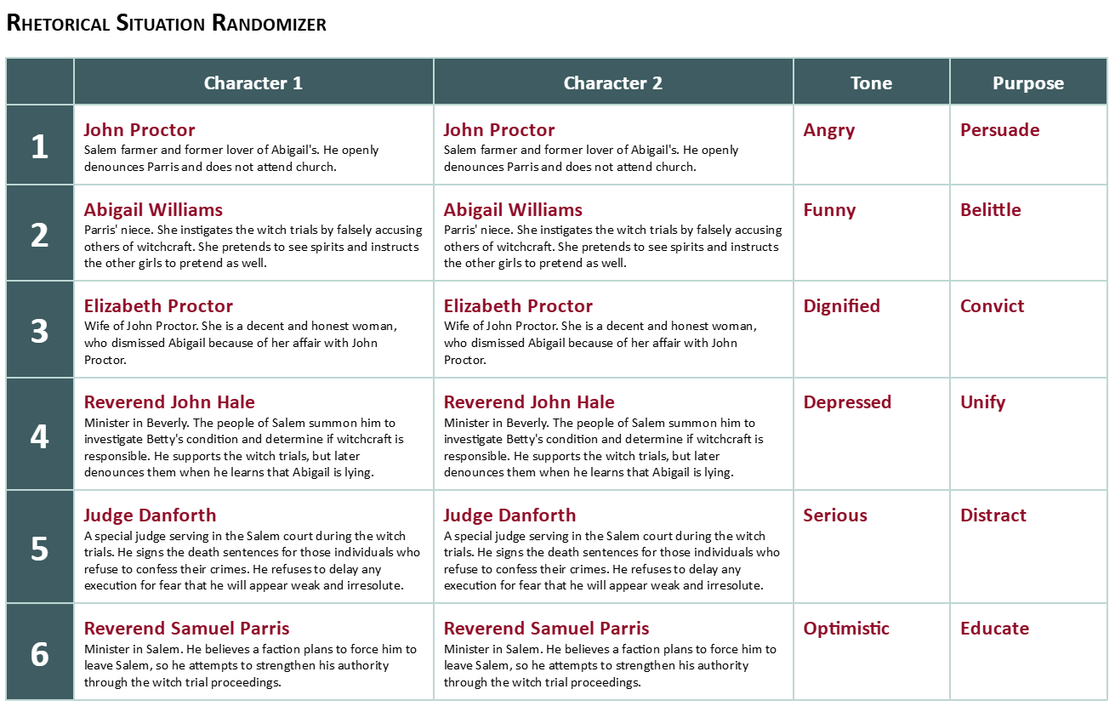

Slide 8
Claim, Evidence, Reasoning, Evidence, Reasoning (CER-ER)
Why does Miller use the devices he does?
How does word choice help achieve the purpose?
What are the characters trying to achieve?
Why does Abigail use the words and tone that she does?

