Slide 2
Adults Don’t Write Essays
Written Communication as an Adult

Slide 3
Essential Question
What is the proper way to communicate in professional situations?

Slide 4
Lesson Objectives
Write to communicate concisely and with a specific purpose and audience in mind.
Create effective written responses to everyday situations that demonstrate the key features of professional and personal communication.

Slide 5

ABC Graffiti
Using each letter of the alphabet, list the ways adults communicate in their daily lives.

Slide 6


Goblin Tools
Type in the URL: goblin.tools.
Select the “Formalizer” option on the top menu.
Type in a sentence from the Informal/Unprofessional column of your handout.
Select “more professional” and then select “convert.”
Write down the AI result in the Formal/Professional column on your handout.
Notes:
K20 Center. (2021, September 21). K20 Center 7 minute timer. [Video]. YouTube. https://www.youtube.com/watch?v=gWwvdLxwV9c&list=PL-aUhEQeaZXLMF3fItNDxiuSkEr0pq0c2&index=10

Slide 7
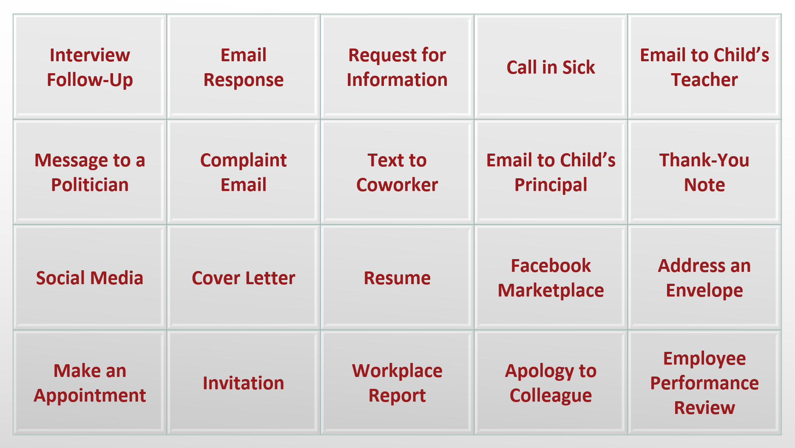

Communication Types Board
Scan or visit: https://k20.ou.edu/types
Notes:
Original Link: https://k20.ekadence.com/public/class/86mYb5/homepage

Slide 8

Stoplight Stickies
Write what questions you may have or things that may confuse you.
Write about a situation that could occur when the rules you found for that communication type might not be appropriate for the situation.
Write why you feel confident about this type of communication

Slide 9

ICAP Video
Notes:
K20 Center. (2025, April 3). K20 ICAP - Writing for Success with Pam Bracken. [Video]. YouTube. https://www.youtube.com/watch?v=UpxpF7yCa5o

Slide 10

Scenario Choice Board
Scan or visit: https://k20.ou.edu/scenarios
Notes:
Original Link: https://k20.ekadence.com/public/class/4LkMrf/homepage

Slide 11

Emoji Reflection
Review the responses for each communication type for your group.
Choose which you like best and which ones best follow the guidelines from before.
Vote on your favorites using your emoji stickers.

