Slide 2
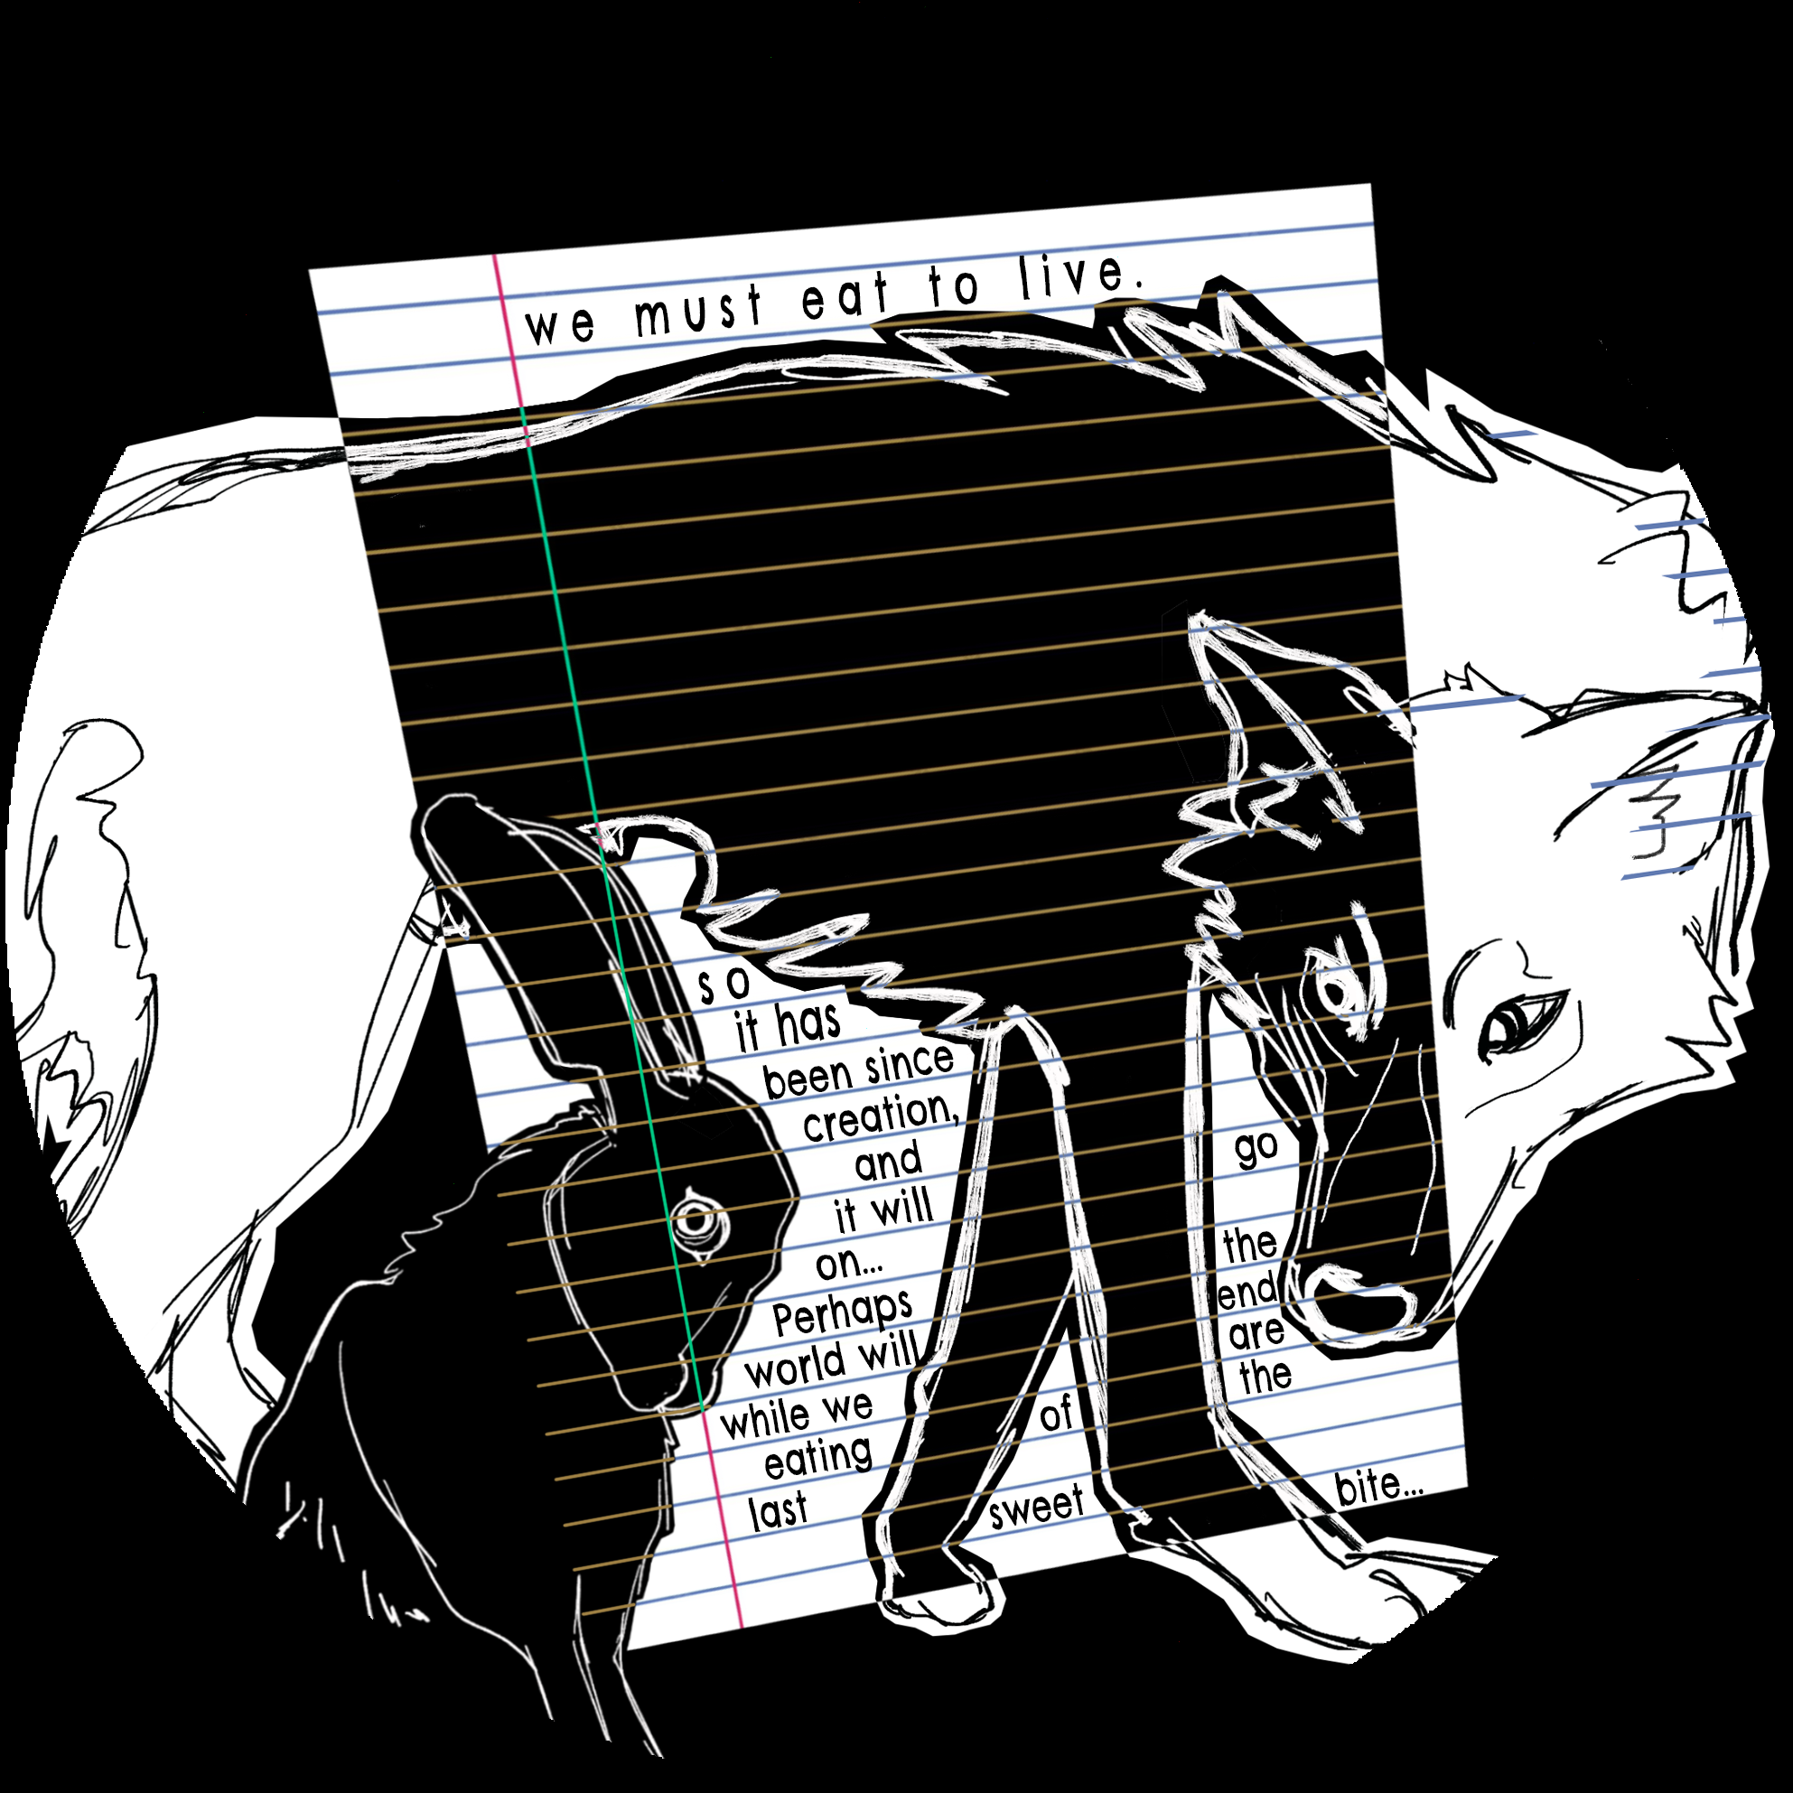
Blackout Poetry: Re-envisioning Writing
Poetry

Slide 3
Essential Question
How can creative constraints, such as blackout poetry, help writers overcome writer’s block and rethink what it means to write creatively?

Slide 4
Learning Objectives
Identify how writers can overcome writer’s block by examining blackout poetry.
Create an original blackout poem by selecting anchor words and arranging them to convey a chosen message or theme.

Slide 5
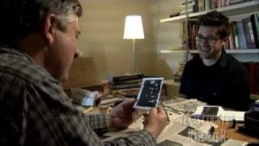
Blackout Poet
Notes:
Texascountryreporter. (2010, February 22). Blackout Poet [Video file]. https://www.youtube.com/watch?v=XqB9kXzJ0UA

Slide 6

Magnetic Statements
Read each statement posted around the classroom.
Move to the statement that most repels you. Discuss why this statement repels you with other students near your chosen poster. Share your common ideas with the class.
Move to the statement that you align with most. Discuss why this statement attracts you with other students near your chosen poster. Share out your common ideas with the class.
Notes:
K20 Center. (n.d.). Magnetic statements. Strategies. https://learn.k20center.ou.edu/strategy/166

Slide 7

I Think/We Think
Individually identify anchor words, themes, and central ideas portrayed in each poem in the “I Think” column.
Discuss your findings with your group and record any common ideas about each poem in the “We Think” column.
Discuss as a class.
Notes:
K20 Center. (n.d.). I think/We think. Strategies. https://learn.k20center.ou.edu/strategy/141

Slide 8
Poetic Elements
Working with your group, identify and record examples of the following poetic elements you may find in each poem. Explain how these elements contribute to the overall themes of the poems.
Tone
Mood
Imagery
Figurative Language (metaphor, simile, personification)

Slide 9
How does the tone, mood, and inclusion of specific figurative language contribute to the overall themes of these poems?

Slide 10

Blackout Poetry
Choose a mentor text to work from.
On a separate piece of paper, write down any words or phrases that relate to a specific theme you want to focus on.
Scan the text and circle any anchor words.
  words that are relevant to your theme or topic.
List your anchor words on your paper and plan out your poem.
Use your marker to black out the text, line by line, except for the words and phrases you have chosen to use in your poem.

Slide 11
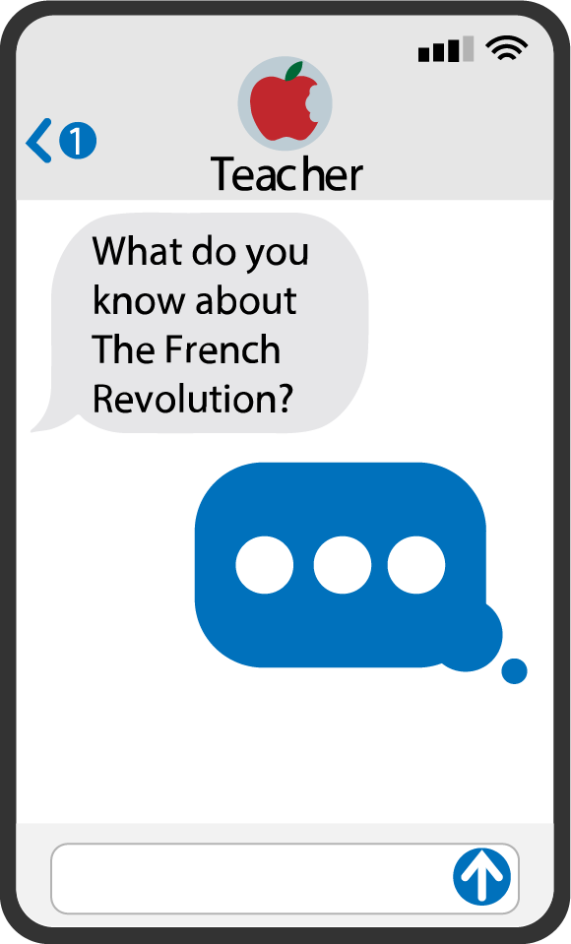

Quick Write
On your paper, spend 5 minutes responding to the following prompt:
Revisit your responses from the magnetic statements activity. Did your creative process change the meaning of what it is to be a poet or writer?
Notes:
K20 Center. (n.d.). Quick write. Strategies. https://learn.k20center.ou.edu/strategy/1127

