Slide 2
Library 101

Slide 3
Essential Question
What skills are necessary for effectively using the Dewey Decimal System to shelve books, and how can these skills be applied in other areas?

Slide 4
Lesson Objectives
Identify the structure and purpose of the Dewey Decimal Classification system.
Categorize books using the Dewey Decimal system.
Analyze the importance of organization in libraries for effective information retrieval.

Slide 5
Caption This!
Notes:
K20 Center. (n.d.). Caption this. Strategies. https://learn.k20center.ou.edu/strategy/82

Slide 6
KWL Chart
What I Know (K):
What do you know about libraries? Shelving books? Take a moment to jot down all you can think of and elaborate.
Notes:
K20 Center. (n.d.). KWHL graphic organizer. Strategies. https://learn.k20center.ou.edu/strategy/127

Slide 7
KWL Chart
What I Want to know (W):
What are some questions do you have about libraries and working in the library?
What are some questions you have about shelving books?

Slide 8
Dewey Decimal System
The Dewey Decimal System is a hierarchical system for classifying library materials.
Created by Melvil Dewey, an American librarian in 1876. He sought to create a systematic method to organize library collections.
The system divides knowledge into ten main categories, each assigned a three-digit number (ex. 200 - Religion).
Each main category can be subdivided into more specific subjects by adding decimal points and additional digits.

Slide 9
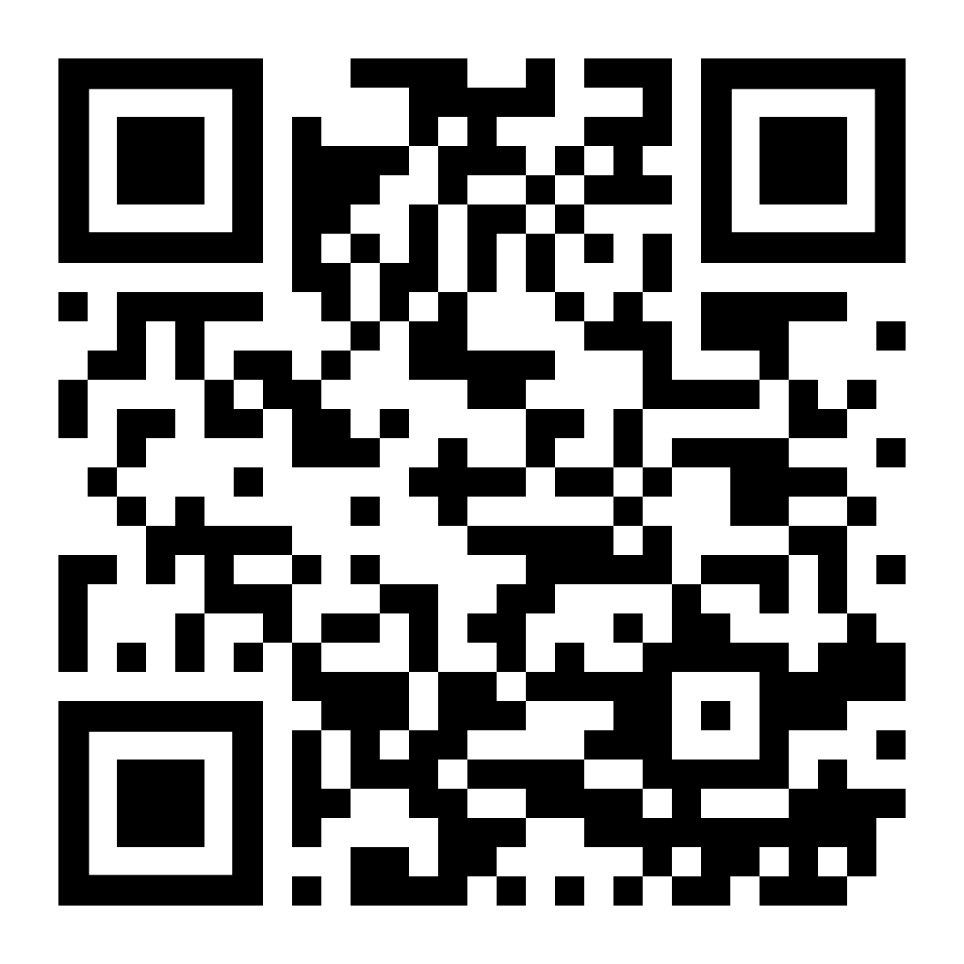
Digital Book Shelving
Go to your LMS to retrieve the link: https://shelver.mrs-lodges-library.com/
Practice Shelving both Fiction and using the Dewey System.

Slide 10
30-Second Expert
Read/watch your article/video. Take notes over what you learn.
Prepare a short (30 sec.) share out in your groups.
Have your group’s “expert” or speaker share out with the class.
Notes:
K20 Center. (n.d.). 30-second expert. Strategies. https://learn.k20center.ou.edu/strategy/1048

Slide 12
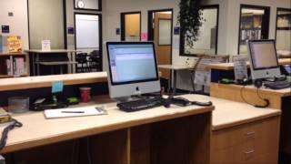

Slide 13
Interview with Nell Johnson

Slide 14
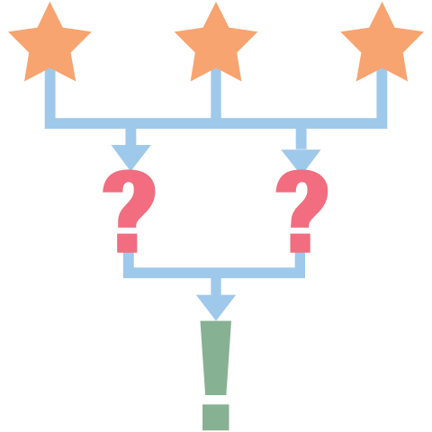
3-2-1
What are three things you learned from the video?
What are two questions you still have?
What is one thing you found interesting?
Notes:
K20 Center. (n.d.). 3-2-1. Strategies. https://learn.k20center.ou.edu/strategy/117

Slide 15
KWL Chart
What I Learned (L)
What did I learn about shelving books and the library sorting systems?

Slide 16
Your Turn
Go to your assigned shelf with your stack of books.
Re-shelf the books accordingly.
Take a picture / have your partner check your work

