Slide 2
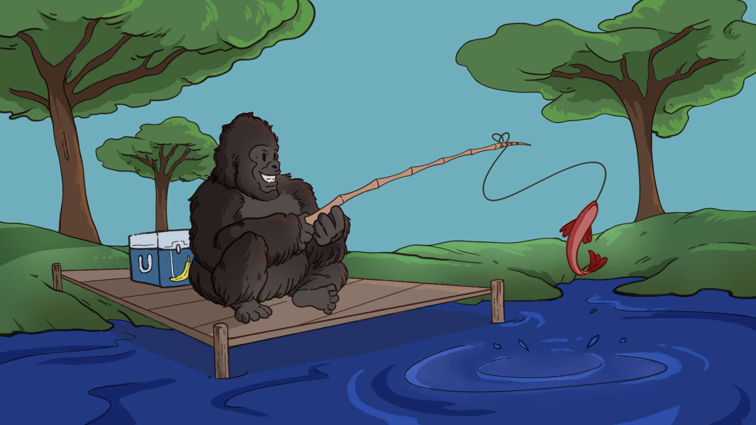
So, Prove it!
Experimental Design in Psychology

Slide 3
Essential Question
How does the scientific method help test ideas about human thought and behavior?

Slide 4
Learning Objectives
To understand terms related to psychological research.
To demonstrate how experimental design tests a hypothesis.
To apply ethical guidelines to experimental design.

Slide 5
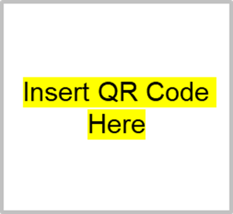
Always, Sometimes or Never True
Scan the QR code that leads to a Google form.
Or type in <insert URL>
Read each statement and mark it: Always, Sometimes, or Never True
Notes:
K20 Center. (n.d.). Always, sometimes, or never true. Strategies. https://learn.k20center.ou.edu/strategy/145

Slide 6
Myths Debunked
7 Widely Believed Myths in Psychology
Notes:
PSYCHSIDE. (2020, August 31). 7 Widely Believed Myths in Psychology You Probably Thought Were True. YouTube. https://youtu.be/rs5cGZp5q1Y?feature=shared

Slide 7
Mapping out Research
Sort parts of an experiment.
With a partner, sort your set of cards onto the “Mapping out Research” map.
The cards are example statements for a fictional experiment.
Note: Some cards are “red herrings” or distractors that contain poorly worded operational definitions. Place these on the fish spaces.
Notes:
K20 Center. (n.d.). Card Sort. Strategies. https://learn.k20center.ou.edu/strategy/147

Slide 8
Mapping Out Research | Answers
Key Term | Example
Research Question | Do pets make you happy?
Hypothesis | People who interact with pets for 2 hours/day score higher on a happiness scale than people who do not interact with pets.
Independent Variable | Interacting with your pet for 2 hours/day.
No Independent Variable | No pets for you!

Slide 9
Mapping Out Research | Answers
Key Term | Example
Dependent Variables | 1. Mean score of 7 on happiness scale. 2. Mean score of 5 on happiness scale.
Control Group | People who don’t interact with pets.
Experimental Group | Pet interactors.
Conclusion | People who have and play with pets regularly are happier than people who do not.

Slide 10
Mapping Out Research | Answers
Red Herrings | Confounding Variables
People with pets are happier. | Pets with different personalities.
Kitty cat named Fluffikins. | More young people in the control group.
Happy folks! | Crazy cat ladies in the experimental group.
Rufus the idiot dog.

Slide 11
Jigsaw
Read your assigned article.
Complete your “Let’s Prove It” handout.
Confirm the details in the same group you read the articles with.
In groups of three, have one person who read each article discuss their findings.
Be prepared to share out for the class after your discussions.
Notes:
K20 Center. (n.d.). Jigsaw. Strategies. https://learn.k20center.ou.edu/strategy/179

Slide 12
What is the IRB?
The Institutional Review Board (IRB) is an administrative body established to protect the rights and welfare of human research subjects. The IRB:
Reviews all research involving human participants at a university, hospital, or other research facility.
Protects the welfare, rights, and privacy of human subjects.
Has the authority to approve, exempt, disapprove, monitor, or modify research activities under its jurisdiction.
Notes:
What is the Institutional Review Board (IRB)? (2024) Division of Research and Innovation. Oregon State University.https://research.oregonstate.edu/ori/irb/what-institutional-review-board-irb
Research. (n.d.). IRB considerations in review of protocols. Fordham University. https://www.fordham.edu/academics/research/institutional-review-board/guidelines-and-procedures/irb-considerations-in-review-of-protocols/

Slide 13
Ethical Principles for Human Research
Informed consent
lets people know what will happen before they agree to it
Protection from harm
includes mental, emotional, physical and social harm
maintains that deception must be used with care
Right to Withdraw
respects autonomy
protects participants if they become uncomfortable
Confidentiality
protects identity and reputation
Debriefing
informs participants what the experiment is about afterwards
Notes:
Curriculum Press 2020 Psychology Factsheets, 2020/21 Series, Issue 1 of 3, September 2020. ISSN: 1351-5136 https://cdn2.assets-servd.host/curriculum-press/production/files/257-Ethical-Guidelines.pdf
Research. (n.d.). IRB considerations in Review of Protocols. Fordham University. https://www.fordham.edu/academics/research/institutional-review-board/guidelines-and-procedures/irb-considerations-in-review-of-protocols/

Slide 14
Digital Posters
Propose your own Psychological Research experiment!
Decide on a psychological concept you wish to explore and what kind of experiment you could conduct.
Complete the “Let’s Prove It” graphic organizer for your proposed experiment.
Choose a poster presentation template from Canva and visually represent the information from your organizers to explain your experiment.
Notes:
K20 Center. (n.d.). Canva. Tech tools. https://learn.k20center.ou.edu/tech-tool/612

Slide 15
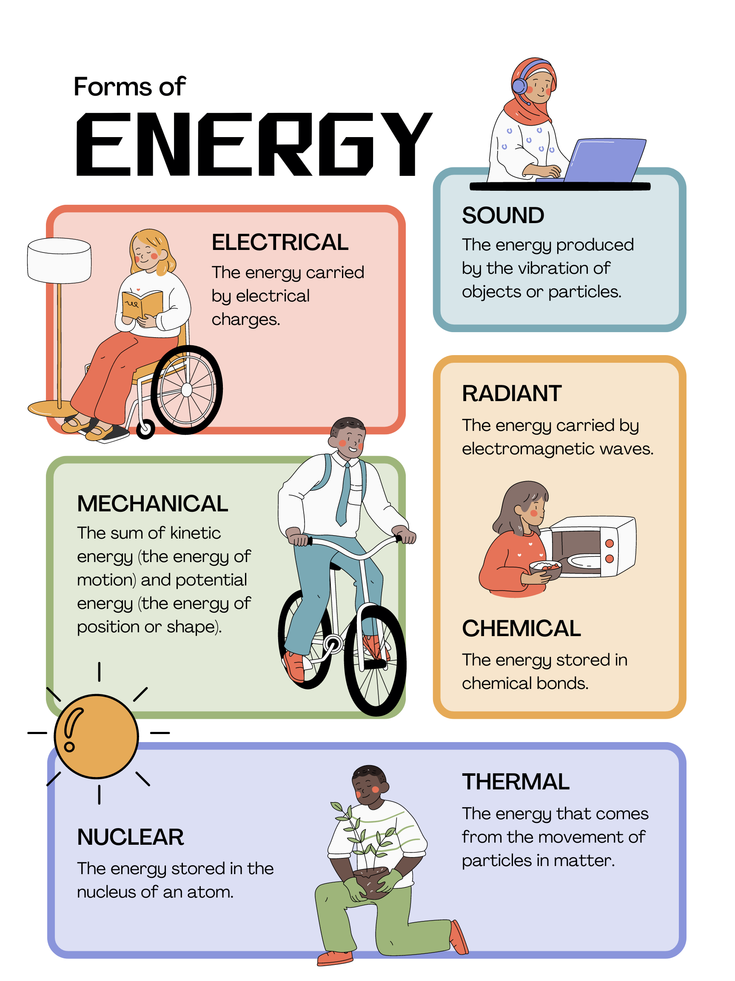
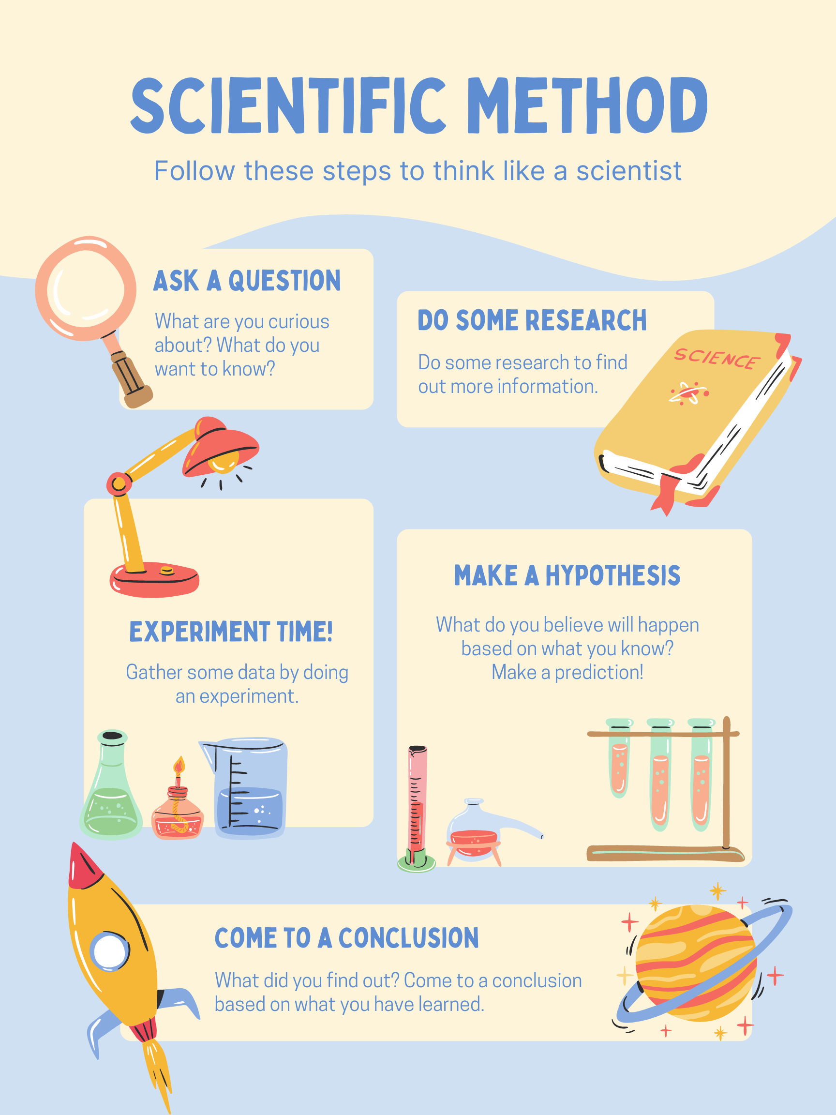
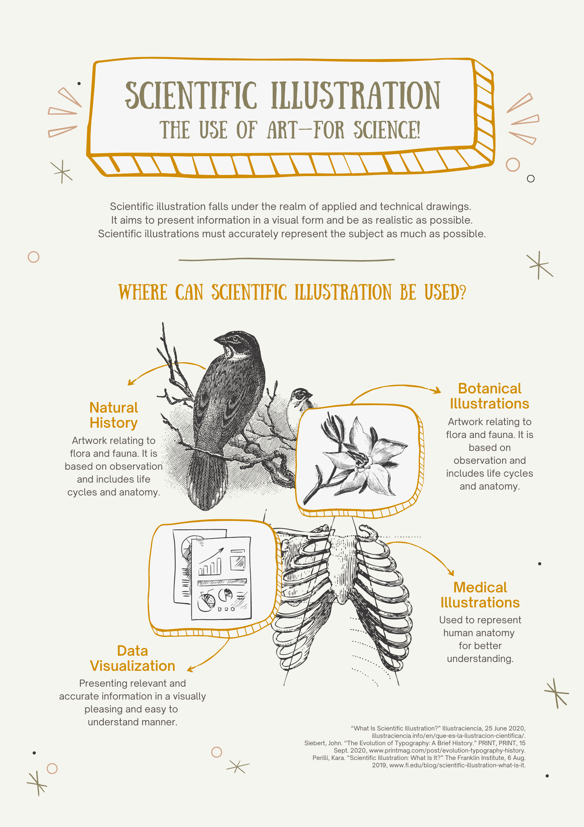
Sample Canva Templates

Slide 16
I Used to Think…But Now I Know
Reflect on what you have learned about psychological research experimental design. Answer the following on a sticky note:
What did I used to think about psychological experiments?
What do I think now?
Notes:
K20 Center. (n.d.). I used to think . . . but now I know. Strategies. https://learn.k20center.ou.edu/strategy/137

