Slide 1

Adulting 101
Researching Life Skills

Slide 2
Essential Question
What are the essential skills needed for independent living/life as an adult?

Slide 3
Learning Objectives
Identify an essential area of independent adult life and explore related skills.
Demonstrate understanding of a particular skill by creating a short, multimodal presentation.

Slide 4


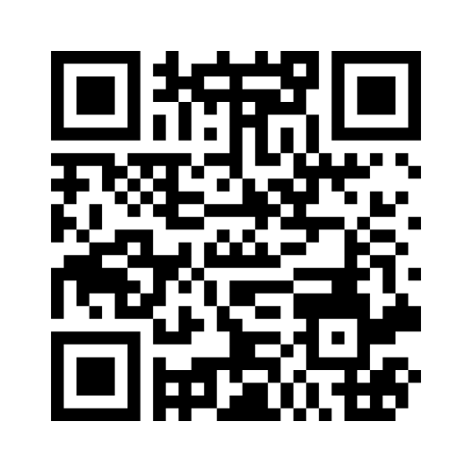
Collaborative Word Cloud
What essential life skills are needed to be a successful adult?
Go to menti.com
Enter this code:
XXXX XXXX
Notes:
Update this page with your Mentimeter access code and QR code.
K20 Center. (n.d.). Collaborative word clouds. Strategies. https://learn.k20center.ou.edu/strategy/103

Slide 5


Wakelet
Using Wakelet, explore three of the life skills you identified in the word cloud.
Complete entries for three categories in your Life Skills Note Catcher.
Go to
tinyurl.com/
k20adulting101

Slide 6

Life Skill Presentation
Select one of the skills that you identified.
Scan the QR code to access a presentation template.
Follow the link to access
the exemplar presentation.
Go to
sampleURL.com
Notes:
Provide the One-Pager Template and the Stress Management handout for students on this page.
Be sure to upload the two handouts to your Google Drive or classroom LMS, and then update the QR code and sample link on this page with your own.

Slide 7

Stress Management
Stress is mental or emotional strain caused by any number of situations, including positive changes. Everyone experiences stress, so having coping mechanisms for stressful times is an important and relevant adult skill.
Stress is normal and manageable.
Notes:
Presentation time: 2 minutes
Start at 2:48 and end at 3:45
LACountyLibrary. (2022, March 30). Adult 101: Stress management for teens and young adults [Video]. YouTube. https://www.youtube.com/watch?v=Yqyntp

Slide 8

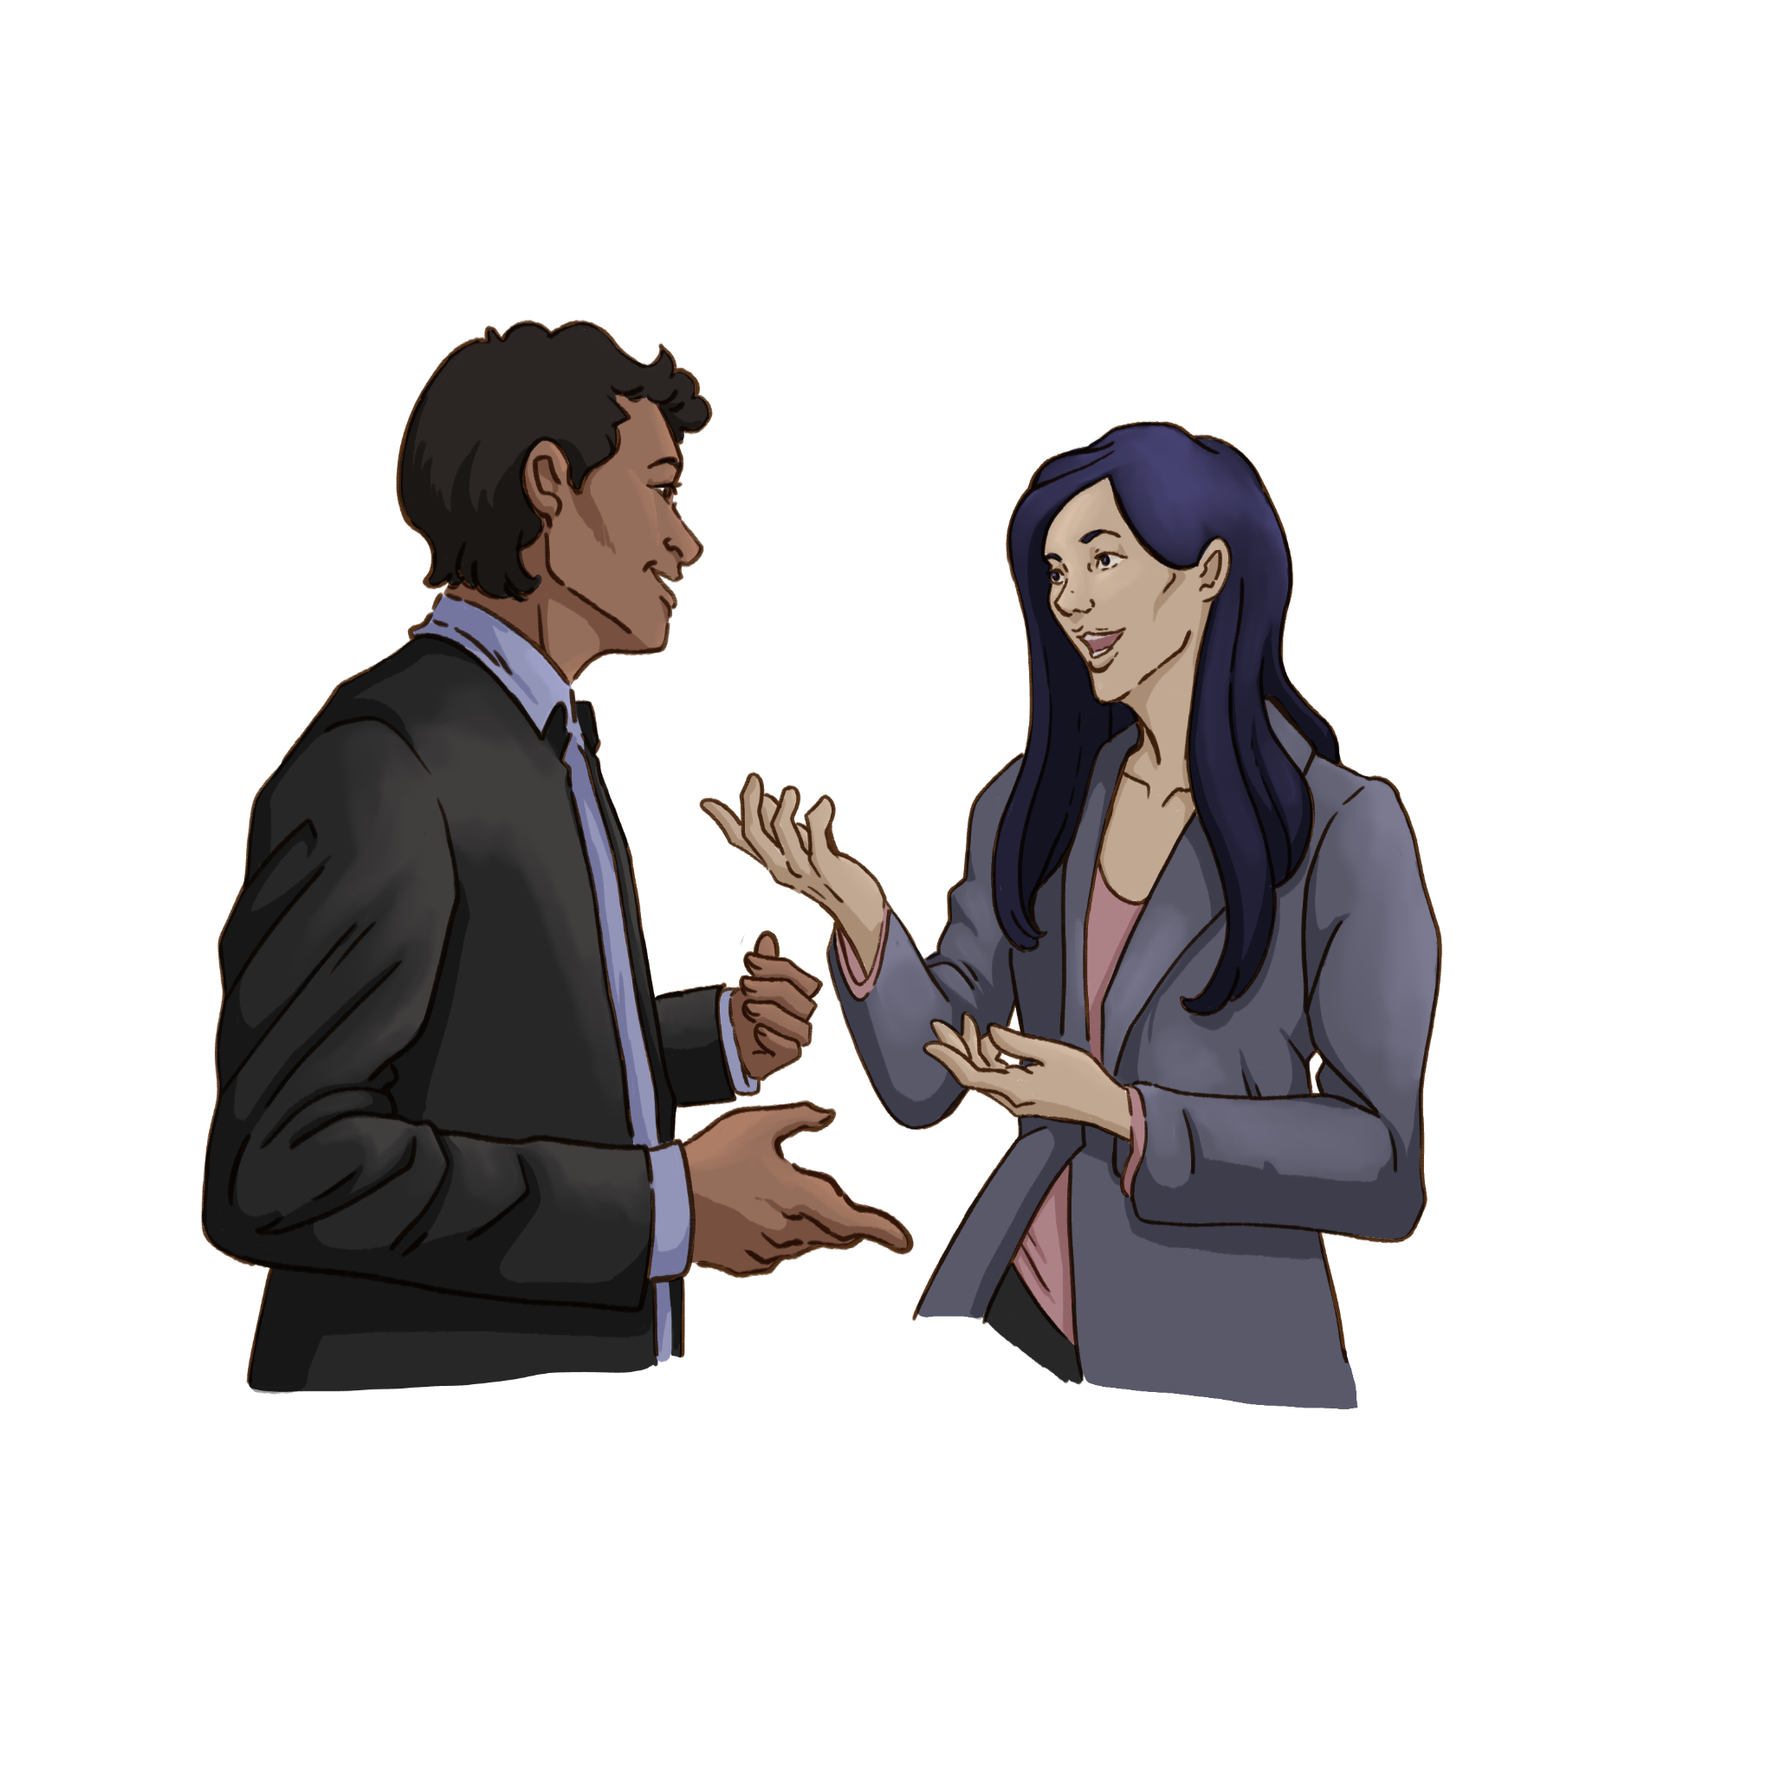
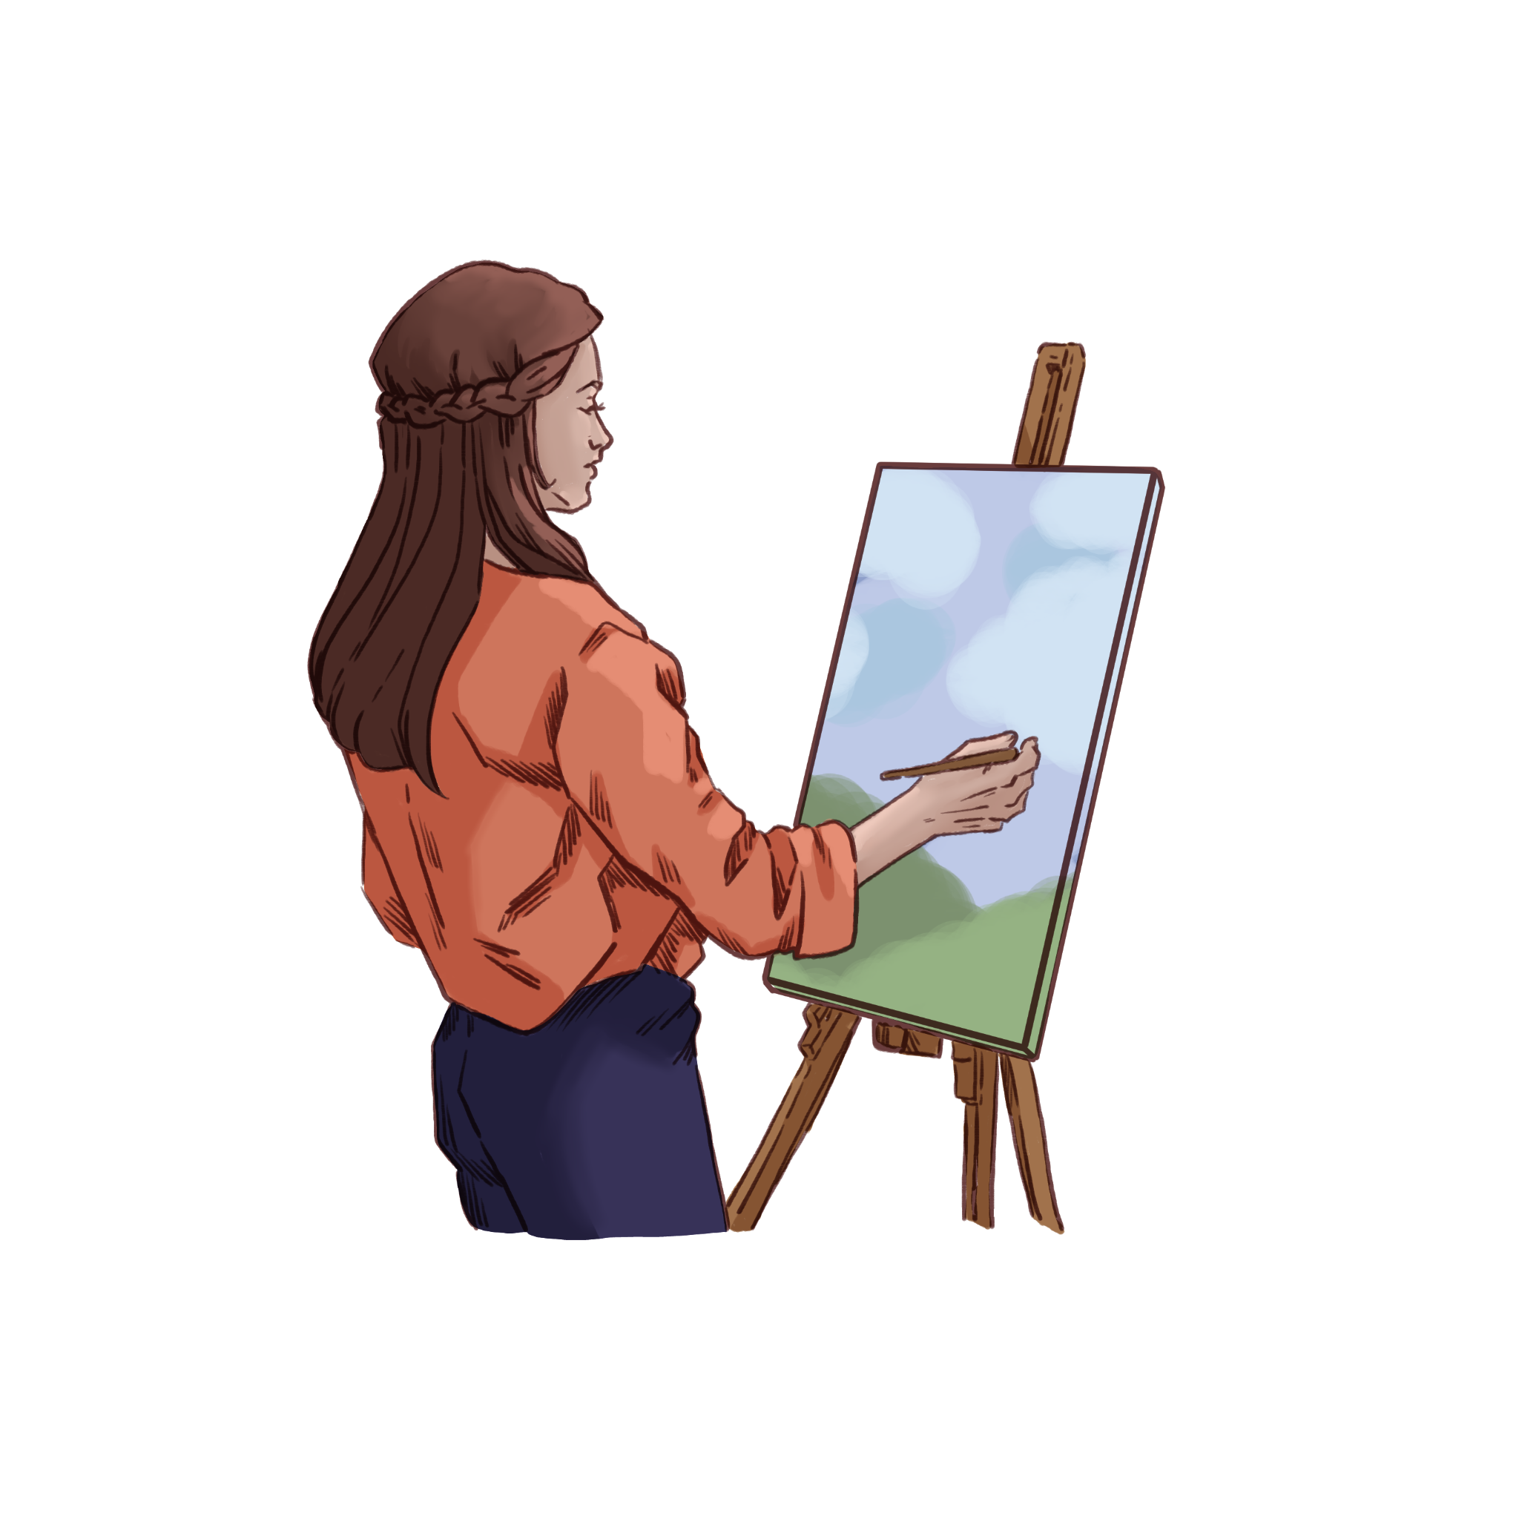
Stress Management Techniques
Try one of these:
Express your feelings:
The four A’s: Avoid, Alter, Adapt, Accept
5-5-5 breathing.
Chair yoga
Do something you enjoy
Connect with friends, family, nature, a pet, etc.
Get enough sleep
Break big projects into smaller pieces.
Notes:
1 minute

Slide 9

What’s the Worst Thing
That Could Happen?
Think of a situation that is stressing you out.
Imagine the worst outcome.
What would you do to prepare for that
situation?
Let’s talk about it.
Listen to this message.
Notes:
Use at your discretion as time allows. The song is 2 minutes long. You can stop it at 1:24 to save time.
Icon made by Freepik from www.flaticon.com. https://www.flaticon.com/free-icons/stress
The Real Bobby McFerrin. (2023, September 21). Don’t Worry Be Happy [Video]. YouTube. https://www.youtube.com/watch?v=JKZ92za6Dbo

Slide 10

Research
Research your topic until you can explain it to a peer.
When you are ready, take turns using the 30-Second Expert strategy with a partner to share what you have learned about your skill so far.
Notes:
K20 Center. (n.d.). 30-second expert. Strategies. https://learn.k20center.ou.edu/strategy/1048

Slide 11

Triangle-Square-Circle
Reflect with your partner:
What are three important things you’ve learned from your research?
What have you learned that “squares” with your thinking?
What’s a question that’s still “circling” in your mind?
Notes:
K20 Center. (n.d.). Triangle-square-circle. Strategies. https://learn.k20center.ou.edu/strategy/65

Slide 12
Presentation Expectations
Rubric
What is Multimodality?
When multiple forms of media are used to present information. This allows learners to make more connections to the topic.
Read the rubric.
Questions about teaching your chosen skill?
Building a QR Code for Works Cited/Resources
Use qrcode-monkey.com to build your QR codes.

Slide 13
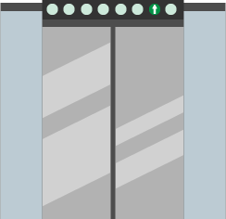
Elevator Speech
Teach your adulting skill to your classmates in 30 seconds.
Explain why it is important to know as an adult.
Any questions?
Notes:
Student presentations will vary in time.
K20 Center. (n.d.). 30-second expert. Strategies. https://learn.k20center.ou.edu/strategy/1048

Slide 14

Gallery Walk
As you listen to each adulting skill presentation, fill in the sections of your Presentations Note Catcher.
All sections must be complete.
Notes:
K20 Center. (n.d.). Gallery walk / carousel. Strategies. https://learn.k20center.ou.edu/strategy/118

Slide 15
Presentations
As you listen to each adulting skill presentation, fill in the sections of your Presentations Note Catcher.
All sections must be complete.

Slide 16

Two Stars and A Wish
What are two common themes you noticed across the skills presentations, and what is one specific action you will take to incorporate these skills into your daily life?
Notes:
K20 Center. (n.d.) Two stars and a wish. Strategies. https://learn.k20center.ou.edu/strategy/83

