Slide 1
Generational Dynamics
Comparing and Contrasting the Generations

Slide 2
Generational Quiz
You will take the “Which Generation Do You Belong To” quiz.
Answer each question with the response that best represents you.
Notes:
K20 Center. (Sep. 21, 2021) K20 Center 5 minute timer [Video]. YouTube. https://www.youtube.com/watch?v=EVS_yYQoLJg

Slide 3
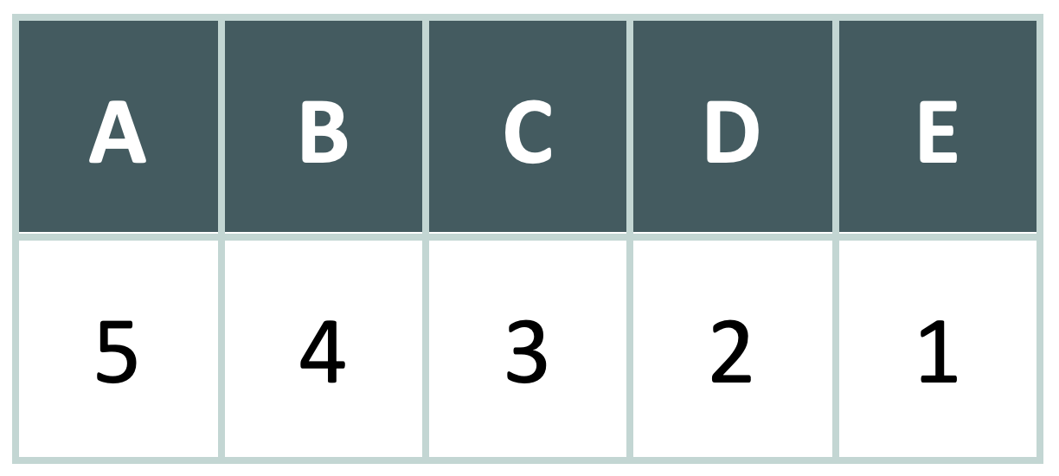
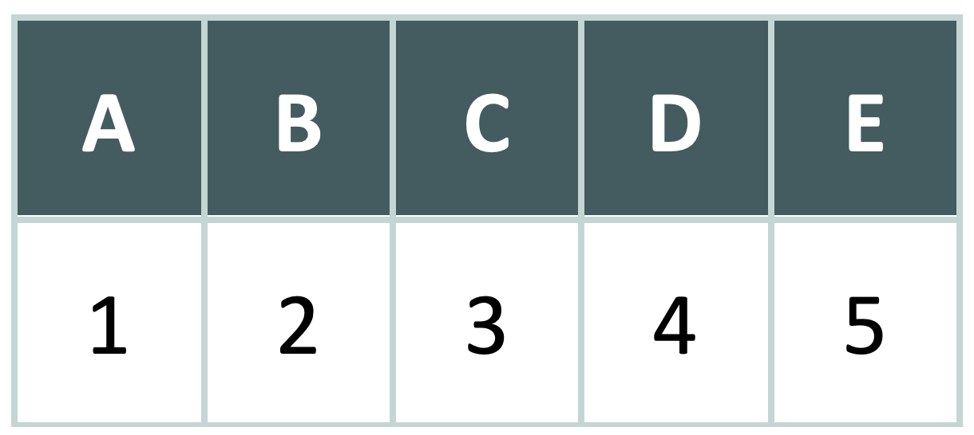
Scoring Your Quiz
Add up all of your answers to see which generational group you belong to!
For all questions
except 2, 6, & 10:
For questions 2, 6, & 10:

Slide 4
Which Generation Do You Belong To?
Silent Generation (1928-1945)
Baby Boomers (1946-1964)
Generation X (1965-1980)
Millennials (1981-1997)
Generation Z (1998-2010)

Slide 5
If your score was 49-60

Slide 6
If your score was 39-48

Slide 7
If your score was 29-38

Slide 8
If your score was 20-28

Slide 9
If your score was 12-19

Slide 10
Essential Question:
How do stereotypes influence our perceptions of different groups?

Slide 11
Lesson Objectives:
Students will examine how social groups are composed of people who share common characteristics, such as interests, beliefs, behaviors, and feelings.
Students will investigate stereotypes associated with different generational groups.

Slide 12
What is a stereotype?
A widely held, fixed, and often oversimplified belief or image about a particular type of person or thing.
Science teachers wear glasses and lab coats.
Cheerleaders are popular.
Social studies teachers are coaches.
The teacher’s pet sits front and center in class.
Notes:
Accessible definition: A stereotype is when people make quick, simple judgments about a whole group without seeing how each person is different. These shortcuts often lead to unfair ideas.
Fancy definition: A stereotype is an oversimplified generalization about a group that disregards individual differences and often perpetuates bias.

Slide 13
Generations Card Sort
In pairs, sort the cards into one of the five categories:
Silent Generation
Baby Boomers
Generation X
Millennials
Generation Z
Once you have completed your sort, compare your reasons with surrounding groups.

Slide 14
Jigsaw Expert Groups
Your group will be assigned one generation to read and become the expert on.
Once you have read, discuss as a group the characteristics of that generation and add that information to your Note Catcher.
As a group, discuss possible stereotypes associated with your generation and add that to your Note Catcher as well.
Be prepared to share your findings.

Slide 15
Jigsaw Share Out
In your new groups, take turns sharing out the findings from your assigned generation.
As each person shares, fill out the corresponding sections of their Note Catcher.

Slide 16
Mood Board Instructions
You will create a visual representation of the generation you were assigned during the quiz. Your board must include the following:
Minimum of 6 images/symbols to represent identities, events, & traits of that generation’s years
Minimum of 4 words or phrases from that time period
A concise "memoir" of your generation to sum it up in just 6 words

Slide 17
Gallery Walk/Parking Lot
Hang your poster around the room and visit posters from other generations.
As you walk around write down on your sticky note any lingering questions you have about any of the generations or things you notice on these mood boards.
Post your sticky note on the designated parking lot.

Slide 18
Exit Ticket
Answer the following prompt using a minimum of 7-9 complete sentences. Be sure to answer all parts of the prompt.
Compare and contrast the stereotypes of two generational groups (e.g., Baby Boomers and Millennials) in terms of work ethic, tech adaptability, social values, and communication styles.
Discuss how these stereotypes shape societal perceptions, whether they are accurate or misleading, and provide examples.
Reflect on how this information influences your view of family, teachers, and colleagues.

