Slide 2
Location, Location, Location
Importance of Location

Slide 3
Essential Question
How does location impact the success of businesses and markets?

Slide 4
Lesson Objectives
Explain the causes and effects of job outsourcing.
Describe how a location can provide advantages or disadvantages for businesses and industries.

Slide 5
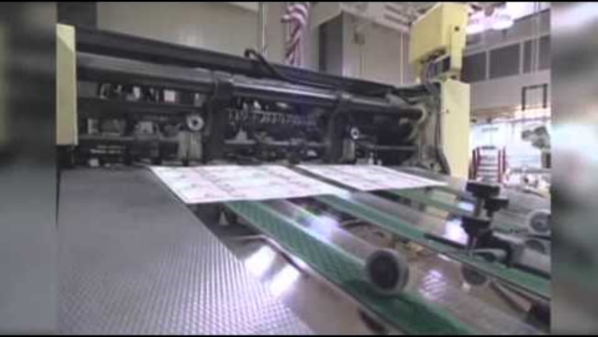
Job Outsourcing
Why It Matters: Outsourcing Jobs
Notes:
Associated Press. (2012, October 24). Why it matters: outsourcing jobs. [Video]. YouTube. https://youtu.be/ymT1W-g_FCY?si=9qZw1xXAeBlNbTpp

Slide 6
Video Reflection
What are some examples of how job outsourcing can impact Americans?
Why are U.S. companies outsourcing jobs?
What are some potential solutions to keep job opportunities in the United States?

Slide 7
Cycling Through the Story of Huffman’s
Pick one color to represent “helpful” things, then highlight the word “helpful” at the top of your handout.
Then pick another color to represent “hurtful” things, then highlight the word “hurtful” at the top of your handout.
Notes:
K20 Center. (n.d.) Categorical Highlighting. Strategies. https://learn.k20center.ou.edu/strategy/192

Slide 8
Cycling Through the Story of Huffman’s
As you read about Huffy bikes, use the corresponding highlighters to highlight things that you believe were “helpful” or “hurtful” to the Huffman Company.
Notes:
K20 Center. (n.d.) Categorical Highlighting. Strategies. https://learn.k20center.ou.edu/strategy/192

Slide 9
Cycling Through the Story of Huffman’s
What do you believe was “helpful” to the Huffman Company and why?
What do you believe was “hurtful” to the Huffman Company and why?
Notes:
K20 Center. (n.d.) Categorical Highlighting. Strategies. https://learn.k20center.ou.edu/strategy/192

Slide 10
Location
How did location play a role in the rise and fall of the Huffman Company?
Be prepared to share your reasoning.

Slide 11
Vocabulary
Infrastructure: the physical structures (like roads & schools) and systems (like laws) that support a country and its economy
Manufacturing: the process of creating new products from raw materials
Markets: a system that determines the price someone will pay in exchange for a product or service, which is influenced by a variety of factors

Slide 12
Examples: Infrastructure
Transportation
Utility Services (Water, Electricity, etc.)
Healthcare
Public Education
Government
Online Networks and Internet Access
Notes:
Good Wife. (2022, February 13). Public Infrastructure. [Illustration]. Noun Project. https://thenounproject.com/icon/public-infrastructure-4617818/

Slide 13
Examples: Manufacturing
Specialized Tools/Equipment
Available Materials
Skilled Laborers
Mass Production
Factories
Notes:
Bahrul Ulum. (2024, July 4). Manufacturing. [Illustration]. Noun Project. https://thenounproject.com/icon/manufacturing-7040244/

Slide 14
Examples: Markets
Labor Costs
Material Costs
Supply
Demand
Scarcity
Notes:
Eucalyp. (2020, May 21). Global Markets. [Illustration]. Noun Project. https://thenounproject.com/icon/global-markets-3685625/

Slide 15
Here’s the Scoop on Braum’s
As you read about the history of the Braum’s Ice Cream and Dairy Store, underline where you see examples of the following:
Infrastructure
Manufacturing
Markets

Slide 16
Netflix’s Binge-Worthy Beginning
As you read about the history of Netflix, think about what is different about this company.
Circle anything you notice that is really different from the Huffy’s and Braum’s companies.

Slide 17
Critical Thinking Cube
Describe: Describe the infrastructure of Netflix.
Apply: What can we do with the information from this lesson?
Compare: Compare the locations of the Huffman, Braum’s, and Netflix companies. How are they similar? different?
Analyze: How did outsourcing impact Netflix?
Synthesize: How are the infrastructure, manufacturing, and/or markets of Netflix like another company you know?
Argue: Is location the most important reason a business succeeds or fails? Justify your answer.
Notes:
K20 Center. (n.d.). Critical Thinking Cube. Strategies. https://learn.k20center.ou.edu/strategy/1583

Slide 18
Cognitive Comics
How does location impact the success of businesses and markets?
Create a 3–6 cell comic strip to answer this question.
Draw a picture and write a caption for each frame/cell.
Write a summary of your creation at the bottom of the page or on another piece of paper.
Notes:
K20 Center. (n.d.) Cognitive comics. Strategies. https://learn.k20center.ou.edu/strategy/198

