Slide 2
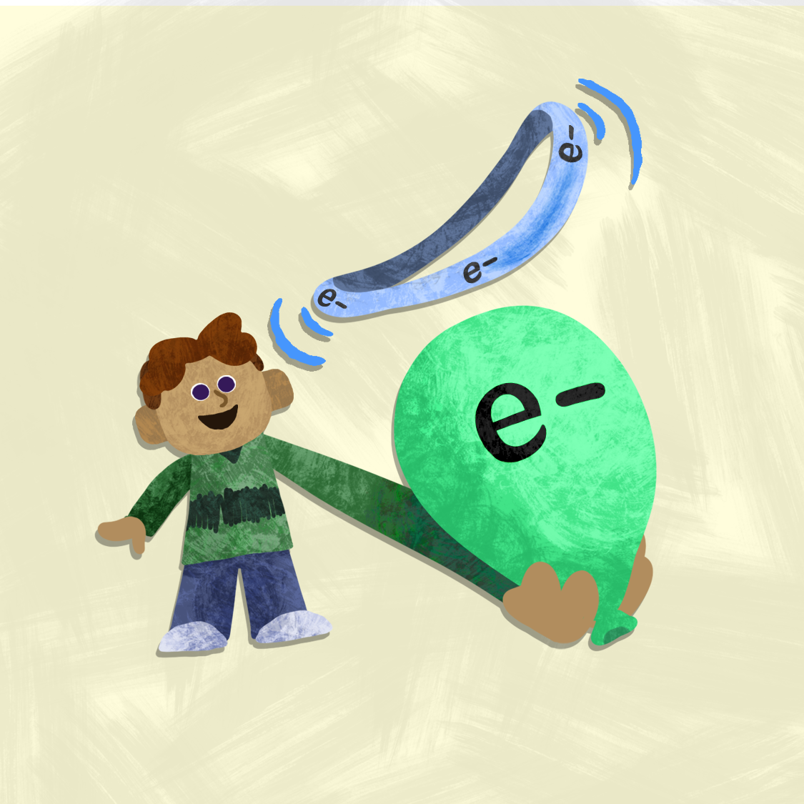
All Charged Up
Electrostatics

Slide 3
Essential Question
How is static charge generated and how do isolated charges separated by a distance relate to force?

Slide 4
Lesson Objectives
Describe how objects become charged and how they attract or repel each other using words like charge, positive, negative, and force.
Use Coulomb’s Law to figure out how strong the push or pull is between charged objects and which way it goes.
Make a diagram, model, or poster to show what happens with static electricity and lightning, and share your ideas with others.

Slide 5

I Notice, I Wonder
As you watch the video on the next slide, write down things that you notice (observations) and things you are wondering about (questions).
Notes:
K20 Center. (n.d.). I notice, I wonder. Strategies. https://learn.k20center.ou.edu/strategy/180

Slide 6
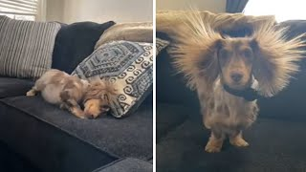
Static electricity makes dog's hair hilariously stand up
Notes:
Rumble Viral. Static Electricity Makes Dog’s Hair Hilariously Stand Up [Video]. YouTube. https://www.youtube.com/watch?v=HXJBi7ZQHIo

Slide 7
I Notice, I Wonder-Discussion
Share with the class something you noticed about in the video.
Share what you might be wondering about after watching the video.
What are some of the common words or phrases we heard in the answers that were shared?
Notes:
K20 Center. (n.d.). I notice, I wonder. Strategies. https://learn.k20center.ou.edu/strategy/180

Slide 8

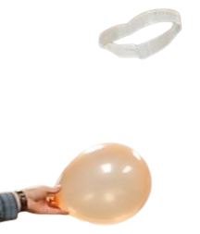
Levitating Ring
You and your group will have 20 minutes to levitate a plastic ring using only a balloon.
Supplies:
  Balloon
  Grocery bag
  Scissors
  Paper towel

Slide 9
Levitating Ring - Discussion
How was the task accomplished?
How was it similar to the video of the dog?
How was it different?
What is the science behind what is happening?

Slide 10

Gist
Think about the video and the activity you just did.
Use some of the vocabulary words to explain what is happening in either the video or the activity.
Notes:
K20 Center. (n.d.). Gist. Strategies. https://learn.k20center.ou.edu/strategy/3289

Slide 11
What is a Charge?
Charge = a property of matter
Two types:
Positive (+) → lack of electrons
Negative (-) → excess electrons
Measured in coulombs (C)
Symbol: q

Slide 12
Where Does Charge Come From?
Charge comes in tiny units
Each electron has:
Charge = e = 1.6 x 10⁻¹⁹ C
Total Charge:
q = ne
n = the number of electrons gained or lost
Notes:
Ask: If an object gains electrons, is n positive or negative?

Slide 13
Charge in Real Life
Friction can transfer electrons
Examples:
Blanket gains electrons → negative
Dog loses electrons → positive
What must happen to the total charge in the system?

Slide 14
Charge is Conserved
Charge cannot be created or destroyed
It can only be transferred
If one object gains electrons, another must lose them
The system must stay balanced

Slide 15
Law of Electric Forces
Opposites attract ( + and -)
Likes repel ( +/+ or -/-)
Think:
Push a part = repel
Pull together = attract
Attract
Repel
Notes:
https://youtu.be/Zyz4kgCZMu0?si=A0ptgxXKCB84h5wS

Slide 16
Introducing Coulomb’s Law
Coulomb’s Law: The electrical force between two charges is directly related to the size of the charges and inversely proportional to the distance between the charges.
Electric Force depends on:
Size of the charges
Distance between them

Slide 17
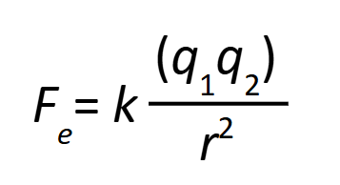
Coulomb’s Law Equation
F_{e} = electric force
q₁, q₂ = charges
r = distance
k = constant
Notes:
You will need to explain the equation in terms of direct and inverse relationships. For example if charge is tripled on each object then the force increases by 9. If the distance is quadrupled then the force decreases by 16. If the distance is reduced by one third then the force increases by a factor of 9.

Slide 18
What the Equation Means
Direct Relationship
Bigger charge → Stronger Force

Slide 19
What the Equation Means
Inverse Relationship
Greater distance → Weaker Force

Slide 20
Reasoning Through Changes
If charge doubles → force increases
If charge triples → force increases A LOT
If distance doubles → force decreases
If distance quadruples → force decreases A LOT
Which matters more: distance or charge? Why?

Slide 21
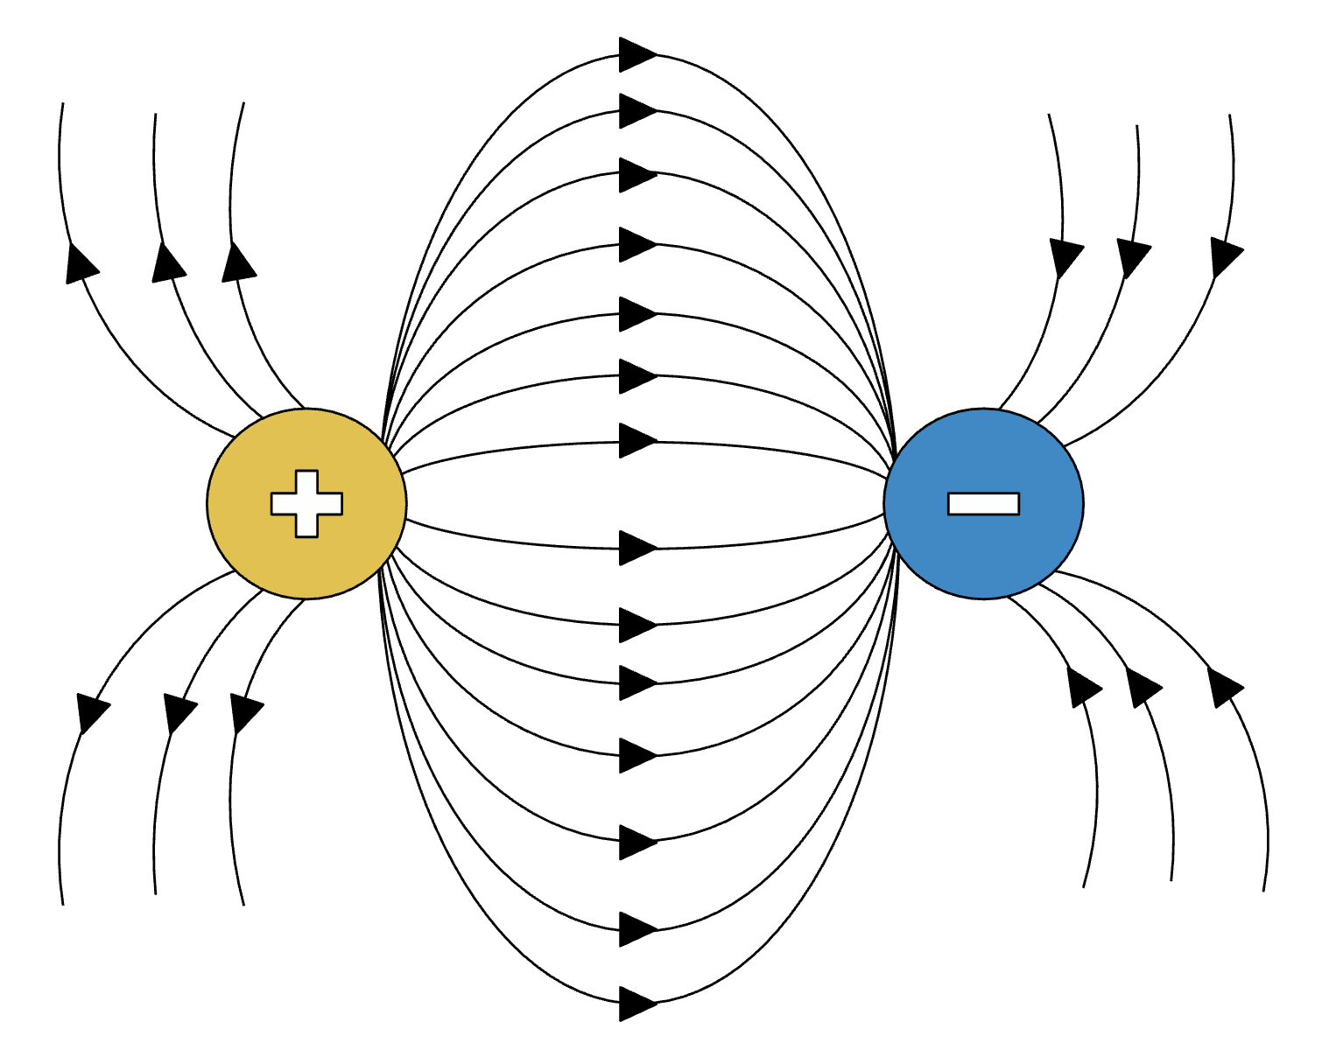
Connecting to Energy
Electric forces create fields
Fields store energy
When objects move:
Energy is transferred
Energy is conserved
Notes:
https://www.sciencefacts.net/electric-field-vs-magnetic-field.html
These lines represent the electric field. The energy isn’t just in the objects, it exists in the space between them. When the objects move, that stored energy changes.

Slide 22
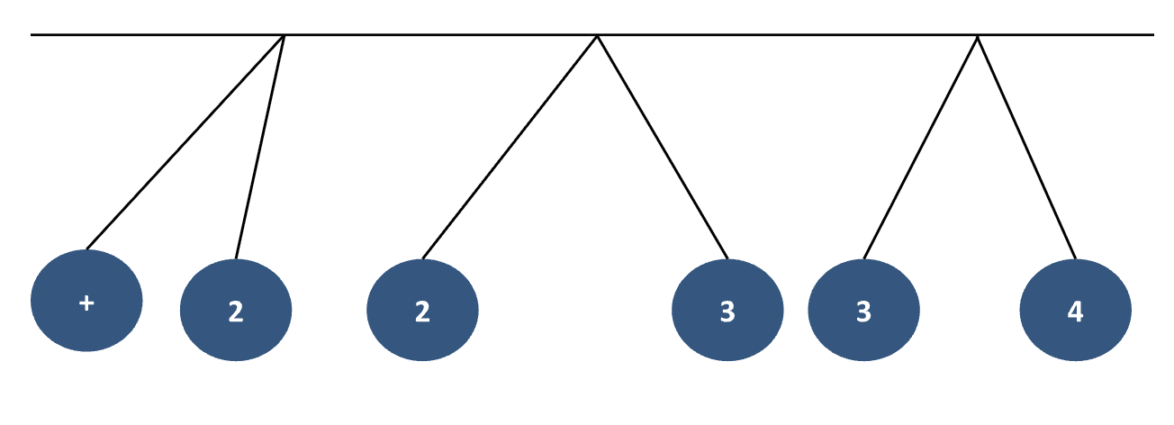
Practice Problems
In your groups work on the practice problems.
Even if you are unsure how to solve it, try!

Slide 23

Research Time
In your small group research how lightning works
On your poster you must include:
  Clear and concise answer
  Drawings or Diagrams with labels
  Vocabulary from the lesson

Slide 24

Gallery Walk
Hang your groups poster on the wall around the room.
Walk around the room and visit each poster from the other groups.
Use a sticky note to leave a question about their research that can improve their information.

Slide 25
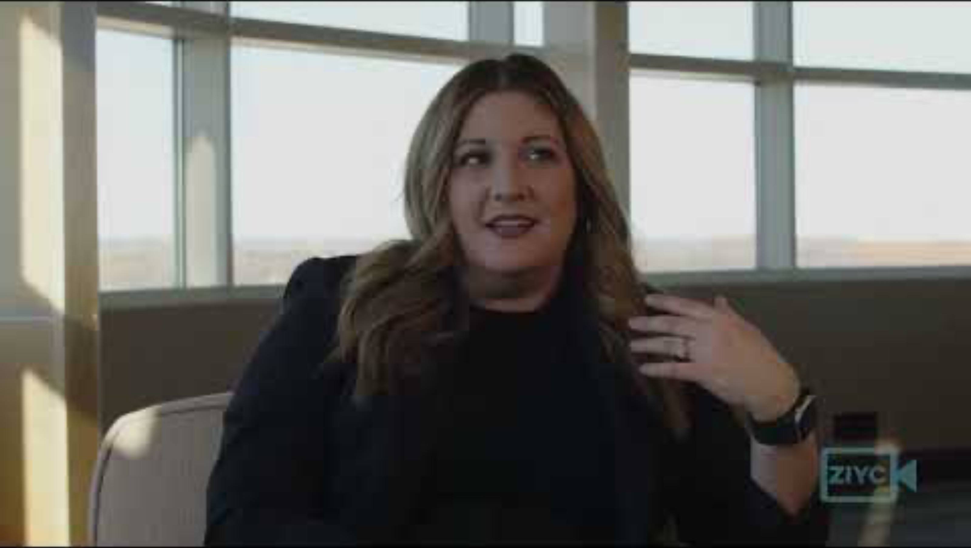
Career-Focused – Climatologist with Monica Maddox
Notes:
K20 Center. (2026, May 11). Career-focused - climatologist with Monica Maddox. YouTube. https://www.youtube.com/watch?v=Am10w_ksBQg

Slide 26
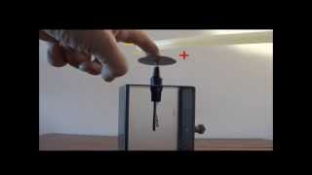
Electroscope Demo Science Library

Slide 27

What’s Happening!?
Based on what you have learned so far, explain what is happening in the video and why.
Share your response with your partner.
Discuss with the whole class your ideas.
Notes:
K20 Center. (n.d.). Think-pair-share. Strategies. https://learn.k20center.ou.edu/strategy/139

