Slide 2
Photo Slides
Match each photo to a statement in the U.S. Constitution that supports the activity.

Slide 3
Photo 1
ArtisticOperations/411 Images. (2012, May 12). United States of America 2886966. Retrieved from https://www.flickr.com/photos/billmorrow/5820650315/in/photostream/

Slide 4
Photo 2
Allison, K. (2017, Sept. 24). Washington Redskins players kneeling before the game with the Oakland Raiders. Retrieved from https://en.wikipedia.org/wiki/U.S._national_anthem_protests_(2016%E2%80%93present)#/media/File:Washington_Redskins_National_Anthem_Kneeling_(37301887651).jpg

Slide 5
Photo 3
Morrow, B. (2011, June 10). Proud new United States citizen. Retrieved from https://www.flickr.com/photos/billmorrow/5820650315/in/photostream/

Slide 6
Photo 4
Pixabay user 6151189 (2016, Nov. 16). Country church [Pixabay image]. Retrieved from https://pixabay.com/en/country-church-scenery-trees-autumn-2683279/

Slide 7
Photo 5
Carter, P. (2013, April 6). Pixabay image. Retrieved from https://pixabay.com/en/girl-gun-shooting-hunting-female-605710/

Slide 8
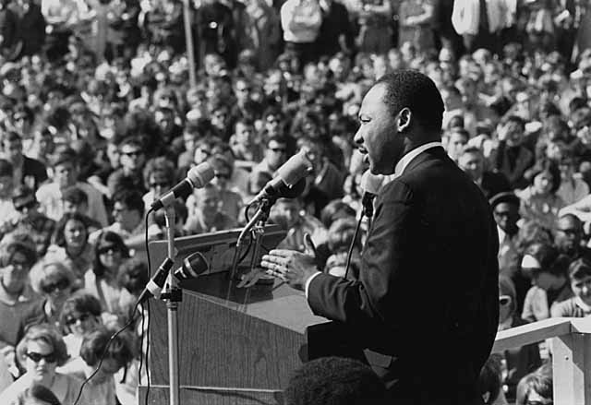
Photo 6
Minnesota Historical Society. (1967, April 27). Martin Luther King, Jr., speaking against the Vietnam War, St. Paul Campus, University of Minnesota. Retrieved from https://www.flickr.com/photos/minnesotahistoricalsociety/5355384180/sizes/o/in/photostream/

Slide 9
Photo 7
United Nations. (2013, May 7). World Press Freedom Day, 3 May 2013 [Live Windows Project – ECV Atlantique, Nantes] [Video file]. Retrieved from https://www.youtube.com/watch?v=UWmXiZT9-Dc

Slide 10
Photo 8
The All-Nite Images. (2015, April 29). NYC Rise Up and #ShutItDown for Baltimore. Retrieved from https://commons.wikimedia.org/wiki/File:NYC_Rise_Up_and_-ShutItDown_for_Baltimore_(17317585865).jpg

Slide 11
Photo 9
Feller, P. (2017, Oct. 19).Jury Box, Courtroom, Jackson County Courthouse, Edna, Texas 1710191500bw. Retrieved from https://www.flickr.com/photos/nakrnsm/37626291050

Slide 12
Photo 10
Skidmore, G. (2010, Nov. 2). United States Senate candidate Rand Paul voting on election day in Bowling Green, Kentucky. Retrieved https://www.flickr.com/photos/gageskidmore/5140365242

