Slide 2
VOTING RIGHTS IN AMERICA
US History Lesson

Slide 3
Circle Map Activity
On a piece of notebook paper, draw three circles and draw a rectangular frame around the circles. In the center, write the words, “Voting Rights”.
Voting Rights

Slide 4
Circle Map activity
As you watch the following video, jot down notes in the NEXT inner circle.
Write what you learn in the video.
Voting Rights

Slide 5
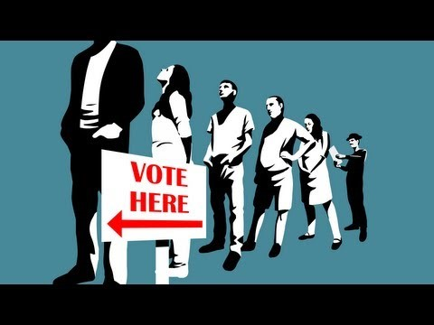
Video
The Fight for the Right to Vote in the United States

Slide 6
Circle Map Activity
Given the struggle for voting rights in the U.S., why do so few citizens exercise their right to vote?
Write down 3 statements inside the rectangular frame.
Voting Rights

Slide 7
Group Investigation
Read one of the documents
Answer the questions about your document on the Document Analysis graphic organizer.
Share what you learned with the rest of the group.
Fill in what is shared with you for the other documents.

Slide 8
Should Ex-Convicts Be Allowed To Vote?
I used to think….
But now I know….

Slide 9
How Engaged are Americans in Voting?
With your new group, create a 10 question survey to poll people in our community about their level of involvement in voting.
What questions would be important to ask?

