Slide 2
Meat Your Match: Dialogue Skills with a Twist
Dialogue Writing

Slide 3
Learning Objectives
Recognize dialogue that uses correct punctuation.
Create dialogue that is essential to the plot of a narrative.
Notes:
Read aloud

Slide 4
Essential Questions
How does dialogue impact the plot of a narrative?
Notes:
Read aloud

Slide 5
Commit and Toss
What is your favorite quote from a fictional character?
Write that quote on your piece of paper.
Crumple up your paper and toss it across the room.
Notes:
K20 Center. (n.d.). Commit and toss. Strategies. Retrieved from https://learn.k20center.ou.edu/strategy/119

Slide 6
Need Some Ideas for a Quote
"Never forget what you are, for surely the world will not. Make it your strength. Then it can never be your weakness."
-Tyrion, Game of Thrones by George R.R. Martin
"My thoughts are stars I cannot fathom into constellations."
-Augustus Waters, The Fault in Our Stars by John Green
"Words are, in my not-so-humble opinion, our most inexhaustible source of magic."
-Albus Dumbledore, Harry Potter and the Deathly Hallows by J.K. Rowling
"We accept the love we think we deserve."
-Charlie, The Perks of Being a Wallflower by Stephen Chbosky
"To die would be an awfully big adventure."
-Peter, Peter Pan by J.M. Barrie
"Don’t let the hard days win."
-Aelin Ashryver Galathynius, Throne of Glass series by Sarah J. Maas

Slide 7
Commit and Toss
4. Pick up a piece of paper that is not yours.
5. Read your chosen quote.
6. What makes these quotes memorable?
Notes:
K20 Center. (n.d.). Commit and toss. Strategies. Retrieved from https://learn.k20center.ou.edu/strategy/119

Slide 8
Sentence Scramble
Each set of cards contains two quotes, two sets of quotation marks, two commas, two periods, and either the words “he said” or “she said.”
Put these cards in the order that you believe is grammatically correct.
Notes:
K20 Center. (n.d.). Sentence Scramble. Strategies. https://learn.k20center.ou.edu/strategy/4073

Slide 9
Sentence Scramble - Answers
Sentence Number | Correctly Punctuated Sentence
1 | “So who made the machines? That’s who we want to contact,” he said.
2 | He asked, “So…what does the thinking?”
3 | “I was hoping you would say that,” she said.
4 | “They always come around,” she said.
5 | “Oh, there is a brain all right,” he said.
Notes:
K20 Center. (n.d.). Sentence Scramble. Strategies. https://learn.k20center.ou.edu/strategy/4073

Slide 10
Sentence Scramble - Answers
Sentence Number | Correctly Punctuated Sentence
6 | “First it wants to talk to us,” she said.
7 | “There’s no doubt about it,” he said.
8 | She asked, “You’re not understanding, are you?”
9 | “The meat is the whole deal,” he said.
10 | “This is altogether too much,” she said.
Notes:
K20 Center. (n.d.). Sentence Scramble. Strategies. https://learn.k20center.ou.edu/strategy/4073

Slide 11
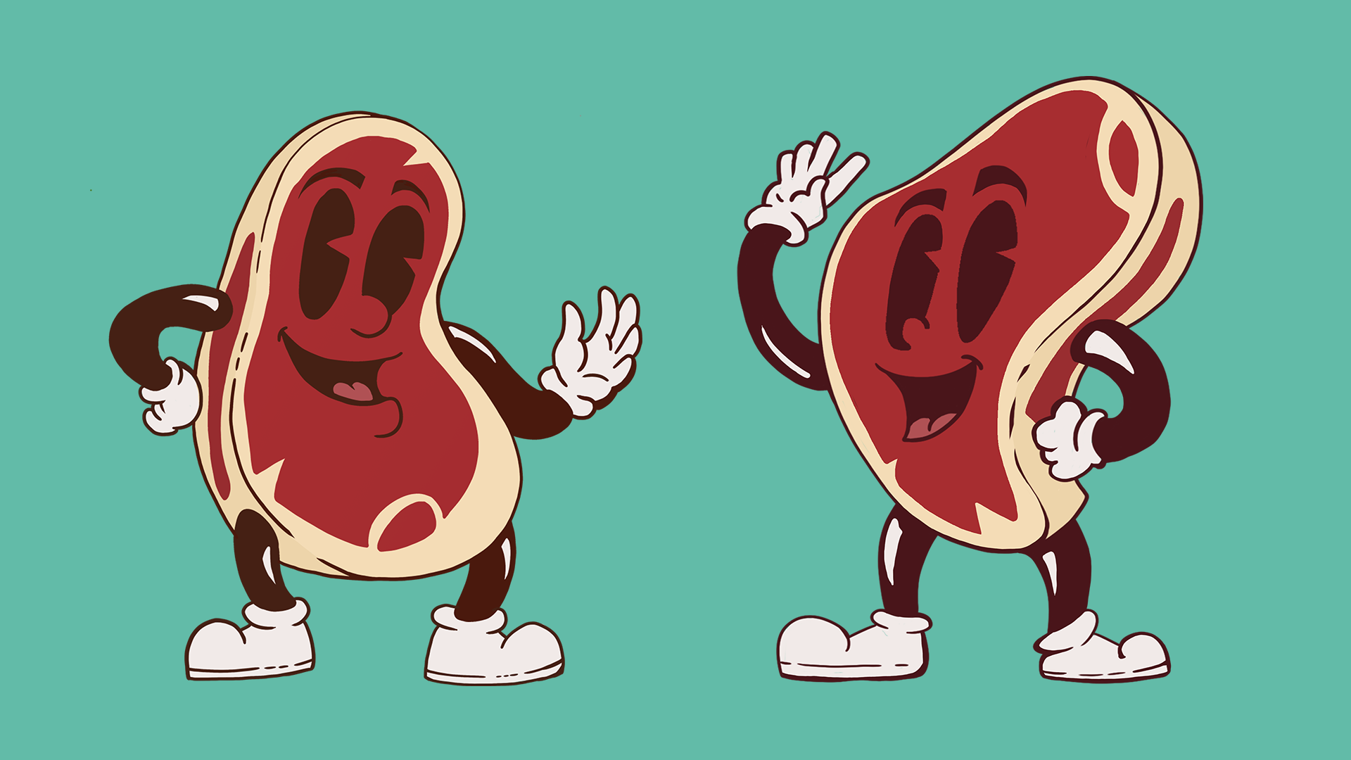
“They’re Made Out of Meat”
About the story
Written in 1990.
One of Bisson’s most famous short stories.
As you read pay close attention to the structure of how the story is written.

Slide 12
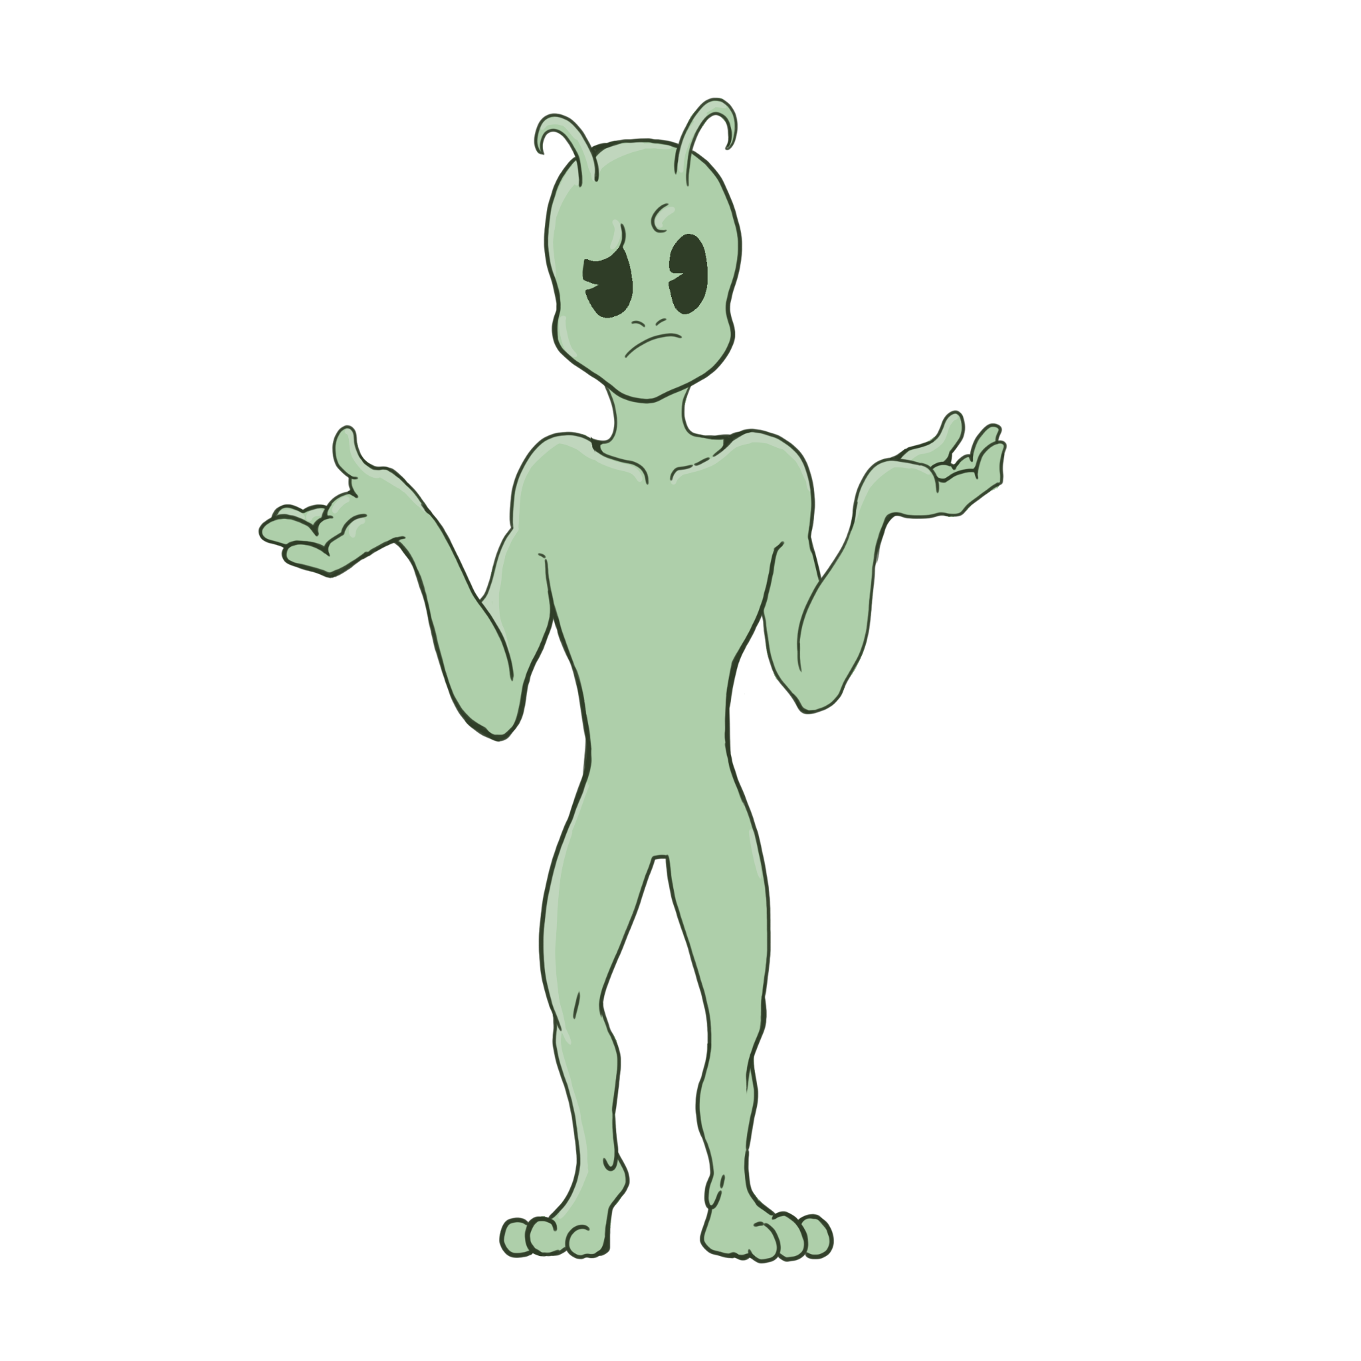
“They’re Made Out of Meat”
What do you notice about the structure of the story?
What would have been different about the story if Bisson would have included narrative clues with the dialogue?

Slide 13
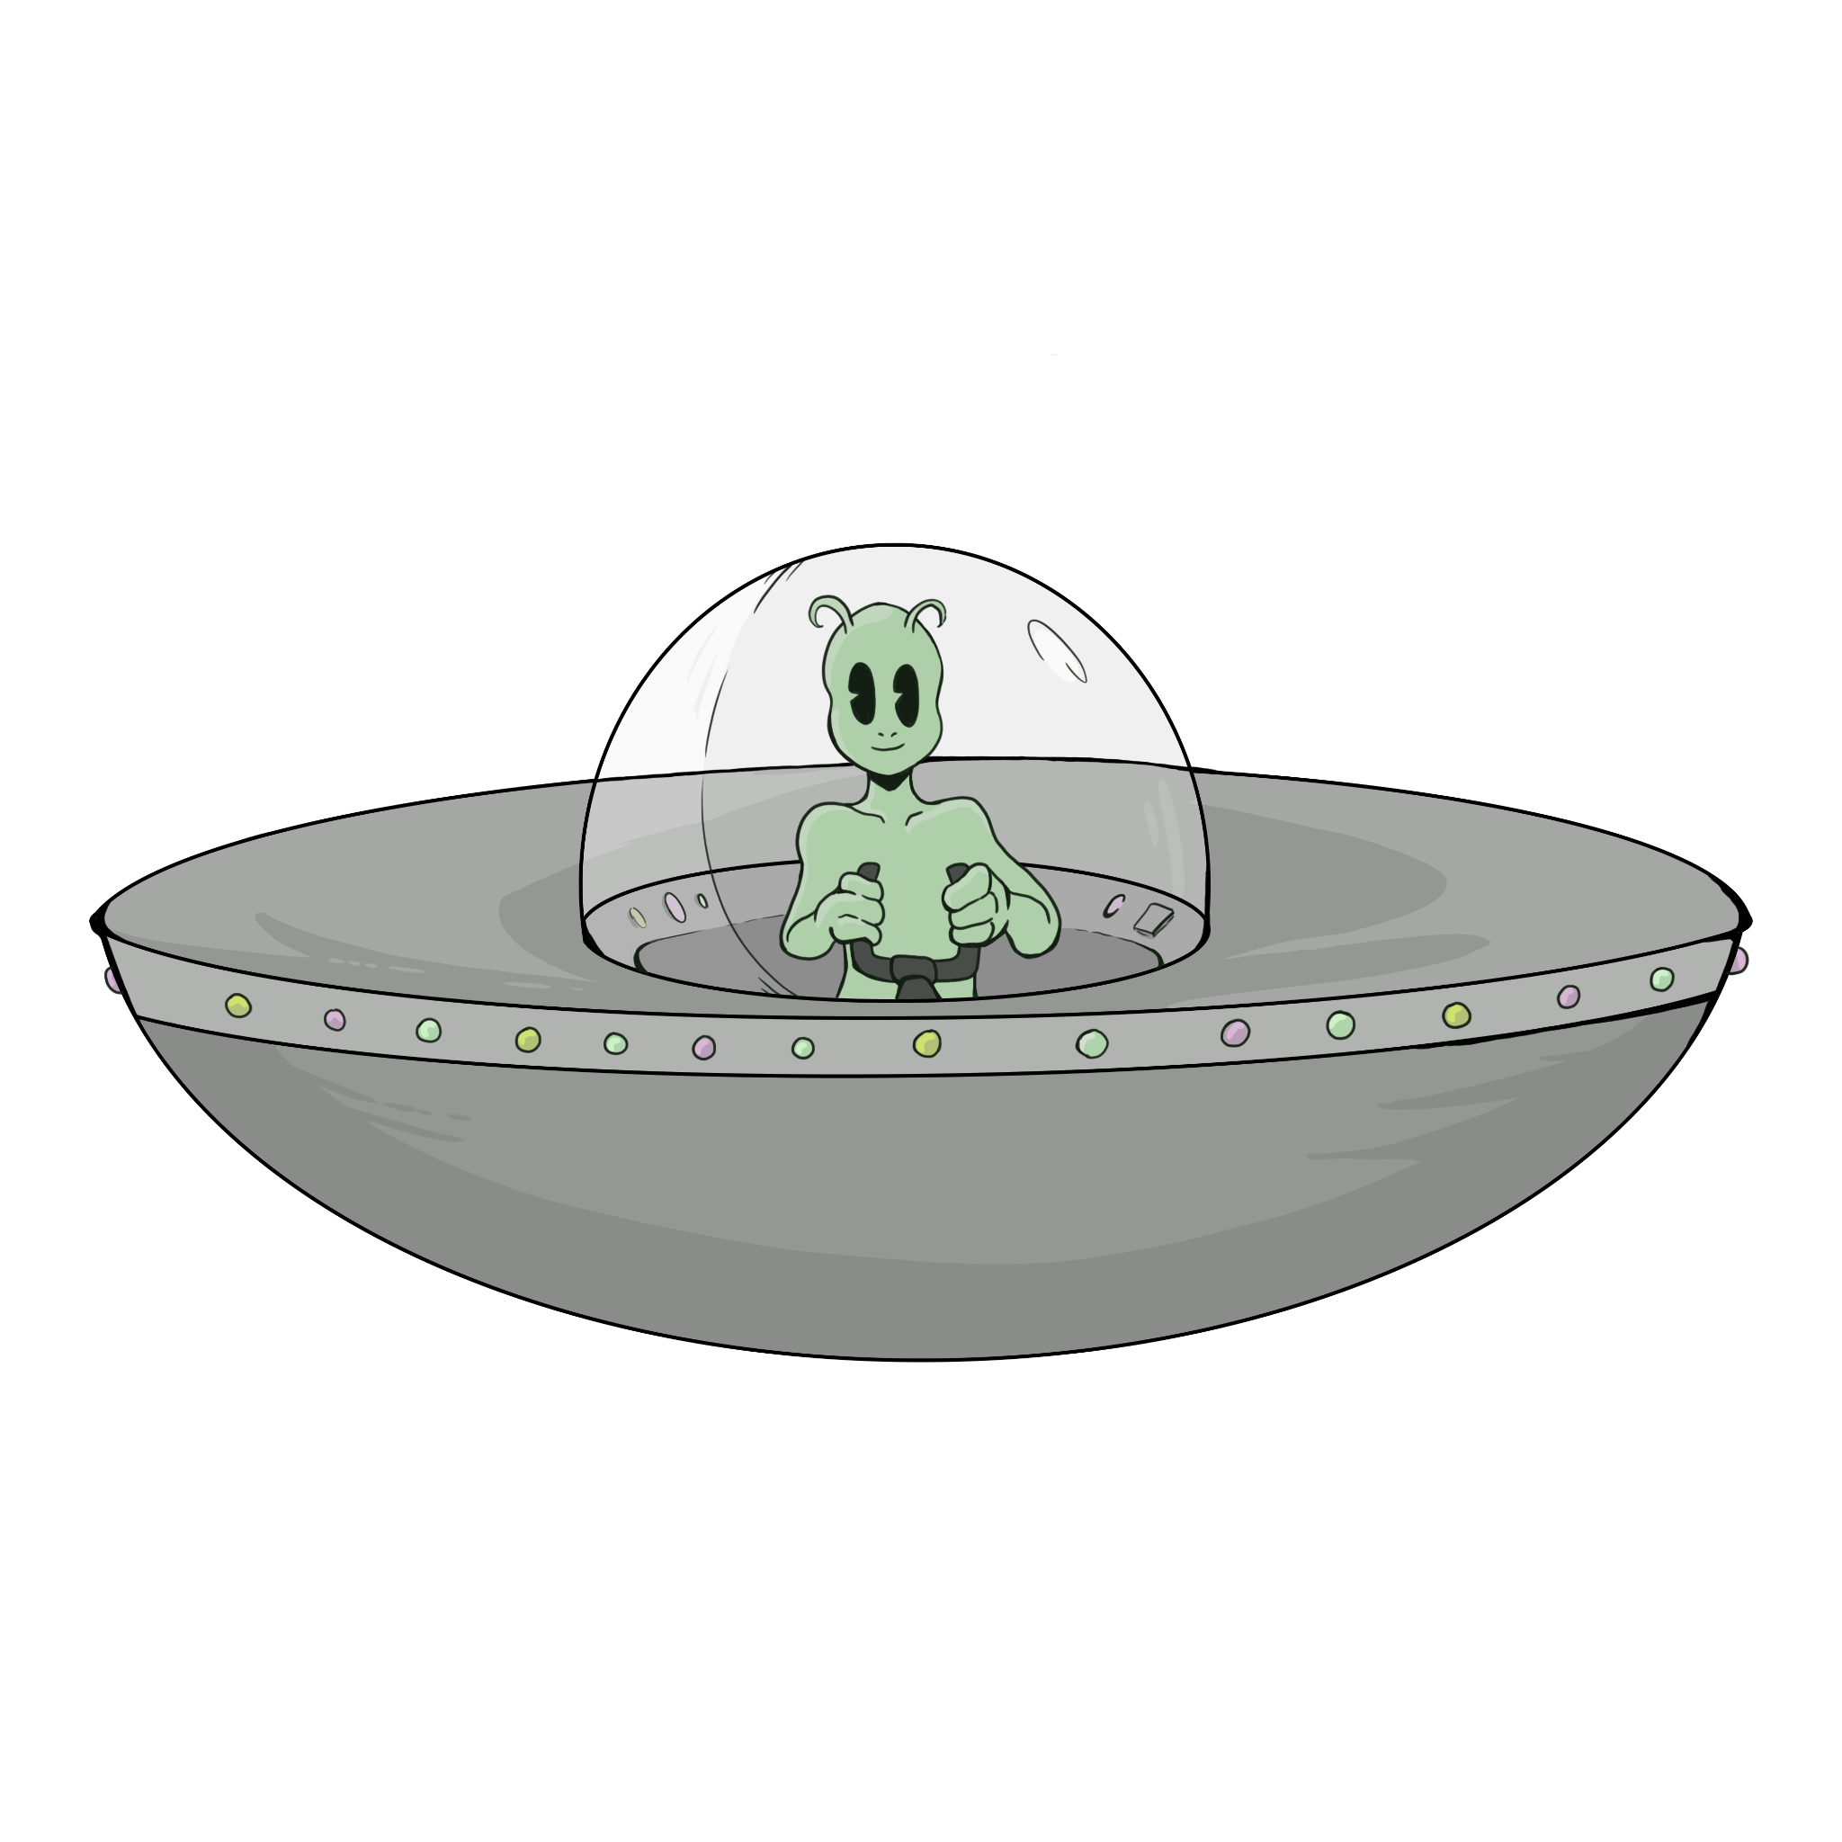
Dialogue Definitions
Dialogue tag: a phrase that precedes or follows a bit of written dialogue and establishes who the speaker is, how they are delivering the dialogue, and whether a new speaker is talking.
Ex: “Go away, Mark!” she shouted.
Dash: Indicates dialogue was interrupted.
Ex: “I just meant –” he began.
Ellipses: Indicates the speaker trailed off.
Ex: “I was wondering if…” she mused.
Notes:
How to use dialogue tags: 5 tips for formatting dialogue - 2024. MasterClass. (n.d.). https://www.masterclass.com/articles/how-to-use-dialogue-tags
Team, R. E. (2023, July 24). 6 unbreakable dialogue punctuation rules all writers must know. Reedsy. https://blog.reedsy.com/guide/how-to-write-dialogue/dialogue-rules-punctuation/

Slide 14
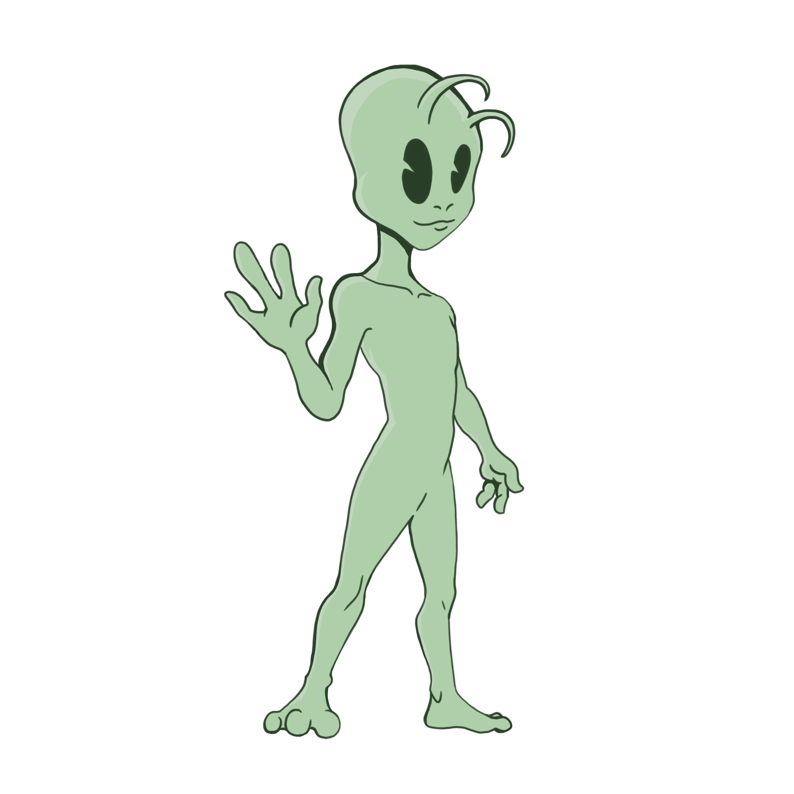
Dialogue Examples
“I really don’t think this is a good idea, guys,” Sally warned.
Ben shook his head and said, “Nah, it’s a great idea!”
“I don’t know…”
“Oh, come on! It’ll be great!”
Sally chewed on her bottom lip. “Okay, I guess we–”
Ben grinned. “Woohoo!” he cheered.
Notice: Instead of using a period at the end of a line of dialogue, use a comma. Periods are only used if there is no dialogue tag afterwards.

Slide 15
Dialogue Practice
Get into groups of TWO.
ONE member of each group needs to open up a blank Google Doc.
Share that Doc with your partner. Make sure to add them as an Editor on the doc.
Notes:
K20 Center. (n.d.). Google Docs. Tech Tools. https://learn.k20center.ou.edu/tech-tool/2327

Slide 16
Prepare your Questions
Choose one or more of the following questions to ask your partner to keep a conversation going:
"If you could have any superpower, what would it be and why?"
“What did you do this summer?”
"What’s the most interesting place you’ve ever visited or want to visit?"
"What’s a book, movie, or show that you think everyone should experience?"
"What’s the best piece of advice you’ve ever received or given?"

Slide 17
Have a Conversation
Take turns writing
Ask questions
Student 1:
Student 2:
Student 1:
Ask follow-up questions
Hey.
Hello.
What did you do this summer?
Oh, not much. We did go on a really cool trip!
That’s neat. Where do you go?
We went to South Padre. The beach was great. Did you go anywhere?
No, we mostly stayed home. I had to cut wheat this summer.

Slide 18
Dialogue Practice
Have a one-page conversation in your Google Doc about something interesting you did this summer.
5. Once you have filled up the page, add in correct
punctuation and dialogue tags.
K20 10 Minute Timer
Notes:
K20 Center. (n.d.). Google Docs. Tech Tools. https://learn.k20center.ou.edu/tech-tool/2327
K20 Center. (Sept. 21, 2021). K20 10 Minute Timer. https://youtu.be/9gy-1Z2Sa-c?feature=shared

Slide 19
Add Punctuation and Dialogue Tags
“Hey,” Bobby said.
Mia replied, “Hello.”
“What did you do this summer?” asked Bobby.
“Oh, not much. We did go on a really cool trip!” Mia gushed.
“That’s neat. Where do you go?”
“We went to South Padre. The beach was great. Did you go anywhere?”
Bobby sighed. “No, we mostly stayed home. I had to cut wheat this summer.”

Slide 20
Essential Question
How does dialogue impact the plot of a narrative?

Slide 21
Short Story with Dialogue
Compose a 500-word short story that heavily relies on dialogue to propel the plot.
Short stories can be based on true events or entirely imagined.
Use the Rubric as a guide.

Slide 22
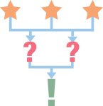
3-2-1
What are 3 things you learned?
What are 2 ways your writing was impacted?
What is 1 lingering question you have about dialogue?
?
!
Notes:
K20 Center. (n.d.). 3-2-1. Strategies. https://learn.k20center.ou.edu/strategy/117

