Slide 2
Periodic Shuffle
Introduction to Periodicity and Electron Configuration
Notes:
Free image: attribution required. See above

Slide 3
Essential Questions
How do patterns allow for making predictions?
How can the periodic table be used to make predictions about the properties of elements?

Slide 4
Learning Objectives
• Analyze electron configuration patterns of the periodic table.
• Discover valence electrons patterns of the periodic table.

Slide 5
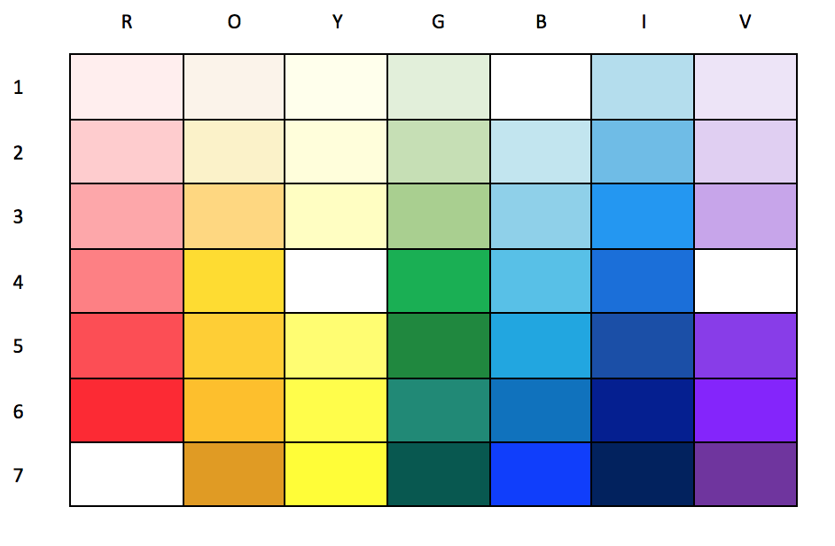
Filling in What’s Missing
How do you know what should go in the empty squares?
Share out what you think should be in each empty square.
Notes:
ENGAGE Give students a few minutes to consider how they would fill in the missing parts of the grid, and how they know what their answer is. Have some students share what they are thinking & how they came to that conclusion. As students engage with the ROYGBIV table, they should begin constructing knowledge about how to identify and analyze patterns.

Slide 6
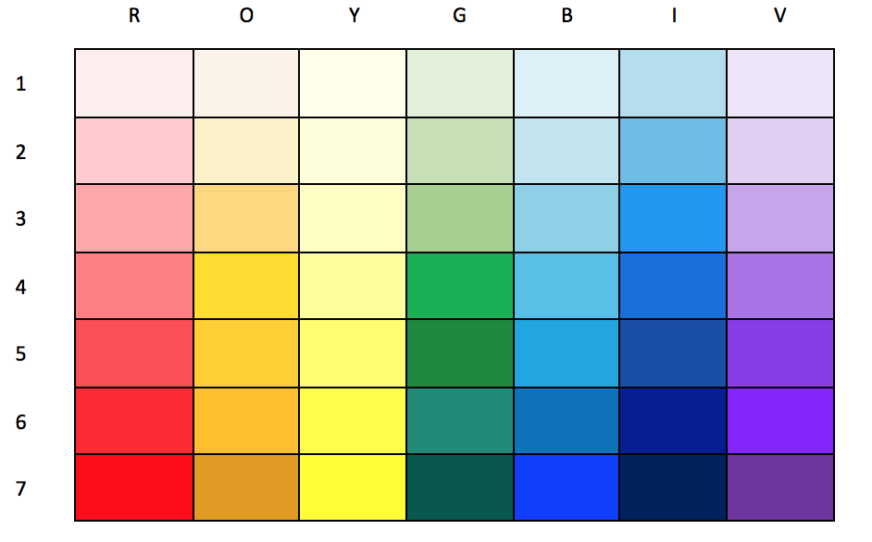
The Answers
How close were your predictions?
Notes:
The correct answer is the image on the right. Point out the patterns.
The patterns in the ROYGBIV table are similar to the periodic table which will be explored throughout the lesson. The horizontal pattern in the ROYGBIV table is analogous to the electron configuration in the periodic table, while the vertical pattern is analogous to the valence electrons.

Slide 7
Periodic Shuffle: Electron Configuration
Each group will get one card.
Use the Explore handout and follow the directions.
For step 3, place your sticky notes on the large classroom periodic table.
Notes:
EXPLORE

Slide 8
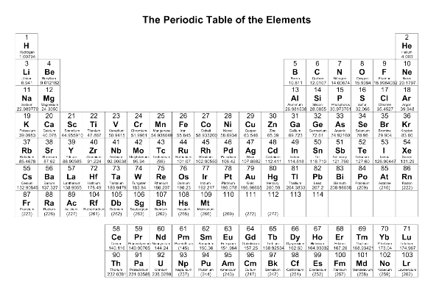
Color your Periodic Table
Select four colors.
Color in the s, p, d, and f blocks.
Include a legend indicating which color represents each of the blocks.
Notes:
EXPLAIN
Source: N.a. (n.d.). 10 Best Periodic Table Of Elements. Printablee. https://www.printablee.com/post_periodic-table-of-elements-printable_400652/

Slide 9
Periodic Shuffle: Valence Electrons
Get back in your group and complete the Valence Electrons handout.
On sticky notes, write the number of valence electrons for each group, then place your sticky notes on the large classroom periodic table.
Notes:
EXTEND

Slide 10
Word Splash
Write a sentence or short paragraph about how all of these words fit together based on what you’ve learned.
Use these words:
Electron configuration
Periodic table
Valence electrons
s, p, d, and f orbitals
Notes:
EVALUATE

