Slide 1
Alienstock:
Storming Area 51
ELA 7th or 8th Grade

Slide 2
Essential Questions
How do different types of articles and media express similar or contradicting ideas about the same topic?
How do you determine the relevance, reliability, and validity of information?

Slide 3
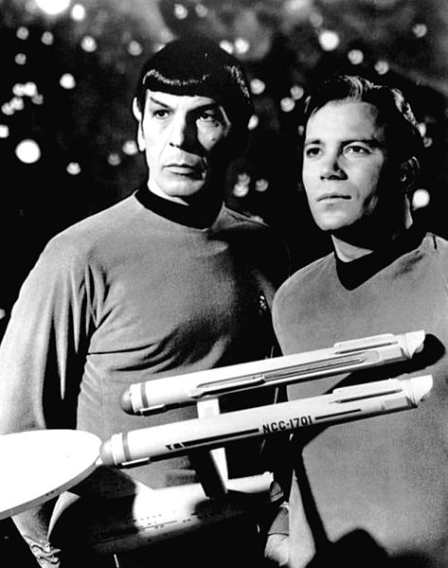
What do these TV shows and movies have in common?
Sources:
Fox. (n.d.). The X-Files (season 11). Wikipedia. Retrieved from https://en.wikipedia.org/wiki/The_X-Files_(season_11)
Lava Bear Films. (n.d.). Arrival, Movie Poster.jpg. Wikipedia. Retrieved from https://en.wikipedia.org/wiki/File:Arrival,_Movie_Poster.jpg
NBC Television (1968 January 12). Leonard Nimoy William Shatner Star Trek 1968.JPG. Wikipedia. Retrieved from https://en.wikipedia.org/wiki/File:Leonard_Nimoy_William_Shatner_Star_Trek_1968.JPG

Slide 4
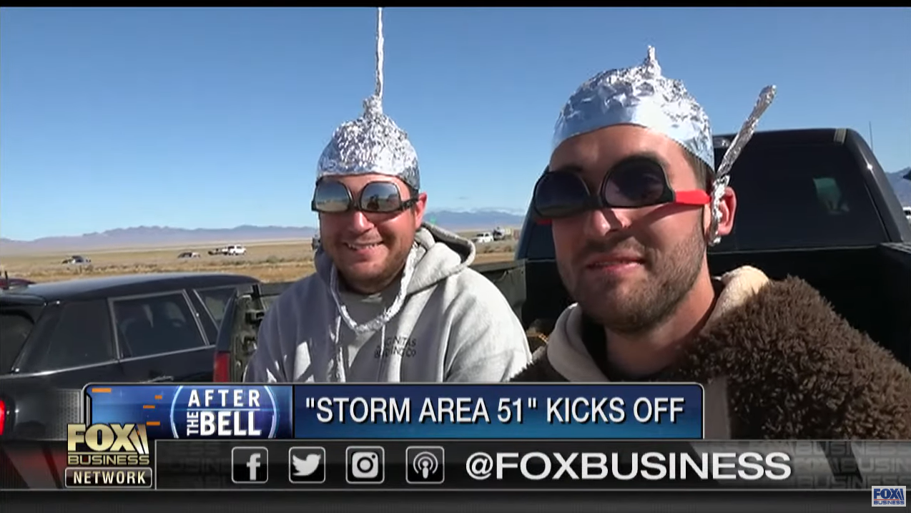
Fox Business (2019, September 20). Fox Business talks to 'Storm Area 51' attendees in Nevada desert. YouTube. Retrieved from https://youtu.be/Ysko_2Xavh8

Slide 5
Video Discussion
What opinions do you think the reporters have about the Alienstock event?
What opinions do you think the people who came to the event have about aliens?

Slide 6
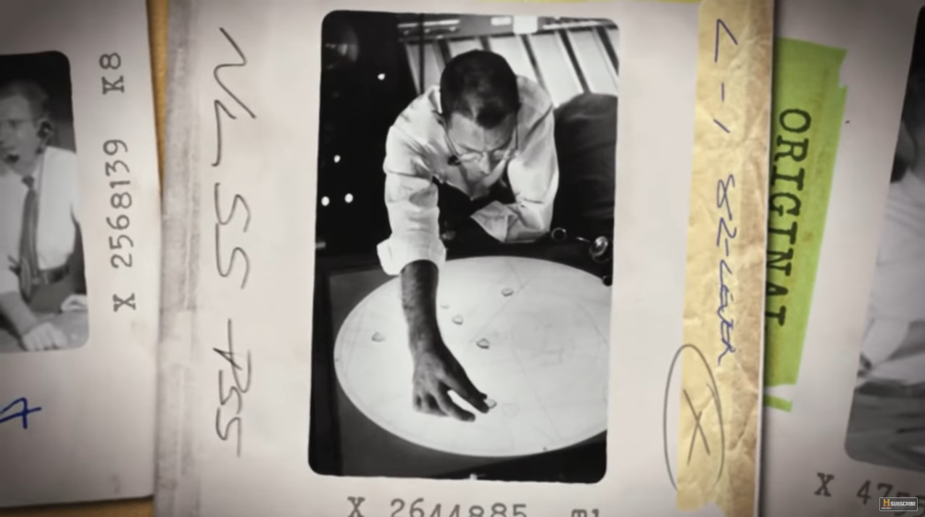
History (2019 March 17). Project Blue Book: Declassified - The True Story of the D.C. UFO Sightings | History. YouTube. Retrieved from https://youtu.be/UKzI3uu_oTQ

Slide 7
Video Discussion
How does this video differ from the first video?
In your opinion, do the people in this video believe in the possibility of aliens?

Slide 8
Aliens exist.
Choose a corner of the room to express whether you:
Strongly Agree
Agree
Disagree
Strongly disagree

Slide 9
Why-Lighting
In your assigned reading:
Highlight the main ideas that support or disprove the existence of aliens.
In the margins, jot down why the information is important.

Slide 10
T-Chart
Proof Aliens Exist
Proof Aliens Don’t Exist
With your group:
Discuss any information you highlighted that supports the existence of aliens.
Discuss any information you highlighted that disproves the existence of aliens.
Place the information in the proper column on the T-Chart.
Pixel Perfect (2017. March 3). Vector Notepad. Pixabay. Retrieved from https://pixabay.com/photos/vector-notepad-notepad-5x8-notepad-2111645/

Slide 11
Is the article you read valid and reliable?
As a group, go over the checklist together.
Determine whether the article you read is valid and reliable or untrustworthy.

Slide 12
How Valid Are These Articles?
Articles:
Validity:

Slide 13
Jigsaw
Create a mixed group of all the articles read.
Teach your information to the rest of the group.
Add information to the T-chart.
1
2
4
3

Slide 14
Example CER
Claim: Doing your assignments on a computer is easier than writing them on paper.
Evidence: Our school has a computer lab and most students have worked with computers.
Reasoning: Since assignments can be stored online, students can access their work anywhere.

Slide 15
Claim, Evidence, and Reasoning (CER)
With your group:
Choose one claim:
Aliens do exist.
Aliens do not exist.
There is not enough evidence to determine the existance of aliens.
Write down your text evidence—quotes or statements from the readings—supporting your claim.
Explain the reasoning behind your claim.

Slide 16
Aliens exist, revisited.
Choose a corner of the room to express whether you:
Strongly Agree
Agree
Disagree
Strongly disagree

