Slide 2
Untwining and Intertwining
Chemical Reactions

Slide 3
Essential Question
What is the benefit of classifications?

Slide 4
Lesson Objectives
Students will classify chemical reactions by identifying patterns and organizing reactions into meaningful categories using a card sort activity.
Students will develop critical thinking skills by predicting definitions and examples of different types of chemical reactions based on prior knowledge.
Students will demonstrate understanding of reaction types by creating and presenting analogies that differentiate between them, incorporating real-world and chemistry-based examples.

Slide 5
Classification
With your partner, sort your cards into groups.
Choose groups that make sense to you.
Be prepared to share how you chose to group the objects and why.
Notes:
K20 Center. (n.d.). Card sort. Strategies. https://learn.k20center.ou.edu/strategy/147

Slide 6
Definitions and Examples
With your partner, determine definitions and examples for the following words:
Combustion
Synthesis
Decomposition
Single Displacement
Double Displacement

Slide 7
Share Out
We need five volunteers to share with the class your definition and example for one of the following words:
Combustion
Synthesis
Decomposition
Single Displacement
Double Displacement
Notes:
K20 Center. (n.d.). Take five. Strategies. https://learn.k20center.ou.edu/strategy/150

Slide 8
Gallery Walk
In your group you will walk around the room and visit each of the 10 chemical reaction types.
For each chemical reaction type you will fill out a Frayer Model.
Write the chemical reaction as the vocabulary term and focus on the following:
Description
Characteristics
Examples and Non-examples
An image representation.
Notes:
K20 Center. (n.d.). Gallery walk/carousel. Strategies. https://learn.k20center.ou.edu/strategy/118

Slide 9
Chemical Reaction Frayer Models
Write the chemical reaction as the vocabulary term and focus on the following:
Description
Characteristics
Examples and Non-examples
An image representation.
Notes:
K20 Center. (n.d.). Frayer model. Strategies. https://learn.k20center.ou.edu/strategy/126
K20 Center. (n.d.). K20 Center 4 minute timer [Video]. YouTube. https://www.youtube.com/watch?v=kpCsfuvzQeY

Slide 10
Chemical Reaction Poster
With your group, create a poster that has an analogy for each chemical reactions. Include the following:
Name of each reaction type
At least one analogy for each of the reaction types
At least two chemistry examples of each reaction
Have fun and be creative!

Slide 11
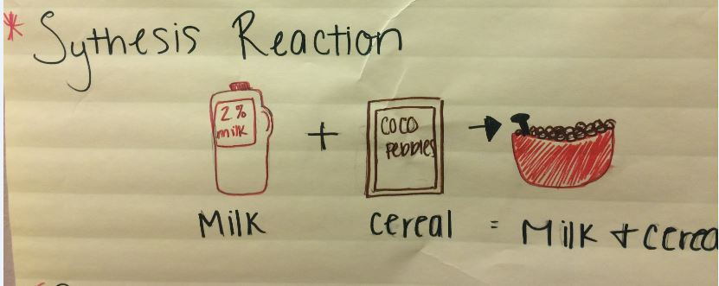
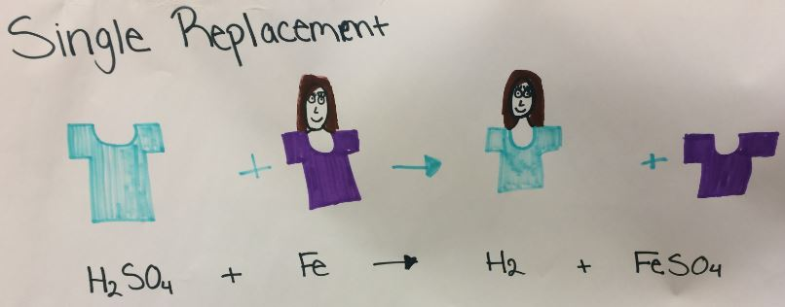
Analogy Examples

Slide 12
Present Your Poster
With your group, plan how you will present your poster to the class. Feel free to add motions or create a skit.

