Slide 1
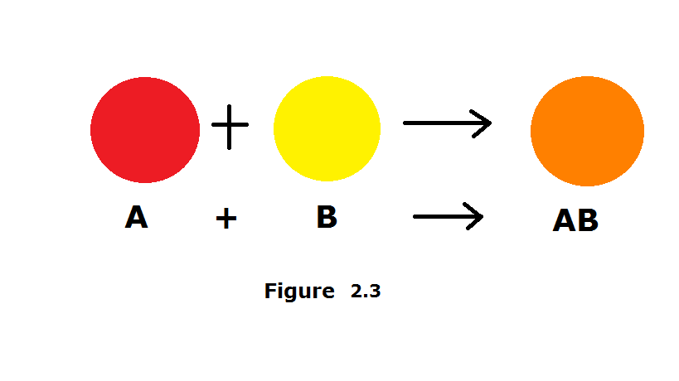
Synthesis
Synthesis is when two or more substances combine to form a single substance. | Example: A + B → AB

Slide 2
Synthesis reaction
2H_{2 (g)} + O_{2 (g)} → H₂O_{(l)}
Ask Yourself
Are the reactants combining to form one product?

Slide 3
Decomposition
Decomposition reactions occur when a single reactant is broken down. | AB → A + B

Slide 4
Decomposition Reaction
NaHCO_{3 (s)} → Na_{(s)} + CO_{2 (g)} + H₂O _{(l)}
Ask Yourself
Is there one reactant forming more than one product?

Slide 5
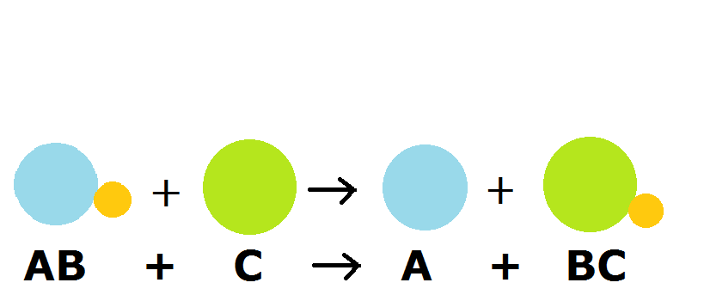
Single Replacement Reaction
Single Replacement reactions occur when atoms of one element replace the atoms of a second element. | AB + C → AC + B

Slide 6
Single Replacement Reaction
Zn_{(s)} + 2HCl _{(aq)} → H_{2(g)} + ZnCl_{2 (aq)}
Ask Yourself
Is there a single element replacing an element in a compound?

Slide 7
Double Replacement Reaction
Double Replacement reactions occur when elements in two compounds are exchanged. | AB + CD → AD + CB
AB + CD → AD + CB

Slide 8
Double Replacement Reaction
KI_{(l)} + PbNO_{3 (l)} → PbI_{2 (s)} + KNO_{3 (l)}
Ask Yourself
Are elements in two reactants replacing each other in the products?

Slide 9
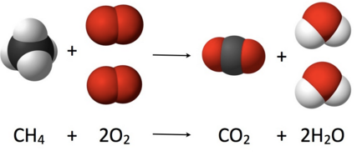
Reaction Types:
Combustion reactions form carbon dioxide and water as products. | CH₄ + 2O₂ → CO₂ + 2 H₂O

Slide 10
Combustion Reaction
CH₄ + 2O₂ → CO₂ + 2 H₂O
Ask Yourself
Are CO₂ and H₂O products?

