Slide 2
The Best of the Best
Darwinian Fitness

Slide 3
Learning Objective
Students will define Darwinian fitness and identify examples and non-examples of biological fitness based on traits that enhance survival and reproduction.
Students will analyze how environmental changes influence the selection of beneficial traits and explain how heritable traits drive population changes through natural selection.
Students will analyze the impact of human activity on the fitness of organisms by using real-world examples and will demonstrate their understanding through the creation of a cognitive comic or PSA.

Slide 4
Essential Question
Why is biological fitness such a difficult concept to describe?

Slide 5
Survival of the Fittest
Dora: “I think ‘fit’ means being bigger and stronger.”
Lance: “I think ’fit’ means being more likely to reproduce.”
Felix: “I think ‘fit’ means being able to run faster.”
Keisha: “I think ‘fit’ means being more intelligent.”
Which person do you agree with most? Go to that corner and talk with everyone else there about why your statement is the best choice.

Slide 6
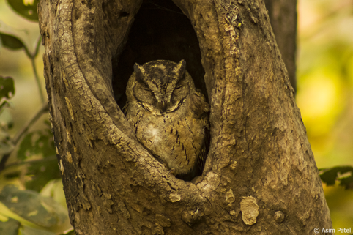
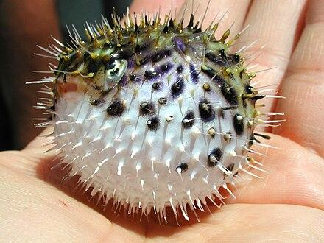
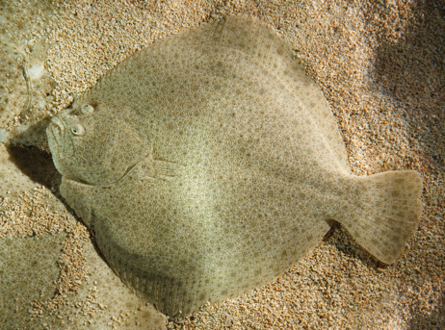
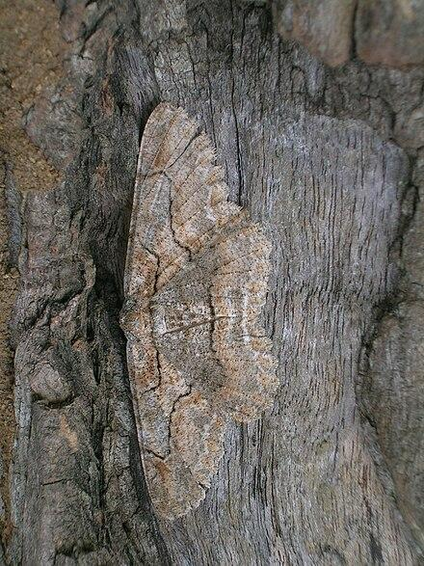
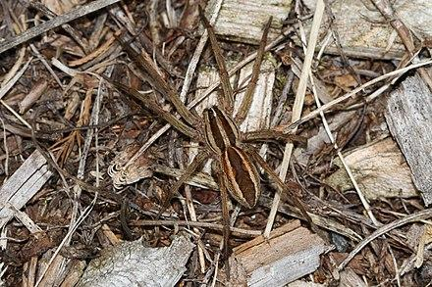
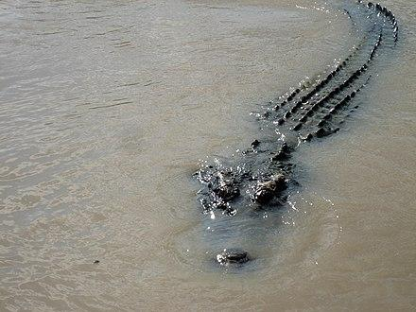
What makes them special? What is ‘useful’ about what makes them special?

Slide 7
Which of these animals fit your definition for ‘survival of the fittest’? Which don’t?

Slide 8
Examples and Non-Examples
Think back on how you defined the term "survival of the fittest."
Create a T-chart on a piece of paper. Label one side Examples and the other Non-Examples.
List animals that support that definition in the examples side.
Animals that don't support that definition in the non-examples side.

Slide 9
Mice in the Desert
Look at the image on your paper.
Work with your group to figure out what is happening and why it is happening.

Slide 10
Why-Lighting
What is the human influence on Darwinian fitness?
Highlight phrases within the article that contribute to answer the question.
Write in the margins why you highlighted each phrase.

Slide 11
Cognitive Comics
Your comic should include:
There needs to be a message—What are you trying to explain?
Use the information from the reading to help you.
Illustrations—What images will help you convey your message?

Slide 12
Metacognition (Thinking about Learning)
Take time to reflect and write down HOW each activity listed below helped you learn. Try not to write WHAT you learned, but think about how the activity made learning easier or harder and how you will approach similar activities in the future.
Four Corners: Deciding who you agreed with about the definition
Examples and Non-Examples: Did the animals fit what you picked?
The Mice in the Desert handout
Why-Lighting the article
Making a comic from your Why-Lighting notes

