Slide 1
What does it mean for two geometric objects to be “the same”?

Slide 2
Activity:
Draw, a triangle that matches each description below as accurately as possible. When you are done drawing the triangle, cut it out and post it on the appropriate poster.
#1: ∆BOT such that BO = 4 in., OY = 5 in., and YB = 6 in.
#2: ∆FLY such that FL = 6 in., m L = 45º, and LY = 4 in.
#3 ∆JAW such that m J = 45º , m A= 60º, and AW = 5 in.
#4: ∆TUX such that m T = 60º, TU = 6 in., and m U = 45º
#5: ∆VEG such that m V = 75º, m E = 60º, and m G= 45º
#6: ∆ZIP such that m Z = 30º, ZI = 6 in., and IP = 4 in.

Slide 3
What can you conclude about the triangles in each poster?

Slide 4
What does it mean to be the same?
Two shapes are the same if they have the same shape and size, meaning that one can be moved, turned, or flipped so that it fits exactly on the other.
Two shapes are the same if they have the same shape but difference sizes, meaning one can be moved, turned, flipped, or shrunk so that it fits exactly on top the other.

Slide 5
What does it mean to be the same?
Two shapes are congruent if they have the same shape and size, meaning that one can be moved, turned, or flipped so it fits exactly on the other.
Two shapes are similar if they have the same shape but different sizes, meaning one can be moved, turned, flipped, or shrunk so it fits exactly on the other.

Slide 6
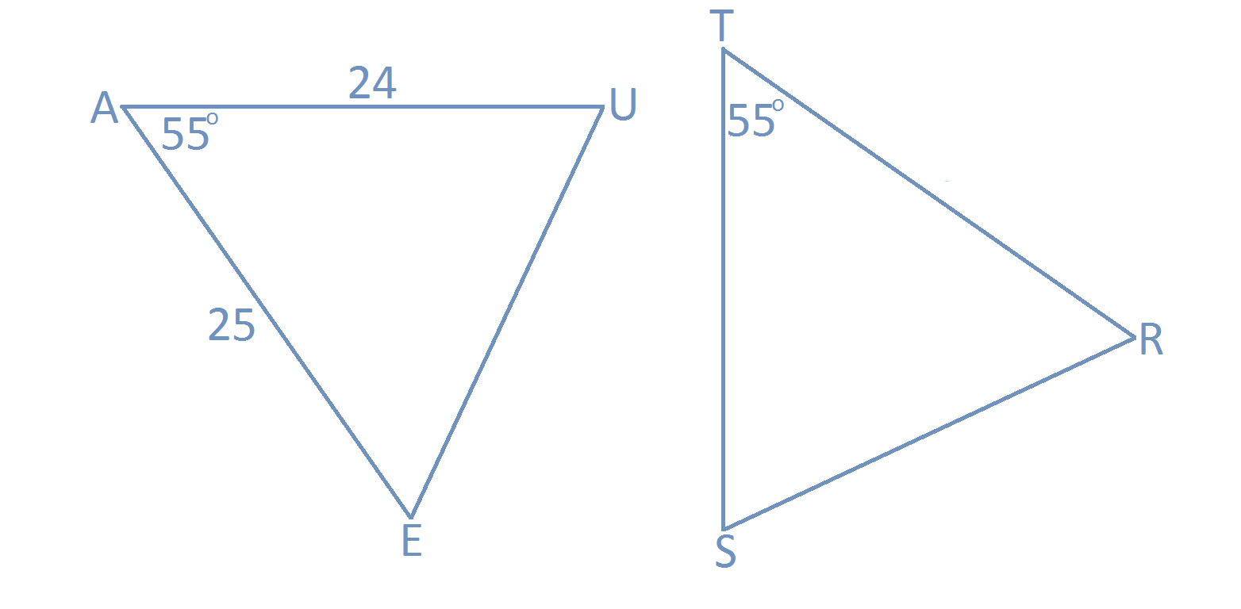
What does it mean to be congruent?
The two triangles shown below are congruent. What does this mean about the length of their sides? What does it mean about the measures of their angles?

Slide 7
What does it mean to be the same?
Determine if each statement is DEFINITELY TRUE, MAYBE TRUE, or NOT TRUE.
Angles U and S have the same measure.
AU = TS
AE = ST
Angles E and S have the same measure.
5. UE = SR

Slide 8
What does it mean to be the same?
Knowing that sides and angles have equal measures for two triangles is not enough to draw conclusions. We need to know which sides and angles are congruent.
Option 1:
A = T AU = TR
U = R UE = RS
E = S AE = TS
Option 2:
A = T AU = TS
U = S UE = SR
E = R AE = TR

Slide 9
Suppose option one is correct
Can we find a way to summarize all six statements in option one in one brief statement that gives all the information we need about ∆AUE and ∆TRS?
Option 1:
A = T AU = TR
U = R UE = RS
E = S AE = TS
∆AUE ∆TRS

Slide 10
Congruence Statements
How would the congruence statement change if option two were correct?
Option 2:
A = T AU = TS
U = S UE = SR
E = R AE = TR
∆AUE ∆TSR

Slide 11
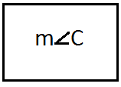
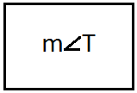
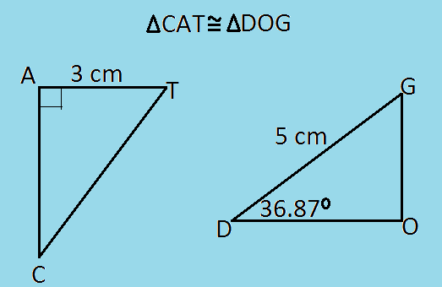
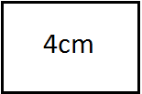
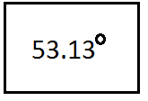
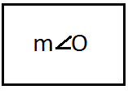
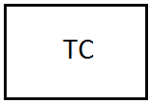
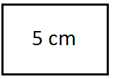
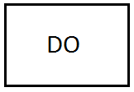
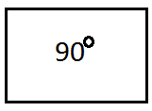
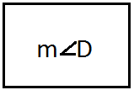
Let’s Play: Congruence Sets

Slide 12
Reflection:
On your exit slip, write:
3 things you learned today
2 comments you have about today’s lesson
and
1 question you have about congruent triangles

