Slide 1
Warm Up: Think-Pair-Share What does it mean for two triangles to be congruent? What things are important to remember when working with congruent triangles?
Day 2

Slide 2
Let’s Play: Guess What? (Triangle Edition)

Slide 3
Question: What information do we need before we can be sure we have congruent triangles? Is there more than one way to tell we have congruent triangles?

Slide 4
Reflection: Examine the posters we made in our last class. Do they support the claims we just made? Why or why not?

Slide 5
Triangle Congruences
#1. The three sides of the triangles are congruent.
#2: Two sides and the angle between them are congruent for both triangles.
#3 Two angles and a side not between them are congruent for both triangles.
#4: Two angles and the side between them are congruent for both triangles.
#5: All three angles for both triangles are congruent.
#6: Two sides and an angle NOT between them are congruent for both triangles.
SSS
SAS
AAS
ASA

Slide 6
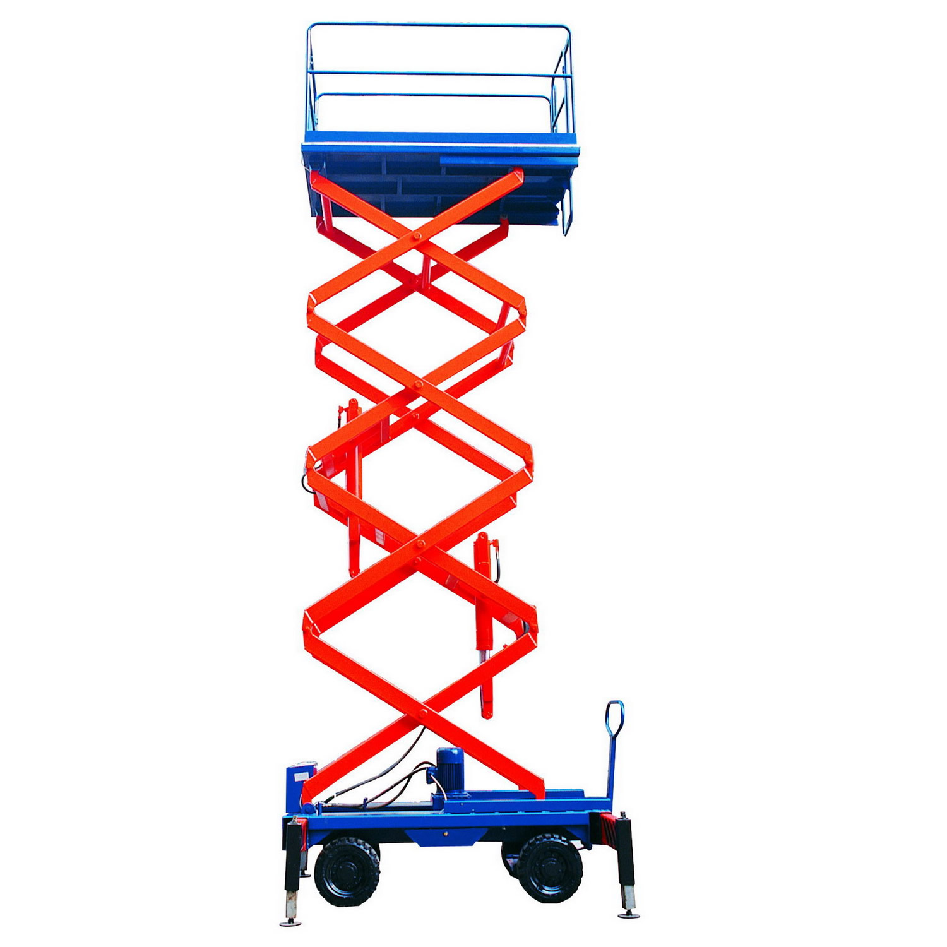
So why do we care?

Slide 7
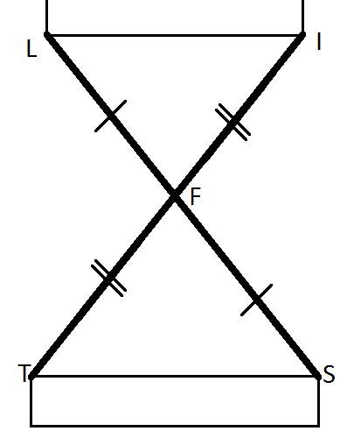
STATEMENT | REASON
1. F is the midpoint of LS and IT
2. LF = FS and TF = FI
3. LF = FS and TF = FI
4. LFI = SFT
5. LFI = SFT
6. ILF = TSF
7. LI || ST
Definition of Congruent Segments
Side Angle Side Triangle Congruence Theorem
Vertical Angles are Congruent
Corresponding Parts of Congruent Triangles are Congruent.
Definition of Midpoint
If Alternate Interior Angles are congruent, then the lines are parallel.
Given

