Slide 2
Max and his life
As you watch the video, jot down things you notice and things you wonder about.
We’ll come back and talk about him at the end, so make sure you write down enough to remember what happens
https://www.youtube.com/watch?v=cAl6ZoQ7Mes
Share a detail or question you wrote down?

Slide 3
Chromosome Card Sort
In the envelope is a full human set of chromosomes
Pair together the chromosomes that match, and arrange the matches in a way that makes sense to you

Slide 4
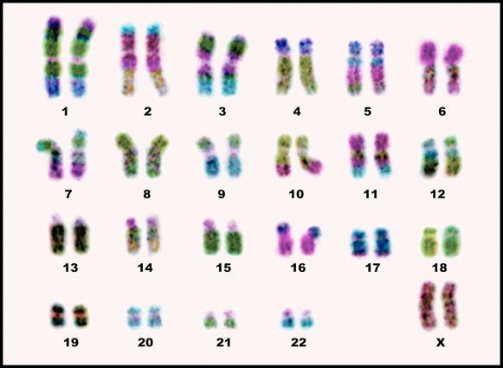
Let’s Talk about It
We made what is called a karyotype: the full set of chromosomes laid out in order of size, shape, and banding.
What was your reasoning for your organization? Did you include size, shape, and banding pattern in your reasons?
Here’s the formal answer
Why are there two of each?
Why does the last set go at the end, and not between 4 and 5?
What is the gender of this person?

Slide 5
I Think/We Think
On your own, think about the card sort and the explanation
Write down what you know about karyotypes, and what you can infer from karyotypes
Now, turn to your partner and share what both of you have written

Slide 6
You’re Now the Genetic Counselor
It’s time to use what you’ve learned
With your partner, you’re going to get two parent’s karyotypes and their child’s karyotype
It is your job to analyze the karyotypes to determine if the child has a genetic disorder or not, and what recommendations you would give the parents

Slide 7
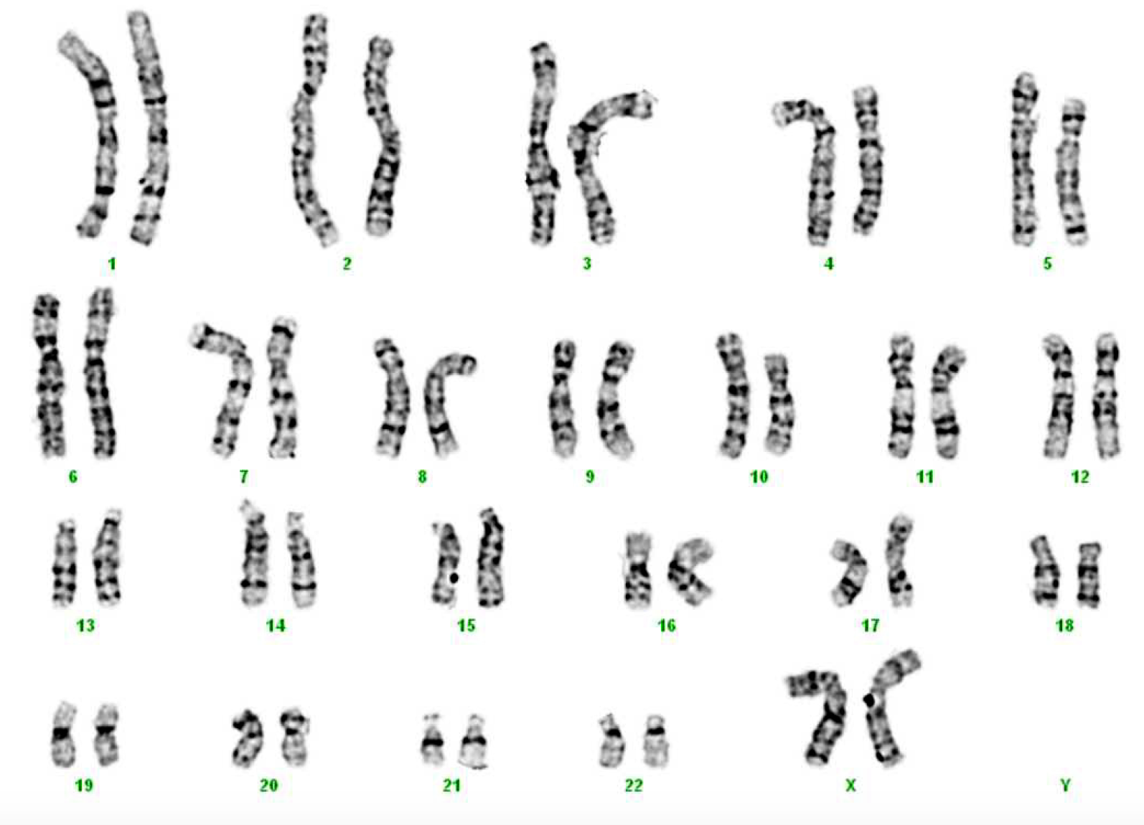
Share Out - Doherty

Slide 8
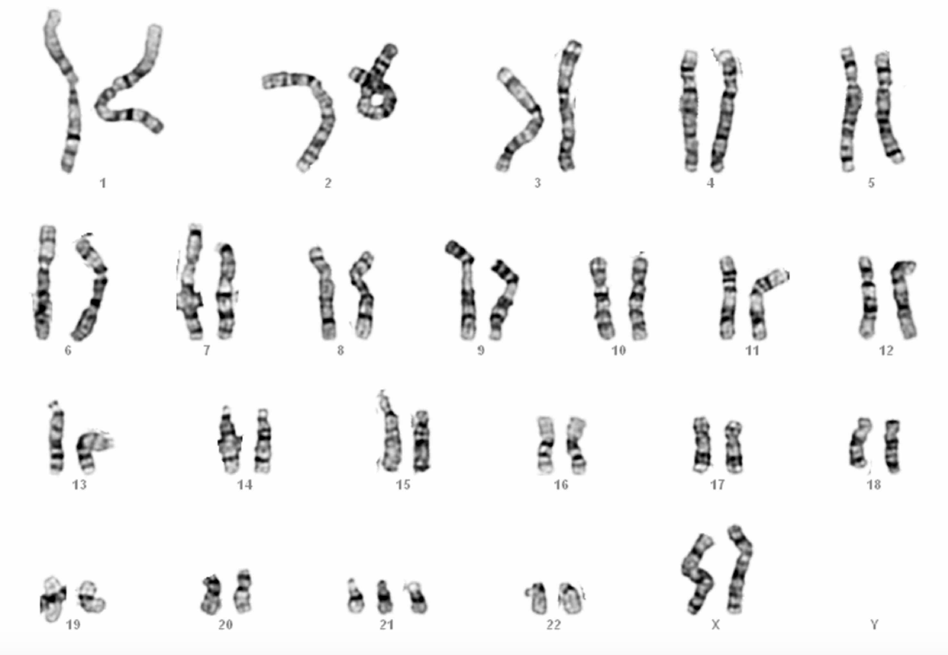
Share Out - Greene

Slide 9
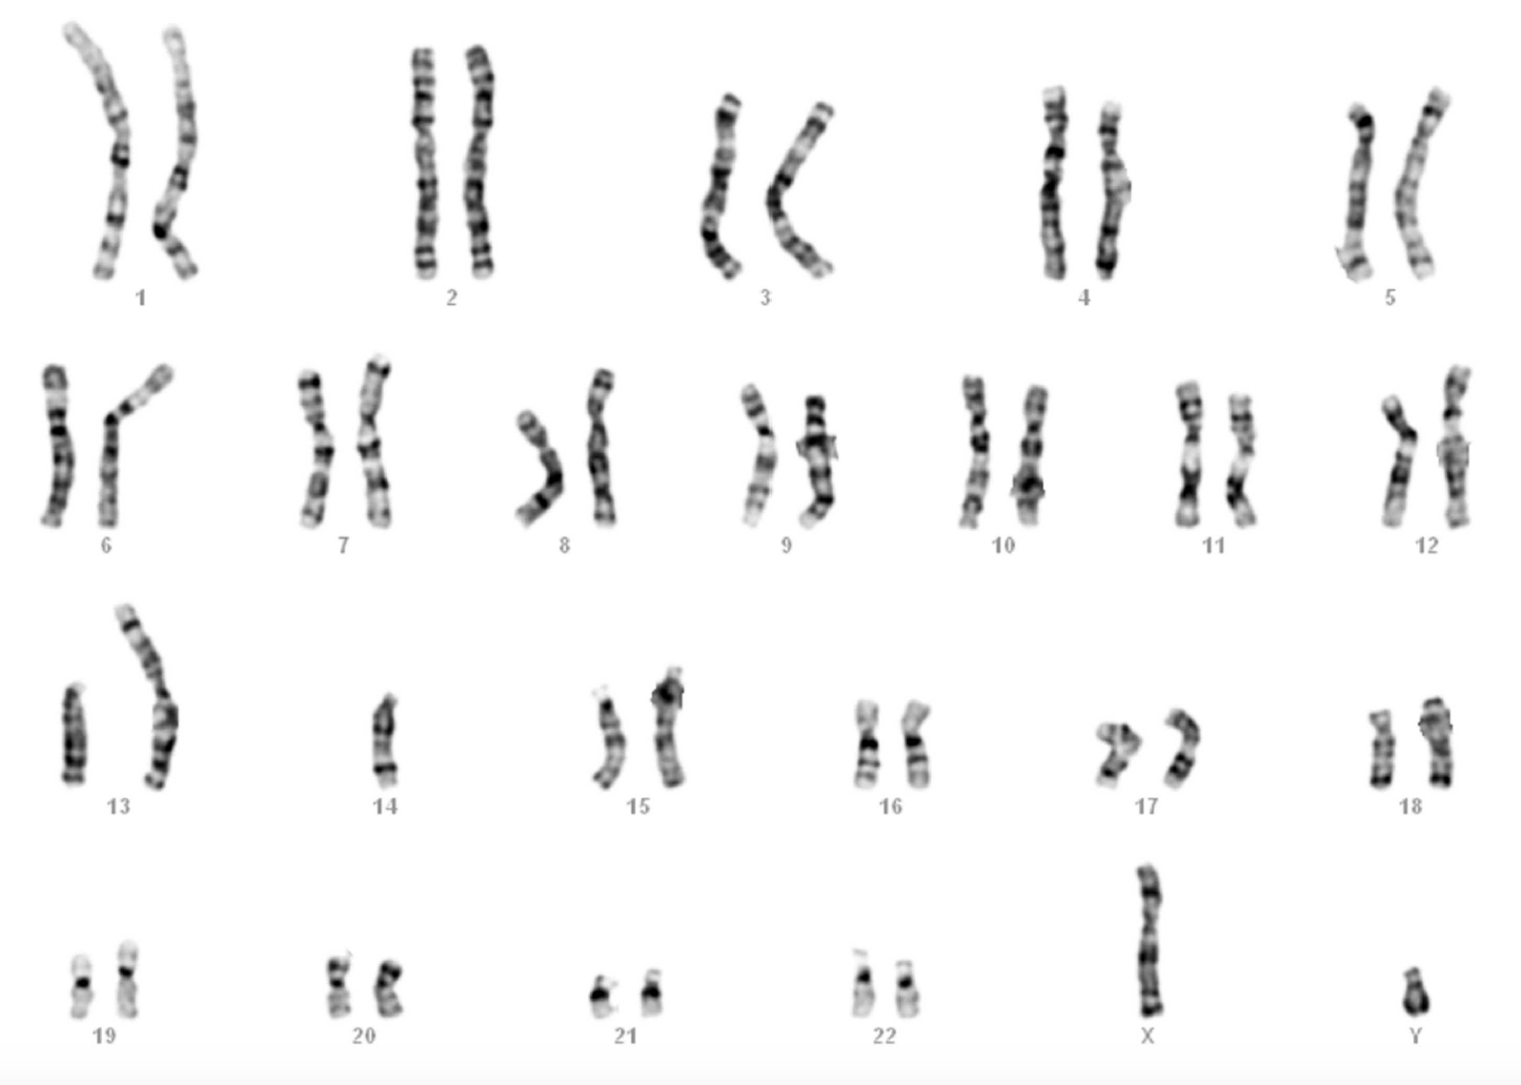
Share Out - Singh

Slide 10
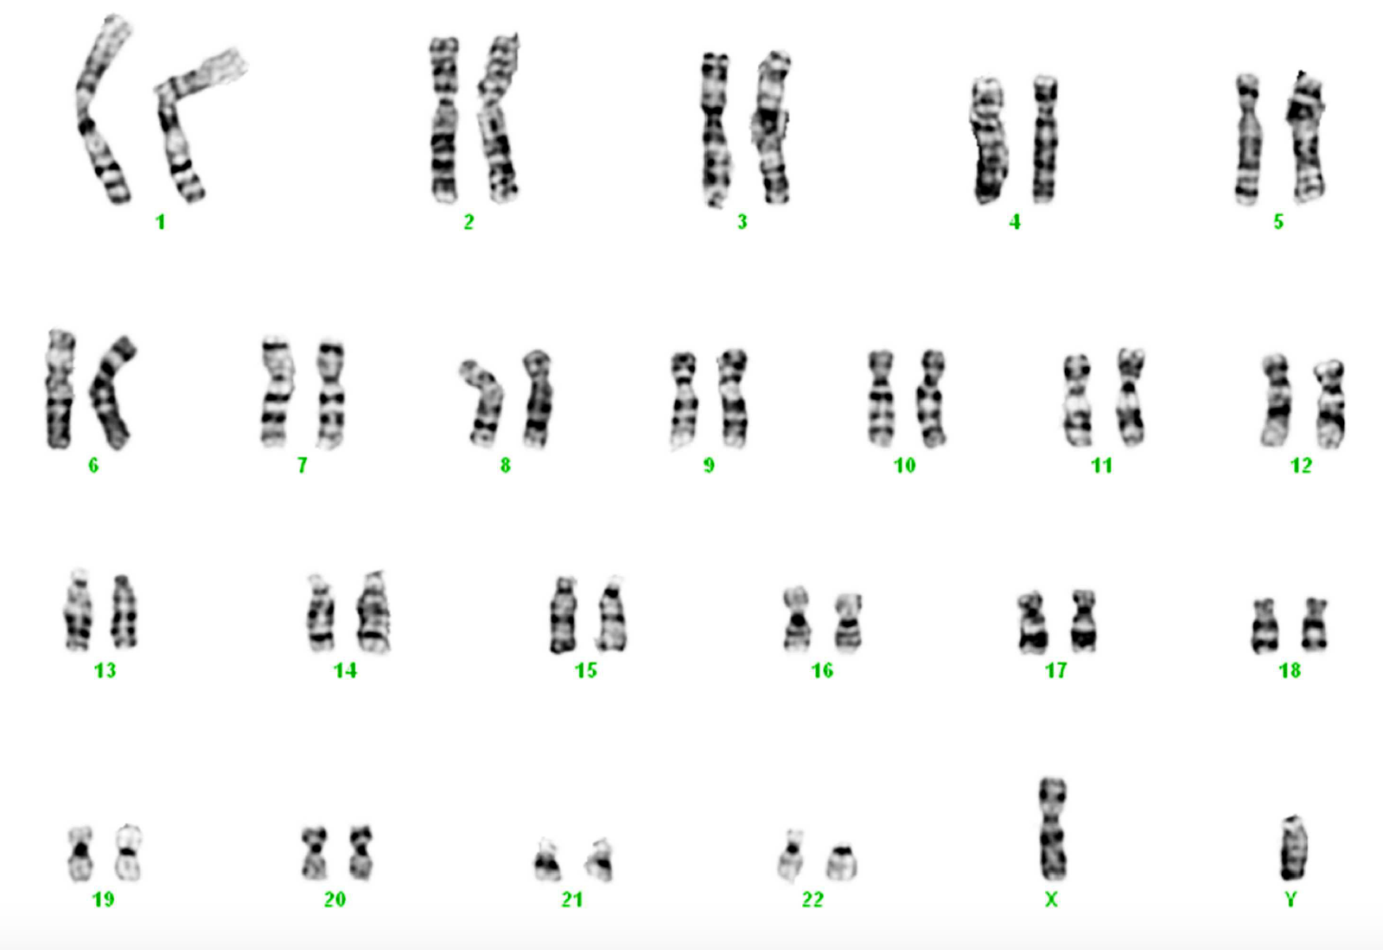
Share Out - Jackson

Slide 11
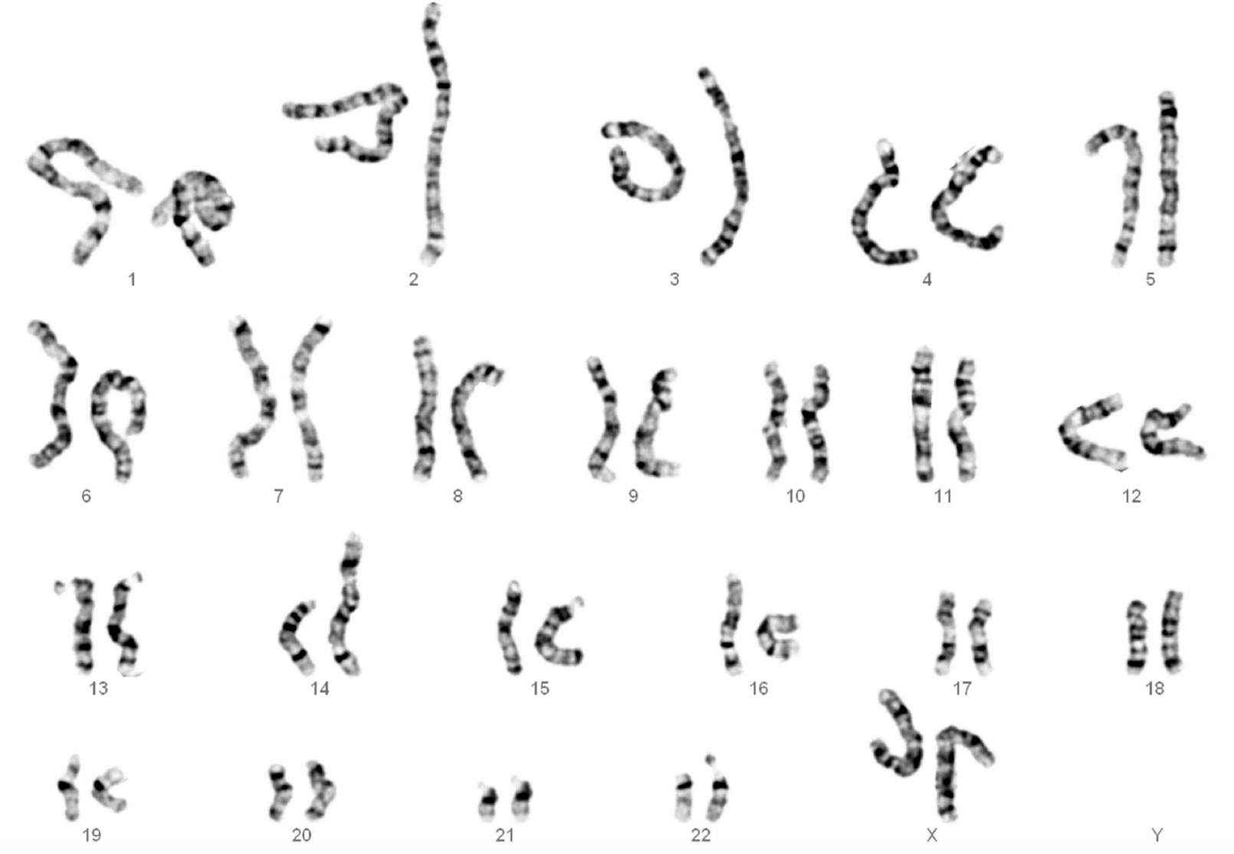
Share Out - Ramierz

Slide 12
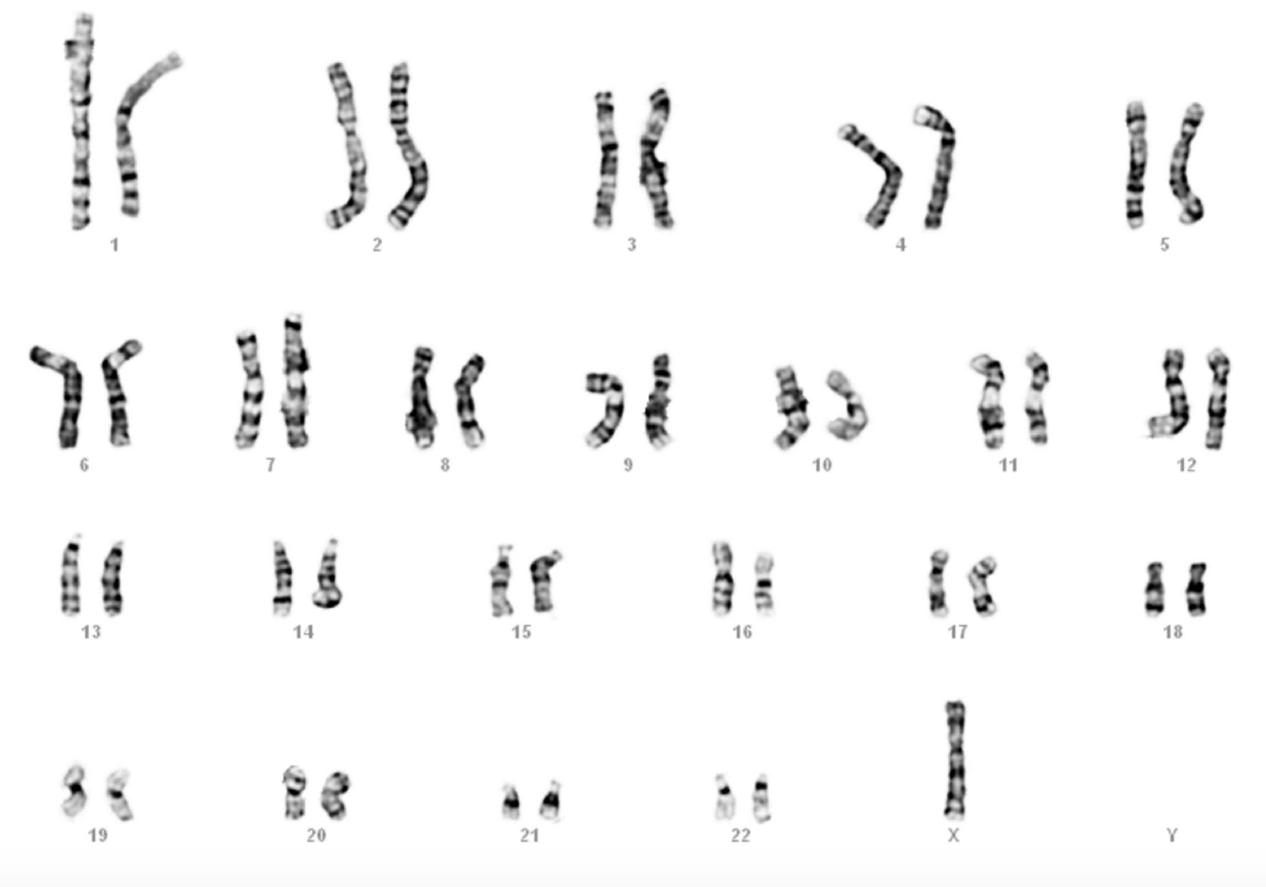
Share Out - Wolf

