Slide 2
Sums of Jumanji
Probability

Slide 3
Essential Question
When might we use probability and why?
Why do we need probability?

Slide 4
Lesson Objective
Be able to find experimental and theoretical probability for simple events.

Slide 5
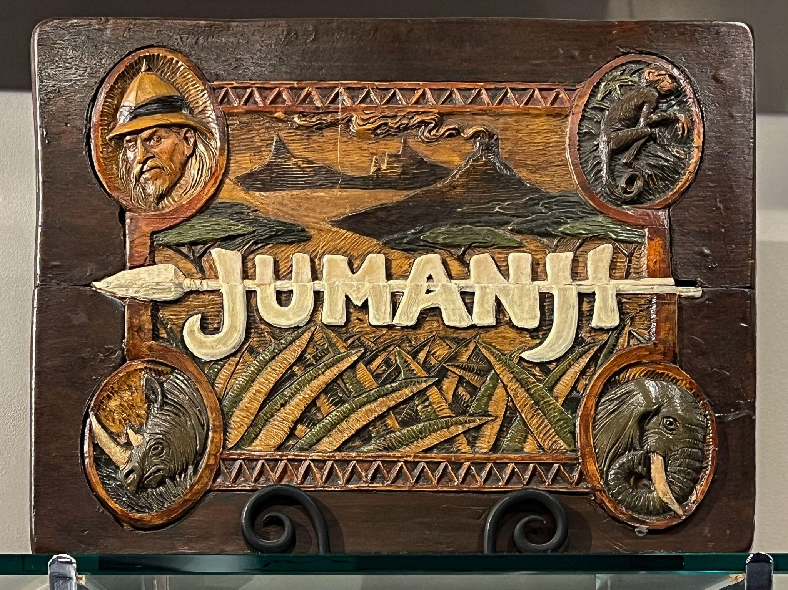
Have you read the book or seen one of the Jumanji movies?
Notes:
Jumanji images – browse 74 stock photos, vectors, and video. Adobe Stock. (n.d.). https://stock.adobe.com/search?k=jumanji&asset_id=692779845

Slide 6
What dangers would you experience in the jungle?
Notes:
Encourage them to think about weather, animals, bugs, plants, etc. This brainstorm will provide a little context for the story.

Slide 7
Story time
Listen to a part of the story about the game of Jumanji.

Slide 8
Think-Pair-Share
What is the likelihood that Judy will roll a 12 to end the game?
Notes:
K20 Center. (n.d.). Think-pair-share. Strategies. https://learn.k20center.ou.edu/strategy/139

Slide 9
Story time
Listen to the rest of the story about the game of Jumanji.
Notes:
Finish reading the rest of the book.
(Video: Finish watching Jumanji (7/8), and then go to slide 12 to show Jumanji (8/8). Ask the question, "What was the likelihood that Alan was going to roll a number that was three or greater?" Was the likelihood greater for Sarah or Alan to finish the game? Why?"

Slide 10
Think-Pair-Share
Do you think Judy is likely to roll a 12 to finish the game?
Which sum or sums would Judy most likely have rolled with two standard dice?
Notes:
FOR THE BOOK

Slide 11
Notes:
YouTube. (n.d.-b). Jumanji (7/8) Movie Clip - earthquake. YouTube. https://www.youtube.com/watch?v=SiUT8u1LckQ

Slide 12
Think-Pair-Share
What is the likelihood that Sarah will roll a 7 to end the game?
Notes:
K20 Center. (n.d.). Think-pair-share. Strategies. https://learn.k20center.ou.edu/strategy/139

Slide 13
Notes:
YouTube. (n.d.-b). Jumanji (7/8) Movie Clip - earthquake. YouTube. https://www.youtube.com/watch?v=SiUT8u1LckQ

Slide 14
Notes:
YouTube. (n.d.-c). Jumanji (8/8) Movie Clip - Jumanji. YouTube. https://www.youtube.com/watch?v=M0TjT53qpFY

Slide 15
Think-Pair-Share
What was the likelihood that Alan was going to roll a number that was three or greater?
Was the likelihood greater for Sarah or Alan to finish the game? Why?
Which sums were Sarah and Alan most likely to roll with two standard dice?

Slide 16
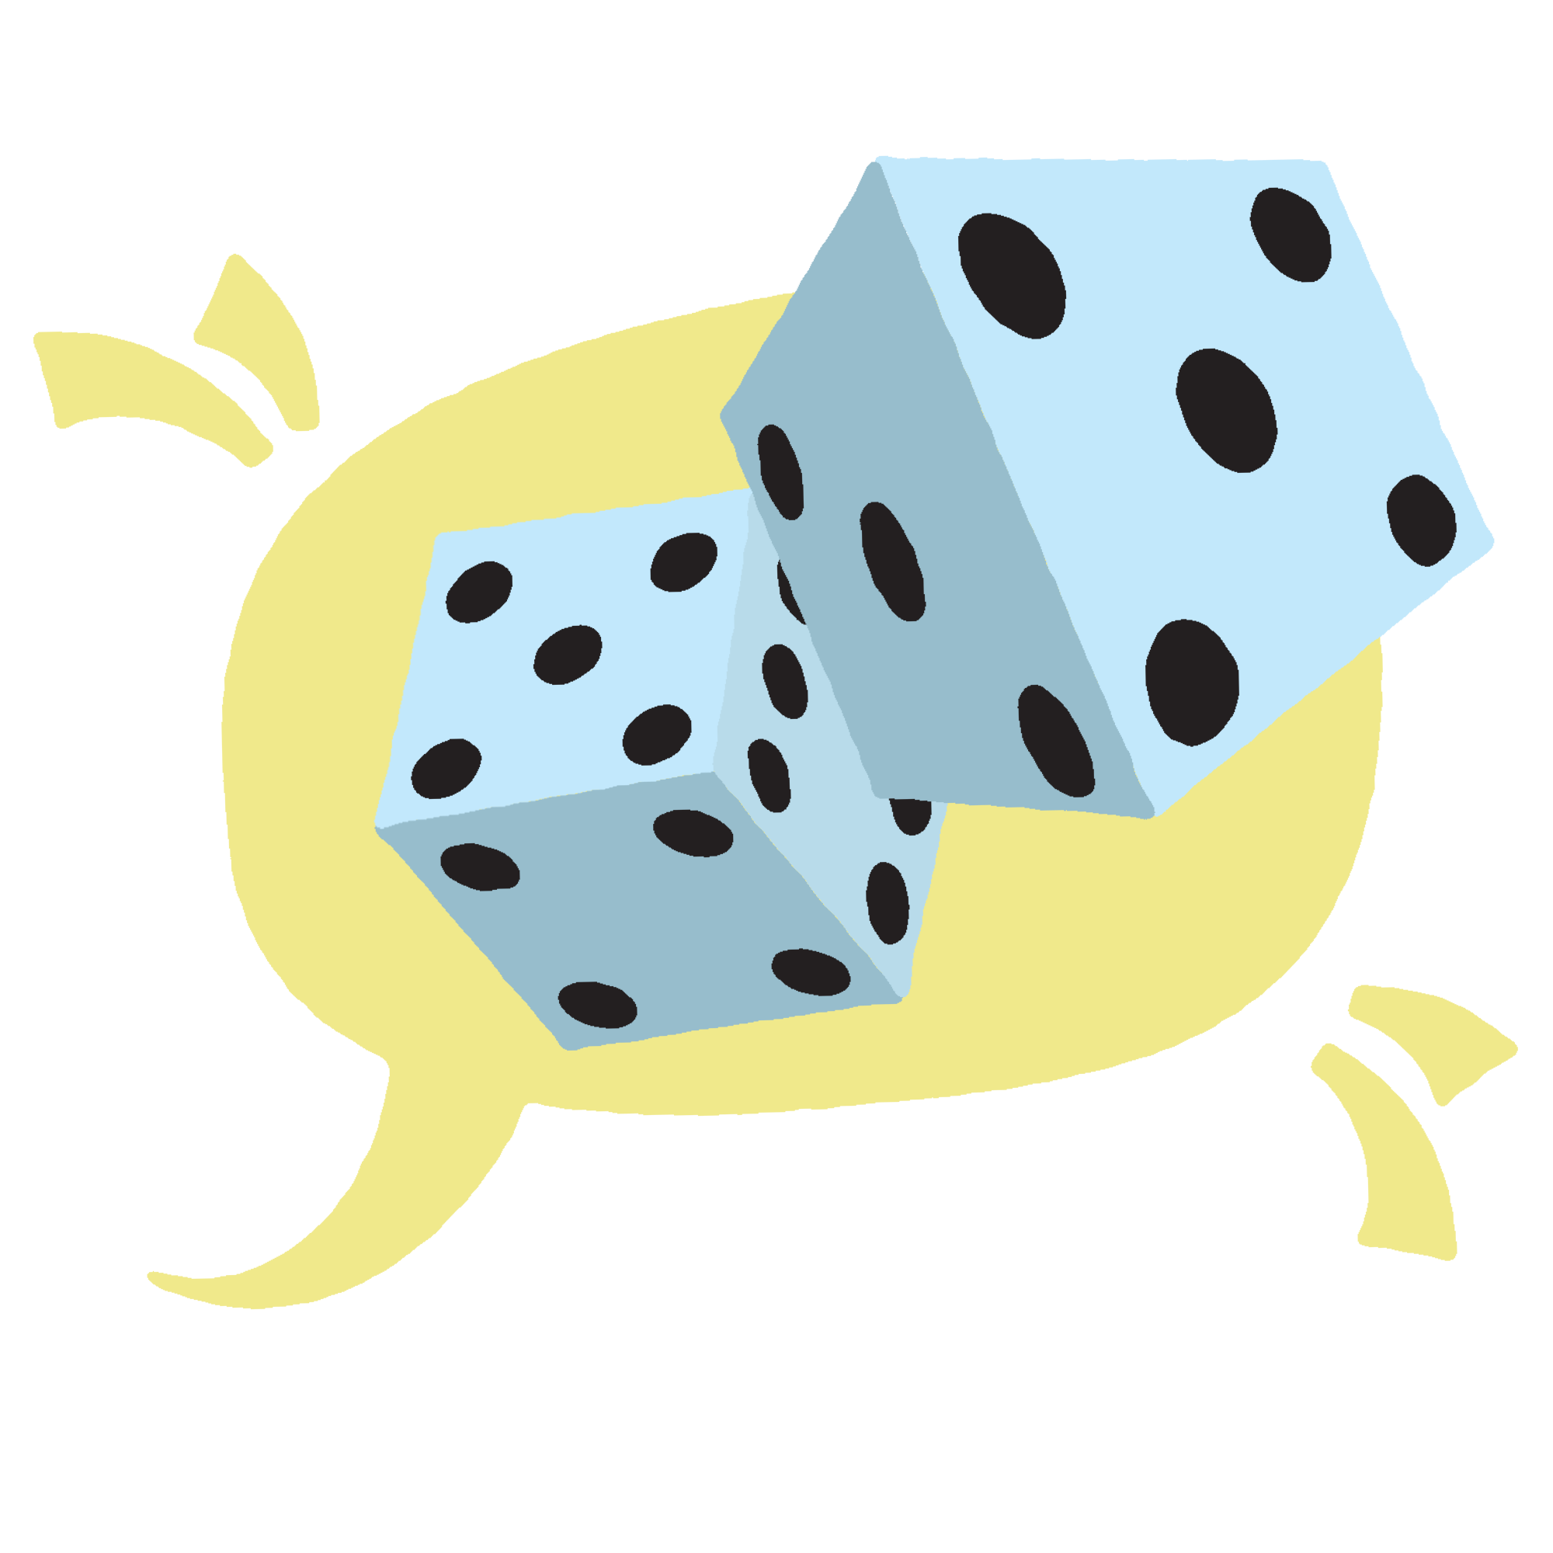
Whole Class Discussion
What sums are impossible to roll with two standard dice?

Slide 17
What is Sample Space?

Slide 18
Sums of Jumanji
Record a prediction as to which sum you think would appear most often and why.

Slide 19
Sums of Jumanji
In pairs:
Roll the two dice.
Record the value of the sum under the corresponding column on your handout. For example: If the dice were a 2 and 3, you would write 2+3 in row 1 under the 5 column.
Continue to take turns rolling the dice until you have reached 15 rolls.
Which sum was actually rolled most frequently?

Slide 20
Making Predictions
Using the follow scenarios, make predictions based on your data.
What might happen to the results if we continued to roll the dice another 10 times, 15 times, 100 times, etc? What would you expect to happen to the sums?
If we rolled the dice 15 more times, how many times would you expect to get a sum that equals _______?
If we had rolled the dice only 5 times, how many times would you expect to have received a sum that equals _______?

Slide 21
Class Discussion

Slide 22
What other games or activities that might have a sample space, theoretical probability, and experimental probability?

Slide 23
Using Games at Home
Using the Game Station Probability Data Sheet, record the following for each game:
The Title
The Sample Space
The Theoretical Probability
If possible, bring a game to class tomorrow for another learning experience.
Notes:
Jumanji images – browse 74 stock photos, vectors, and video. Adobe Stock. (n.d.). https://stock.adobe.com/search?k=jumanji&asset_id=692779845

Slide 24
Game Stations
Choose a game to play and record experimental probability.

Slide 25
What Did I Learn Today?
Write down what you now understand about probability.
Notes:
K20 Center. (n.d.). What did I learn today. Strategies. https://learn.k20center.ou.edu/strategy/169

