Slide 2
Sums of Jumanji
Probability

Slide 3
Essential Question
When might we use probability and why? Why do we need probability?

Slide 4
Lesson Objective
Students will be able to find experimental and theoretical probability for simple events.

Slide 5
Have you read the book or seen the movie Jumanji?
Notes:
Begin by asking if students have read the book or seen the movie Jumanji. If you have students who have read the book or seen the movie, ask one or two of them to provide a brief description of the story.

Slide 6
What dangers would you experience in the jungle?
Notes:
Encourage them to think about weather, animals, bugs, plants, etc. This brainstorm will provide a little context for the story.

Slide 7
Story time
Listen to a part of the story about the game of Jumanji.
Notes:
Next, read the book to the class, but stop on page 22 after Judy is told by Peter "If you roll a twelve you can get out of the jungle."
(For video clip Jumanji 7/8, play the first 39 seconds, stopping the video right before Sarah rolls the dice.)

Slide 8

Think-Pair-Share
Do you think Judy is likely to roll a 12 to finish the game?
Notes:
FOR THE BOOK
Students will reflect on the spectrum of likelihood (impossible, 0; unlikely, between 0 and 1/2; likely as not, 1/2; likely, between 1/2 and 1; or certain, 1). Instruct students to turn to their elbow partners and take turns sharing and explaining their responses. Student pairs will then share with the whole class what they discussed (what they agreed or disagreed upon and why).

Slide 9
Think-Pair-Share
Do you think Sarah is likely to roll a 7 to finish the game?
Notes:
FOR THE VIDEO
Students will reflect on the spectrum of likelihood (impossible, 0; unlikely, between 0 and 1/2; likely as not, 1/2; likely, between 1/2 and 1; or certain, 1). Instruct students to turn to their elbow partners and take turns sharing and explaining their responses. Student pairs will then share with the whole class what they discussed (what they agreed or disagreed upon and why).

Slide 10
Story time
Listen to more of the story about the game of Jumanji.
Notes:
Finish reading the rest of the book.
(Video: Finish watching Jumanji (7/8), and then go to slide 12 to show Jumanji (8/8). Ask the question, "What was the likelihood that Alan was going to roll a number that was three or greater?" Was the likelihood greater for Sarah or Alan to finish the game? Why?"

Slide 11
Think-Pair-Share
Do you think Judy is likely to roll a 12 to finish the game?
Which sum or sums would Judy most likely have rolled with two standard dice?
Notes:
FOR THE BOOK

Slide 12
Think-Pair-Share
What was the likelihood that Alan was going to roll a number that was three or greater?
Was the likelihood greater for Sarah or Alan to finish the game? Why?
Which sums were Sarah and Alan most likely to roll with two standard dice?
Notes:
Video: Finish watching Jumanji (7/8), and then show Jumanji (8/8).

Slide 13
Whole Class Discussion
What sums are impossible to roll with two standard dice?
Notes:
Allow students time to consider a few sums that would be impossible to create when rolling two standard dice. Students will hopefully come to a consensus that the sums can only be 2-12. Nothing less and nothing more would be possible unless they were to use dice with more sides or different numbers.

Slide 14
What is Sample Space?
Range of possible outcomes.
Notes:
Briefly explain that the range of possible outcomes is called the Sample Space. In the story, the sample space are the possible sums.

Slide 15
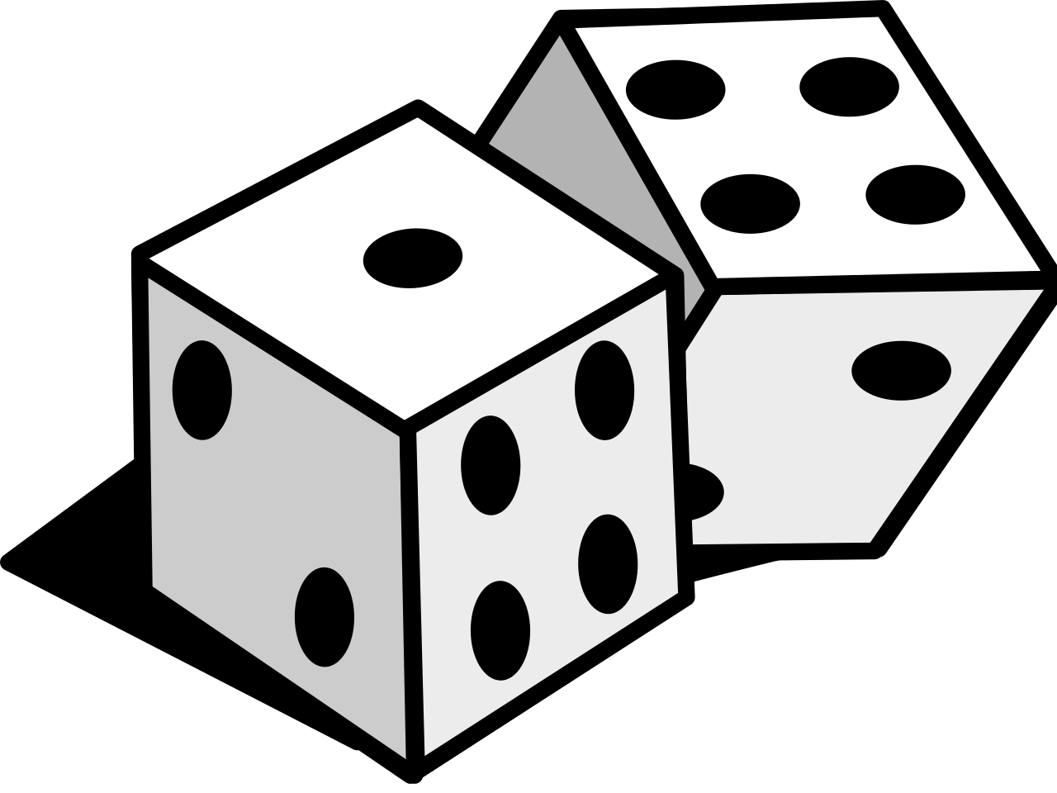
Sums of Jumanji
Record a prediction as to which sum you think would appear most often and why.
Notes:
This Photo by Unknown Author is licensed under CC BY-SA
Before students begin rolling the dice, say to students, "Record a prediction at the top of your sheet: Which sum you think would appear most often and why?"

Slide 16
Sums of Jumanji
In pairs:
Roll the two dice.
Record the value of the sum under the corresponding column on your handout.
For example: If the dice were a 2 and 3, you would write 2+3 in Roll 1 under the 5 column.
Continue to take turns rolling the dice until you have reached 15 rolls.
Which sum was actually rolled most frequently?
Notes:
Ask each pair to roll the two dice 15 times. After each roll, students should record the value of the sum under the corresponding column. (See the image below for an example.)
After students complete 15 rolls, determine which sum appeared most frequently. Was it what they predicted? Take a moment to explore which sums theoretically should have appeared most frequently (6 and 8).

Slide 17
Making Predictions
Using the follow scenarios, make predictions based on your data.
What might happen to the results if we continued to roll the dice another 10 times, 15 times, 100 times, etc? What would you expect to happen to the sums?
If we rolled the dice 15 more times, how many times would you expect to get a sum that equals _______?
If we had rolled the dice only 5 times, how many times would you expect to have received a sum that equals _______?
Notes:
On the Sums of Jumanji handout. Make these questions available to pairs as they begin to finish the “Sums of Jumanji” experiment.
Student pairs should use proportional reasoning (or knowledge to make equivalent fractions or ratios) to consider and answer these questions. Each group will receive different answers based on their experimental data. Also, for the groups who cannot solve for a whole number, discuss the implications and meaning of "part of whole" for these instances. For example, ask, "Can you roll the sum ‘6’ 13.2 times? Is that a good representation? Why or why not?"
Each group will have different quantities for each sum, because each experiment will vary slightly in outcomes. These differences can be explored later during the Explain portion of the lesson.

Slide 18
Class Discussion
Notes:
After student pairs make their claims based on the scenarios from slide 17, ask open-ended questions to facilitate a class discussion. Allow students to reflect on their results before asking them to share aloud. This reflection time provides an opportunity for all to consider and formulate a response in order to contribute to the group discussion.

Slide 19
What other games or activities that might have a sample space, theoretical probability, and experimental probability?
Notes:
Following the discussion, instruct students to think about other games or activities that they have at home that might have a sample space, theoretical probability, and experimental probability. As a whole group, brainstorm and list games or activities on the board. These values should be recorded in a shared digital document (Google Docs, Google Slides, etc.) linked in the attachments or provided on a handout for each student.

Slide 20

Using Games at Home
Using the shared digital document, record the following for each game:
The Title
The Sample Space
The Theoretical Probability
If possible, bring a game to class tomorrow for another learning experience.
This Photo by Unknown Author is licensed under CC BY-NC
Notes:
For homework, have students find sample space and theoretical probability using a game or activity that they have access to at home. These values should be recorded in a shared digital document (Google Docs, Google Slides, etc.) linked in the attachments or provided on a handout for each student.
Create a shared digital document (Google Docs, Google Sheets, Google Forms, etc.) for students to record each game title, the sample space, and the theoretical probability. If you don’t have a digital resource, students will bring these on a sheet of paper to record as they walk into class the following day.
(Optional: Ask students to bring the game or activity that they used for homework to school the next day so that their data for sample space and theoretically probability directly connect to the experimental data that they will record from the game stations)

Slide 21
Game Stations
Choose a game to play and record experimental probability.
Notes:
In the same shared digital document used the night before, students should record their experimental probability findings for each game that they play. See the example below for what it might look like.

Slide 22
What Did I Learn Today?
Individually, write down what you know understand about probability.
Notes:
After all findings have been recorded, each student should individually reflect through a detailed writing using the strategy What Did I Learn Today. Writing should specifically focus on the connections (similarities and differences) between the experimental findings compared to the sample space and theoretical probability for each game listed or just the games they played in class. Students should also create and record examples of possible predictions based on the data from the experimental probability and the theoretical probability for each game (or just the games that they played in class).

