Slide 1
Jurassic Art
Ceramic Creation of Dinosaur Eggs, Jurassic Park-style

Slide 2
Essential Question
How do we make visual conclusions based on the evidence presented?

Slide 3
Lesson Objectives
Explore LEARN style and formatting conventions.
Practice editing attachments using APA style and LEARN style and formatting conventions.

Slide 4
What is it?
On the next slides, you’ll see the skeletons of animals or creatures known today.
Take a few moments to analyze each skeleton and guess what it is.
We’ll discuss each picture together.
Once the answer is revealed, take a moment to reflect on the following:
What surprised you about this skeleton?
What did you find most interesting about it?
What, if anything, was troubling to you about this skeleton?
Notes:
K20 Center. (n.d.). Surprising, interesting, troubling. Strategies. https://learn.k20center.ou.edu/strategy/926

Slide 5
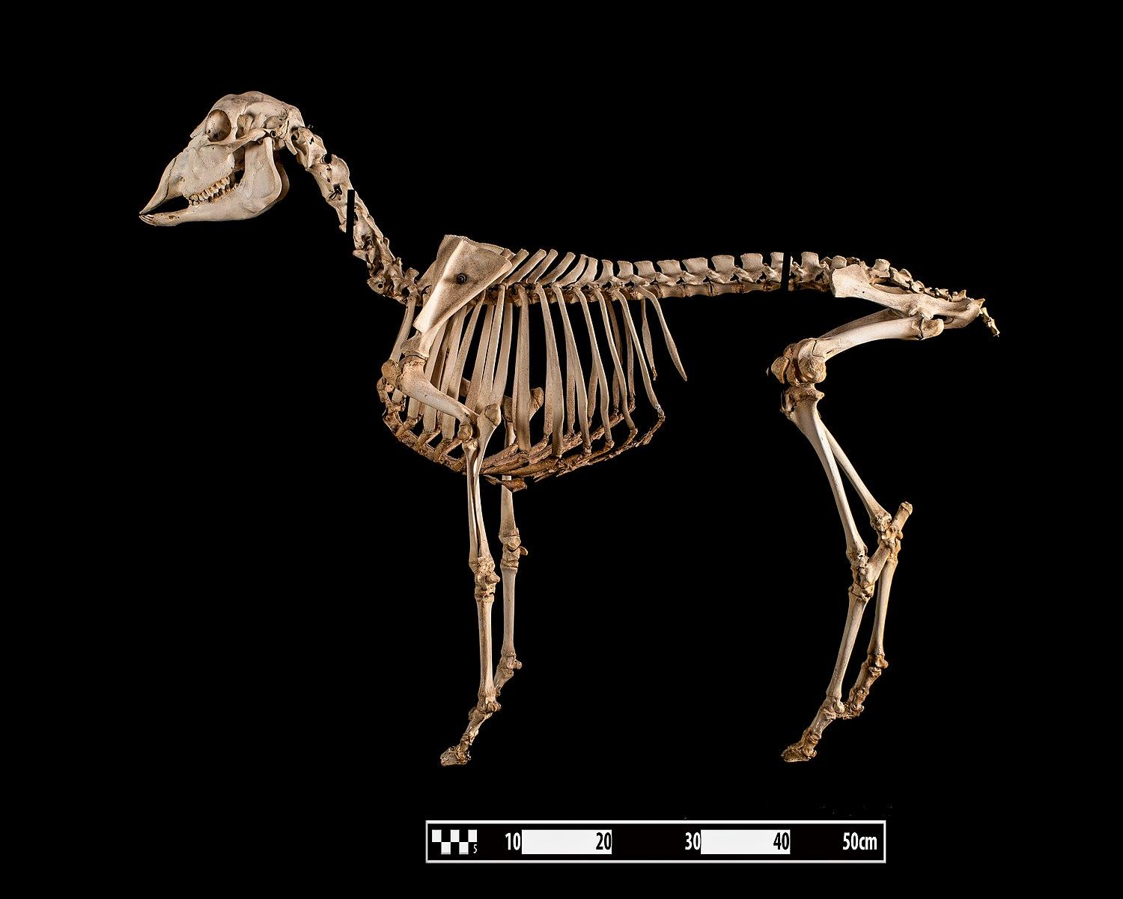
What is it?
Notes:
Museum of Veterinary Anatomy (FMVZ USP). (2015, December 16). Sheep skeleton at MAV-USP [Photograph]. Wikimedia Commons. (https://commons.wikimedia.org/wiki/File:Sheep_skeleton_at_MAV-USP.jpg

Slide 6
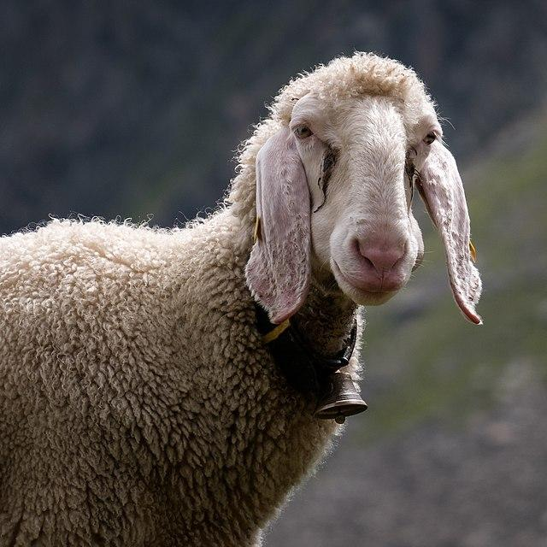
What is it?
What surprised you about this skeleton?
What did you find most interesting about it?
What, if anything, was troubling to you about this skeleton?
Notes:
Answer: Sheep
Basotxerri. (2018, July 16). Stubai - Tiroler Bergschaf -BT- 01 [Photograph]. Wikimedia Commons. https://commons.wikimedia.org/wiki/File:Stubai_-_Tiroler_Bergschaf_-BT-_01.jpg

Slide 7
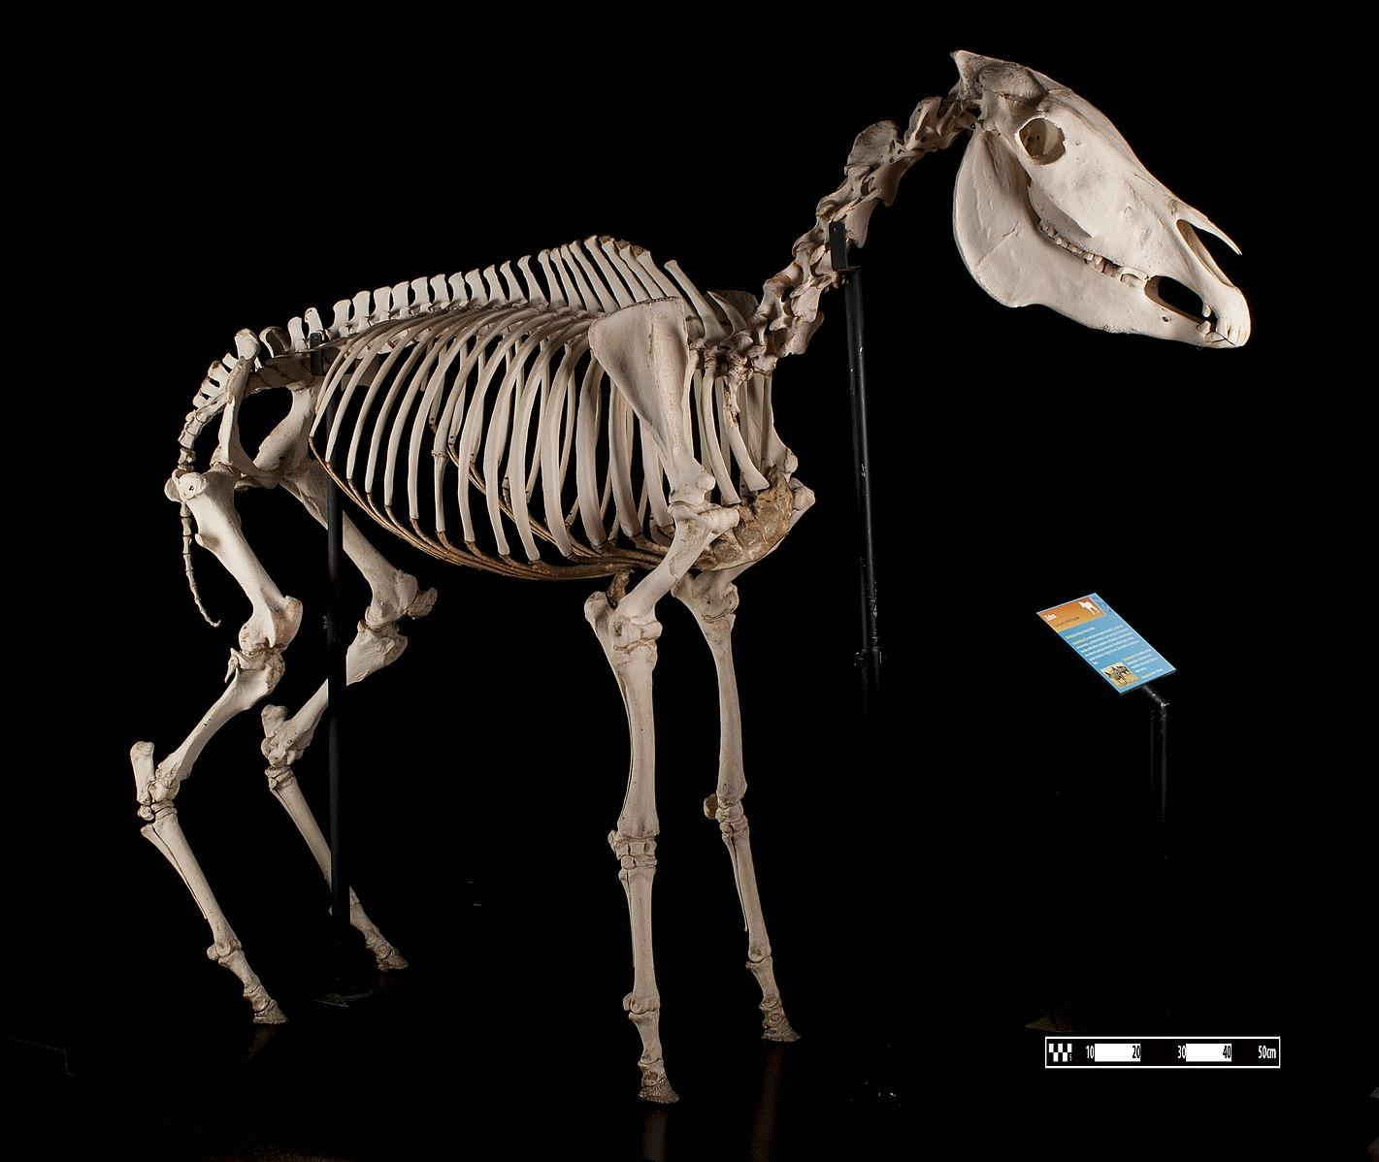
What is it?
Notes:
Museum of Veterinary Anatomy (FMVZ USP). (2015, December 16). Zebra skeleton at MAV-USP [Photograph]. Wikimedia Commons. https://commons.wikimedia.org/wiki/File:Zebra_skeleton_at_MAV-USP.jpg

Slide 8
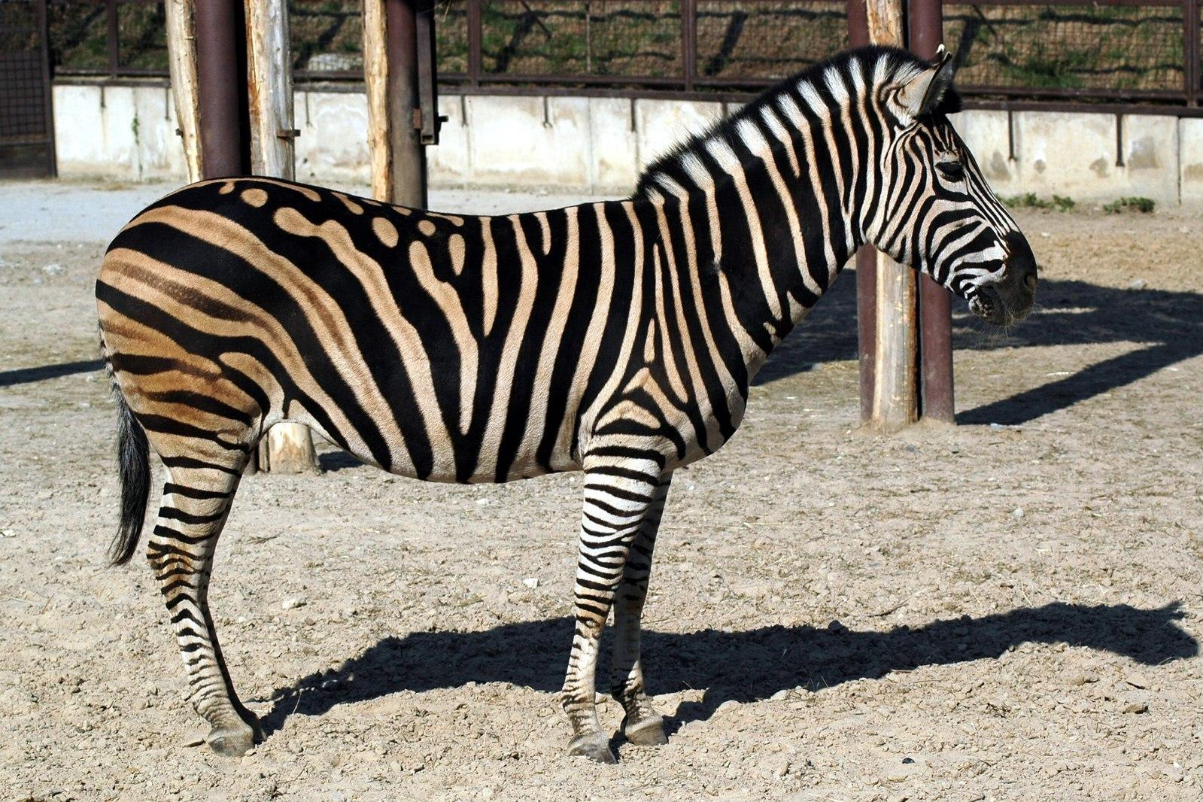
What is it?
What surprised you about this skeleton?
What did you find most interesting about it?
What, if anything, was troubling to you about this skeleton?
Notes:
Answer: Zebra
Novak, S. (2006). Zebra 02 [Photograph]. Wikimedia Commons. https://commons.wikimedia.org/wiki/File:Zebra_02.jpg

Slide 9
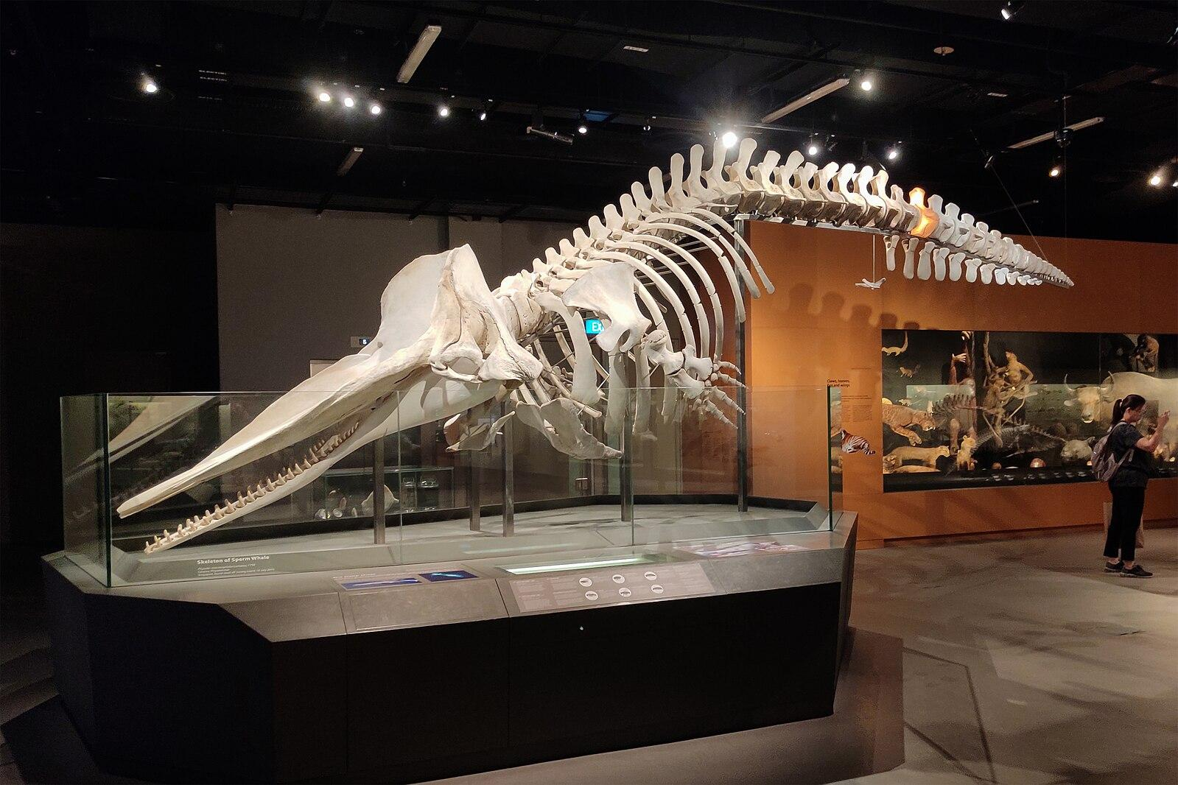
What is it?
Notes:
Reeyad, M. (2023, August 22). Skeleton of sperm whale (Physeter macrocephalus), Lee Kong Chian Natural History Museum [Photograph]. Wikimedia Commons. https://commons.wikimedia.org/wiki/File:Skeleton_of_Sperm_Whale_(Physeter_macrocephalus),_Lee_Kong_Chian_Natural_History_Museum_(105036).jpg

Slide 10
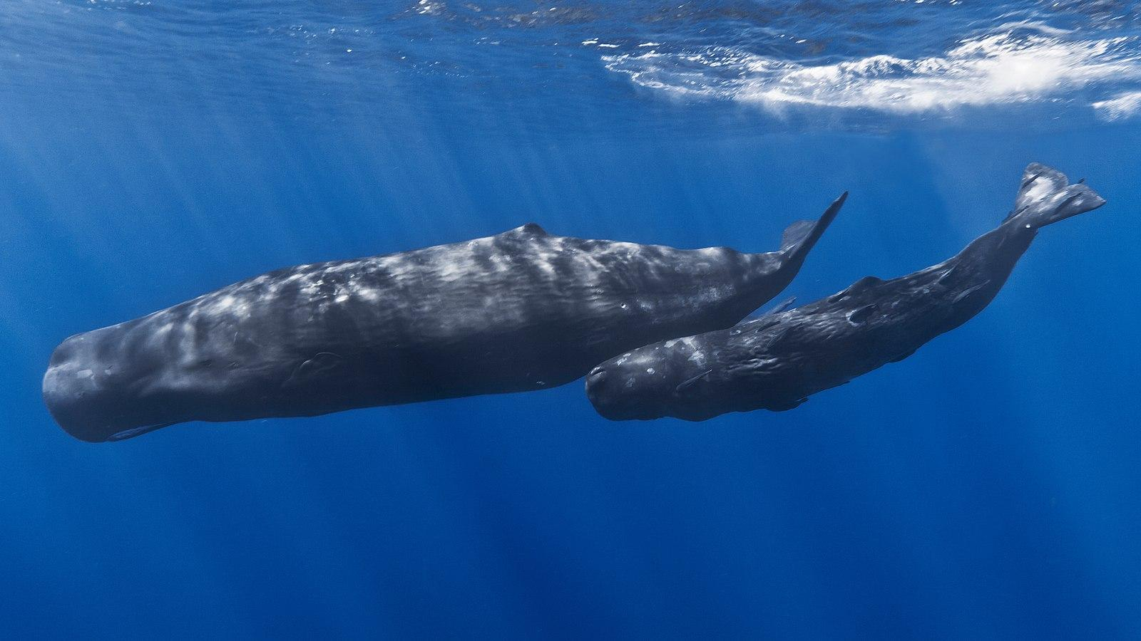
What is it?
What surprised you about this skeleton?
What did you find most interesting about it?
What, if anything, was troubling to you about this skeleton?
Notes:
Answer: Sperm Whale
Barathieu, G. (2013, January 26). Mother and baby sperm whale [Photograph]. Wikimedia Commons. https://commons.wikimedia.org/wiki/File:Mother_and_baby_sperm_whale.jpg

Slide 11
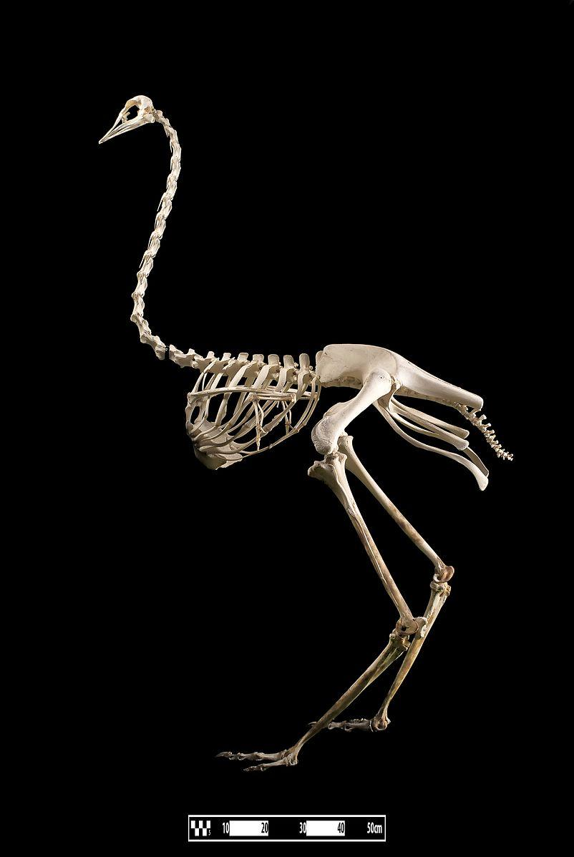
What is it?
Notes:
Museum of Veterinary Anatomy (FMVZ USP). (2016, June 20). Avestruz alta [Photograph]. Wikimedia Commons. https://commons.wikimedia.org/wiki/File:Avestruz_alta.jpg

Slide 12
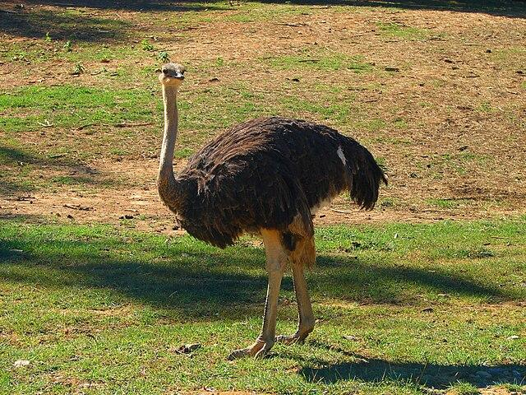
What is it?
What surprised you about this skeleton?
What did you find most interesting about it?
What, if anything, was troubling to you about this skeleton?
Notes:
Answer: Ostrich
Jyothis at Malayalam Wikipedia. (2007, October 30). Ostrich in safari [Photograph]. Wikimedia Commons. (https://commons.wikimedia.org/wiki/File:Ostrich_in_safari.jpg

Slide 13
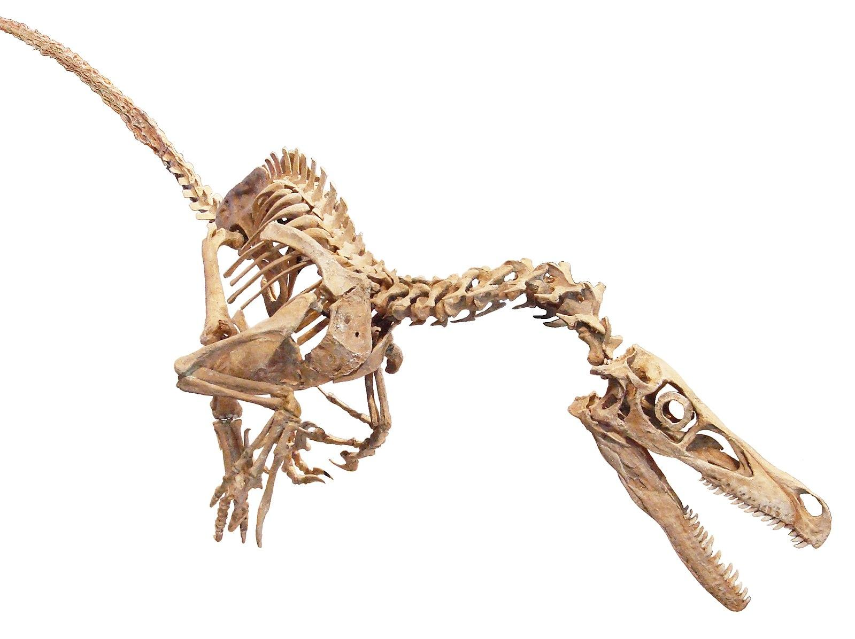
What is it?
Notes:
Vázquez, E. S. (2022, July 13). Velociraptor skeleton white background [Photograph]. Wikimedia Commons. https://commons.wikimedia.org/wiki/File:Velociraptor_skeleton_white_background.jpg

Slide 14
What is it?
What surprised you about this skeleton?
What did you find most interesting about it?
What, if anything, was troubling to you about this skeleton?
Notes:
Answer: Velociraptor
UnexpectedDinoLesson. (2024, August 11). Velociraptor UDL [Photograph]. Wikimedia Commons. https://commons.wikimedia.org/wiki/File:Velociraptor_UDL.png

Slide 15
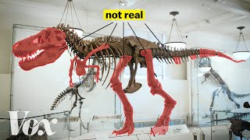
How Scientists Solved this Dinosaur Puzzle
Notes:
https://www.youtube.com/watch?v=oPPJ7GGDyAw

Slide 16
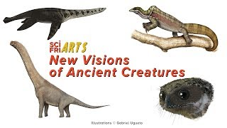
PaleoArt - New Visions of Ancient Creatures
Notes:
https://www.youtube.com/watch?v=t5NIua_Dveo

Slide 17
Let’s Discuss
Were paleontologists lucky when it came to their tyrannosaurus rex reconstruction guesswork, or smart?
How has technology changed the guesswork?
Do you agree with the practice of “filling in the blanks” for exhibits?

Slide 18
Sketch It
Choose a dinosaur model to sketch.
Start with a basic shape, then fill in details.
Sketch your model from as many different angles as you can in the given amount of time.
Don’t be afraid to add your own interpretation to their appearance!

Slide 19
Choose a Dinosaur
Oviraptor | Allosaurus
Maiasaura | Hypacrosaurus
Apatosaurus | Pinacosaurus
Triceratops | Protoceratops
Alamosaurus | Coelurosauria
Sinornithomimus | Citipati

Slide 20
Claim, Evidence, Reasoning
Question: "How do paleontologists and paleoartists determine what a dinosaur looked like?"
Focusing on the dinosaur you have chosen, complete the CER:
Make a CLAIM by answering the research question.
Research your dinosaur to gather EVIDENCE in support of your claim.
Explain your REASONING by forming a conclusion based on your research.
Notes:
K20 Center. (n.d.). Claim, evidence, reasoning (CER). Strategies. https://learn.k20center.ou.edu/strategy/156

Slide 21
Create Your Infographic
Using your collected research, create an infographic about your chosen dinosaur.
Go to Canva.com and log in or sign up.
Choose an infographic template to use.
Use the Dinosaur Infographic Rubric as a guide while creating your infographic.
Notes:
K20 Center. (n.d.). Canva. Tech tools. https://learn.k20center.ou.edu/tech-tool/612

Slide 22
Sketch It, Again.
Now that you have thoroughly researched your chosen dinosaur, use your graphic organizer to sketch the different perspectives and parts of your dinosaur.
Be thorough and take your time.
Remember that these sketches will be displayed with your infographic and sculpture.

Slide 23
Time to Sculpt!
Using the sketches on your graphic organizer as a guide, sculpt a baby version of your dinosaur and its egg.
Make sure to use your Dinosaur Sculpture Rubric and your gathered research as a reference while you work.

Slide 24
Show Off Your Work
Set up your sculpture, infographic, and sketches for display.
With your partner, walk around the room and observe your classmates’ work.
Take time to discuss each display with your partner.
Notes:
K20 Center. (n.d.). Gallery walk/carousel. Strategies. https://learn.k20center.ou.edu/strategy/118

Slide 25
Rose, Bud and Thorn
As you reflect on the work you have done, answer the following questions on a sheet of paper:
Rose: What are you most proud of accomplishing during this project?
Bud: What real world connections do you see between science and art after completing this project?
Thorn: What struggles did you encounter during this project?
Notes:
K20 Center. (n.d.). Rose, Bud and Thorn. Strategy. https://learn.k20center.ou.edu/strategy/2224

