Slide 2
The Art of Taking Up Space
Day 1: Installation Art

Slide 3
Essential Question
What is the purpose of installation art?

Slide 4
Learning Objectives
Learn about installation art.
Collaborate in groups to plan, implement, and create an installation work of art.
Create three-dimensional sculptures to fill a specific space.

Slide 5
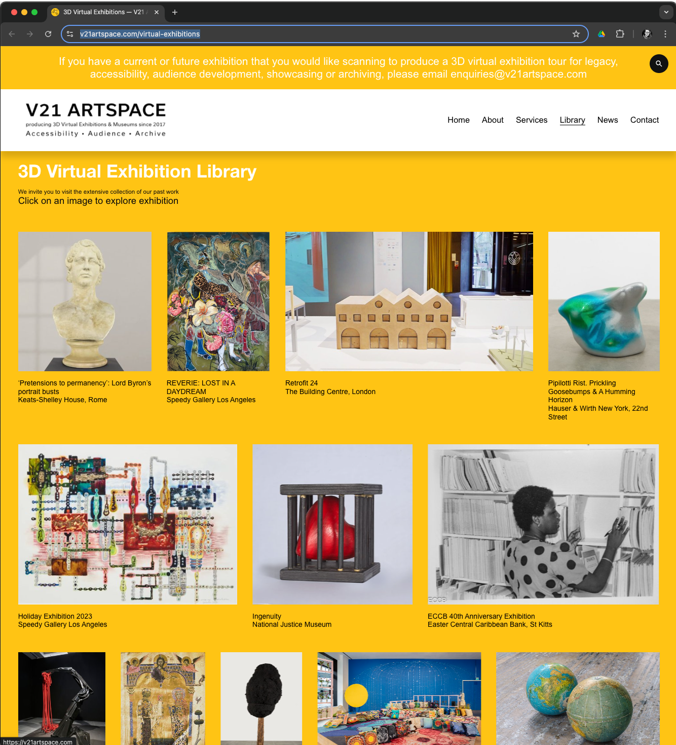
Choose an exhibition to explore:
https://v21artspace.com/virtual-exhibitions

Slide 6
Art Installations
Describe the art installation that you toured.
What was the theme?
What drew your attention?
How do these installations change the way we perceive the space?
What emotions or thoughts do these artworks provoke?
Notes:
Engage: Virtual Art exhibition
Once all students have had a chance to share with their partner, ask individuals to share with the class what their partner explained to them. Then, hold a whole-class discussion.
20-30 minutes

Slide 7
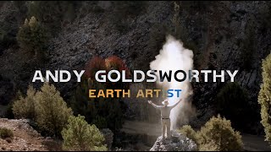
Notes:
Sheridan, C. (2020, May 19). Andy Goldsworthy - Earth artist and his process [Video]. YouTube. https://www.youtube.com/watch?v=sngXz55b4bc
9 minutes

Slide 8

Point of Most Significance
What stood out to you the most about Andy Goldsworthy?
Write down on a sticky note the point of most significance for you from the video.
Post your sticky note and be ready to explain why it resonated with you.
Notes:
5 minutes

Slide 9
The Art of Taking Up Space
Day 2: Brainstorming

Slide 10
Review Point of Most Significance
What common themes do you see in what we all wrote as our POMS?
Notes:
5 minutes
Once all sticky notes are collected, begin reading out loud student responses and grouping similar ideas to start making connections and gauging students' learning.

Slide 11
Art Installation Parameters
Location | Permanency | Medium
[Add specifics here] | [Add specifics here] | [Add specifics here]
Notes:
5 minutes

Slide 12
Putting the Pieces Together: Brainstorming
Phase 1: Independent
Observe
Reflect
Needs
Develop
Notes:
5 minutes

Slide 13
Putting the Pieces Together: Brainstorming
Phase 1: Independent
Phase 2: Group Collaboration
Observe
Reflect
Needs
Develop
Share Ideas
Identify Similarities
Narrow Down
Create a Plan
Notes:
10 minutes

Slide 14
Begin Making Drawings and Models
Notes:
50 minutes

Slide 15
The Art of Taking Up Space
Day 3: Drawings and Models

Slide 16
Continue Making Drawings and Models
Notes:
50 minutes

Slide 17
The Art of Taking Up Space
Day 4: Principles of Design

Slide 18
Principles of Design
Movement
Rhythm
Emphasis
Notes:
30-40 minutes

Slide 19
Movement
Movements refers to how the viewer’s eye is guided through the artwork. Movement helps direct the viewer’s attention from one element to another. In your installation, think about how people will physically move around or within the space.
Consider:
How will their eyes travel across the different components of your work?
Are there natural lines or shapes that will guide them?
How can you use the space’s layout to encourage interaction or discovery?
Notes:
10 minutes

Slide 20
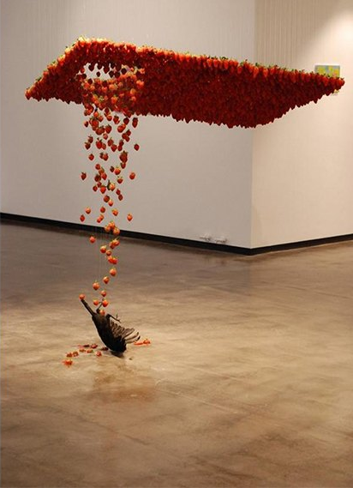
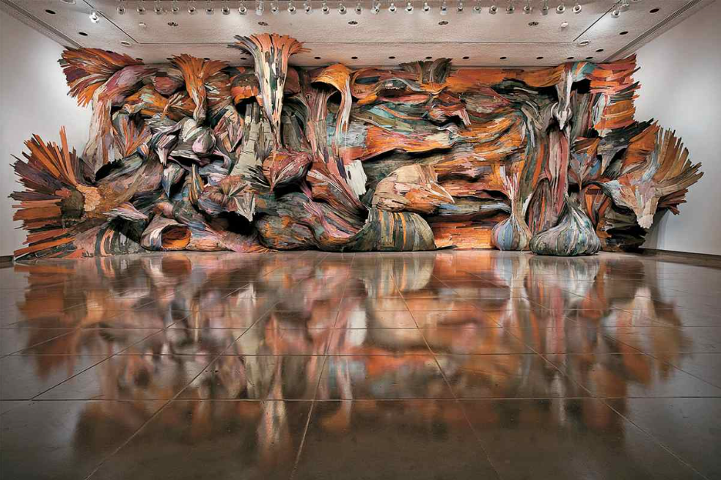
Right: Henrique Oliveira installation at Rice Gallery in Houston, titled Tapumes
Left: Claire Morgan installation of a crow falling through a plane of strawberries
Notes:
Lansroth, B. (2016, October 19). What is installation art and how does it transform our perception? Widewalls. https://www.widewalls.ch/magazine/installation-art

Slide 21
Rhythm
Rhythm in design is about creating a sense of repetition or a visual beat, much like rhythm in music. It’s achieved by repeating certain shapes, colors, or textures in a way that creates harmony or contrast.
Consider:
Are there patterns or repeating elements in your installation that will provide a sense of rhythm?
How can you alternate these elements to create interest and keep viewers engaged without overwhelming them?
Think about how rhythm can reflect the natural flow or pace of movement within a space.

Slide 22
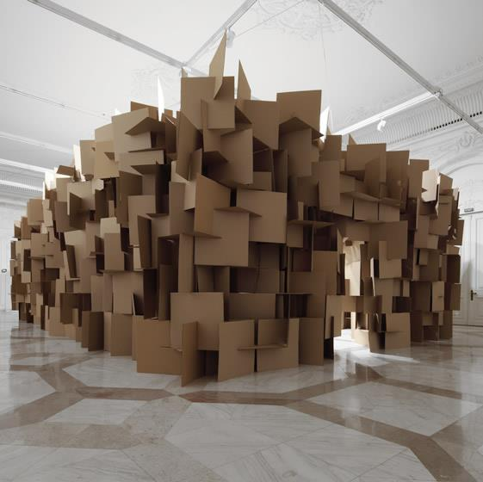
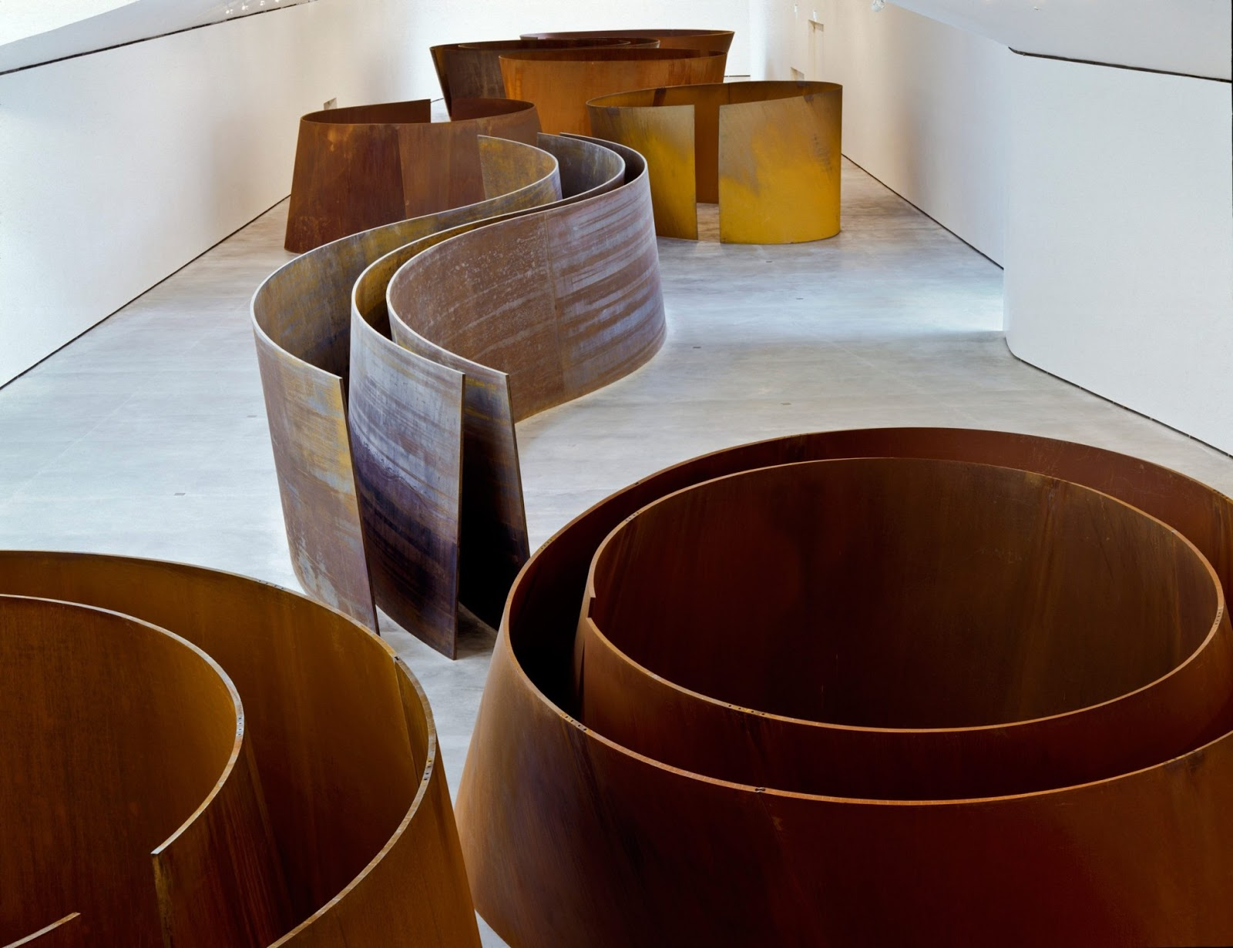
Right: Richard Serra, The Matter of Time, 1994-2005
Left: Zimoun, cardboard box installation
Notes:
Manaugh, G. (2011, June 6). The Space of Preparation. BLDGBLOG. ttps://bldgblog.com/2011/06/the-space-of-preparation/
Guerin, F. (2019, September 16). Richard Serra, The matter of time @ Guggenheim Bilbao. Fx Reflects. https://fxreflects.blogspot.com/2019/09/richard-serra-matter-of-time-guggenheim.html

Slide 23
Emphasis
Emphasis is about creating a focal point or directing attention to a specific part of your installation. You can do this through contrast, color, scale, or placement.
Consider:
What part of the installation should stand out the most?
How can you make this element the focal point while maintaining balance in the overall composition?
What will be the emotional or thematic impact of your point of emphasis?

Slide 24
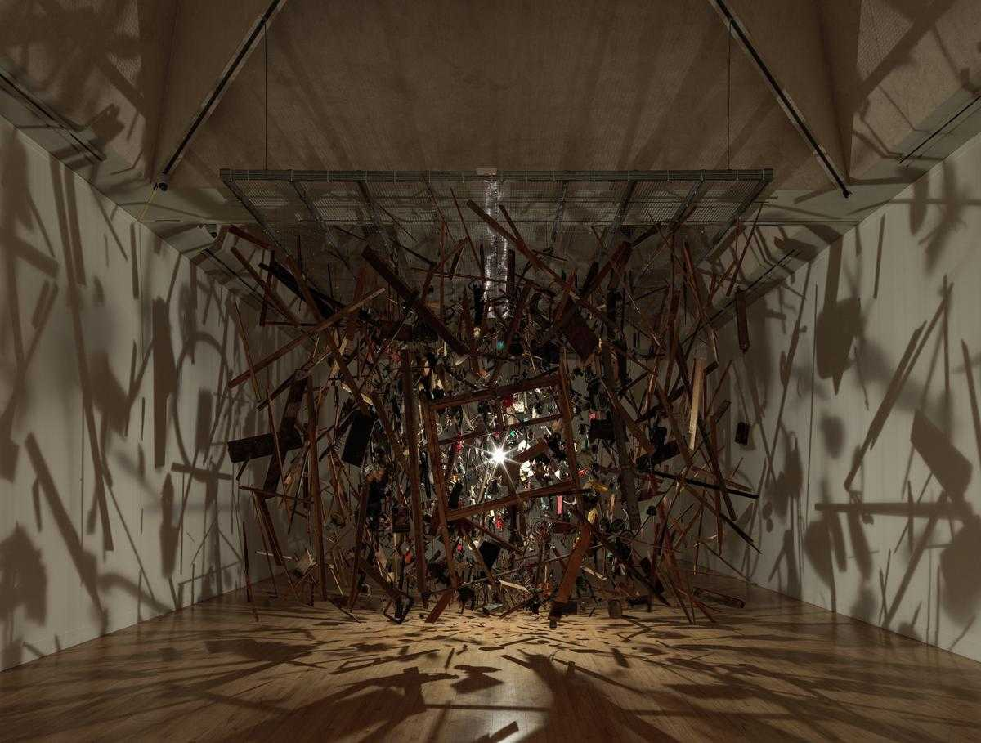
Left: Cornelia Parker CBE RA
Cold Dark Matter: An Exploded View (1991) Tate
Notes:
Tate. (n.d.). Art term: Installation art. Tate. https://www.tate.org.uk/art/art-terms/i/installation-art

Slide 25
Relating to your Client
How do you make sure you understand and meet the client’s goals?
What are the practical requirements of the space? How does the client use this space?
What are your client’s thematic or stylistic preferences?
How can you balance your creative ideas with practical constraints or client preferences?

Slide 26
Guest Speaker/Client/Principal
What goals or themes do you want the installation to reflect?
Are there any restrictions or guidelines that must be followed?
How do you see the installation contributing to the school environment?

Slide 27
Refine Proposals
Be sure to include:
A written overview of your concept
Describe how you incorporate the Principles of Design.
Point out how you have met key client considerations.
List the materials you will use and describe how you will execute your design.
Include one or more sketches or a mini mock-up
of the design.

Slide 28
The Art of Taking Up Space
Day 5: Feedback and Refinement

Slide 29

Gallery Walk
Observations/Compliments:
I was drawn to this proposal because…
One thing I really like about this installation is…
The proposal uses movement/rhythm/emphasis effectively because…
Suggestions for Improvement:
One element that could be refined or clarified is…
I’m curious about how the group plans to…
What challenges might arise in constructing or installing this,
and how will the group address them?

Slide 30
The Art of Taking Up Space
Build the Art

Slide 31

Notes:
WHYY. (2022, April 14). Michelle Lopez: sculptor and installation artist – movers & makers (2022) [Video]. YouTube. https://www.youtube.com/watch?v=XloMp6Ett74

Slide 32
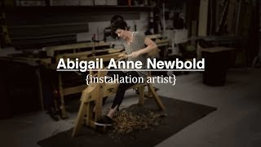
Notes:
HCT.media. (2013, October 17). Abigail Anne Newbold | Installation art documentary [Video]. YouTube. https://www.youtube.com/watch?v=T4dLi2xDxA0

Slide 33
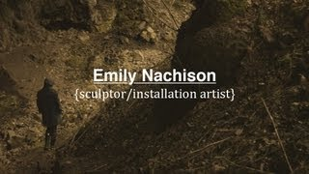
Notes:
HCT.media. (2013, March 14). Emily Nachison | Sculptor/installation artist (documentary) [Video]. YouTube. https://www.youtube.com/watch?v=uM5cB4NN9OA

Slide 34

Plus Delta Reflection
What went well (Plus)?
What you would change or do differently if you were to do a similar project in the future (Delta)?

