Slide 2
Taxed and Confused
Understanding Taxes

Slide 3
Essential Question
Why do we pay taxes and what do we get in return?

Slide 4
Objectives:
Understand the purpose of taxes.
Identify the different types of taxes.
Recognize to whom taxes are paid and what they fund.
Analyze the implications of taxation on individuals and communities.

Slide 5


ABC Graffiti
Work quickly to write words or phrases that answer the prompts at each station!
Notes:
https://k20.ou.edu/k20timers
K20 Center. (2021, September 21). Two Minute Timer. YouTube. https://www.youtube.com/watch?v=HcEEAnwOt2c&list=PL-aUhEQeaZXLMF3fItNDxiuSkEr0pq0c2&index=4

Slide 6
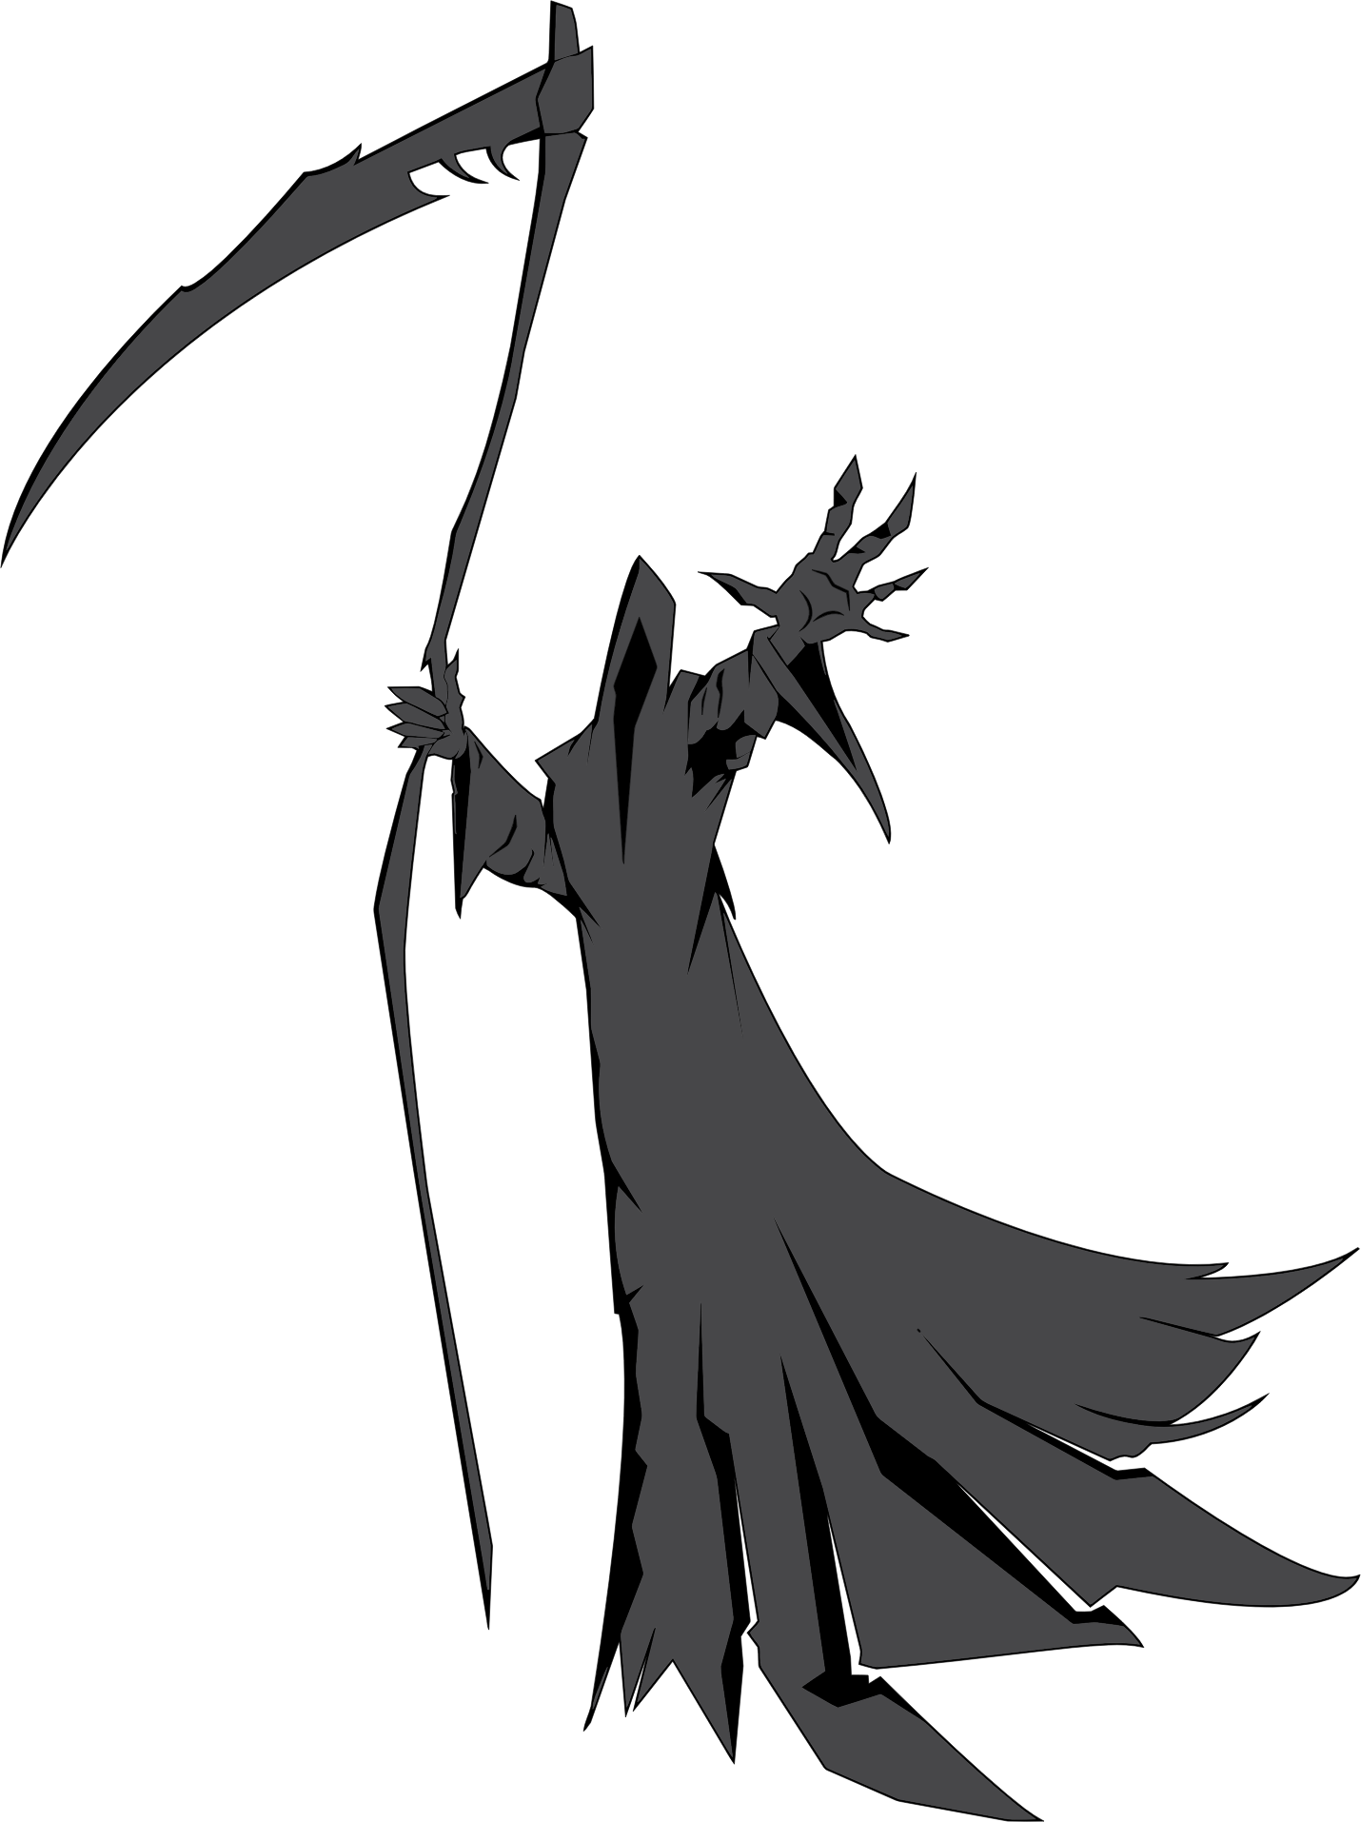
Typical U.S. taxes
Federal payroll
State income
Property
Sales
Estate/inheritance
Custom/tariff
Capital gains
Corporate income
Vehicle registration
Hotel/lodging
Notes:
GDJ. (2018, March 30). Grim reaper illustration [PNG]. Openclipart. https://openclipart.org/detail/299353/grim-reaper-illustration

Slide 7
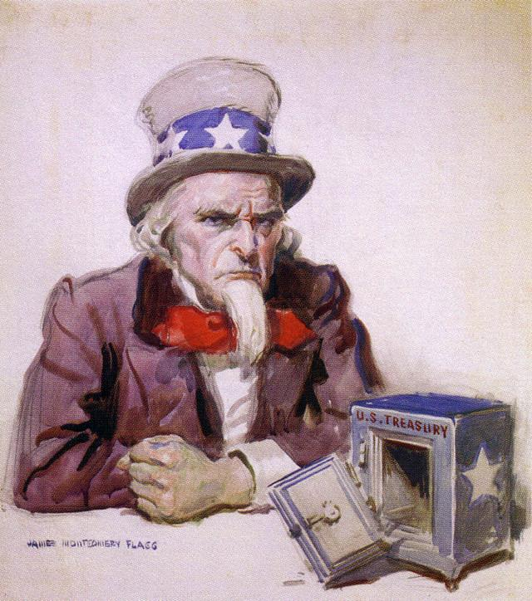
Elevator Speech
What kind of tax is it?
What does the tax pay for?
Who pays for the tax, and how?
What are some examples of when a tax is added and who benefits from it?
Notes:
Flagg, J. M. (1920). Uncle Sam is broke [Illustration]. Flickr. https://www.flickr.com/photos/infrogmation/3216700056

Slide 8
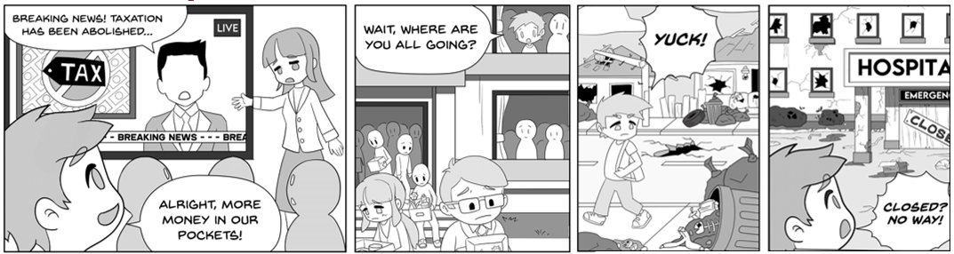
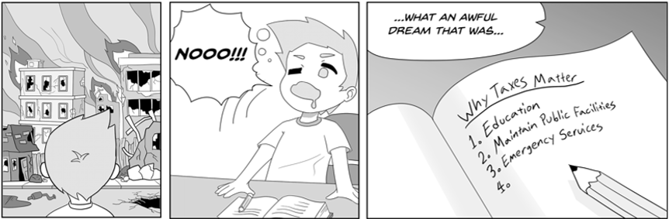
“A Day Without Taxes”
Notes:
Comic Strip

Slide 9


Think - Pair - Share Reflection
Which public service would you miss the most without taxes?
  Why?

Slide 10
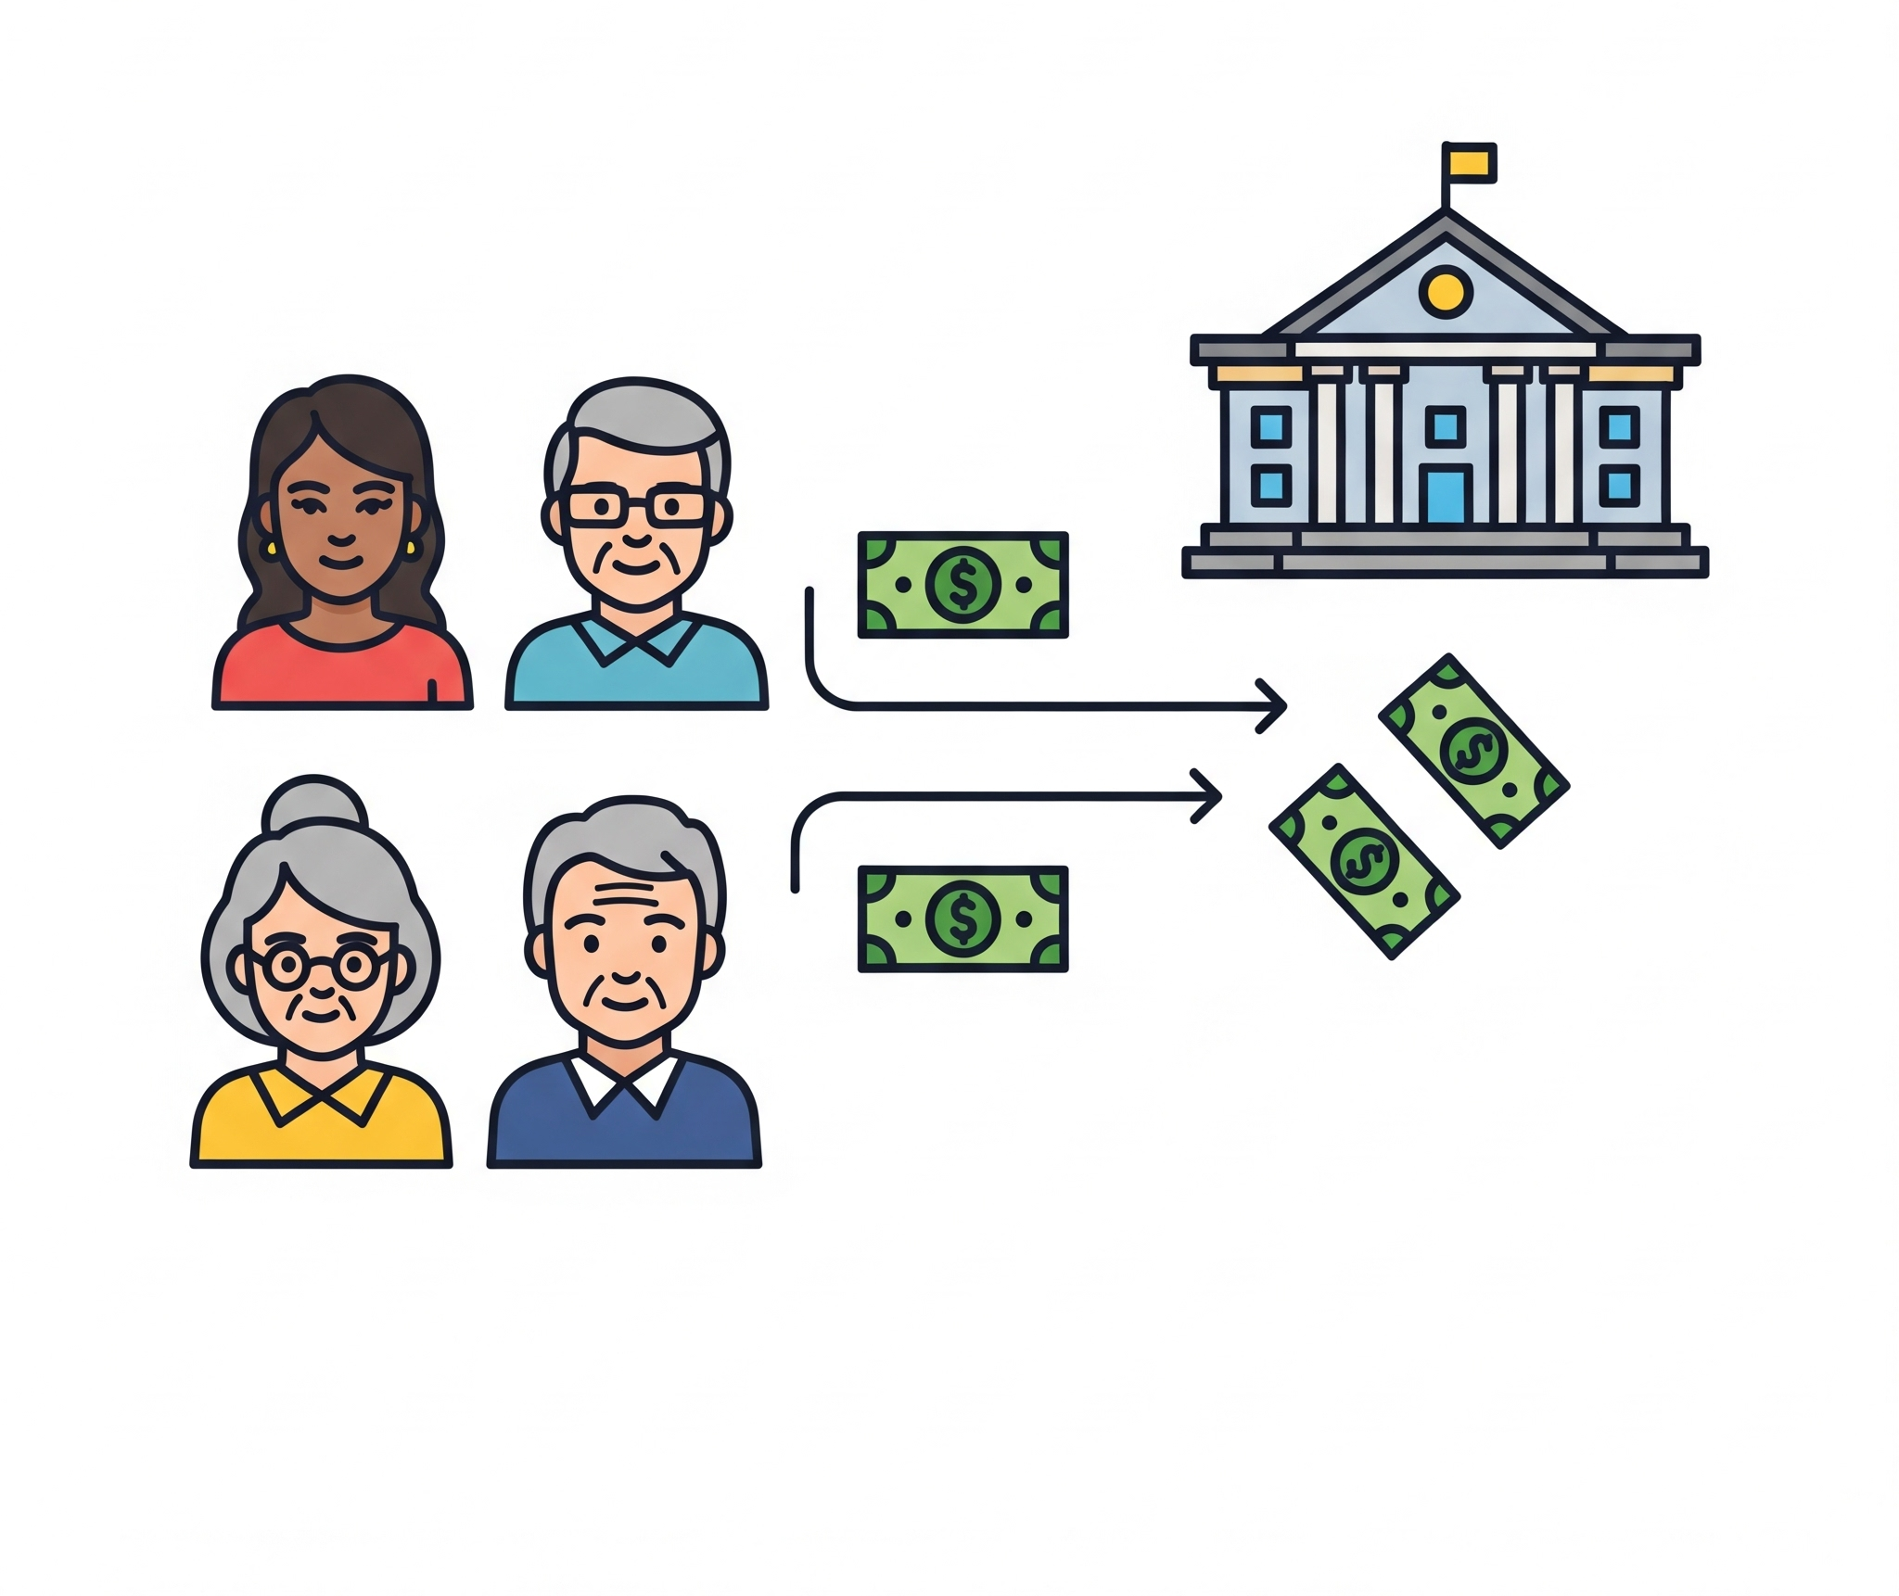
What are Taxes?
A mandatory payment or charge collected by local, state, and national governments from individuals or businesses to cover the costs of general government services, goods, and activities.
Notes:
Gemini. (2025, June 13). Who pays taxes? [AI-generated digital art]. Google. https://gemini.google.com

Slide 11

Why do we pay Taxes?
To fund public goods and services:
  Schools
  Roads
  Police
  Firefighters
  Social Services
  Parks
  Military
  Health Care
Notes:
Alternate terms: Schools → Education; Roads, parks → Infrastructure; Military → Defense
Gemini. (2025, June 13). Work hats [AI-generated digital art]. Google. https://gemini.google.com

Slide 12
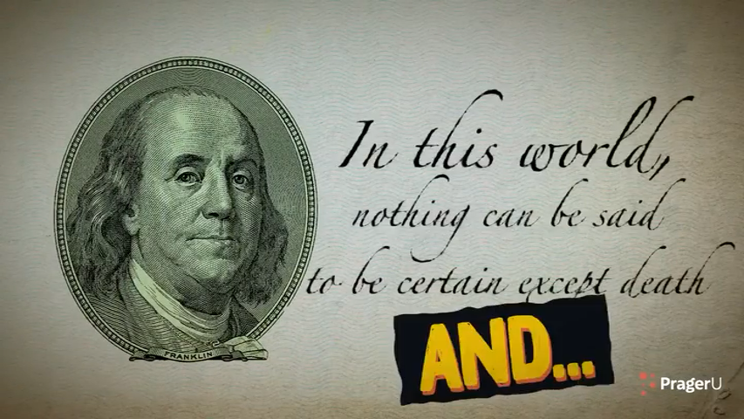
Understanding Taxes
Notes:
PraegerU. (2023, April 13). Understanding Taxes [Video]. YouTube. https://www.youtube.com/watch?v=P1D9zvd04eM

Slide 13
Levels of Government & Taxes
Local | State | Federal
Income Tax
Social Security
State Income Tax
Education
Trash Collection
Sales Tax
Property Tax
Defense
Water Services

Slide 14
Levels of Government & Taxes (answers)
Local | State | Federal
Property Tax
Sales Tax
Income Tax
Trash Collection
State Income Tax
Social Security
Water Services
Education
Defense

Slide 15
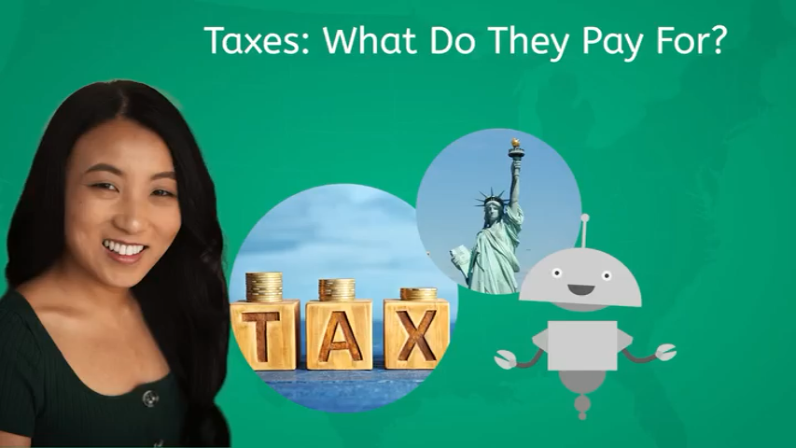
Taxes: What Do They Pay For?
Notes:
Miacademy Learning Channel. (n.d.). Taxes: What do they pay for? - Government services and spending [Video]. YouTube. https://www.youtube.com/watch?v=HJV7SbkeC60

Slide 16
Common Types of Taxes
Tax Type | What It’s On | Who Pays
Income Tax | Wages/Salaries | Workers
Sales Tax | Purchases | Consumers
Property Tax | Real Estate | Homeowners
Payroll Tax | Social Security/Medicare | Employee/Employer
Excise Tax | Gas, Cigarettes, Soda | Consumer (indirectly)

Slide 17
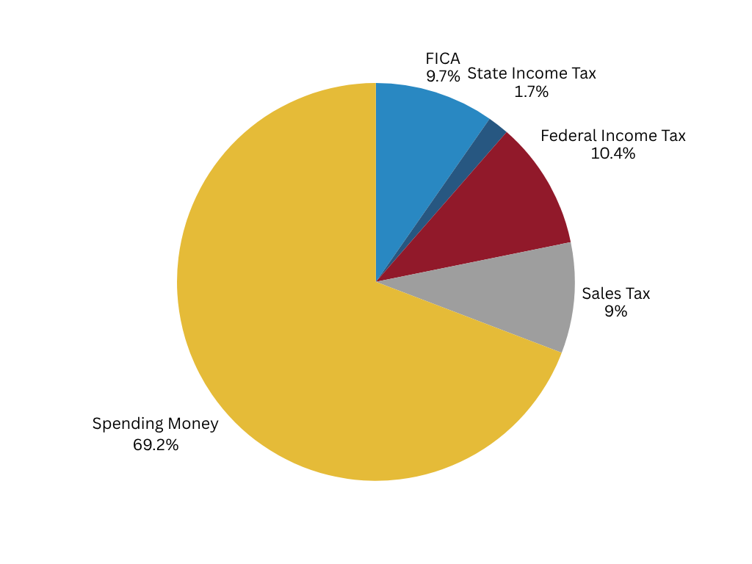
How Taxes Impact Individuals
Paycheck: Deductions (FICA, Federal/State Income)
Spending: Sales tax increase cost of goods

Slide 18
How Taxes Impact Businesses
Corporate Taxes: On profits
Small Business Concerns: Tax planning, write-offs
Example: A cafe making $80,000 owes 10.5% in state business taxes: How much is that?

Slide 19
How Taxes Impact Businesses
Corporate Taxes: On profits
Small Business Concerns: Tax planning, write-offs
Example: A cafe making $80,000 owes 10.5% in state business taxes: How much is that?
$80,000 · .105 = $8,400

Slide 20

Wrap-Up Question
How would your life change if there were no taxes?
Notes:
Pixabay. (2015, March 1). Puzzle missing particle last piece [Photograph]. Pixabay. https://pixabay.com/photos/puzzle-missing-particle-last-piece-654963/

Slide 21

Tax Scenario Analysis
For each scenario, record your reasoning and solution.
Notes:
K20 Center. (2021, September 21). Three Minute Timer. YouTube. https://www.youtube.com/watch?v=iISP02KPau0&list=PL-aUhEQeaZXLMF3fItNDxiuSkEr0pq0c2&index=5&t=13s

Slide 22

S-I-T
What is one thing you learned about taxes that surprised you?
Why do you think understanding taxes is important for citizens?
How do you feel about the current tax system?

