Slide 2
Beyond the Zombie Wars
World Geography
7th Grade

Slide 3
Essential Questions
“What is culture?”
“What elements of culture are worth preserving?”

Slide 4
Definition of Culture
Culture is a set of beliefs, social practices, traditions, values, customs, or way of life that are shared by a group of people in a place or time.
Source: Merriam-Webster Dictionary
https://www.merriam-webster.com/dictionary/culture

Slide 5
Think, Pair, Share
Think of an example of culture.
What traditions, beliefs, or social customs are important to your family? This school?
Pair with an elbow partner.
Share your example.
Notes:
This might be that we have at school a shared identity of our school mascot, school song. Our family has certain traditions that we do at home (food, holidays) or certain phrases that we use as a family.

Slide 6
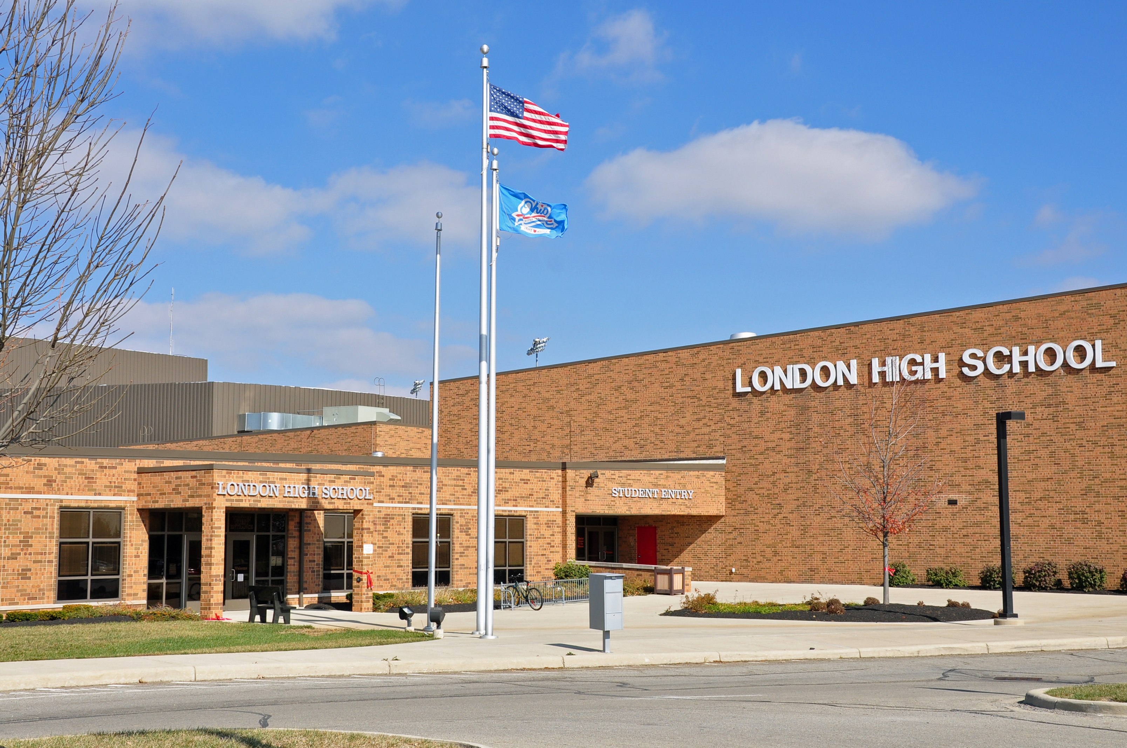
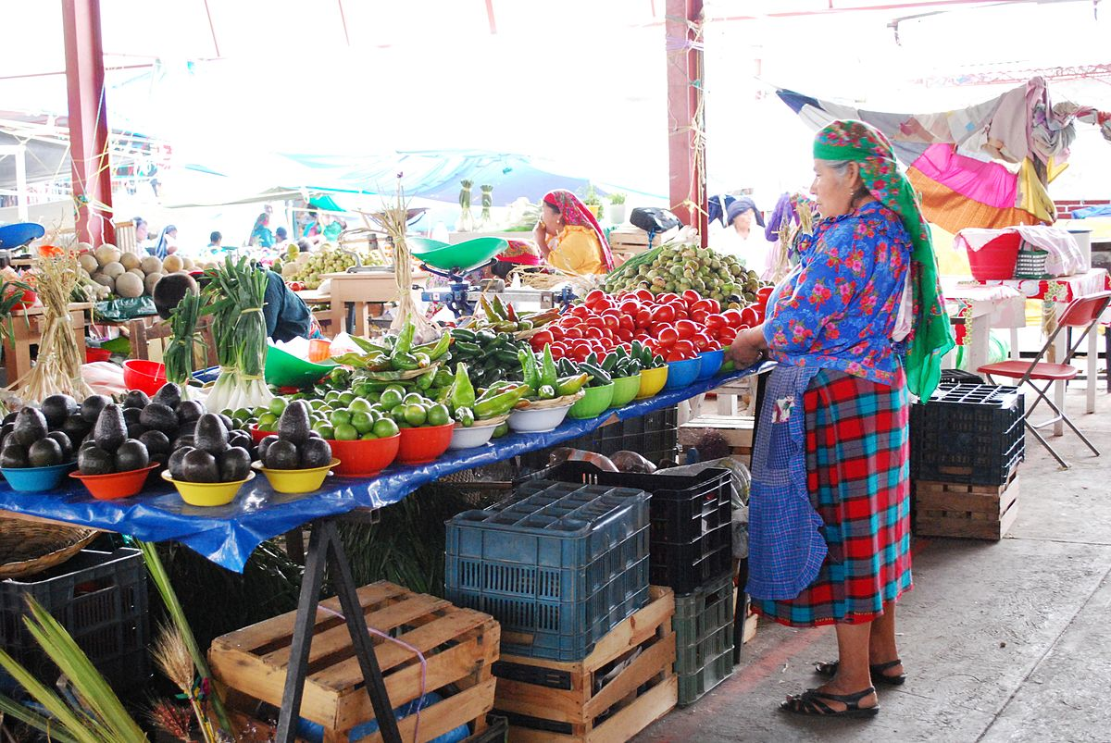
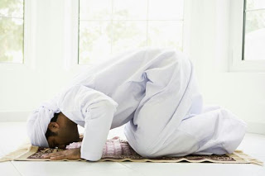
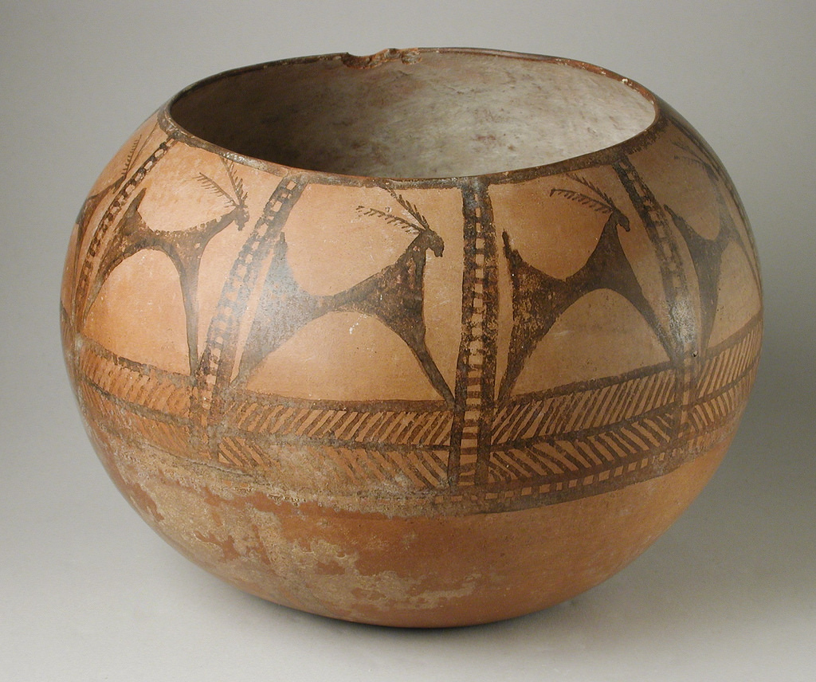
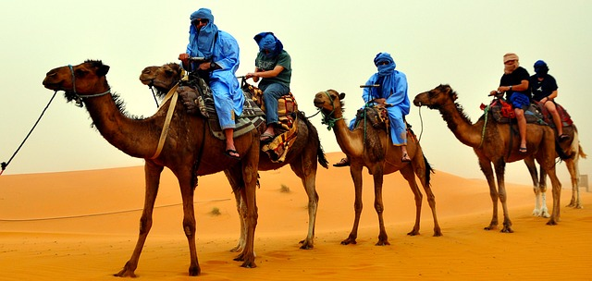
Examples of Culture
This Photo by Unknown Author is licensed under CC BY-NC-ND
This Photo by Unknown Author is licensed under CC BY-NC-ND
This Photo by Unknown Author is licensed under CC BY-SA-NC
This Photo by Unknown Author is licensed under CC BY-SA
This Photo by Unknown Author is licensed under CC BY-SA
This Photo by Unknown Author is licensed under CC BY-NC-ND
Notes:
Have students in the class identify these examples of how they represent culture. Discuss as a class.

Slide 7
Where do we find culture?
PERSIA GRAPHIC ORGANIZER
Political | Economic | Religion | Social | Intellectual | Area/ Geography
Who is in charge? How might government influence the way people live? | How do we make a living? How does that affect the way we live? | How does religion influence our lives? | What food or clothing influence this country? What are our traditions and customs? | How do we express ourselves in music, art, literature? What does this say about us? | How does the geography, climate, and environment on HOW we live?
Notes:
Pass out Persia graphic organizer. Discuss each section with the class by using the United States as the example. For example, political means a system of government. What are our government policies? How do those impact our culture—2ns Amendment and the Right to Bear Arms, etc. Economic examples are capitalism and how our system affects people and their way of doing things. Religion examples are Christianity, Muslim, etc. Social is what traditions or customs we have with one another. Intellectual are how the arts and music are expressed in our culture. Area is how location affects our culture. Ask students to pair with an elbow partner and discuss which pictures from the previous slide might fit into these categories.

Slide 8
Examples of Culture
This Photo by Unknown Author is licensed under CC BY-NC-ND
This Photo by Unknown Author is licensed under CC BY-NC-ND
This Photo by Unknown Author is licensed under CC BY-SA-NC
This Photo by Unknown Author is licensed under CC BY-SA
This Photo by Unknown Author is licensed under CC BY-SA
This Photo by Unknown Author is licensed under CC BY-NC-ND
Notes:
Have students in the class identify these examples of how they represent culture. Discuss as a class.

Slide 9
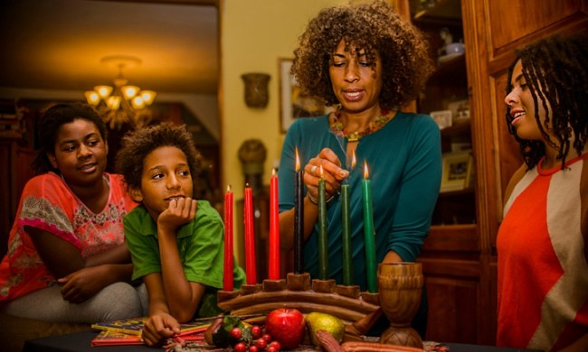
Where do we find culture?
Political | Economic | Religion | Social | Intellectual | Area
Notes:
Pass out Persia Graphic Organizer. With their partner, they are to categorize under what category, we might see these pictures as part of culture.

Slide 10
Beyond the Zombie Wars
Watch this World War Z, the Zombie Wars video
Notes:
This trailer Is located at: https://www.youtube.com/watch?v=HcwTxRuq-uk

Slide 11
Zombie-Free Zones: Europe & Oceania
London/United Kingdom
Paris/France
Rome/Italy
Berlin/Germany
Moscow/Russia
Sydney/Australia
Wellington/New Zealand

Slide 12
Zombie-Free Zones: Africa
Cairo/Egypt
Nairobi/Kenya
South Africa
Libya
Sudan
Nigeria

Slide 13
Zombie-Free Regions: Asia
Southwest Asia: Israel, Lebanon
Southwest Asia: Saudi Arabia
Southwest Asia: Iraq and Iran
South Asia: India
South Asia: Pakistan, Afghanistan
East/Southeast Asia: China, Korea
Southeast Asia: Japan, Indonesia
Southeast Asia: Vietnam, Malaysia

Slide 14
Poster Presentation
Choose a spokesperson from your group to explain your poster.
Groups will walk around and listen to each explanation from the spokesperson.
Groups will leave 3 sticky notes on each poster as feedback.

Slide 15
Poster Feedback: 3 Post-It Notes
Write the name of your own country at the top of each sticky note.
Sticky Note 1—List a difference in culture between this poster and your own country.
Sticky Note 2—List a similarity in culture between this poster and your own country.
Sticky Note 3—List something about the poster the group really liked.

Slide 16
Compare and Contrast
With your group, use the sticky notes you received during the activity to:
Compare the similarities of your country and its culture to other countries. Create a list of at least four similarities.
Discuss the uniqueness of your country as compared with others. Create a list of four ways your country is different from other countries.

