Slide 2
Beyond the Zombie Wars
Understanding Culture

Slide 3
Essential Questions
What is culture?
How does the physical and human environment shape culture?
What elements of culture are important to preserve?

Slide 4
Learning Objectives
Identify and describe the significance of culture.
Create a visual representation of a world region that includes key geographical and cultural features of the area.
Compare and contrast cultural elements between regions of the world.

Slide 5
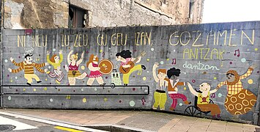
Definition of Culture
Culture is a set of beliefs, social practices, traditions, values, customs, or a way of life that is shared by a group of people in a place or time.
Notes:
Merriam-Webster. (n.d.). Culture definition & meaning. Merriam-Webster. https://www.merriam-webster.com/dictionary/culture
Creative Commons. (n.d.). Photo. https://commons.wikimedia.org/wiki/File:Gozamen_anitzak_dantzan.jpg

Slide 6
Think, Pair, Share
Think of an example of culture.
What traditions, beliefs, or social customs are important to your family? To your school? To your community?
Pair with an Elbow Partner.
Share your example.
Notes:
K20 Center (n.d.). Think, pair, share. Strategies. https://learn.k20center.ou.edu/strategy/139

Slide 7
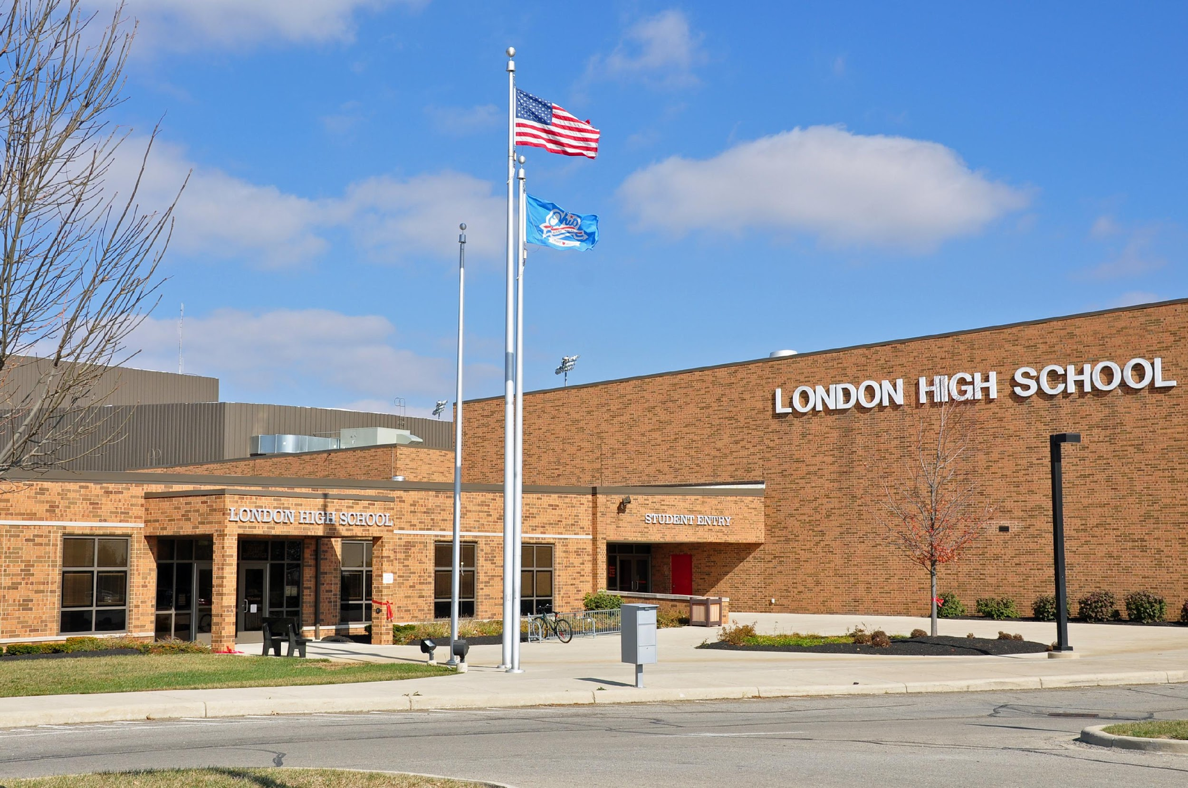
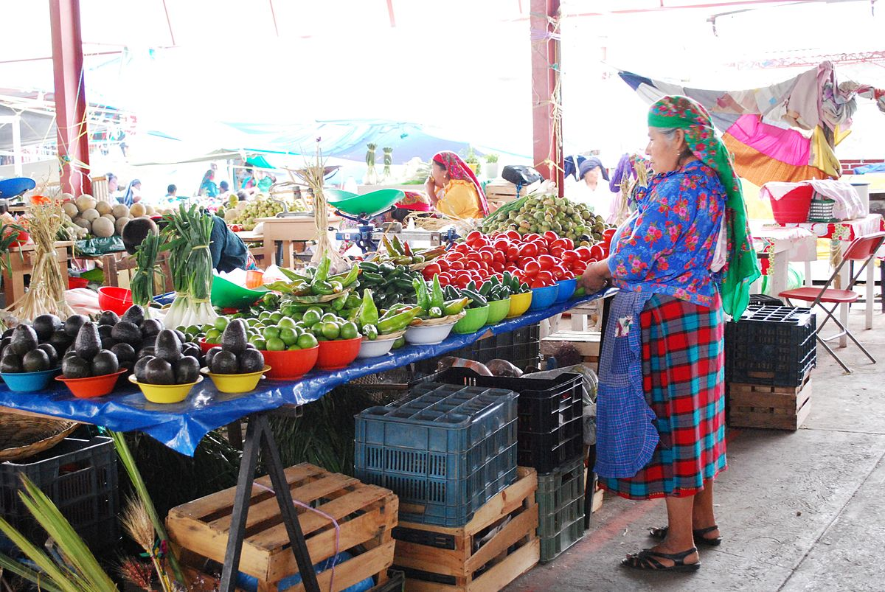
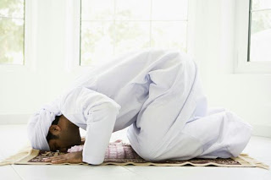
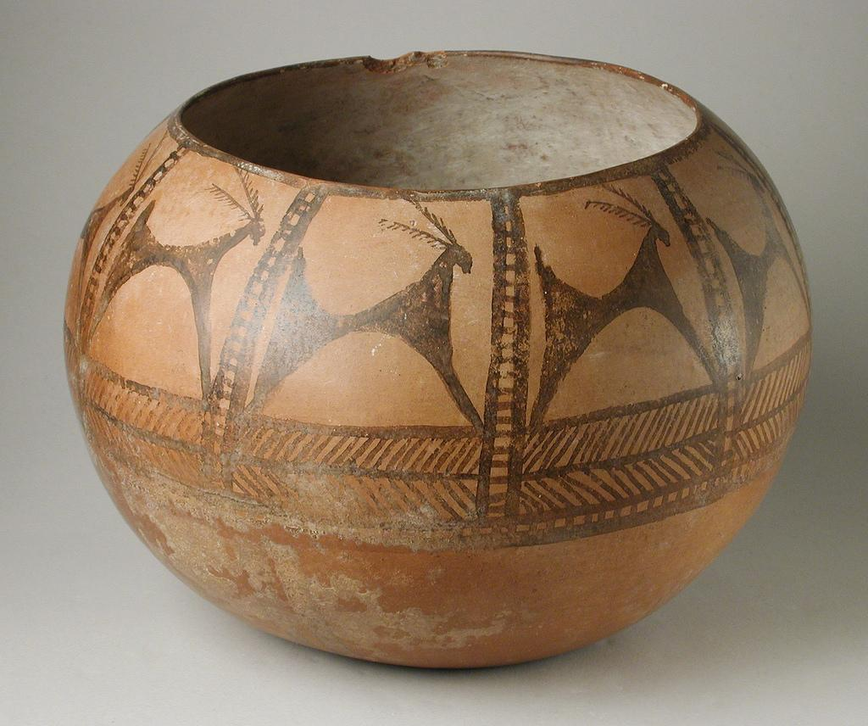
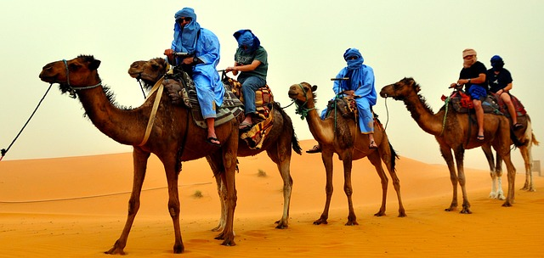
Examples of Culture
Notes:
Ali, H. (2023, October 25). Merits of prostration in prayer. Prayer In Islam. https://prayerinislam.com/merits-prostration-prayer/
Projects, C. to W. (2024, May 25). Wikimedia Commons. https://commons.wikimedia.org/wiki/File:Tlacolula_Market_230122_62.jpg
Wikimedia Foundation. (2024, March 30). London High School (Ohio). Wikipedia. https://en.wikipedia.org/wiki/London_High_School_(Ohio)
Warfield, Zenobia Jeffries. (2018, Dec 18). How I changed my holiday traditions to match my values. Yes! The Solidarity Economies Issues: Solutions We Love. https://www.yesmagazine.org/issue/solidarity-economy/2017/12/18/how-i-changed-my-holiday-traditions-to-match-my-values
Prehistoric painted pottery vessel. Prehistoric Painted Pottery Vessel | LACMA Collections. (n.d.). https://collections.lacma.org/node/184796/
CCO-Photographers. (2017, March 01). Landscape photo of camel riders. Wordpress. https://pxhere.com/fi/photo/913554#google_vignette

Slide 8
Where Do We Find Culture?
PERSIA GRAPHIC ORGANIZER
Political | Economic | Religion | Social | Intellectual | Area/ Geography
Who is in charge? How might government influence the way people live? | How do we make a living? How does that affect the way we live? | How does religion influence our lives? | What food or clothing influence this country? What are our traditions and customs? | How do we express ourselves in music, art, literature? What does this say about us? | How does the geography, climate, and environment on HOW we live?
Notes:
K20 Center (n.d.). PERSIA graphic organizer. Strategies.https://learn.k20center.ou.edu/strategy/113

Slide 9
Examples of Culture
Notes:
Ali, H. (2023, October 25). Merits of prostration in prayer. Prayer In Islam. https://prayerinislam.com/merits-prostration-prayer/
Projects, C. to W. (2024, May 25). Wikimedia Commons. https://commons.wikimedia.org/wiki/File:Tlacolula_Market_230122_62.jpg
Wikimedia Foundation. (2024, March 30). London High School (Ohio). Wikipedia. https://en.wikipedia.org/wiki/London_High_School_(Ohio)
Warfield, Zenobia Jeffries. (2018, Dec 18). How I changed my holiday traditions to match my values. Yes! The Solidarity Economies Issues: Solutions We Love. https://www.yesmagazine.org/issue/solidarity-economy/2017/12/18/how-i-changed-my-holiday-traditions-to-match-my-values
Prehistoric painted pottery vessel. Prehistoric Painted Pottery Vessel | LACMA Collections. (n.d.). https://collections.lacma.org/node/184796/
CCO-Photographers. (2017, March 01). Landscape photo of camel riders. Wordpress. https://pxhere.com/fi/photo/913554#google_vignette

Slide 10
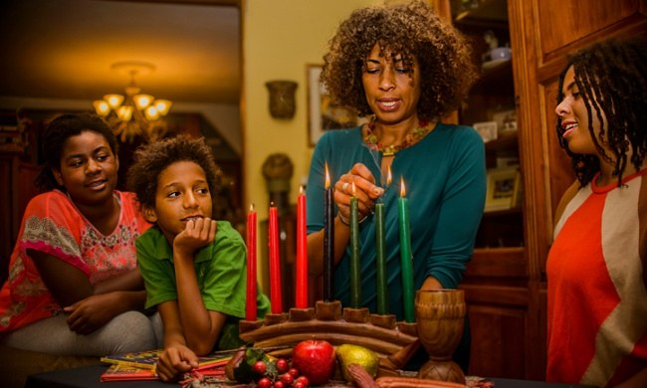
Where do we find culture?
Political | Economic | Religion | Social | Intellectual | Area
Notes:
Wikimedia Foundation. (2024, March 30). London High School (Ohio). Wikipedia. https://en.wikipedia.org/wiki/London_High_School_(Ohio)
Projects, C. to W. (2024, May 25). Wikimedia Commons. https://commons.wikimedia.org/wiki/File:Tlacolula_Market_230122_62.jpg
Ali, H. (2023, October 25). Merits of prostration in prayer. Prayer In Islam. https://prayerinislam.com/merits-prostration-prayer/
Warfield, Zenobia Jeffries. (2018, Dec 18). How I changed my holiday traditions to match my values. Yes! The Solidarity Economies Issues: Solutions We Love. https://www.yesmagazine.org/issue/solidarity-economy/2017/12/18/how-i-changed-my-holiday-traditions-to-match-my-values
Prehistoric painted pottery vessel. Prehistoric Painted Pottery Vessel | LACMA Collections. (n.d.). https://collections.lacma.org/node/184796/
CCO-Photographers. (2017, March 01). Landscape photo of camel riders. Wordpress. https://pxhere.com/fi/photo/913554#google_vignette

Slide 11
Beyond the Zombie Wars
https://www.youtube.com/watch?v=HcwTxRuq-uk
Notes:
YouTube. (2012, November 9). World War Z - Official Trailer (HD). YouTube. https://www.youtube.com/watch?v=HcwTxRuq-uk

Slide 12
Zombie-Free Zones: Europe & Oceania
London/United Kingdom
Paris/France
Rome/Italy
Berlin/Germany
Moscow/Russia
Sydney/Australia
Wellington/New Zealand
Notes:
Bing images. (n.d.) Globe. free graphics globe - Search (bing.com)

Slide 13
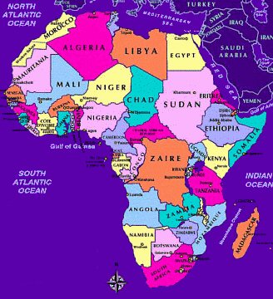
Zombie-Free Zones: Africa
Cairo/Egypt
Nairobi/Kenya
South Africa
Libya
Sudan
Nigeria
Notes:
Bing images. (n.d.). Africa Graphic. totally free african graphics - Search Images (bing.com)

Slide 14
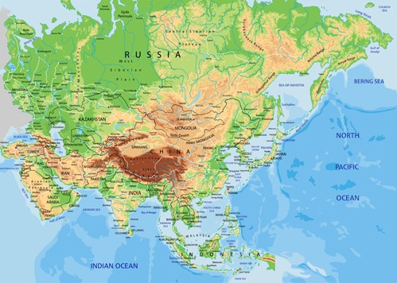
Zombie-Free Regions: Asia
Southwest Asia: Israel, Lebanon
Southwest Asia: Saudi Arabia
Southwest Asia: Iraq and Iran
South Asia: India
South Asia: Pakistan, Afghanistan
East/Southeast Asia: China, Korea
Southeast Asia: Japan, Indonesia
Southeast Asia: Vietnam, Malaysia

Slide 15
Poster Presentation
Choose a spokesperson from your group to explain your poster.
Groups will walk around and listen to each explanation from the spokesperson.
Groups will leave 3 sticky notes on each poster as feedback.

Slide 16
Poster Feedback: 3 Sticky Notes
Write the name of your own country at the top of each sticky note.
Sticky Note 1—List a difference in culture between this poster and your own country.
Sticky Note 2—List a similarity in culture between this poster and your own country.
Sticky Note 3—List something about the poster the group really liked.
Notes:
K20 Center (n.d.). Gallery walk. https://learn.k20center.ou.edu/strategy/118
YouTube. (2021b, September 21). K20 Center 5 minute timer. YouTube. https://www.youtube.com/watch?v=EVS_yYQoLJg
K20 Center (n.d.). Picture notes. https://learn.k20center.ou.edu/strategy/104

Slide 17
Compare and Contrast
With your group, use the sticky notes you received during the activity to:
Compare the similarities of your country and its culture to other countries. Create a list of at least four similarities.
Discuss the uniqueness of your country as compared with others. Create a list of four ways your country is different from other countries.

